Slide 1
Welcome to PKC 2025 Røros, Norway
Tibor Jager and Jiaxin Pan
PKC 2025 Program Co-Chairs

Slide 2
Please upload your slides 24 hrs before the talk!
Use the link from the e-mail with subject
“PKC 2025 speaker slides and videos”
In case of difficulties, please contact Bor, Tjerand, Jiaxin or Tibor

Slide 3
PKC 2025 Facts and Figures
#Submissions = 199 by #499 authors
#Desk rejects = 5
#Early rejects = 55 (about 28%)
#Accepts = 60 (about 30%)
More “acceptable” papers than space in the program - ☺ and ☹
2 soft-merges of 2+2 papers
#Reviews (per PC member) = about 9
Year | #Submissions | #Accepted | AR
2020 | 180 | 44 | 24%
2021 | 156 | 52 | 33%
2022 | 137 | 39 | 29%
2023 | 183 | 50 | 27%
2024 | 178 | 56 | 32%
2025 | 199 | 60 | 30%

Slide 4
PKC 2025 Facts and Figures
#Submissions = 199 by #499 authors
#Desk rejects = 5
#Early rejects = 55 (about 28%)
#Accepts = 60 (about 30%)
More “acceptable” papers than space in the program - ☺ and ☹
2 soft-merges of 2+2 papers
#PC members = 72, #Area chairs = 5
#Subreviewers = 170
Total #reviews = 600+
#Reviews per PC member = 9-10
Year | #Submissions | #Accepted | AR
2020 | 180 | 44 | 24%
2021 | 156 | 52 | 33%
2022 | 137 | 39 | 29%
2023 | 183 | 50 | 27%
2024 | 178 | 56 | 32%
2025 | 199 | 60 | 30%

Slide 5
More PKC 2025 Facts and Figures
Most frequent words in titles of accepted papers:
Most frequent words in titles of rejected papers:
signature | 12
encryption | 12
secure / security | 11
multi | 9
lattice(s) | 8
signature | 17
encryption | 14
secure / security | 13
threshold | 10
lattice(s) | 10

Slide 6
More PKC 2025 Facts and Figures
Most frequent words in titles of accepted papers:
Most frequent words in titles of rejected papers:
signature | 12
encryption | 12
secure / security | 11
multi | 9
lattice(s) | 8
signature | 17
encryption | 14
secure / security | 13
threshold | 10
lattice(s) | 10
“Threshold” → “Multi-user, where a certain number of users…”?
Please continue working on threshold schemes!

Slide 7
Areas and Area Chairs
Advanced PKE (41 submissions for review): Stefano Tessaro
Advanced Signatures and Proof Systems (44): Miyako Ohkubo
Mathematics of Public-Key Crypto (28): Alexander May
MPC and Friends (40): Claudio Orlandi
(Real-World) Primitives and Protocols (43): Mihir Bellare

Slide 8
Areas and Area Chairs
Advanced PKE (41 submissions for review): Stefano Tessaro
Advanced Signatures and Proof Systems (44): Miyako Ohkubo
Mathematics of Public-Key Crypto (28): Alexander May
MPC and Friends (40): Claudio Orlandi
(Real-World) Primitives and Protocols (43): Mihir Bellare
(But take into account that math papers may be intimidating…)

Slide 9
Awards Committee
Best Paper Award:
Mihir Bellare, Alexander May, Miyako Ohkubo, Claudio Orlandi, Stefano Tessaro, Tibor Jager
Test of Time Award:
Masayuki Abe, Aggelos Kiayias, Jiaxin Pan, Edoardo Persichetti, Qiang Tang

Slide 10
Awards
Best Paper Award:
PRISM: Simple And Compact Identification and Signatures From Large Prime Degree Isogenies
Andrea Basso, Giacomo Borin, Wouter Castryck, Maria Corte-Real Santos, Riccardo Invernizzi, Antonin Leroux, Luciano Maino, Frederik Vercauteren, and Benjamin Wesolowski
Test of Time Awards:
Signing a Linear Subspace: Signature Schemes for Network Coding (PKC 2009)
Dan Boneh, David Freeman, Jonathan Katz, and Brent Waters
An Accumulator Based on Bilinear Maps and Efficient Revocation for Anonymous Credentials (PKC 2009)
Jan Camenisch, Markulf Kohlweiss, and Claudio Soriente

Slide 11
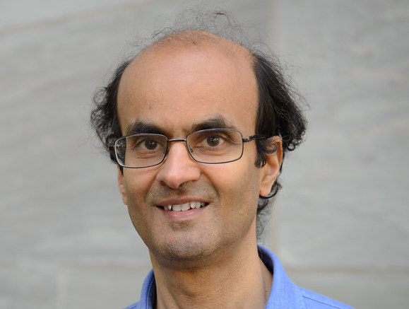
Invited talk
Mihir Bellare
Asymptotic versus Concrete Security: A Tale of Two Cultures, A New Direction for Multi-Party Secure Computation, and the Broader Context of Our Work
Tuesday, 15:00

Slide 12

Thank you
PC members
Subreviewers
Area chairs
General chairs + team
BPA committee
ToT committee
Authors of all submissions

