Slide 1
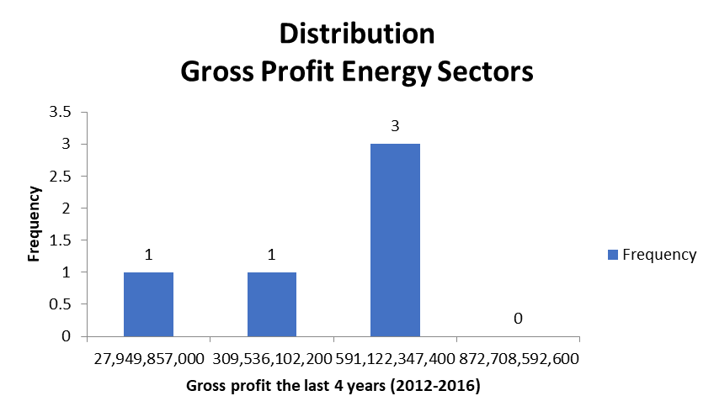
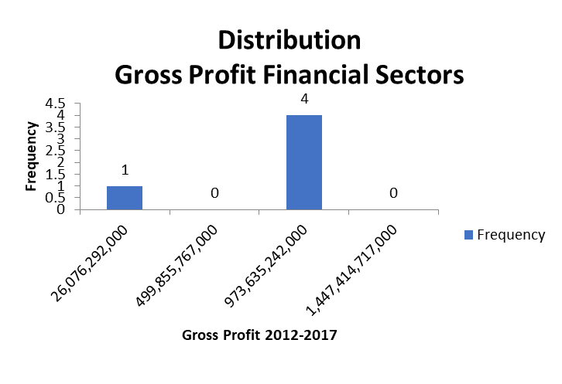
Between Financial Sector and Energy Sector, which has more volatility?
Here are the histogram for the Energy sectors and
Financial Sectors in the year 2012-2016.
Both distribution are left-skewed or negatively skewed, which mean value is less than median and move towards to the left.
Since the standard deviations of both sectorsrespectively are 148,85 Millions and 250,7 Millions. This means financial sectors more volatile than energy sector. Additionally, energy sectors have range of 358 Millions almost half of Financial Sectors, with roughly 600 Millions. These facts strengthen the case of more volatility for Financial sectors than energy sectors.

