Slide 1
Bellabeat Case Study – Fitbit Data Analysis
Tim Foltz – August 2025

Slide 2
Business Task
Analyze Fitbit usage trends to understand consumer habits
Apply insights to Bellabeat products to improve marketing strategies
Deliver actionable recommendations based on data findings

Slide 3
Data Sources
Fitbit Fitness Tracker Dataset (CC0 Public Domain)
~30 participants with activity, sleep, and steps data
Two periods of data in March–May 2016
Some gaps in sleep and heart rate tracking

Slide 4
Methodology
Data cleaning, standardization, and merging across date ranges
Derived helper columns (weekend/weekday, total active hours)
Filtered outliers (e.g., calories >2500 with 0 steps)
Explored patterns in activity, sleep, and calories

Slide 5
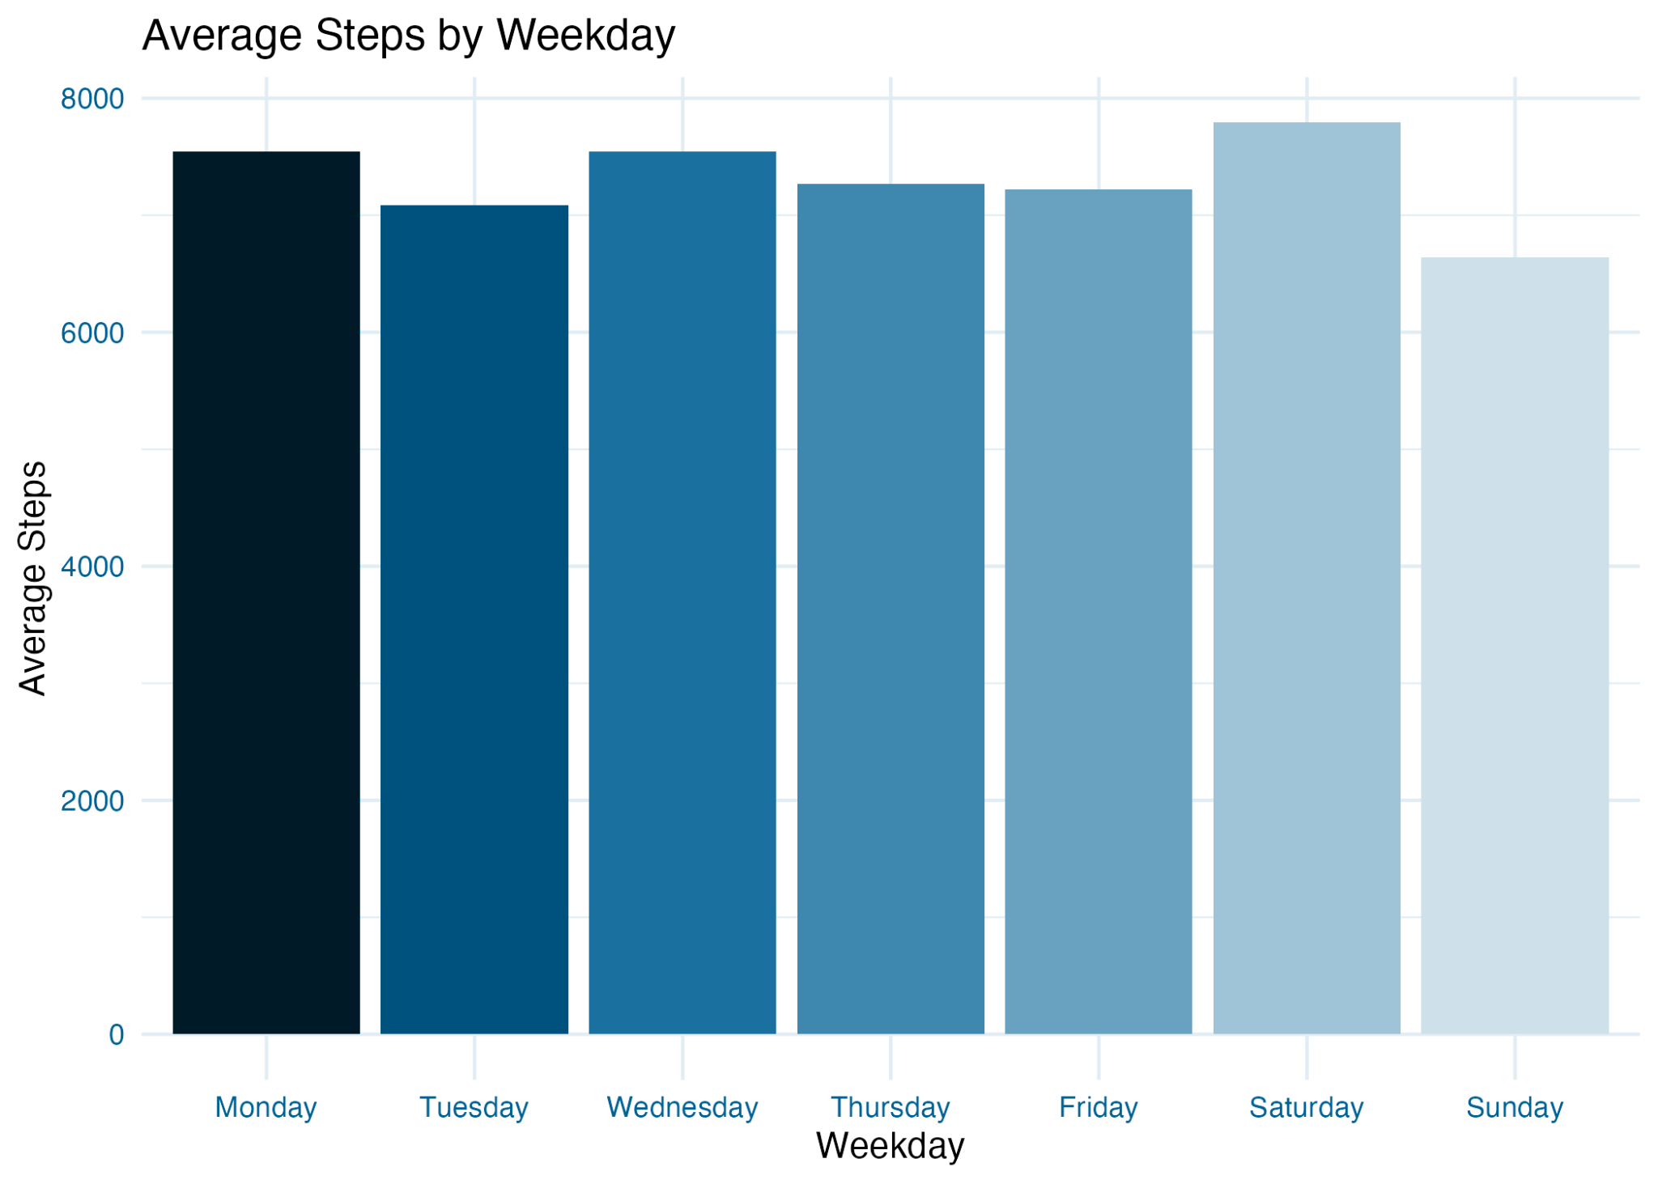
Plot 1 – Average Steps by Weekday
Participants took the most steps midweek, with Monday and Sunday having the lowest averages.Suggests potential for weekend activity campaigns.

Slide 6
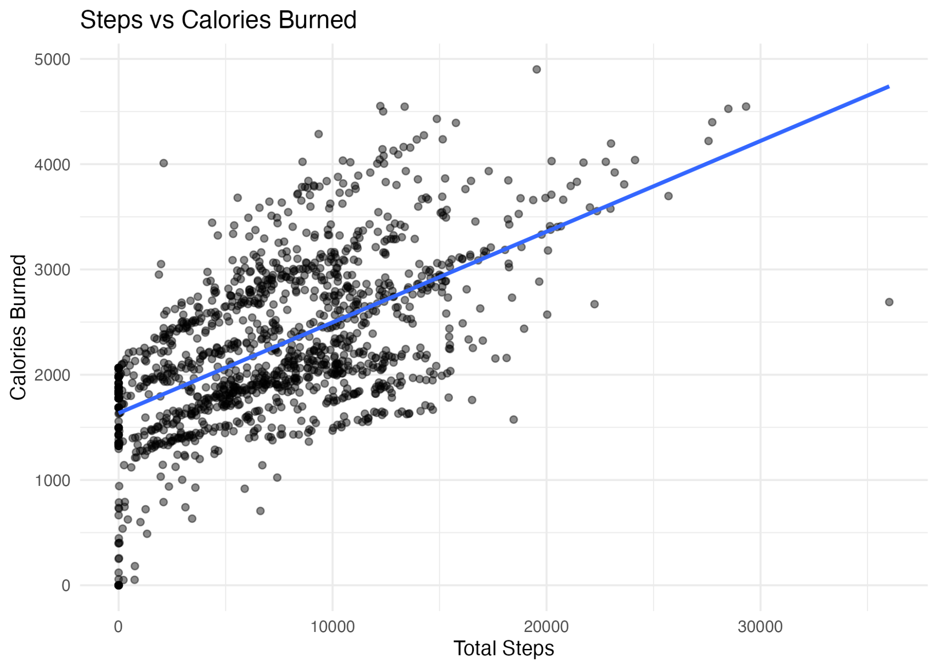
Plot 2 – Steps vs Calories Burned
Clear positive relationship between steps and calories burned.
Calories burned > 0 at ~0 total steps could indicate logged workout without activity on Fitbit.
Notes:
Fitbit

Slide 7
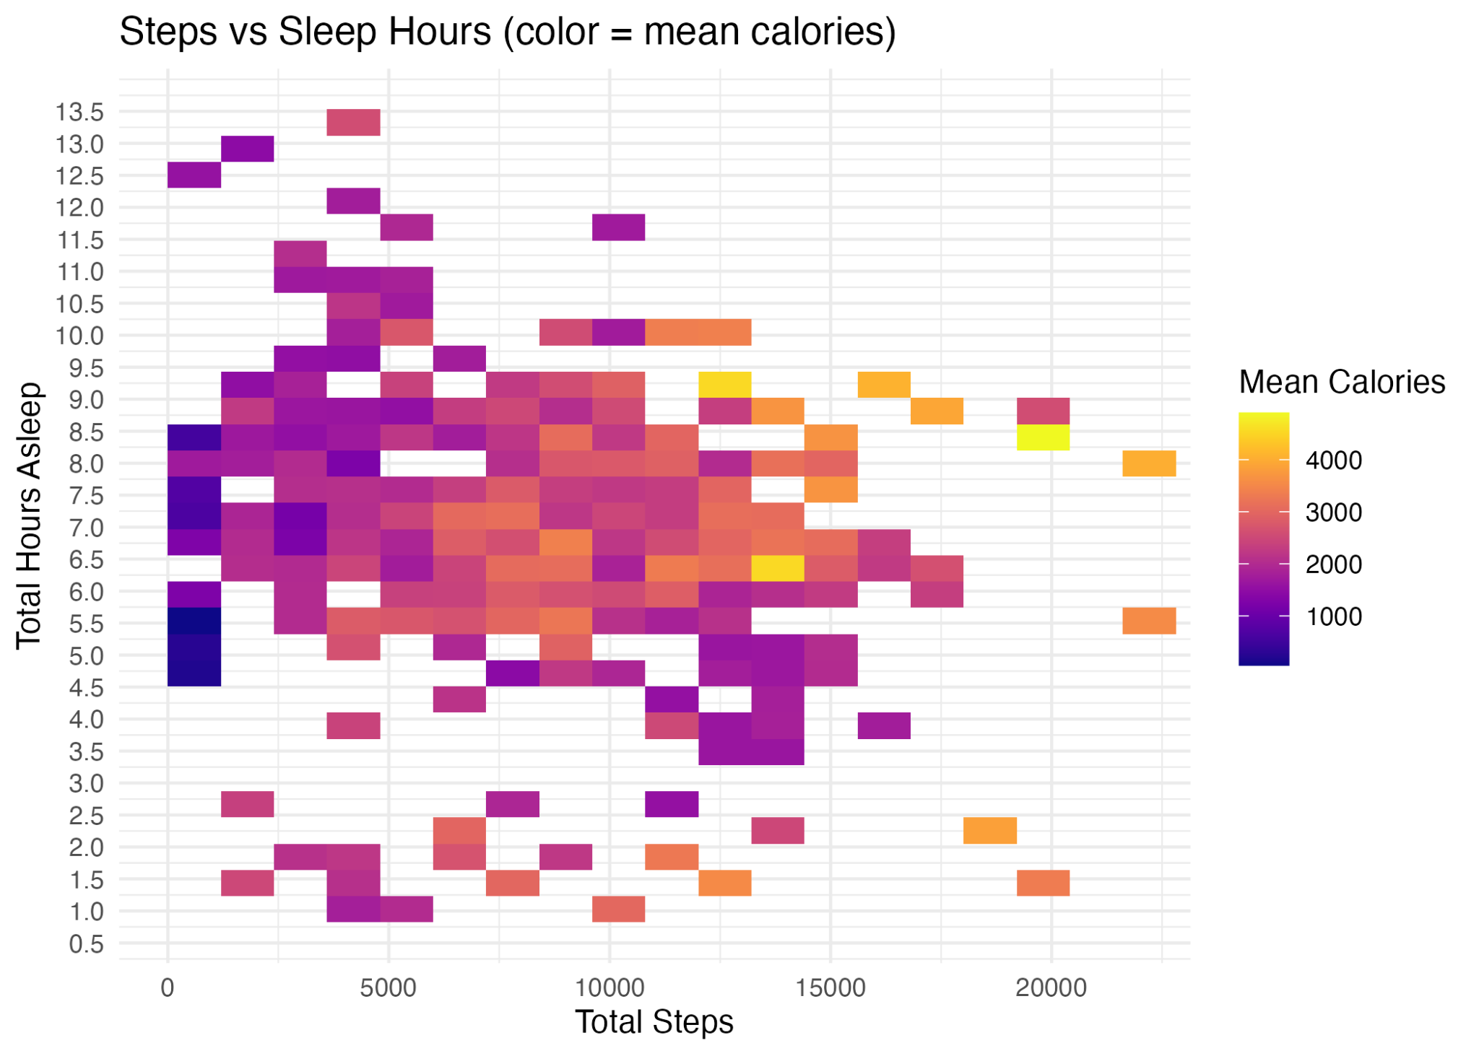
Plot 3 – Sleep Hours vs Steps (Color/Size by Calories)
High calories concentrate with moderate–high steps and ~6–9 hours of sleep; very short sleep correlates with lower calories at similar steps.

Slide 8
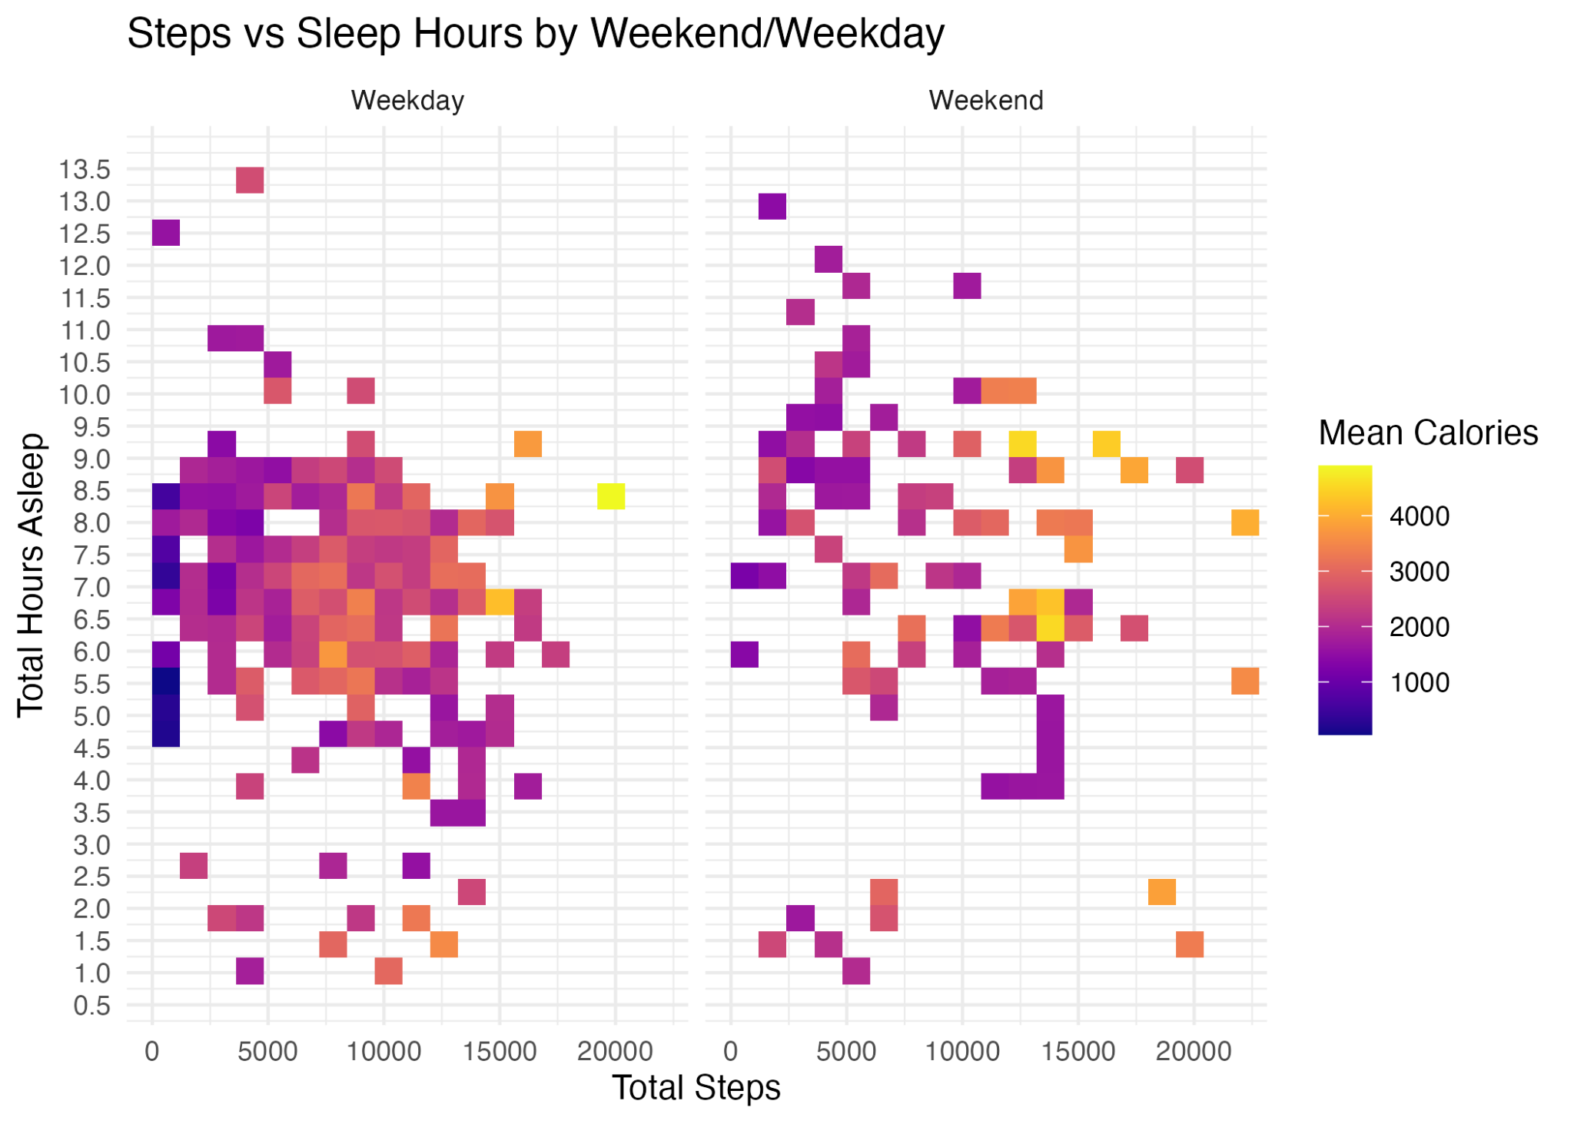
Plot 4 – Weekend vs Weekday % ≥10k Steps
Weekdays show higher very active minutes, while weekends have more lightly active minutes.

Slide 9
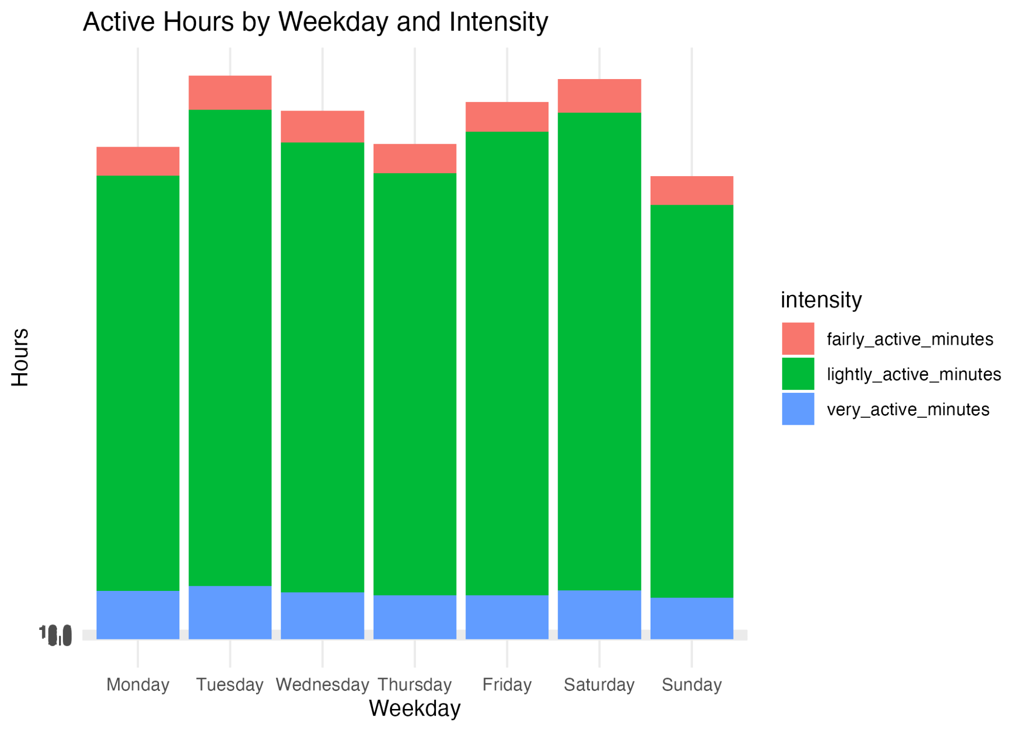
Plot 5 – Active Hours Intensity
Light activity dominates; scope for micro-bursts of higher intensity without increasing total time burden.

Slide 10
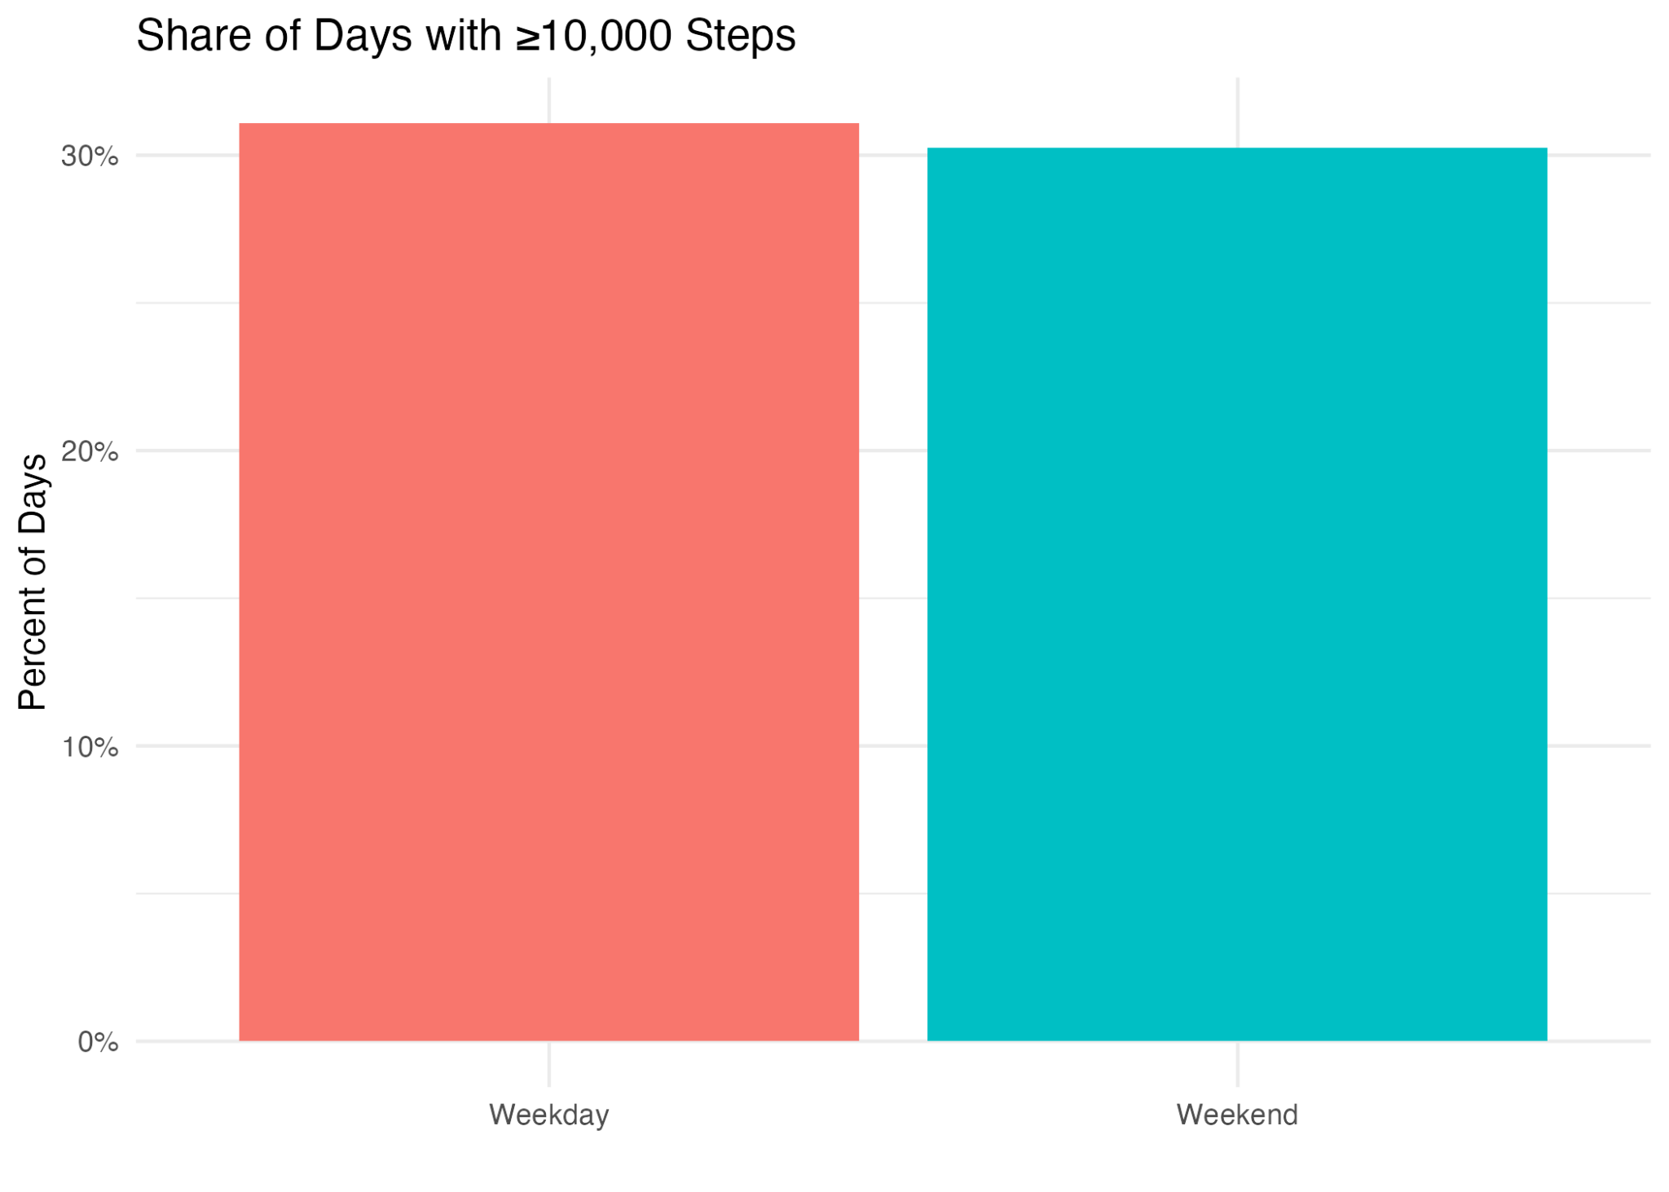
Plot 6 – Percent of Days with 10k or More Steps
No significant variation from weekdays to weekends. Both share ~30%
Participants sleep longer on weekends, which may reduce time for physical activity.
Notes:
Significant

Slide 11
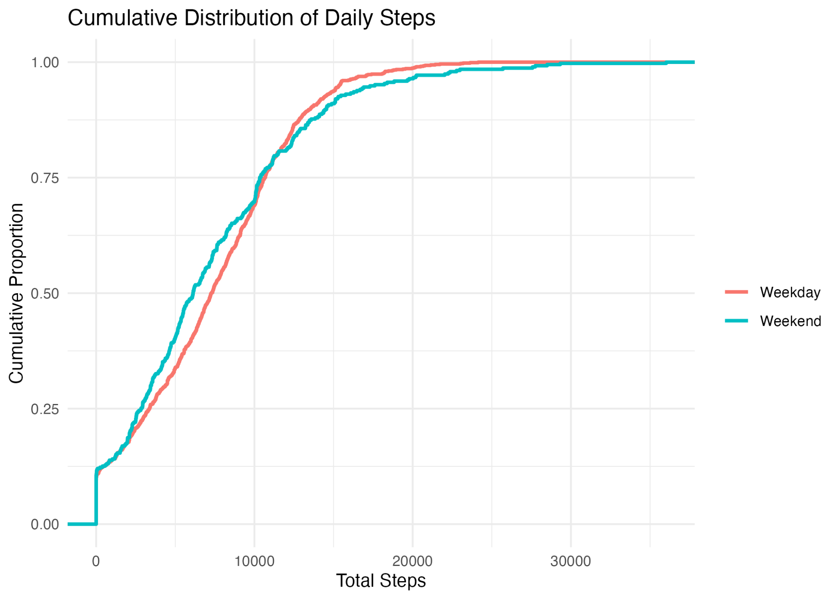
Plot 7 – Distribution of Daily Steps
Read proportions at 10k to quantify weekend vs weekday goal attainment.

Slide 12
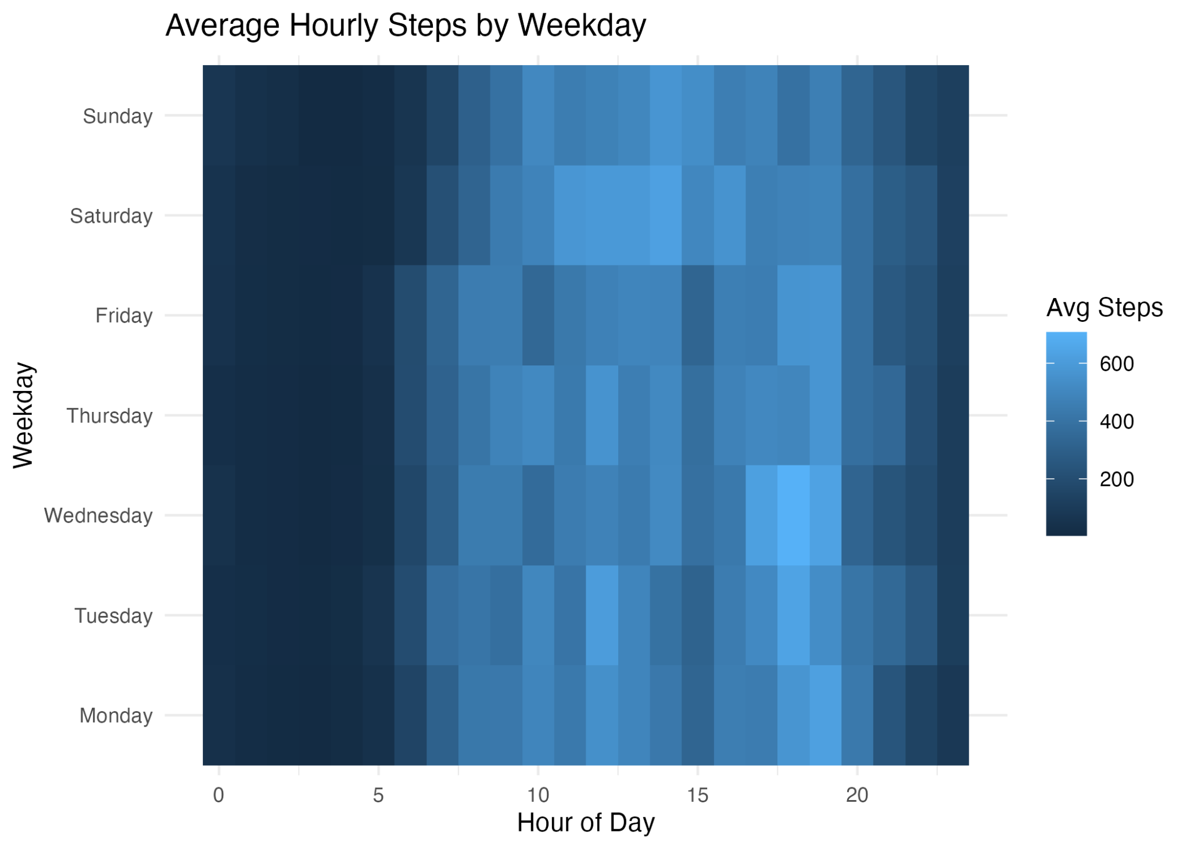
Plot 8 – Hourly Steps Heatmap
Typical day shows moderate steps, ~6–8 hours of sleep, and calories aligned with daily steps + basal burn.
Sleep efficiency is stable overall; room to lift fairly-active time without extending total hours.

Slide 13
Key Findings
Weekends show lower average steps compared to weekdays
Steps strongly correlate with calories burned
More sleep is modestly associated with higher next-day activity
Peak activity occurs midday, with a secondary evening bump

Slide 14
Recommendations
Weekend activation challenges to boost step counts
Sleep coaching nudges for users sleeping <7h
Badge rewards for mixed-intensity activity goals
Personalized hydration/activity reminders during peak hours

Slide 15
Act – Next Steps
Set KPIs: +10% weekend steps, +5% average active hours
A/B test push notification timing for engagement
Segment users by sleep/activity patterns for tailored messaging
Request additional data: seasonal trends, demographics, campaign overlaps

