Slide 1
Table18

Slide 2
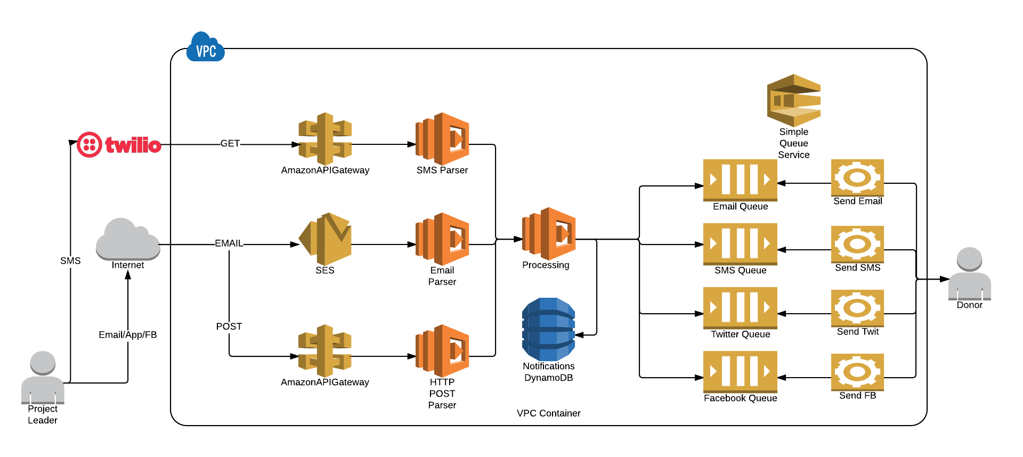
Processing function parallel writes to SQS & DynamoDB
Multi-channel Input from Project Leaders
Multi-channel output to Donors

Slide 3
Requirements (non-scripted)
Setup S3 bucket for inbound emails to be stored
Setup S3 bucket for attachments to be stored
Queue setup to write inbound email into an S3 bucket
Lambda needs access to read this bucket and its objects
Twilio Account is required for SMS in/out
Twilio Account will need an API key and Account ID

