Slide 1
Code Smells
Data Class
Existem várias “data classes” ao longo do código do JABREF, como por exemplo a UnknownExternalFileType (org.jabref.gui.externalfiletype) ou a AutoCompletionInput (org.jabref.gui.autocompleter), que claramente não contém nenhum método que não seja de acesso a informação (getters). Talvez este seja um mal necessário, mas quiçá haja métodos de manipulação de dados ou até mesmo noutras classes, que façam sentido para os encapsulados nesta classe. Estas possíveis alterações melhoram a qualidade do código, aumentando a sua organização e compressão, pois as operações de modificação de classes encontram-se todas no mesmo sítio.
Switch Statements
Nas classes CodeAreaKeyBindings (org.jabref.gui.keyboard) e TextInputKeyBindings (org.jabref.gui.keyboard) existem dois Switches para os mesmos casos, isto é um indicador de que não estamos a aplicar corretamente os princípios de uma linguagem orientada aos objetos. Neste caso, talvez seja possível utilizar o Template pattern para que diferentes classes implementem cada caso. Esta alteração aumenta a organização do código e facilita futuras implementações e evita possíveis erros, pois não temos de alterar todos os switches, que estão localizados em classes diferentes.
Feature envy
Na classe JabRefDesktop (org.jabref.gui.desktop), o método getNativeDesktop acede maioritariamente à informação vinda da classe OS (org.jabref.logic.util), que por sinal serve para a deteção do sistema operativo, portanto o que faria mais sentido era mover este método para essa classe. Esta alteração melhora a legibilidade e arrumação do código.
Realizado por: Diogo Rosa 57464

Slide 2
Long method
In the logic package, inside the bst package there is a class called BibtexNameFormatter. This class has a method (formatName) in it which appears to be a long method.
In this code snippet we can see that the method is longer than it probably should be.
Data class
There is a class inside the logic.bibtext.comparator package called BibEntryDiff. This class is considered a data class since it only has data and its getters. Since this class is only used in one other class (ChangeScanner), a solution is to delete the data class and put its data and functionalities inside the ChangeScanner class.
Speculative generality
There is a class inside the logic.undo package called UndoRedoEvent. This is a subclass of the UndoChangeEvent, within the same class. However, this subclass does not have any data or functionalities other than its superclasses’s. So, this class is being created perhaps with the intention to add other functionalities in the future but does not have them at the moment. A simple solution for this is to delete the subclass and use the superclass instead.
Realizado por: Tiago Fernandes 57677

Slide 3
Lazy Class
Existe um code smell na classe AutoSave org.jabref.model.database.event.Autosave, que identifiquei como uma lazy class. Esta classe não contém nem construtor, nem qualquer outro tipo de método, pelo que deve ser removida do jabref.
Long Method
Existe um code smell na classe Author org.jabref.model.entry.Author, que identifiquei com um long method. O método addDotIfAbbreviation contém inúmeras linhas de código, realizando demasiadas funcionalidades, que poderiam ser resolvidas em outros métodos. Por isso, como solução, deveriam ser criados outros métodos para reduzir esse mesmo método.
Feature Envy
Este code smell encontra-se na classe BiblatexSoftwareEntryTypeDefinitions org.jabref.model.entry.types.BiblatexSoftwareEntryTypeDefinitions, que identifiquei como um feature envy. Esta classe utiliza mais métodos da classe BidEntryType do que os seus próprios métodos, pelo que uma solução possível era passar essas funcionalidades para a BidEntryType.
Realizado por: Tiago Duarte 58125

Slide 4
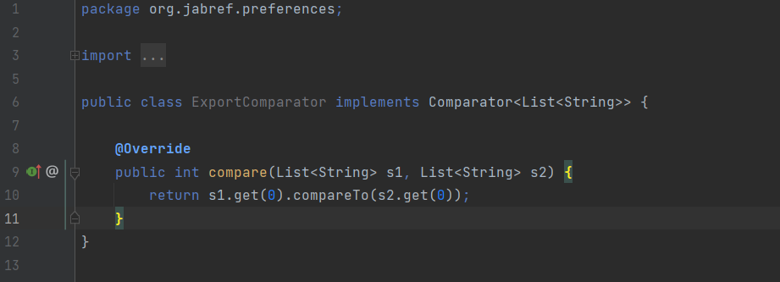
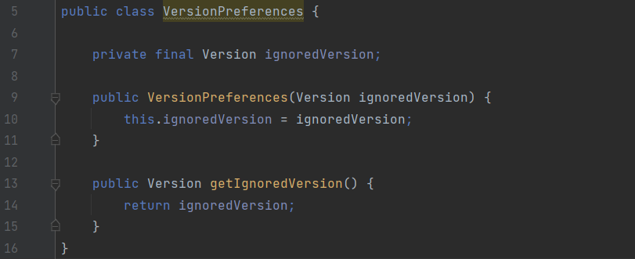
Lazy Class.
Every additional class adds more complexity to the project. More classes just mean more code to maintain. The ExportComparator class is not entirely too useful, has an empty constructor. In conclusion, this class does not do enough to earn the attention of the project. What is made in this class could be done in other classes.
A solution could be collapsing the class or possibly combining it with an existing class. Incline Class or Collapse Hierarchy can help clean up lazy classes if the single responsibility principle (a class should have only one reason to change) is being kept. The refactoring proposal could be implementing the compare method in the classes where it is most needed.
Data Class.
Data class refers to a class which contains only fields and crude methods for accessing them (getters and setters). These are simply containers for data used by other classes. This class does not contain any additional functionality and cannot independently operate on the data that own. It’s a normal thing when a newly created class contains only a few public fields (and maybe even a handful of getters/setters). But the true power of objects is that they can contain behaviour types or operations on their data. In conclusion, this class which is a data class, contain only data and no real functionality, only a getter method. This indicates that it may not be a good abstraction or a necessary class. In this case that this class only uses public methods, one solution could be the use of the Encapsulation (which means, ability to conceal object data. Otherwise, all objects would be public and other objects could get and modify the data of the object without any checks and balances) to hide them from direct access and require that access to be performed via getters and setters only.

Slide 5
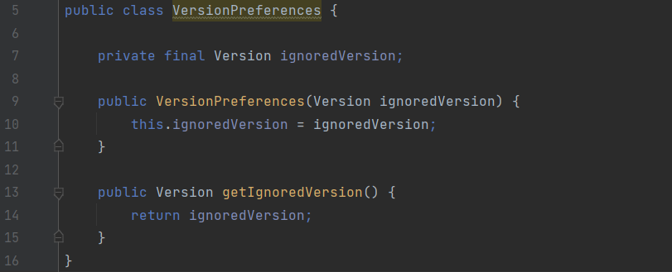
Feature Envy.
This code smell occurs when there is a method that is more interested in the details of a class other than the one it is in. If two methods or classes are always talking to one another and seem as if they should be together, then chances are this is true. The getIgnoredVersion method reaches into the Version object to get the data on which it operates. It “wishes” that it were inside the Version class so that it could have direct access to the variable (ignoredVersion) it is manipulating.
In that case, we may consider moving this method (getIgnoredVersion) to the other class it uses (Version). This would make classes more internally coherent (because we would move a method to a class which contains all the data used by the method). So, in conclusion, the method would become a part of Version class instead of VersionPreferences class since all it does is to use a variable of the type of Version (ignoredVersion).
Realizado por: Dinis Silvestre 58763

Slide 6
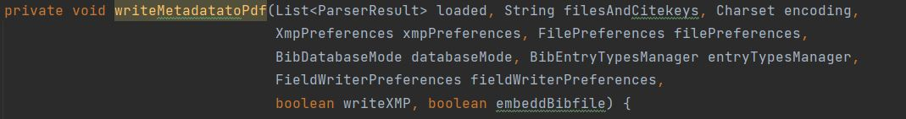
Long Parameter List
Located on line 275 of class Argument Processor, from path src/main/java/org/jabref/cli
Maximum of 7 parameters is advised for methods, this method has 9 parameters.
Refactoring: An auxiliary class containing the encoding(CharSet), filepreferences(FilePreferences), writeXMP(boolean) and embeddBibfile(boolean) and then having one object of that auxiliary class as a parameter would reduce the method’s parameters to 6 and the same information could still be accessed. Doing this would solve the same code smell (long parameter list) for methods writeMetadatatoPDFsOfEntry(line 309), writeMetadatatoPdfByFileNames(line 343), writeMetadatatoPdfByCitekey(line 330), which also have those 4 parameters in common.
Long Method
Located on line 181 of class Argument Processor, from path src/main/java/org/jabref/cli
Method with too many lines of code which makes it confusing and complex.
Refactoring: Some of the ifs could be on auxiliary methods (since there are many of conditions on this method), line 236 has a nested if which can be merged into a single if condition.
Message Chain
Code with structure similar to a typical message chain code smell, a.getB().getC().doSomething();
Refactoring: create instances before to minimize calls inside method.
Realizado por: Artur Lourenço 63764

Slide 7
Design Patterns
Prototype
Podemos verificar este padrão no pacote org.jabref.logic.integrity, na classe IntegrityMessage onde a interface prototype é a clonable e a classe prototype concreta é a IntegrityMessage, esta classe é usada por diversas outras, também podemos verificar outras classes que implementam o clonable, como a BibtexString e a BibEntry. Este pattern permite-nos copiar objetos existentes sem fazer seu código ficar dependente de suas classes.
Factory Pattern – ActionFactory
Podemos encontrar este pattern no package org.jabref.gui.actions onde a classe ActionFactory é a classe criadora, o produto pode ser considerado a interface Action (org.jabref.gui.actions) visto que esta é comum a todos os objetos criados e os outros parâmetros passados são classes java como o command, aqui a classe criadora fornece uma interface para criar objetos, mas permite que as se altere o tipo de objetos que serão criados, no caso podem ser criados menus e botões que podem realizar diversas ações.
Singleton Pattern – ExternalFileTypes
Podemos encontrar este pattern na classe ExternalFileTypes (org.jabref.gui.externalfiletype), onde o singleton é esta mesma classe e o cliente é por exemplo a classe JabRefDesktop (org.jabref.gui.desktop). Este pattern garante-nos que existe apenas uma instância da classe ExternalFileTypes ao longo de toda a execução do programa.
Realizado por: Diogo Rosa 57464

Slide 8
Factory method
There is na abstract class in org.jabref.logic.exporter package called Exporter which is a normal class with some data and functionalities.
This Exporter class works as the product where the ExporterFactory (in the same package) works as the product’s creator (factory). This factory class provides an interface which objective is to create Exporter objects, allowing its subclasses to change and deal with the object in a specific way.
Composite
There is na interface in package org.jabref.logic.importer package called SearchBasedFetcher. This interface works as the component of the patterns and extends the WebFecther interface, located in the same package.
Working as the Leaf of this pattern we have the GrobidCitationFetcher in the package org.jabref.logic.importer.fetcher which implements the SearchBasedFecther interface, implementing both SearchBasedFecther and WebFetcher methods.
In the org.jabref.logic.importer.fetcher package we have a class called CompositeSearchBasedFetcher which implements the SearchBasedFetcher interface. Alike the Leaf class it also implements both SearchBasedFetcher and WebFetcher methods. This was identified as the composite class because it stores SearchBasedFetcher objects. This objects can be either leafs (GrobidCitationFecther) or even other composites (CompositeSearchBasedFetcher).
Template method
There is an abstract class called BibDatabaseWriter in the org.jabref.logic.exporter package.
This class has a method that calls a template method. This template method is responsible for calling the multiple methods in the class (steps of the algorithm) that are implemented in the same class or by another class if the methods are abstract. The class in the JabRef tool that implements these abstract methods is the BibtexDatabaseWriter. This class extends BibDatabaseWriter and belongs to the same package as its superclass. This pattern is easily identified by looking at the template method in the abstract class, since it calls all steps that are implemented within the class or by its subclasses.
Realizado por: Tiago Fernandes 57677

Slide 9
Singleton Pattern
Localização: src/main/java/org.jabref/logic/logging
A classe LogMessages possui um singleton pattern, consiste na existência de um construtor privado para seja possível controlar a quantidade de instâncias da classe LogMessages. Neste caso a classe guarda e aquiva todo o output de uma mensagem.
Factory Pattern
Localização: src/main/java/org.jabref/model/entry/field
A classe FieldFactory é a classe criadora que utiliza a classe OrFields para criar os seus objetos, já o produto é a interface Fields, que é a responsável por fornecer a interface para a criação dos objetos Fields.
Observer Pattern
Localização: src/main/java/org.jabref/gui/fieldeditors
A classe LinkFilesEditor, utiliza a UiThreadObservableList, para poder observar objetos do tipo LinkedFileViewModel. Este pattern serve para que quando algo aconteça na classe observada, a que esteja a observar seja informada dessa mudança.
Realizado por: Tiago Duarte 58125

Slide 10
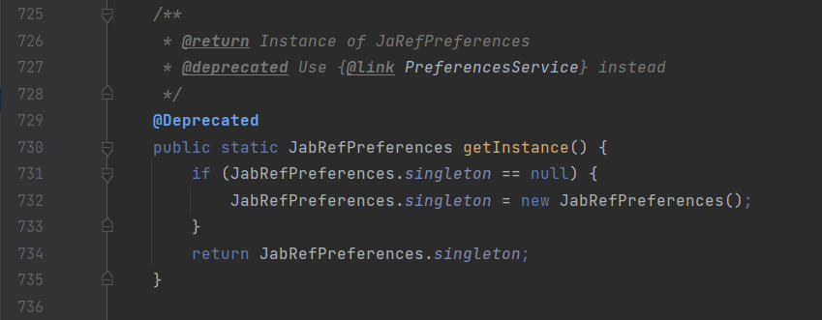
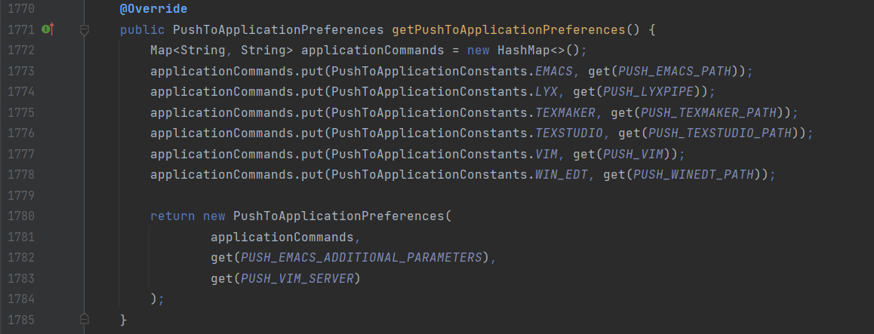
Singleton Pattern
This type of design pattern comes under creational pattern as this pattern provides one of the best ways to create an object. This pattern involves a single class that is responsible to create an object while making sure that only a single object gets created. In this method, a new object is created. This class has only one instance and provides a global point to access it. This variable makes an object accessible, but it pollutes the namespace, and it still allows instantiating multiple objects of that class. So, the solution could be to make the class itself responsible for keeping track of its sole instance, which means, this class could ensure no other instance is created, by intercepting requests to create new objects or even the class could provide the sole way to access the instance
Command Pattern
In this case, the sender object can create a command object to encapsulate the order. The answer is the invoker object that invokes the command objects to complete whatever task it is supposed to do. The sender in this case is this method inside the class that creates a command (called applicationCommand) in which calls a method which is the receiver (get). The command pattern stores different requests (command objects - applicationCommand) into lists and manipulates them before they are completed. This pattern allows, as well, the command to be undone or redone. This pattern has various Benefits such as allowing commands to be manipulated as objects, its functionalities can be added to the command objects, such as putting them into queues and decoupling the objects of the software program.

Slide 11
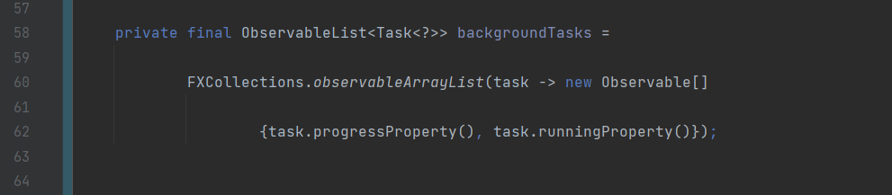
Observer Pattern
The observer pattern is used when there is a one-to-many relationship between objects such as if one object is modified, its dependent objects are to be notified automatically. Observer pattern falls under the behavioural pattern category. The StateManager class uses the ObservableList (a list of tasks – which can be assigned to either isRunning or to getProgress), in order to observe objects of the type of the task, creating an array Observable which keeps the tasks in progress and the tasks running. The observer design pattern is also suitable for any scenario that requires push-based notification. The pattern defines a provider (also known as a subject or an observable) and zero, one, or more observers (depending on the length of the array). In short, observers register with the provider, and whenever the task state change occurs, the provider automatically notifies all observers by calling one of their methods.
Realizado por: Dinis Silvestre 58763

Slide 12
Command
Located on path src/main/java/org/jabref/cli
It would be useful for when this class is called by class ArgumentProcessor (invoker) for us to store diferente commands so we can ‘redo’ them, since the same command may be rquested several times, or be held for later use. This also allows for a queue of commands to be executed in batch.
Factory Method
Located on path src/main/java/org/jabref/gui/maintain
We can identify this design pattern since we have a factory class that controls the class instanciation, replacing constructors, and abstracting the process of object generation so that the object instantiated can be determined at run-time.
Composite
Located on path src/main/java/org/jabref/gui/sidepane
The class SidePaneComponent and SidePane demonstrate the typical Component design pattern
Realizado por: Artur Lourenço 63764

