Slide 1
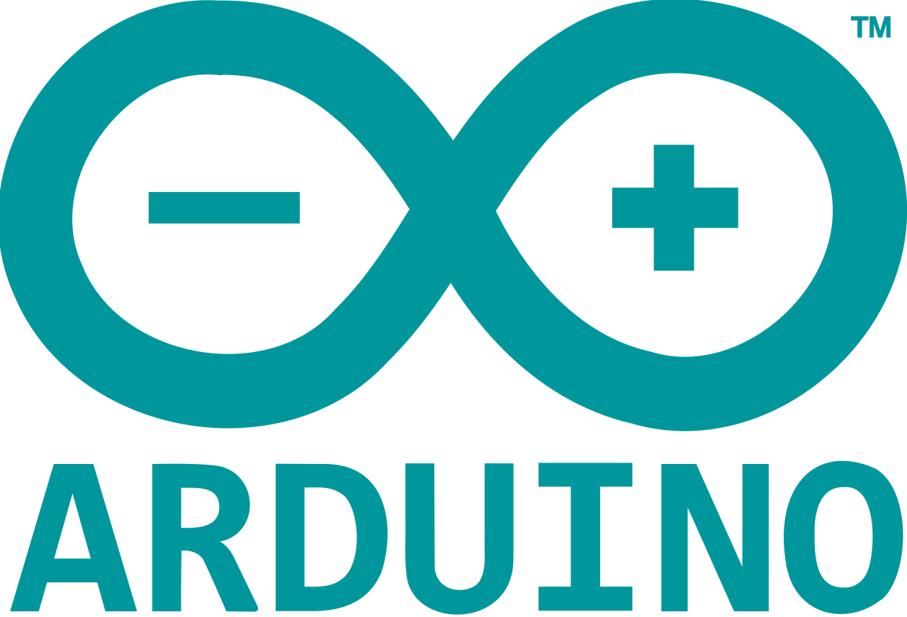

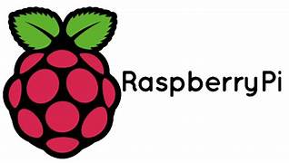
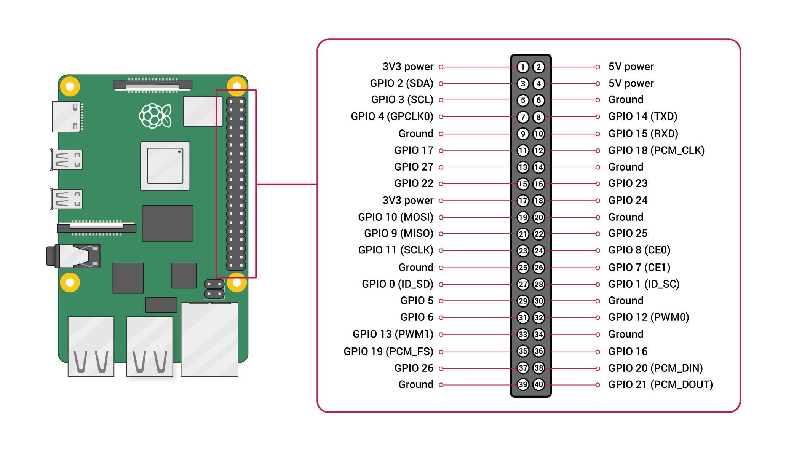
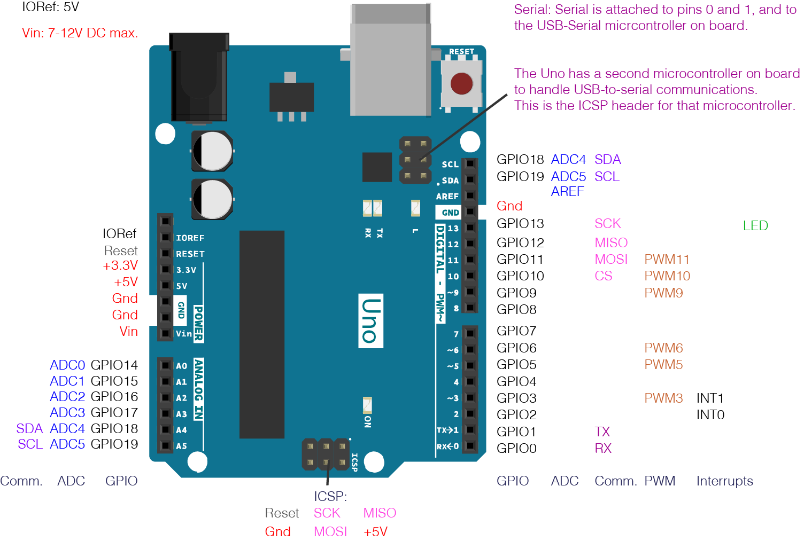
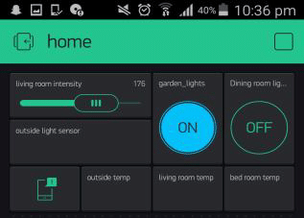

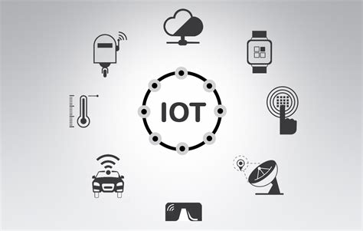

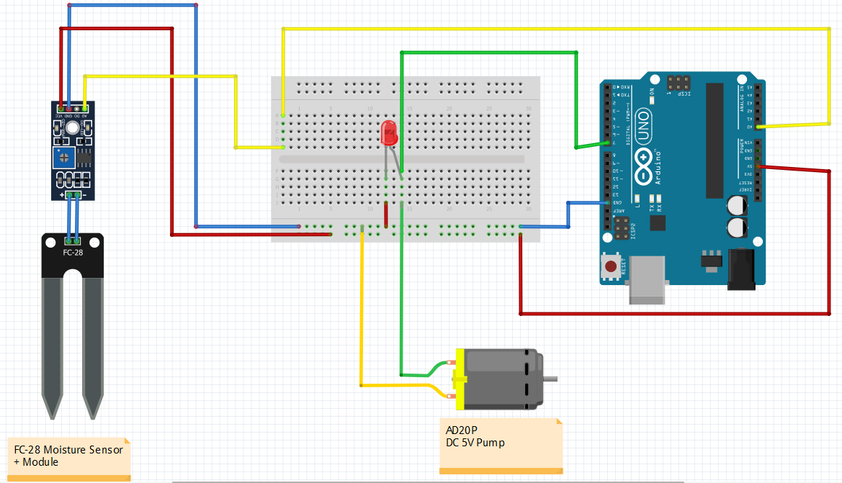
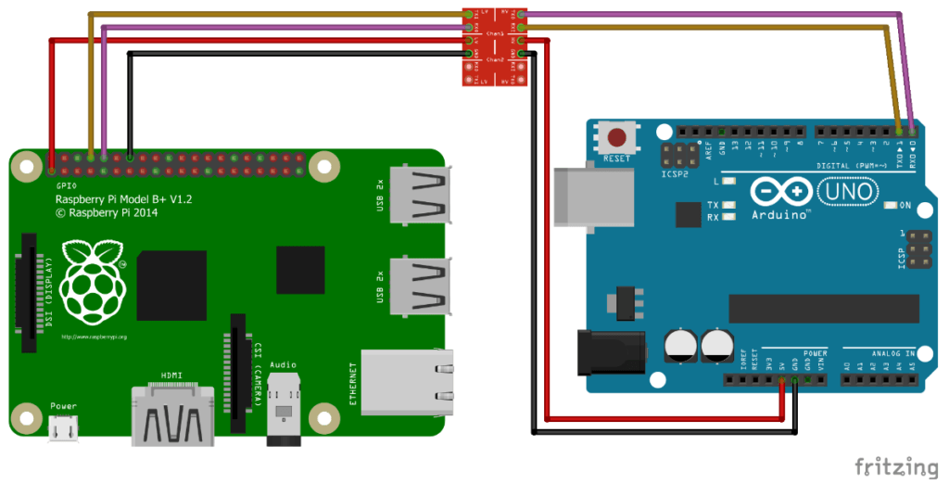
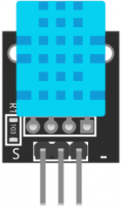
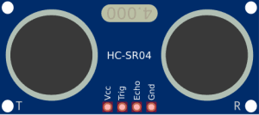
1
RASPBERRY PI
2
3
The Raspberry Pi is a low cost, credit-card sized computer that plugs into a computer monitor or TV, and uses a standard keyboard and mouse. It is a capable little device that enables people of all ages to explore computing, and to learn how to program in languages like Scratch and Python. It’s capable of doing everything you’d expect a desktop computer to do, from browsing the internet and playing high-definition video, to making spreadsheets.
The whole idea of this project was to see what we could connect and read and write from the internet.
Arduino is an open-source hardware and software company, project and user community that designs and manufactures single-board microcontrollers and microcontroller kits for building digital devices.
Applications include:
Data loggers for scientific research.
OBDuino, a trip computer that uses the on-board diagnostics interface found in most modern cars.
OpenEVSE an open-source electric vehicle charger.
XOD, a visual programming language for Arduino.
in this project I use the Arduino to read and write to digital pins and read analogue sensors.
Blynk is a hardware-agnostic IoT platform with white-label mobile apps, private clouds, device management, data analytics, and machine learning.
I use Blynk in this project to display analogue readings and control digital outputs just like switches.
A powerful feature of the Raspberry Pi is the row of GPIO (general-purpose input/output) pins along the top edge of the board. A 40-pin GPIO header is found on all current Raspberry Pi boards (unpopulated on Pi Zero and Pi Zero W). Prior to the Pi 1 Model B+ (2014), boards comprised a shorter 26-pin header.
Blynk allows users to create custom interfaces in their mobile phone to control objects connected through the internet.
4
SENSORS
5
RAPID DEVELOPMENT
6
OVERALL PROJECT GOAL
For this project I have researched many sensors including carbon dioxide, oxygen, temperature and humidity.
Sensors are the core to this application functioning correctly and they will be measuring different parameters.
IN ORDER TO MAKE THIS PROJECT A SUCCESS I IMPLIMENTED A RAPID DEVELOPMENT TECHNIQUIE WHERE I HAD TO PROTOTYPE, TEST, THEN REFINE USING TEST CIRCUITS,
Overall the whole idea of this project is to demonstrate the capabilities of the IOT platform not only using the Raspberry Pi but also the Arduino to communicate over the World Wide Web.

