Slide 1
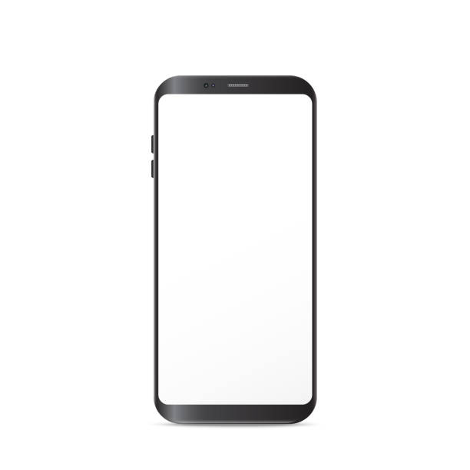
USERNAME:
PASSWORD:
REGISTER
LOGIN

Slide 2
TJFITZSTER
***********
REGISTER
LOGIN
ERROR INCORRECT PASSWORD

Slide 3
TJFITZSTER
***********
REGISTER
LOGIN
ERROR INCORRECT PASSWORD

