Slide 1
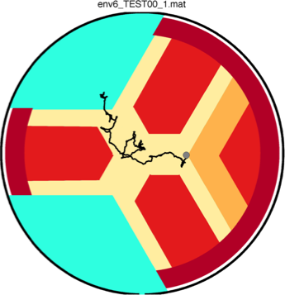
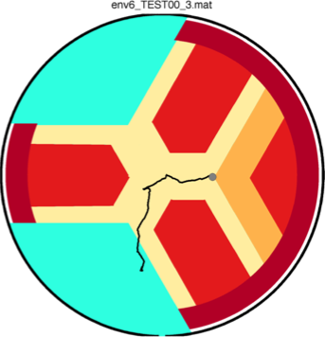

Slide 2
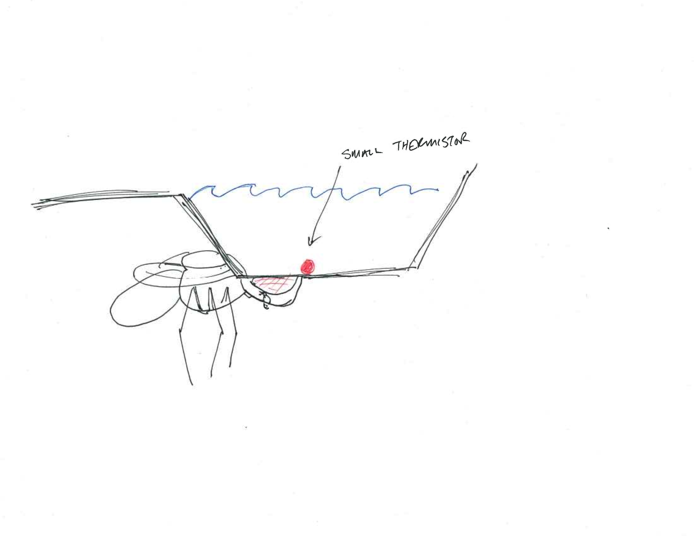
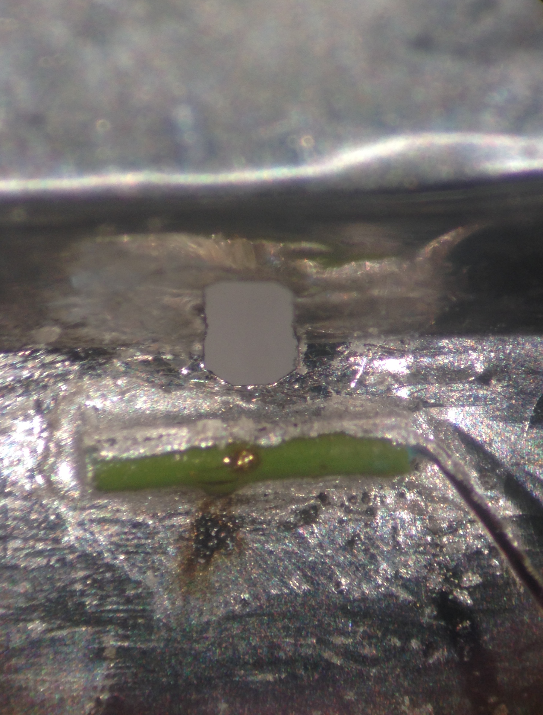
Tiny thermistor saline heating
Learning week:
.500 mm x 3 mm (and smaller)
NTC vs. PTC, and current-limiting circuits
Thermal time constants 10-15 msec
Dissipation constant – here .12 mW/C

