Slide 1
A Modest Inductive Charger
Team 10 – Jeff Brown Kati Dahn Tyler Gilbert Jann Messer

Slide 2
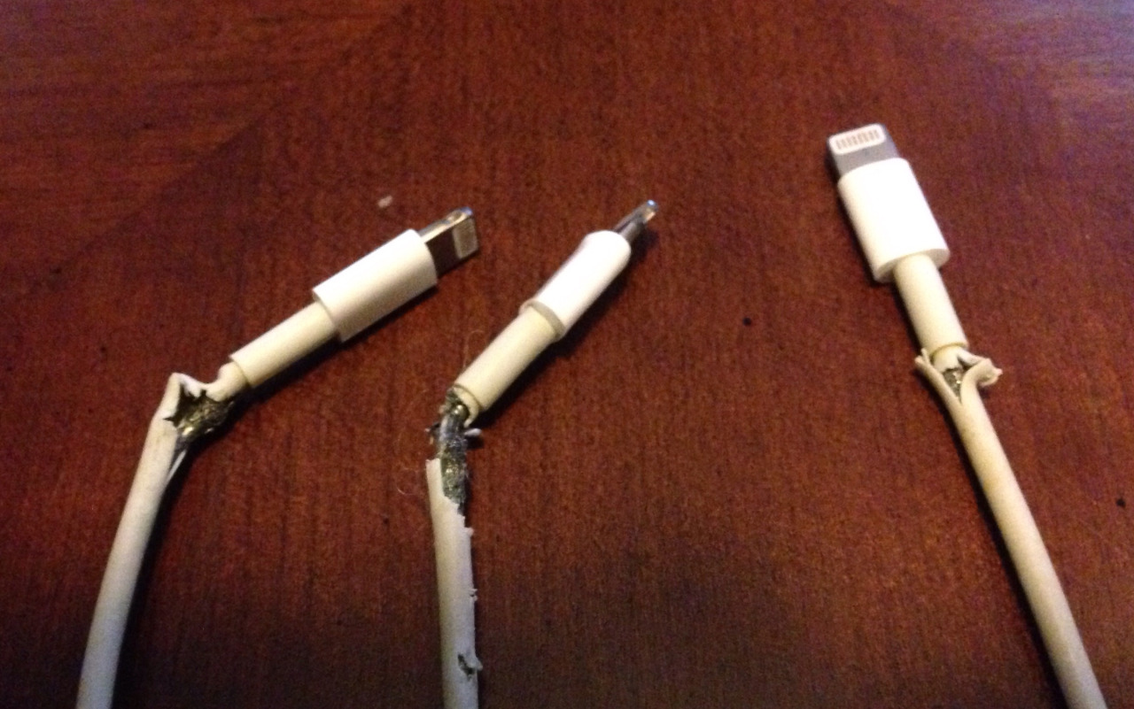
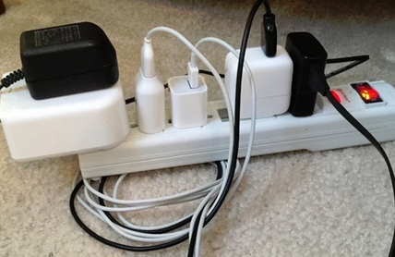
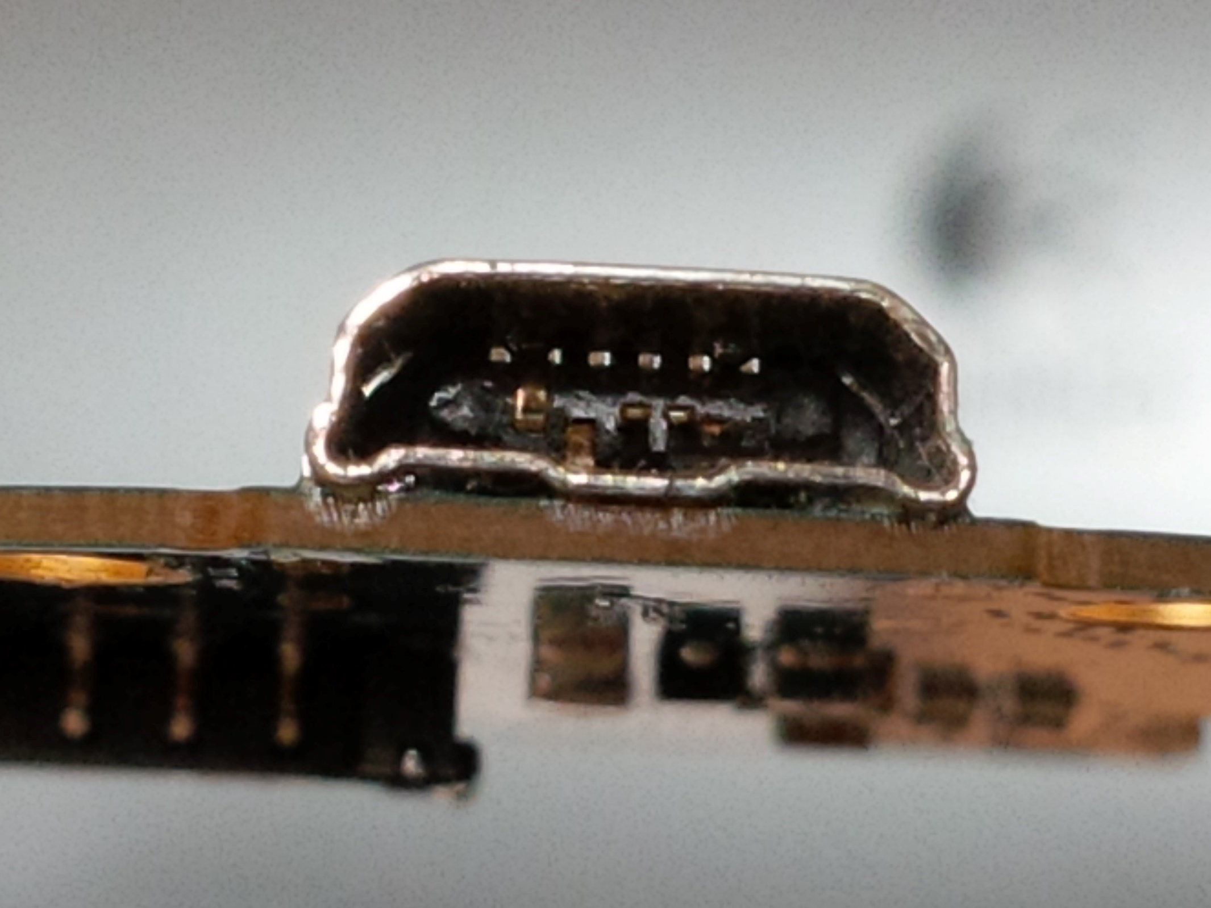
Pitfalls of Wired Charging

Slide 3
Guiding Motivation
“To become more familiar with wireless energy transmission and explore integrating wireless charging technology into consumer electronics.”
A starting point for exploring Power solutions for the internet of things

Slide 4
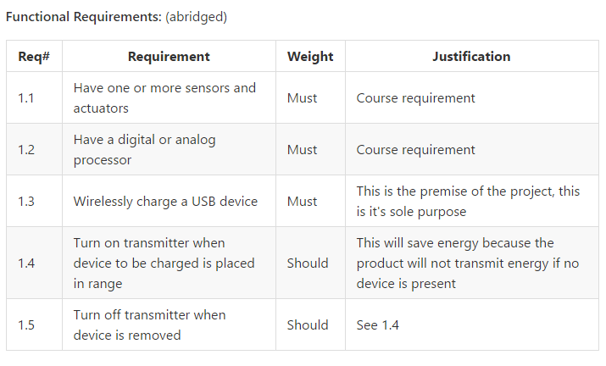
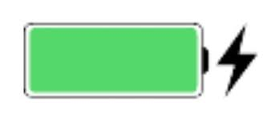
Objective

Slide 5
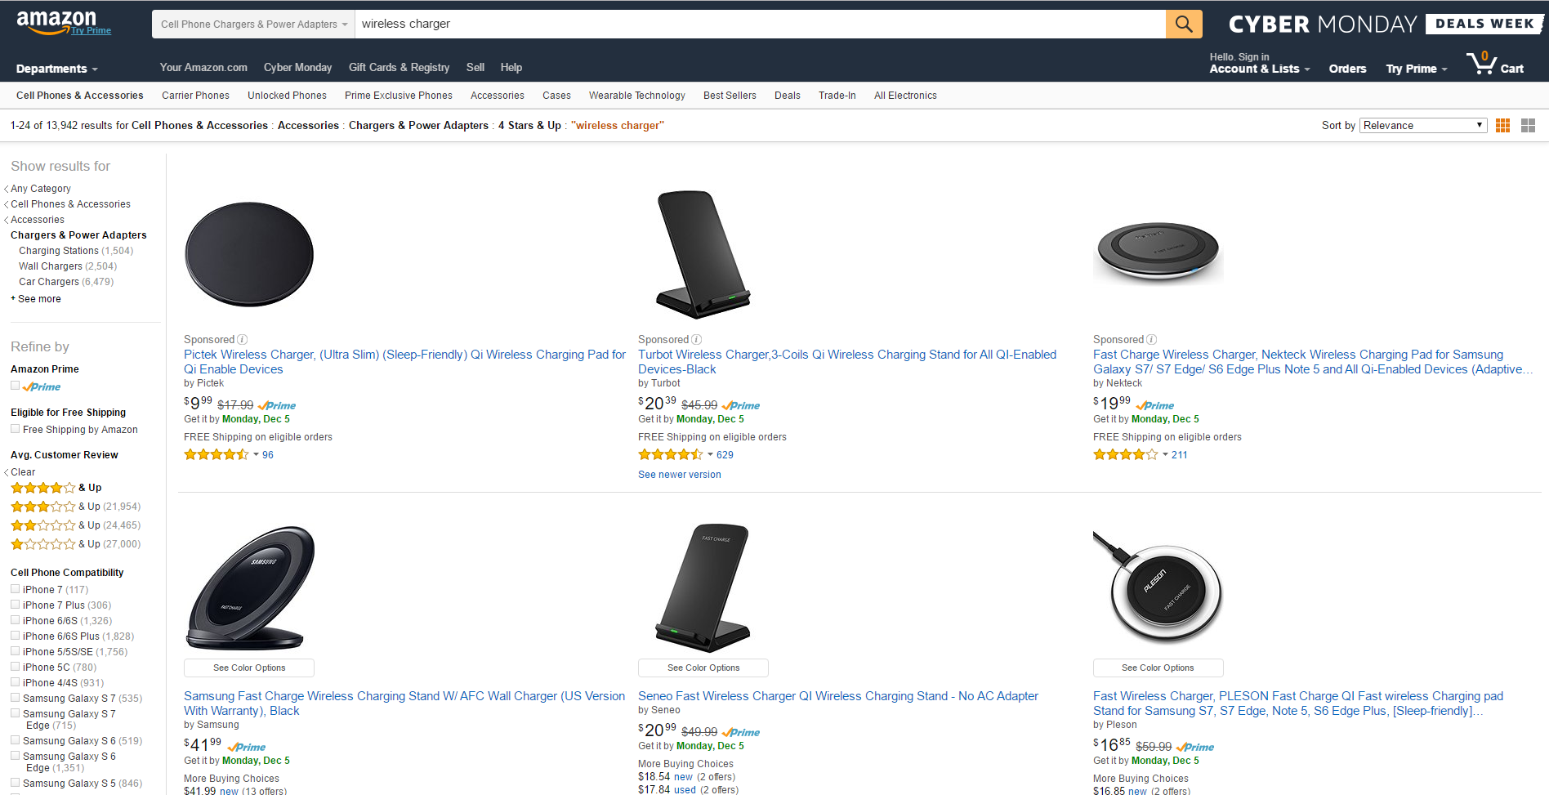
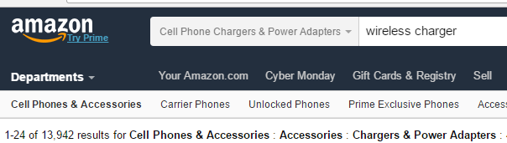
Alternatives
We are by no means re-inventing the wheel here.

Slide 6
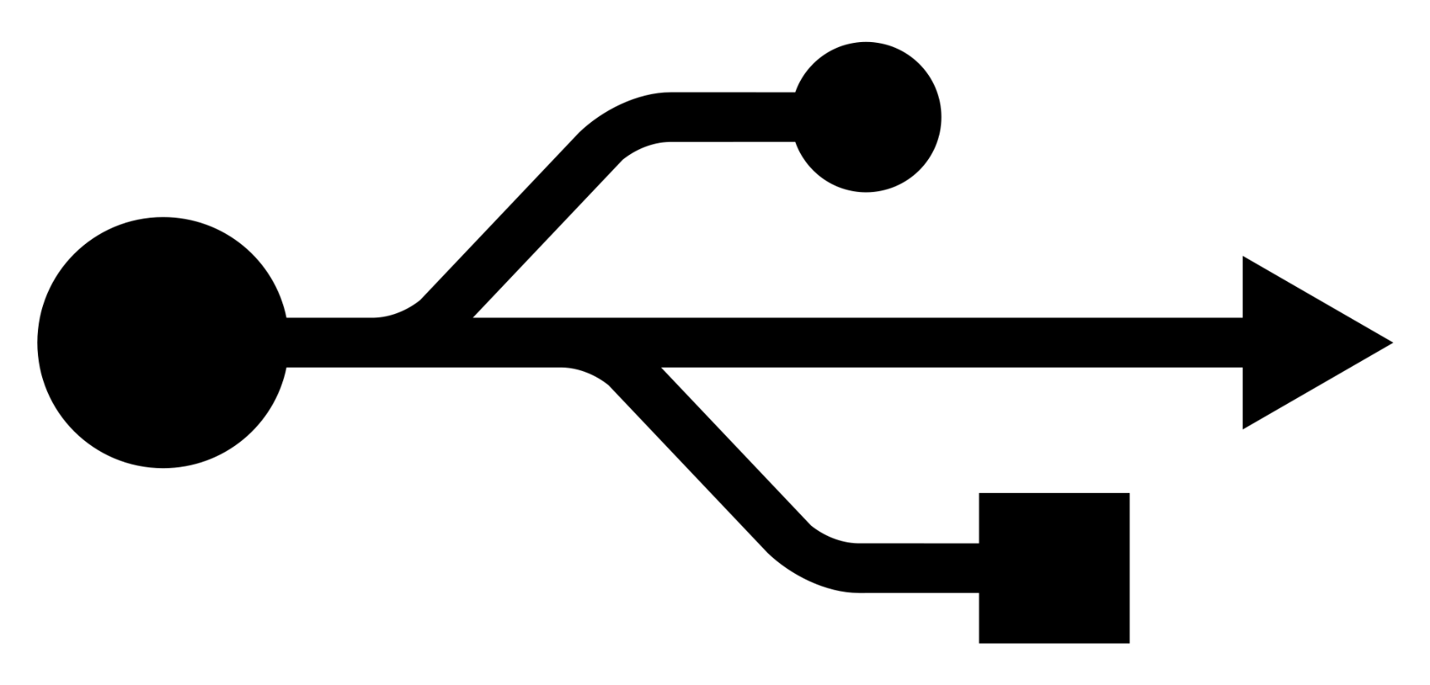
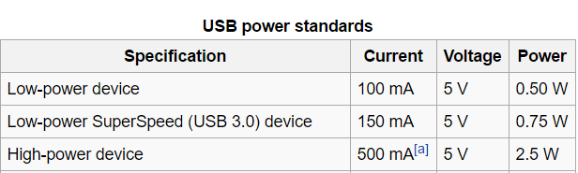
Requirements

Slide 7
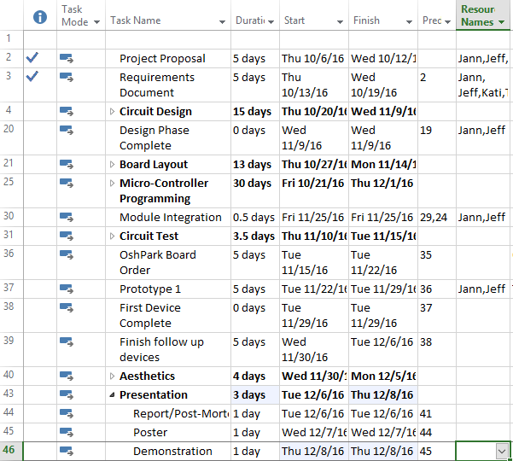
Approach
Block Diagram of Modules
Design Coils
Design Signal Driver
Program Controller
Regulation and Rectification Circuitry
Integration
Testing

Slide 8
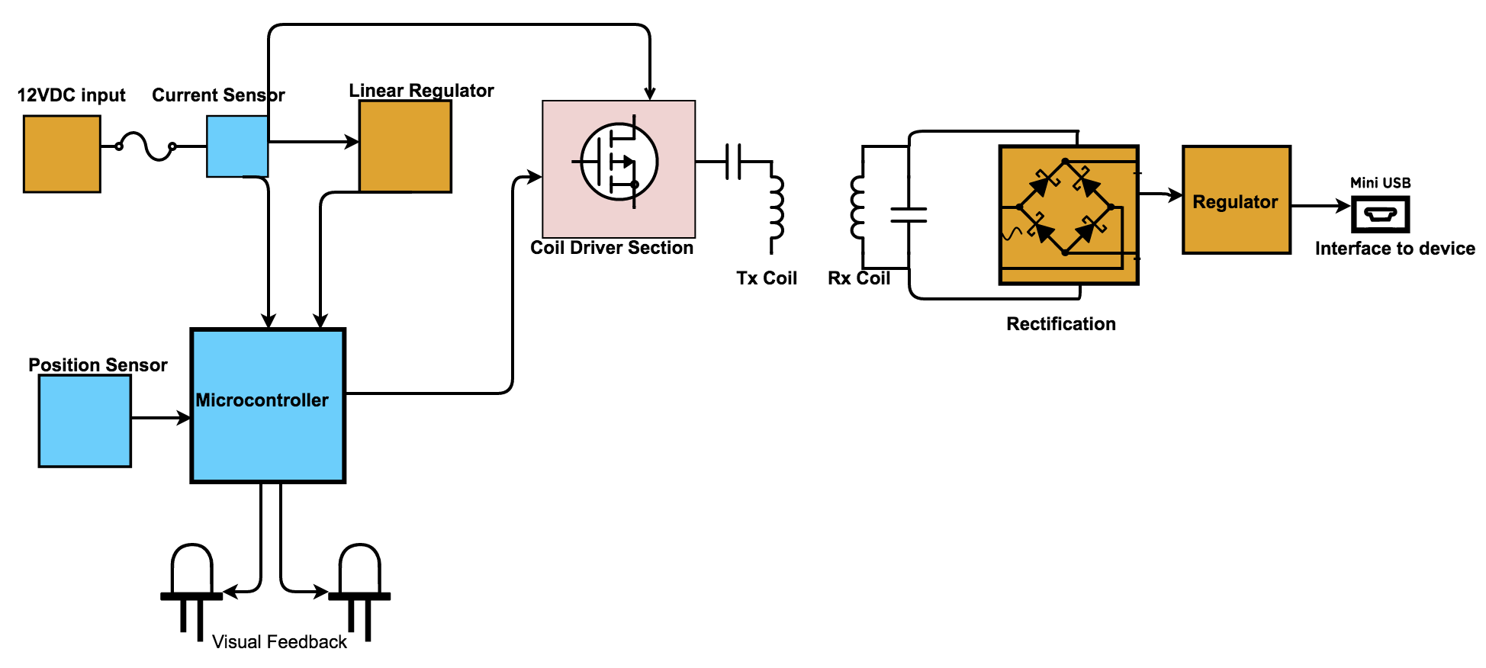
Circuit Design

Slide 9
Coil Design

Slide 10
Driver Design

Slide 11
Regulation and Rectification

Slide 12
Microcontroller software Design

Slide 13
Implementation slide 1 of 2
Details

Slide 14
Implementation 2 bill of materials and Tools

Slide 15
IP and Prior WOrk

Slide 16
Testing

Slide 17
Results

Slide 18
Contributions

Slide 19
Lessons Learned

