Slide 1

Data Science Job Market in the US
Presented By : Taylor Grafft Jayshree Neeta Shrivastava

Slide 2
Hypothesis
Our hypothesis was that the most jobs would be available at Silicon Valley.

Slide 3
Questions
Which locations in the USA has the most opportunities for data scientist?
Which company has the most opportunities in the USA?
Which language do employers want the most for data scientists?
What are the hotspots in the USA for Data scientist?
Which company has the most opportunities in Austin?
Which job position is in most demand?

Slide 4
Describe whether you were able to answer

Slide 5
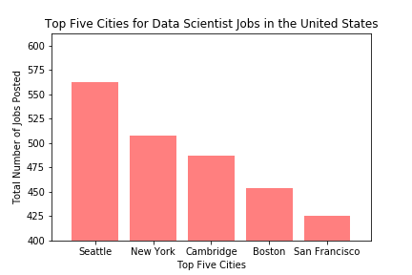

Slide 6
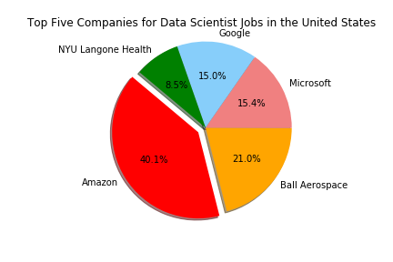

Slide 7
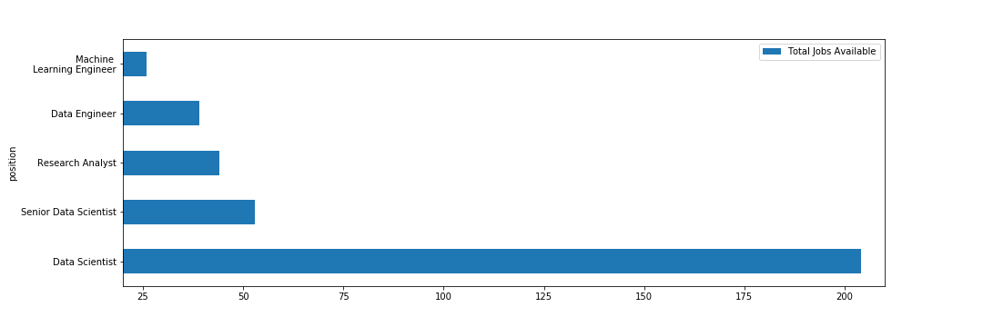
Data Scientist title continues to reign on

Slide 8
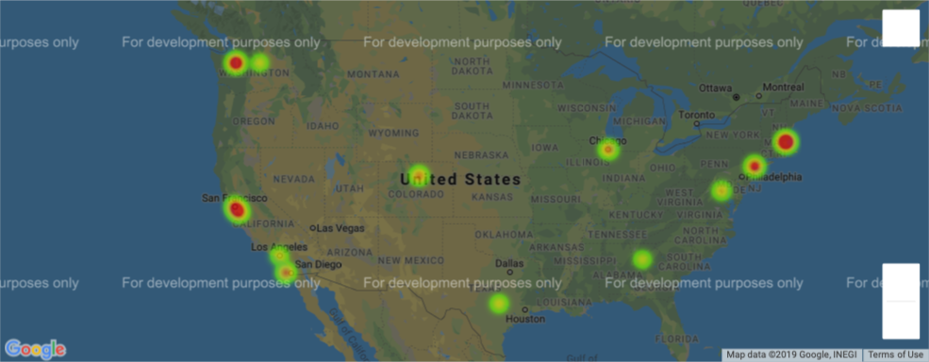
Hot Spots for Data Scientist Jobs in the USA

Slide 9
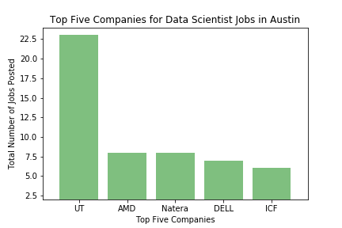

Slide 10
Austin vs Top 5 cities
Cities | Total Jobs
Seattle, WA | 474
Cambridge, MA | 368
New York, NY | 338
Boston, MA | 305
San Francisco, CA | 287
Austin, TX (12th) | 127

Slide 11
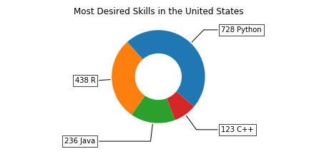
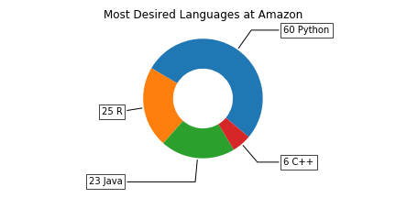
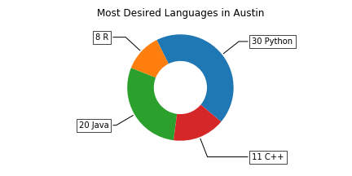
Python is the new R

Slide 12
Conclusion:
Python is the most in-demand language. The popularity of this open-source language has been widely observed. It’s beginner friendly, with many support resources. The vast majority of new data science tools are compatible with it. Python is the primary language for data scientists.

