Slide 1

Data Science Job Market in the US
Presented By : Taylor Grafft Jayshree Neeta Shrivastava

Slide 2
Core Message
As students enrolled in a Data Analytics course at UT, we thought this project would be beneficial to both ourselves and our classmates—to explore the job market in this field because naturally this will be our next step.
Where we found our Data?
- Kaggle.com
- CSV files of 15 major cities in USA. The data was from LinkedIn for jobs posted in August 2018

Slide 3
Questions
Which locations in the USA has the most opportunities for data scientist?
Which company hires the most in the USA?
How is the job market in Austin compared to top 5 cities ?
Which language do employers want the most for data scientists?
Who gets hired?
Which company has the most opportunities in Austin?

Slide 4
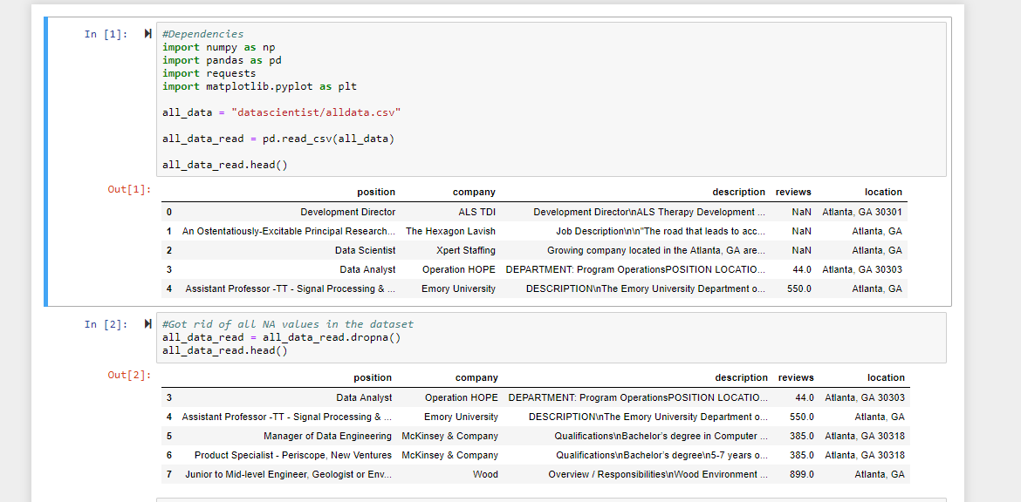
Data cleanup & exploration

Slide 5
Steps for Data Analysis
Import dependencies
Read CSV
Data cleanup
Created Data Frame
Worked on specific columns to get the desired results
Plotted various graphs using Matplotlib

Slide 6
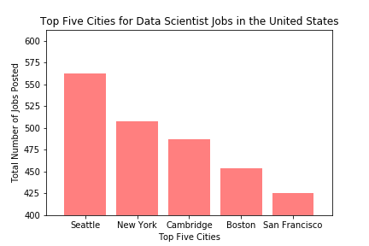
Which locations in the USA has the most opportunities for data scientist?

Slide 7
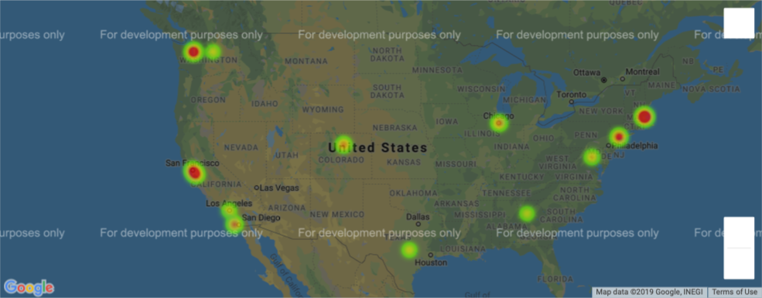
Hot Spots for Data Scientist Jobs in the USA

Slide 8
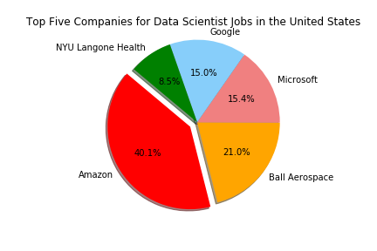
Which company hires the most in the USA?

Slide 9
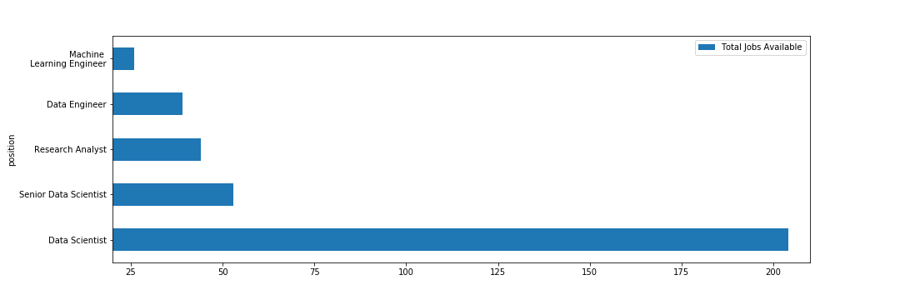
Who gets hired?
Data Scientist title continues to reign on

Slide 10
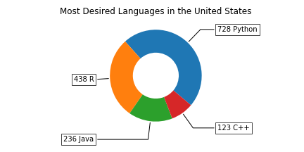
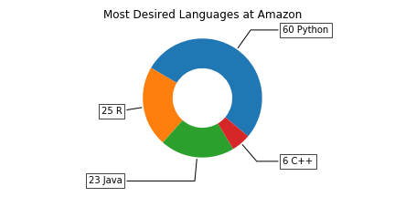
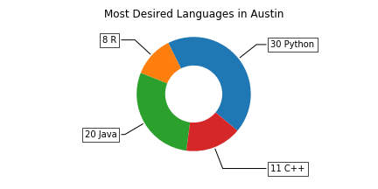
Which language do employers want the most for data scientists?
Python is the new R

Slide 11
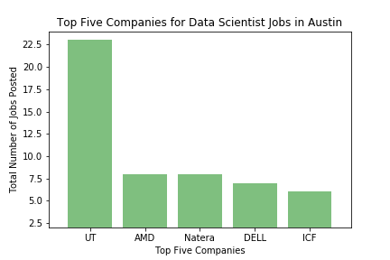
Which company has the most opportunities in Austin?

Slide 12
Austin vs Top 5 cities
How is the job market in Austin compared to top 5 cities ?
Cities | Total Jobs
Seattle, WA | 474
Cambridge, MA | 368
New York, NY | 338
Boston, MA | 305
San Francisco, CA | 287
Austin, TX (12th) | 127

Slide 13
Conclusion
Python is the most in-demand language. The popularity of this open-source language has been widely observed. It’s beginner friendly, with many support resources. The vast majority of new data science tools are compatible with it.
Data Scientist jobs are in high demand in Seattle and with Amazon
UT hires the most Data Scientist in Austin

Slide 14
Possible trend
There is a shortage of 151,717 people with data science skills, with particularly acute shortages in New York City, San Francisco, and LA.
The 2020 estimate calls for 2.7 million job postings for data science and analytics roles

Slide 15
Problems Faced and Going Forward
The description column from the dataset was in HTML format, and therefore gave us issues when looking for specific skills/languages
We were limited to data for August 2018 (although the dataset had around 9000 rows)
If we had more time with this project, we would pull in addition data to show the trend of Data Science jobs over several years

