Slide 1

Data Science Job Market in the US
Presented By : Taylor Grafft Jayshree Neeta Shrivastava

Slide 2
Hypothesis

Slide 3
Questions
Who gets hired? What kind of talent do employers want when they're hiring a data scientist?
Which locations has the most opportunities?
What skills, tools, degrees, or majors do employers want the most for data scientists?
What's the difference between data scientist, data engineer and data analyst?

Slide 4
Describe whether you were able to answer

Slide 5
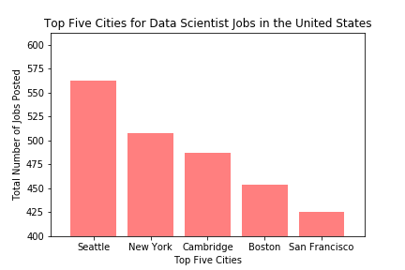

Slide 6
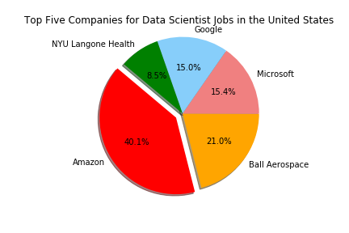

Slide 7
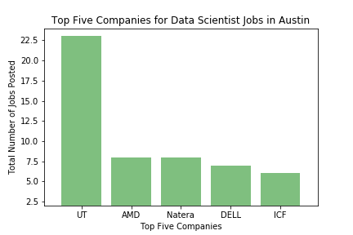

Slide 8
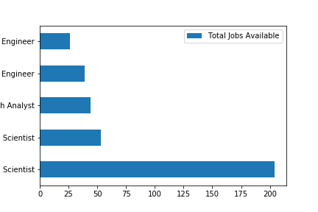

Slide 9
