Slide 1

Data Science Job Market in the US
Presented By : Taylor Grafft Jayshree Neeta Shrivastava

Slide 2
Hypothesis
Our hypothesis was the most jobs available would be at Silicon Valley

Slide 3
Questions
Which locations in USA has the most opportunities?
Which company has the most opportunities in USA?
Which language do employers want the most for data scientists?

Slide 4
Describe whether you were able to answer

Slide 5
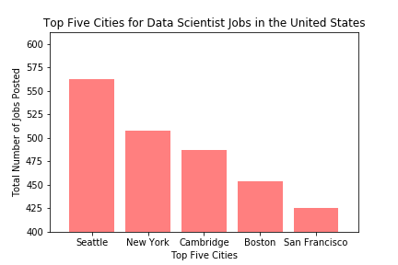

Slide 6
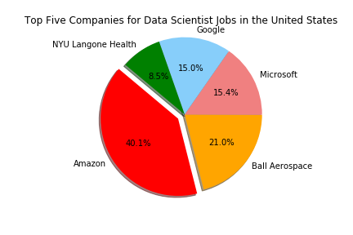

Slide 7
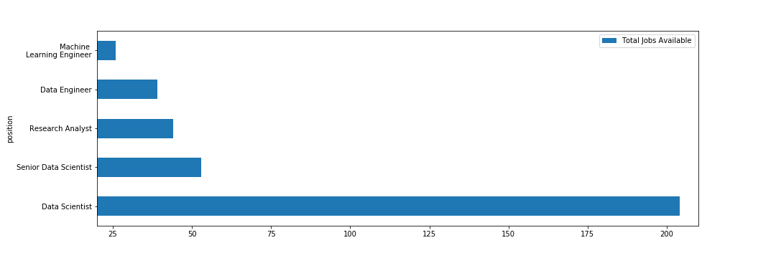
Data Scientist title continues to reign on

Slide 8
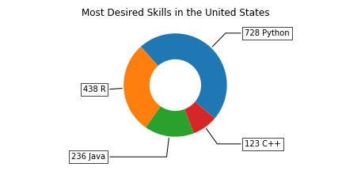
Python is the new R

Slide 9
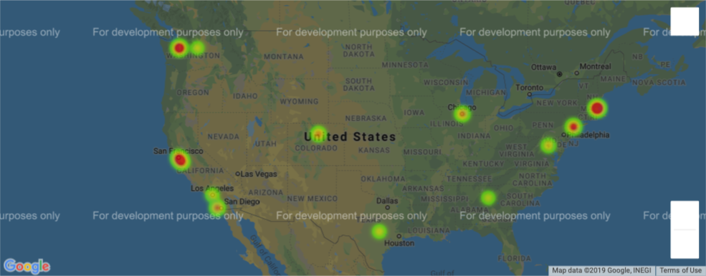
Hot spots for Data Scientist jobs in USA

Slide 10
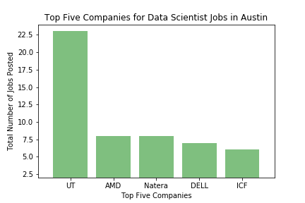

Slide 11
Austin Vs Top 5 cities
Cities | Total Jobs
Seattle, WA | 474
Cambridge, MA | 368
New York, NY | 338
Boston, MA | 305
San Francisco, CA | 287
Austin, TX (12th) | 127

