Slide 1
ECE 6710 Digital VLSI Design Lightening Presentation
Team 06
Steven brown, Andrew Bradbury, Tim grant, travis gray

Slide 2
Overview of Titan
16 bit microprocessor
Instruction set architecture modeled after the CR16 microprocessor
General purpose
12.5 MHz clock speed
4 TCU’s in size
Notes:
General purpose
-Not application specific.
12.5 MHz clock speed
-ensures we can read and write to memory in one clock period
4 TCU’s in size
-reduces the probability of needing custom cells and allows place and route to do the work.

Slide 3
Features of Titan
3 bit VGA
I2S Interface to stream audio
“Reprogrammable”
Off-chip memory
External access to ALU flag and FSM state bits for testing
Notes:
“Reprogrammable”
-Must write application and have a ROM programmed with code
Off-chip memory
-reduces real-estate on the chip and reduces probability for the need for custom cells in place of using the place and route tool.
External access to ALU flag and FSM state bits for testing
-In case chips not working we can debug issues to try to locate the source of error.

Slide 4
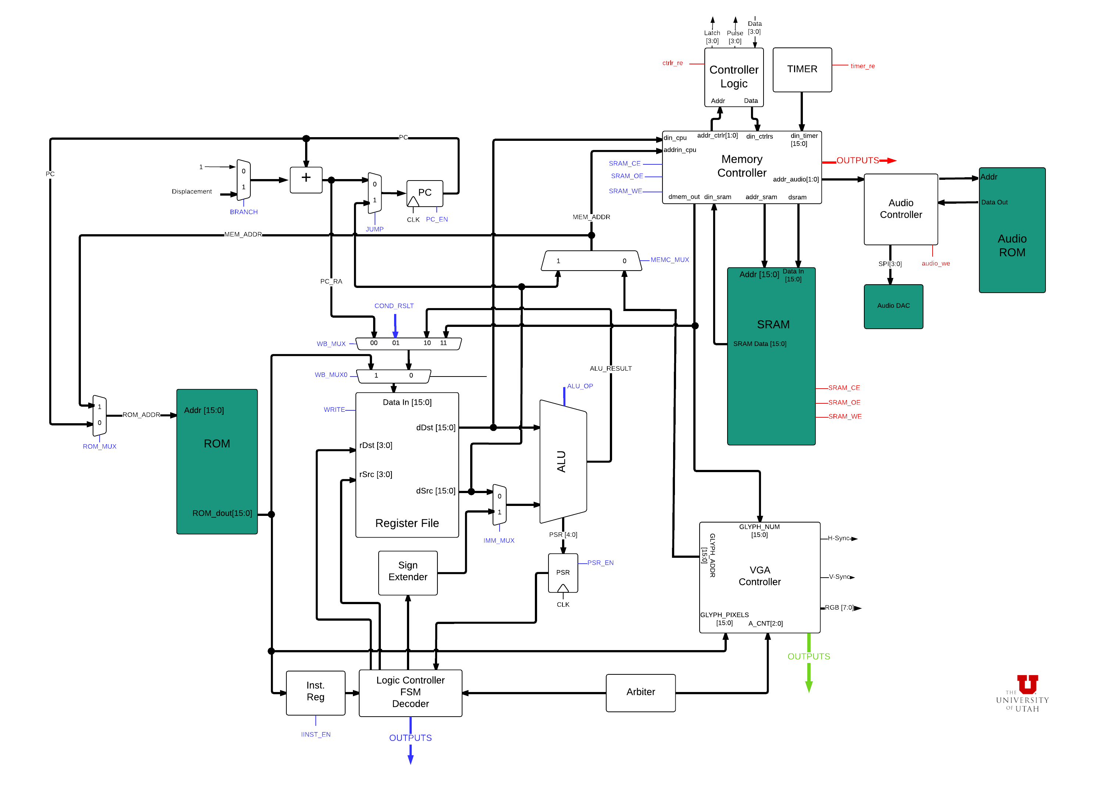
Notes:
Block diagram for our microprocessor

Slide 5
Notes:
Add place and routed layout here.

Slide 6
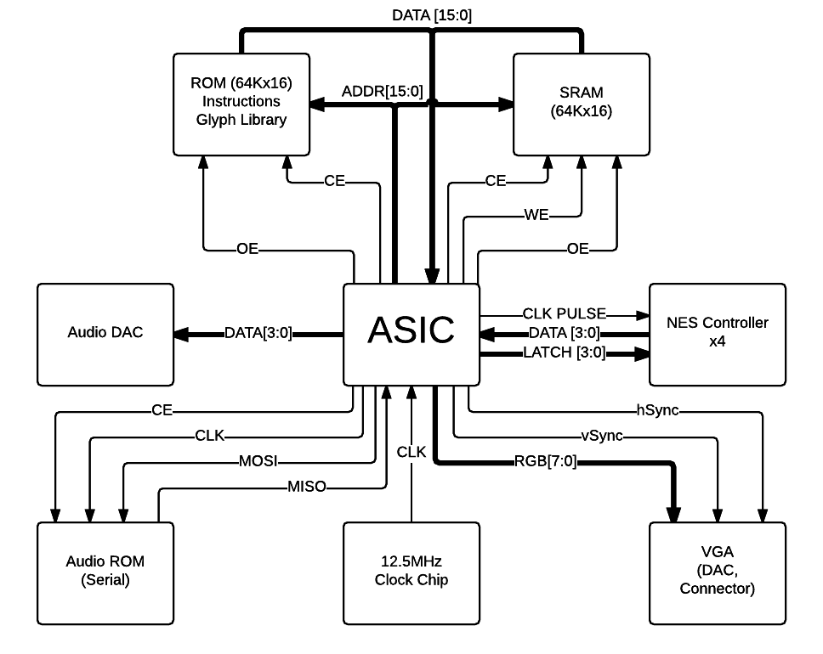
Notes:
This is how our chip look deployed in a system.

Slide 7
Questions?
Steven Brown: steven.m.brown@utah.edu
Andrew Bradbury: a.bradbury8@gmail.com
Tim Grant: tgrant@cs.utah.edu
Travis Gray: travis.j.gray@utah.edu

