Slide 1
T.E.S.S. Titan Entertainment Super System
Team 06
Steven brown, Andrew Bradbury, Tim grant, travis gray

Slide 2
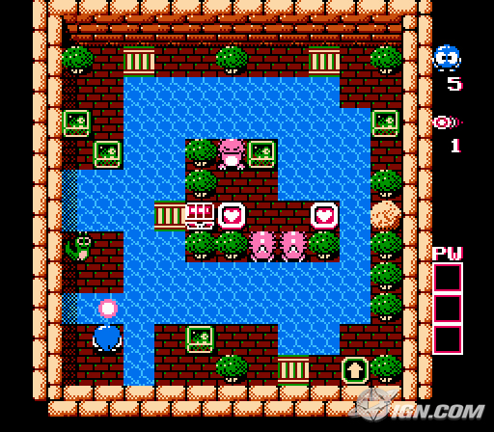
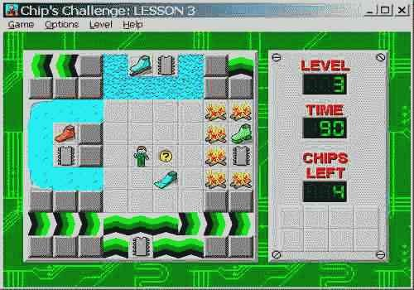

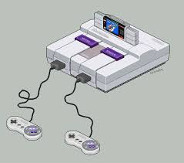

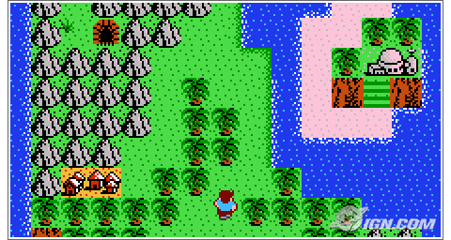


Inspiration
Notes:
General purpose
-Not application specific.
12.5 MHz clock speed
-ensures we can read and write to memory in one clock period
4 TCU’s in size
-reduces the probability of needing custom cells and allows place and route to do the work.

Slide 3
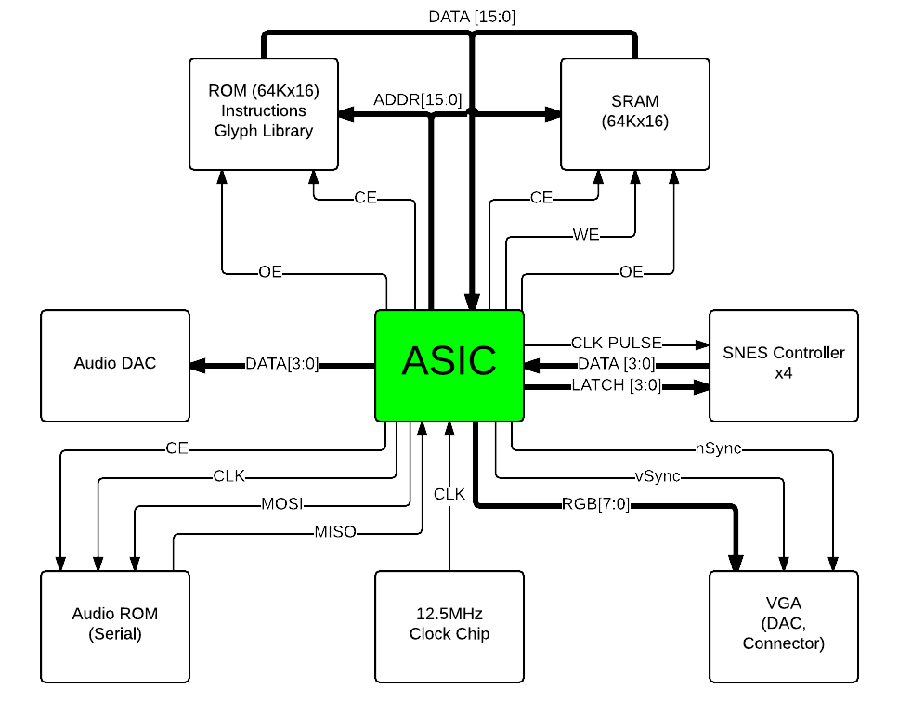
16-bit microprocessor
CR16 ISA
General purpose
12.5 MHz clock speed
4 TCU’s in size
Notes:
This is how our chip look deployed in a system.

Slide 4
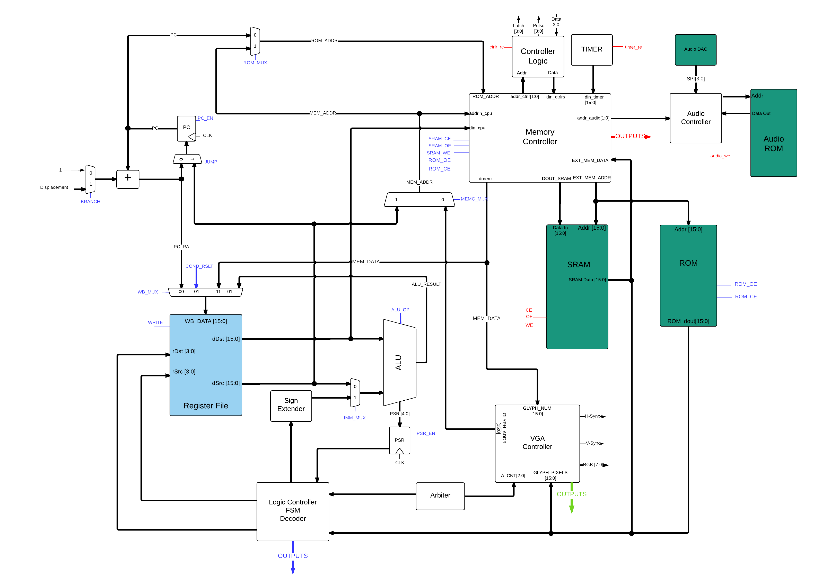
Notes:
2 bit color VGA
I2S Interface to stream audio
Off-chip memory
External access to ALU flag and FSM state bits for testing

Slide 5
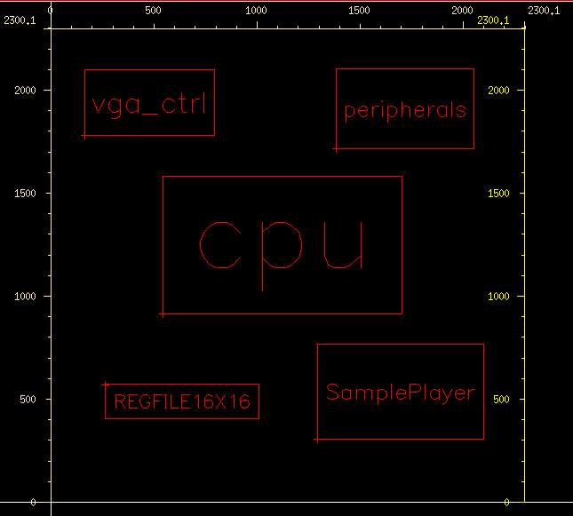
Notes:
Add place and routed layout here.

Slide 6
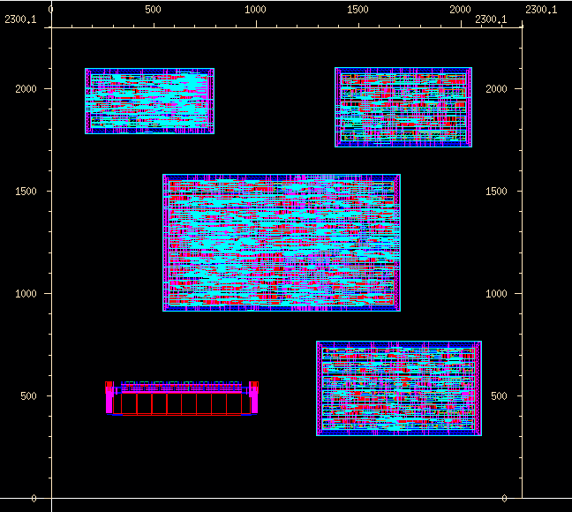
Notes:
Add place and routed layout here.

Slide 7
Questions?
Steven Brown: steven.m.brown@utah.edu
Andrew Bradbury: a.bradbury@utah.edu
Tim Grant: tgrant@cs.utah.edu
Travis Gray: travis.j.gray@utah.edu

