Slide 1
Final presentation of project work
24th of January 2018

Slide 2
Our Team
Team number: 6-6
Kadir Tandogan Tilki
Thomas Bachmaier
Fabian Helfert
Daniela Rinscheid
Johannes Thanner

Slide 3
Project Demo Videos
Whole Project: https://www.dropbox.com/s/jl2ouxzb63lhjzm/proj_demo.mp4?dl=0
Android: https://www.dropbox.com/s/yvz4hxicxolh8hz/android_demo.mp4?dl=0
Web: https://www.dropbox.com/s/no3nzhvpsuml91b/web_demo.avi?dl=0
Step by step explanation via screenshots on the next slides.

Slide 4
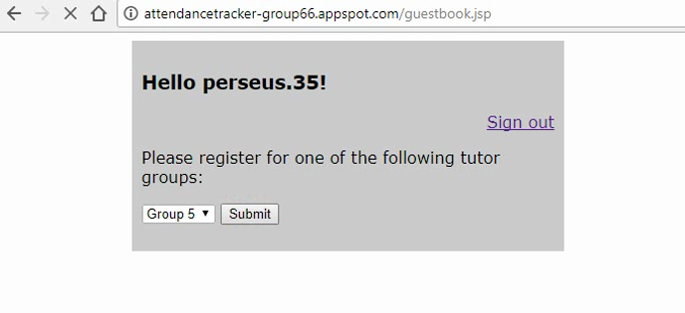
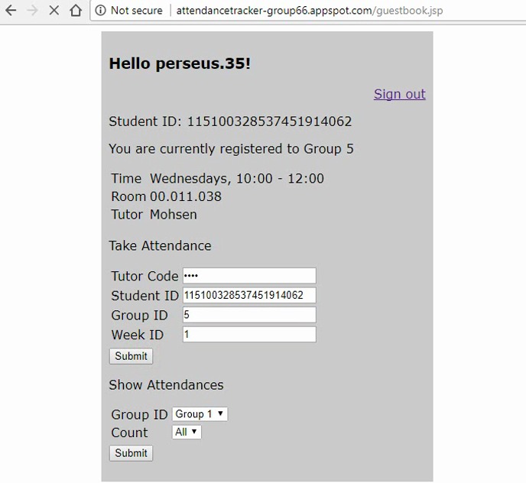
Demo
Register as a new user
Add attendance manually or use the app (next slide)

Slide 5
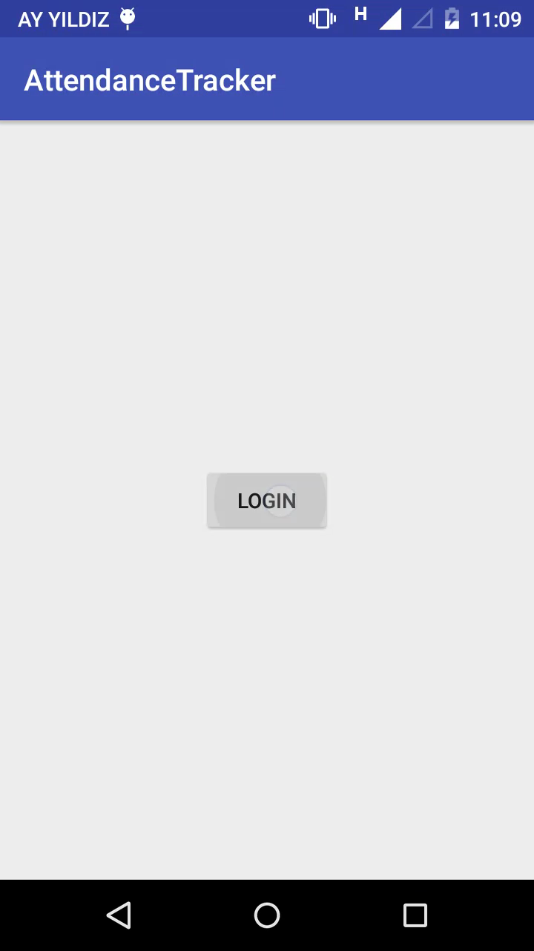
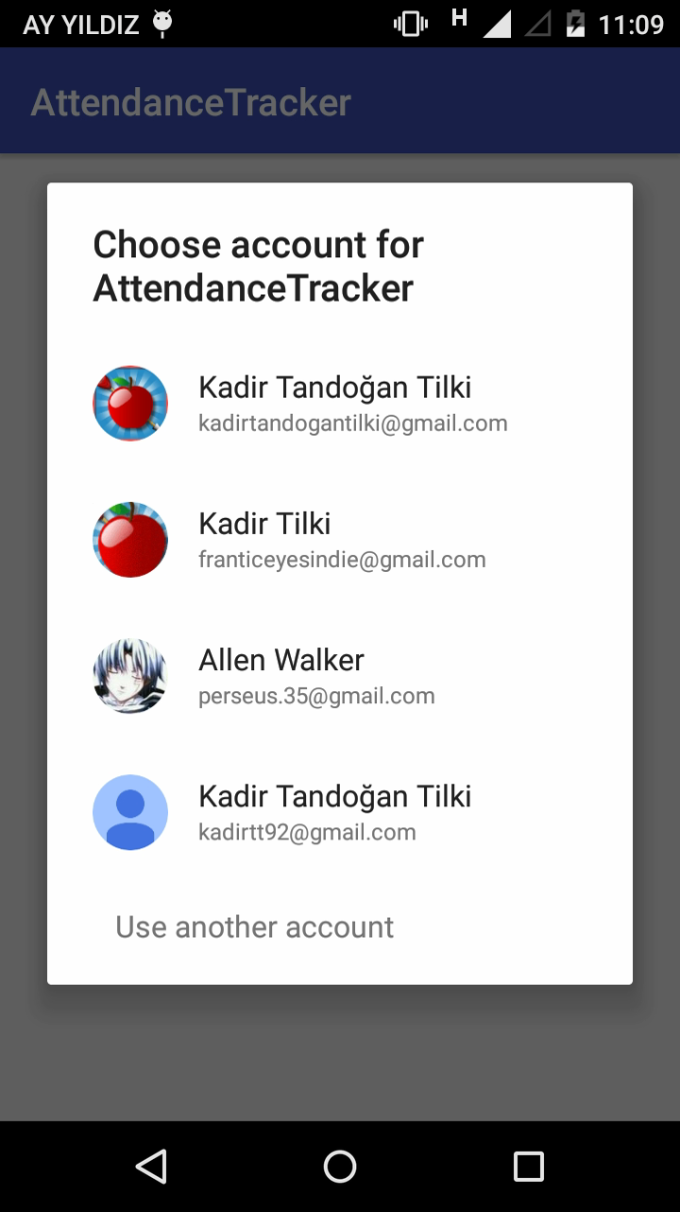
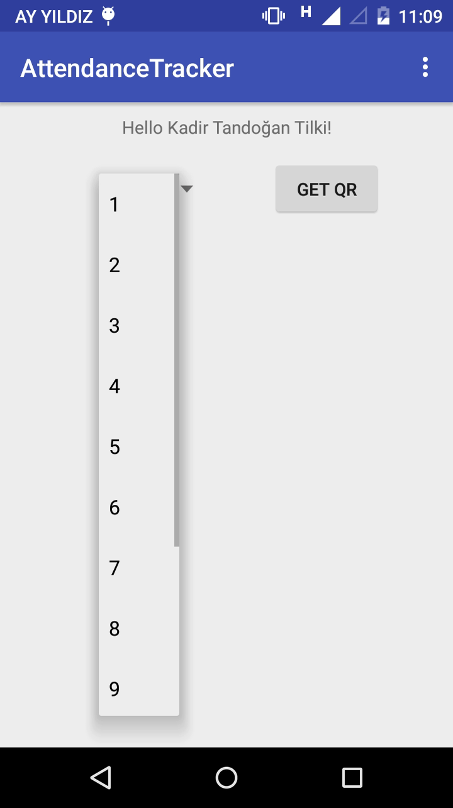
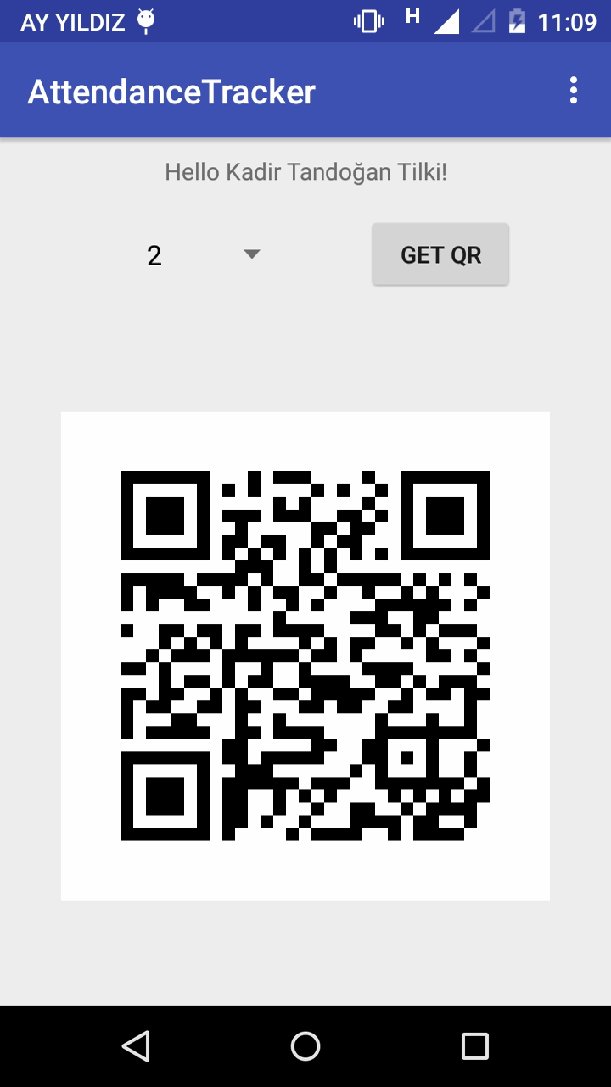
Demo (continued)
Logging In
Choosing Week and Requesting QR Code

Slide 6
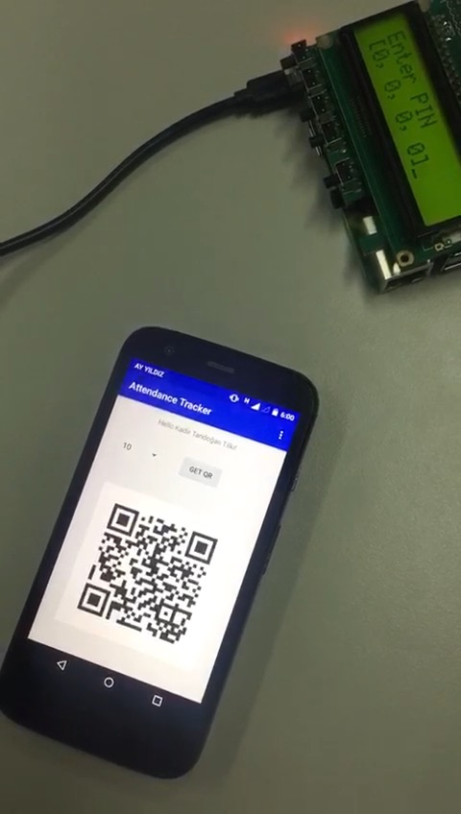
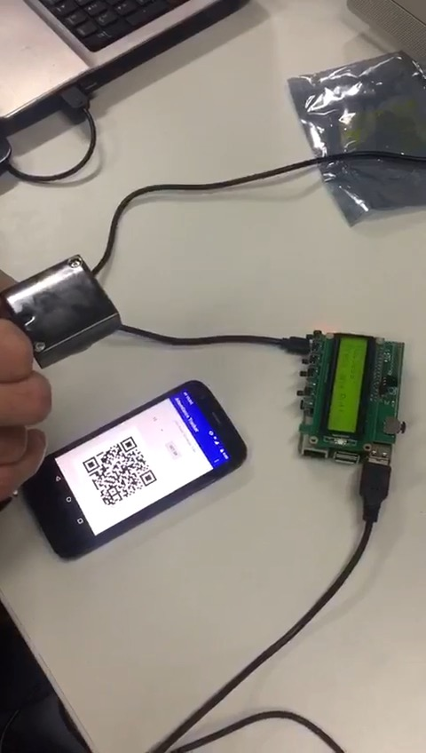
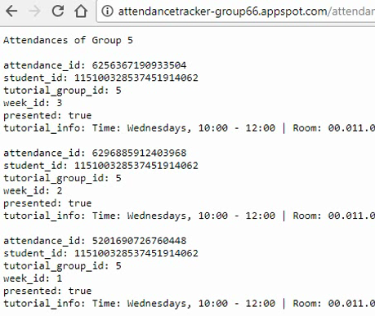
Demo (continued)
Starting PI with Tutor Code (0000)
Scanning QR Code
Attendance is successfully taken

Slide 7
Completed and Due Features
Week | Task | Status
1 | Set up GitHub | Done
2 | Web app User login Check if registered Register for tutor group Show group information | Done
3 | REST Attendance entry and attendance log Check for correct group Display all attendances per group | Done
4 | QR Code on Raspberry Pi Transform attendance string to QR code Read and parse QR code per webcam Display decoded string | Done

Slide 8
Completed and Due Features
Week | Task | Status
5 | Communication between Pi and BE Convert attendance record to XML Submit XML via POST request Server should parse and store request in database Show confirmation if success | Done
6 | Attendance tokens Extend QR creation upon registration Implement GET request to deliver token per student and week Check for correct token before stored in database otherwise failure message Android app Login functionality Retrieve weekly token and display as QR Display attendance history (optional) | Done
7 | Authentication Authenticate tutors and students Handheld checks for credentials | Done

Slide 9
Completed and Due Features
Week | Task | Status
8 | No project recommendations given | Done
9 | Hashchain based Notary Recording attendance Verfying attendance | Not necessary
10 | No project recommendations given | Done

Slide 10
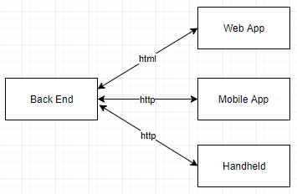
High Level Architecture

Slide 11
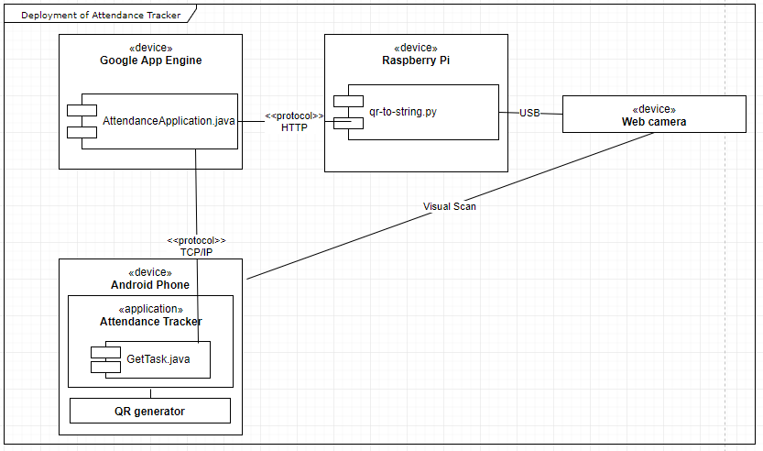
Deployment Diagram

Slide 12
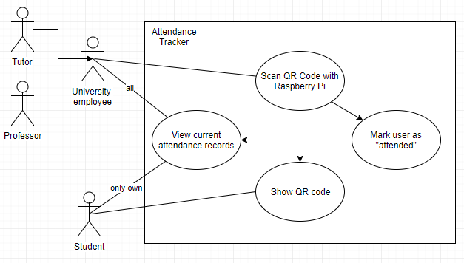
Use Case Diagram

Slide 13
Lessons Learned & Tradeoff
Lesson Learned
Better distribution of tasks
Use of github features for shared collaboration

Slide 14
Future Works
We completed all basic features and some optimization on the code was conducted.
The attendance system is ready to use for next years classes…

