Slide 1


Agile
Presented by: Tammy Hartline Presented to: Leadership
02/18/2023
Approach

Slide 2
Key Facets of the SCRUM-Agile Approach
Click the title for more details from the article -->: 5 Key Characteristics of Agile and SRUM Methodology, By Special Guest, June 21, 2019
Specific SCRUM Teams commit to a single project
Offers better visibility and understanding got key stakeholders, the clients/users, and every team member involved in the project. (Ensuring all expectations are managed effectively.)
Promotes teamwork and high transparency for every step of the development cycle. (This includes planning, reviews and prioritization.)
Creates an environment that allows early identification of development issues and through collaboration, an easy resolution is usually reached.
Exceptional Quality with inexpensive and continuous integration through iterative releases.

Slide 3
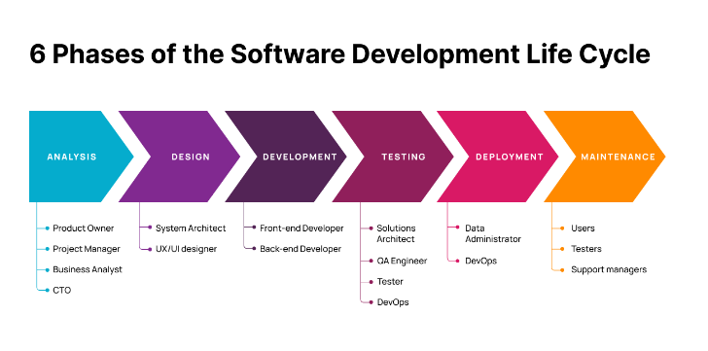
What is the SDLC?

Slide 4

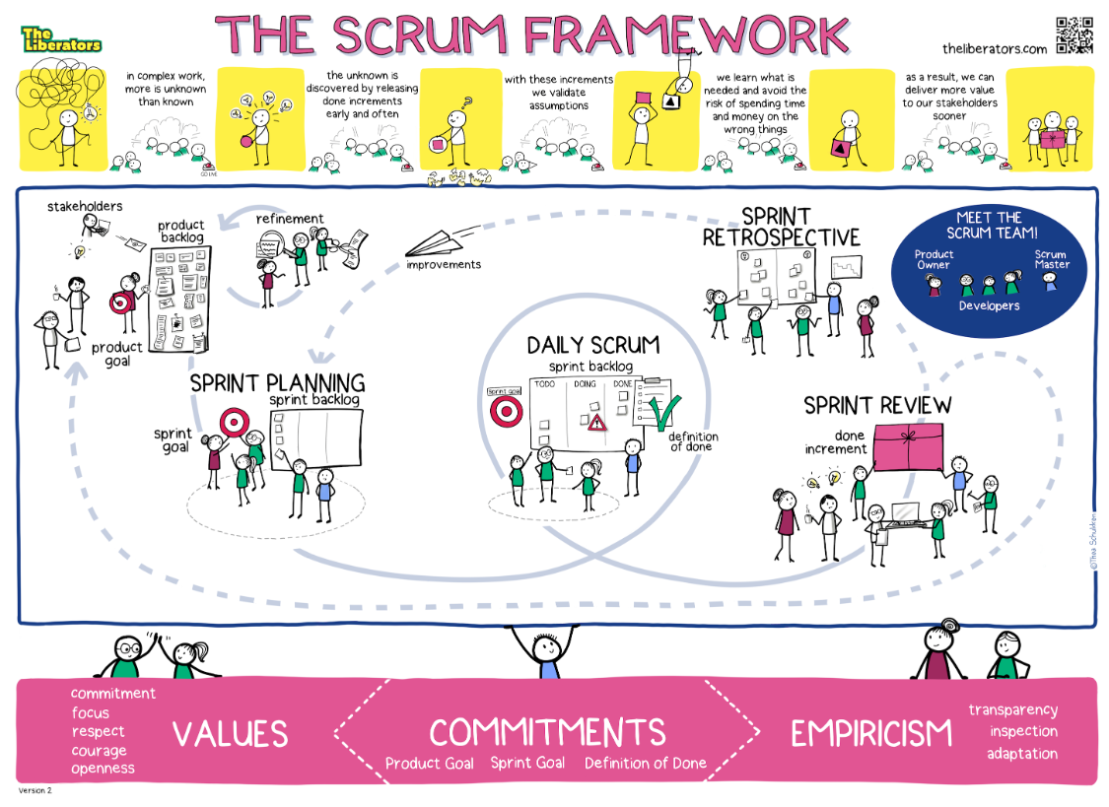
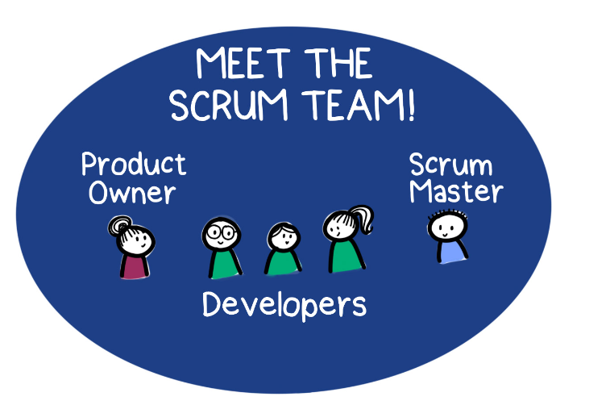
Click the team to learn more→
& Testers
Implementing Agile and The SCRUM Framework

Slide 5
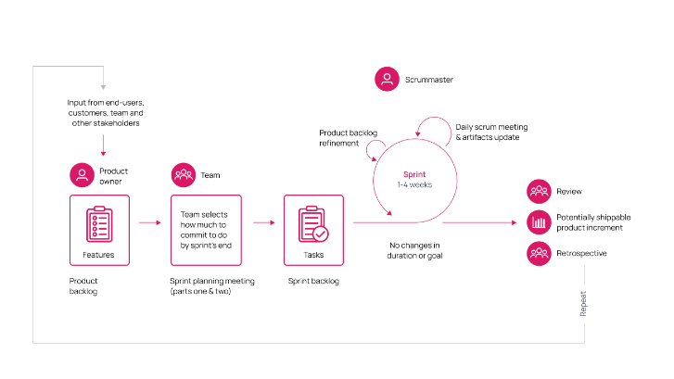
SCRUM
Team Roles and Workflow
← Click the image for more details

Slide 6
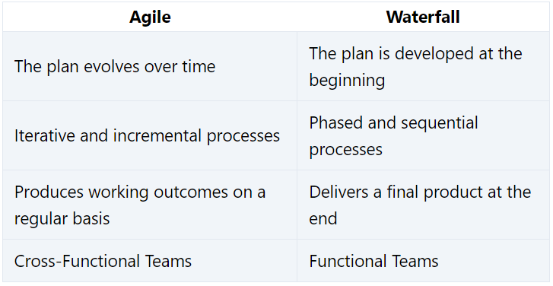
Key Differences Between Agile & Waterfall
When to choose Waterfall:
Your projects have well-defined deliverables and concrete timelines.
When to choose Agile:
Your company doesn’t have complex bureaucracy that would delay decision-making
Your timeline is not concrete, or you do not have a fixed budget.
Some requirements are unknown.
Click table to learn more

Slide 7

References
Slide 2: 5 Key Characteristics of Agile and SRUM Methodology, By Special Guest, June 21, 2019
Slide 4: Christiaan Verwijs, What 4 Key Changes To The Scrum Guide Tell Us About Scrum, November 18, 2020
Slide 3, 5, & 6: Afrebo, The Agile Software Development Life Cycle: What is Agile SDLC and How To Use It?, 2023

