Slide 1
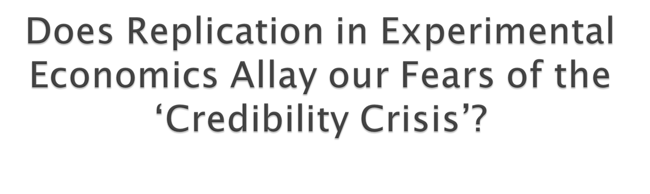
Zacharias Maniadis, Fabio Tufano and John A List
MAER-Net 2015 Prague Colloquium
Notes:
Hi Guys,
I am very happy to be here and share our results in this research in progress. the evidence we shall present is trntative in the sanse that we still need to do some robustness checks. But in any case may I start.

Slide 2

The ‘credibility crisis in science’ raises the question of where economics stands as a science
How credible are our experimental results?
We first show that much more research is needed in order to answer this question. This defines a promising research agenda
Experimental economics: is there enough replication to make us feel safe?
Notes:
In a formal way we can examine the factors that affect the credibility of a discipline. We were also vey affected by Joh Ioannidis’ work as you will see. So in a very structured way we can askthe question whether we have enough evidence to speak about the credibility of experimental economics. We shall see that there is a lack of research in order to do this, hence the previous title of the paper.

Slide 3


Experiments play increasingly important role in economics:
Increasing representation in economic journals
(Card et al., JEP, 2004)
Also in policy analysis and development
Experiments are view as prima facie more credible
(Duflo 2006, Angrist and Pischke, 2010)
Notes:
I know that most of you work with observational studies first, but let me talk a little bit about experimental economics, and why I think it is an important benchmark in order to judge the credibility of economics.

Slide 4

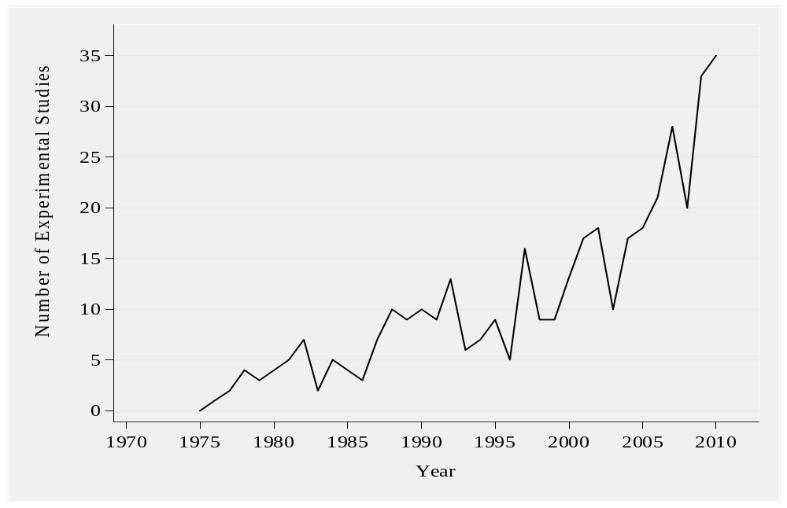
Source: Card, Della Vigna and Malmendier (JEP, 2011)
Notes:
Tom might not like this focus on top 5 journals but this is some evidence on the import of experimental econ. We shall show some evidence of our own very soon.

Slide 5

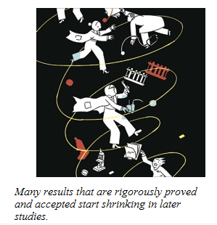
Xs by Jonah Lehrer New Yorker,
13 Dec. 2010

Slide 6

In many disciplines, several widely accepted findings cannot be replicated
The size of treatment effects seems to shrink with successive replications
Examples:
Biomedical sciences (Ioannidis, PloS Med., 2005)
Psychology (Open Science Initiative., 2015)
Ecology (Jennions and Moller, Proc. Royal Soc., 2001)
Notes:
“Treatment effect” is the percentage change in the experimental dependent variable due to applying a specific treatment.

Slide 7
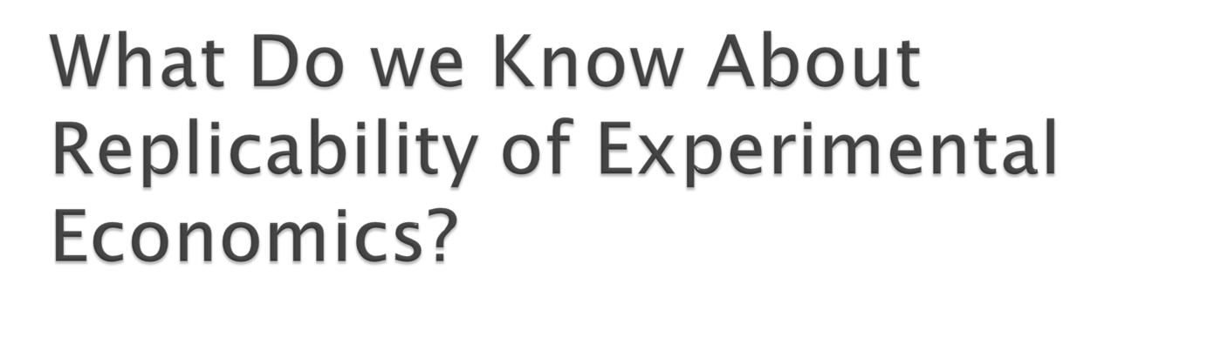
Using a Bayesian model we isolate necessary variables that need to be measured in order to answer this question
Need to use meta-research. Examples of such research abound in psychology and related disciplines
Notes:
On its own, this question seems very difficult to answer and a little bit vague.
We need to put structure in the literature review

Slide 8

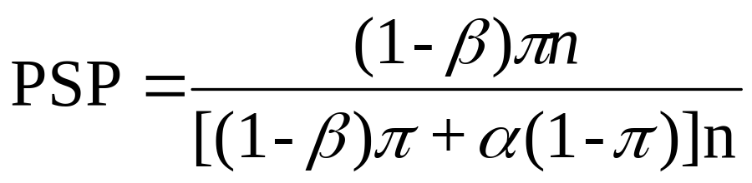
n = No. of associations being studied
π = fraction of n associations actually true
α = typical significance level
(1-β) = typical study power
The Post-Study Probability (PSP) that the research finding is true:
(1)
Notes:
We use a standard framework all Ioannidis that we like to use to define what we call Post-Study (Bayesian) probability
The model can also be extended in a straightforward way to show how a large number of competing researchers in the presence of publication bias and also for the presence of bias, that tends to declare positive effects when there are none.

Slide 9

Rigorous theory testing/high priors
Power/Sample size
Researchers’ competition/publication bias
Research Bias, with three Components:
  1) Degrees of Freedom,
  2) Publication pressure
  3) ‘Positive Results’ Premium’
Frequency of Replication
Notes:
Basically the list I will talk about here defines a research agenda, and might be very interesting for such an audience of meta-analysts. We would like to work on these questions and we are open to ideas for collaboration. At the same time we would like help with any literature that you might think would help us. As meta-analysts you might be familiar with work that we are missing.

Slide 10
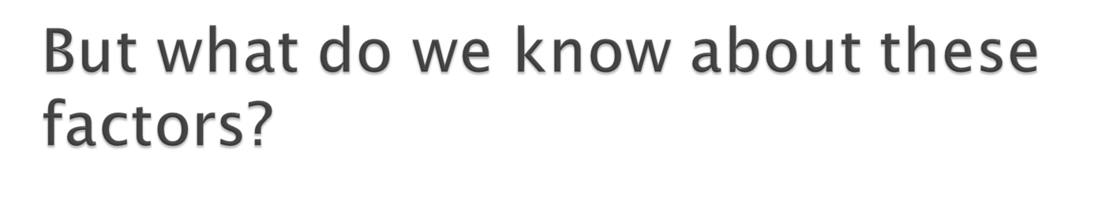
We argue that there is serious lack of evidence
Juxtaposed with other behavioral disciplines such as psychology, we see where research need to be directed

Slide 11

Priors: Delong and Lang (1992): econ tends to study true hypotheses. Card and Dellavigna (2011): 68% of field experiments lack theory
Power: Ortmann and Le (2013); Doucouliagos, Ioannidis and Stanley (2015) calculate low power
Publication Bias: Doucouliagos and Stanley (2013), Brodeur, Le and Sangnier (2012) and many more
Replication: Duvendack,Palmer-Jones and Reed (2015) show low success rates
Notes:
The only study we know about that estimates how likely our hypotheses are is by Delong and Lang, who find that economics hypotheses are very likely. Delong and Lang (1992) indicate that economics in general study true hypotheses.
Card and Dellavigna (2011), focused on a particular set of empirical studies, field experiments, and estimated that 68% of field experiments are purely exploratory, lacking any explicit theory. This is some initial evidence on the question of where our priors come from and how large they are
Only very recently researchers started looking at estimating the power of economic empirical designs retrospectively, and we have that Ortmann and Le (2013) focus on a very restrictive set of results, experiments of the dictator game, and find median power close to 0.25
LOOK INTO THE PAPERS FOR PUBLICATION BIAS
With respect to the number of replication is the economics literature, only a very recent study by Duvendack,Palmer-Jones and Reed (2015) who find that 2/3 of studies cannot be replicated but who do not quentify the frequency of replications

Slide 12

Retrospective power analysis in psychology:
  Cohen (1962) found median power 0.48
  Sedlmeier and Gigerenzer (1989) review ten studies in 70s-80s in several disciplines following Cohen’s approach
  Bakker, van Dijk, and Wicherts’ (2012) general power estimate equal to 0.35.
Notes:
I will just illustrate the antithesis with psychology, concerning the calculation of power retrospectively.
Psychology and related disciplines such as marketing have a much larger tradition of retrospective power analysis. Cohen (1962) started this line of research, analyzing the 1960 volume of the Journal of Abnormal and Social Psychology, and found a median power equal to 0.18 for small effect sizes, 0.48 for medium effect sizes (the relevant case according to the author) and 0.83 for large effect sizes. Sedlmeier and Gigerenzer (1989) review the evidence about a series of more than ten studies in the seventies and eighties that retrospectively calculated power following Cohen’s lead. These studies were not only in psychology but also in other social sciences such as sociology and marketing. Studies from psychology and the cognate disciplines of communication and education found similar results as Cohen (1962). However, studies in the fields of Journalism, Sociology and Marketing found considerably higher average power for medium effect sizes (0.71-0.89). Sedlmeier and Gigerenzer (1989) also conducted the same exercise for the 1984 issue of the Journal of Abnormal Psychology and found that not a single study out of 54 relevant papers calculated the power of their design or discussed their choice of sample size. For the papers of that issue, the authors found median power 0.44 for medium effect sizes (compare with Cohen’s 0.46). Very recently, Bakker, van Dijk and Wicherts (2012) estimated median power equal to 0.35.

Slide 13

We may not know much about the Post-study probability that we should assign to a positive result
But at least if frequent replications occur, we can be reassured that the PSP converges to the truth fast (Maniadis, Tufano and List 2014)
But do they?

Slide 14

What fraction of experimental economic papers are replications across the last 40 years?
Do enough “tacit” replications exist to make us feel safe?
Which factors affect the ‘success rate’?
Notes:
Now, if our evidence is not enough to tell us whether we need to feel safe, perhaps replications are so common that this should not be an issue. In fact, after discussions with leading experimental economists we have heard the argument many times that plentiful replication exists in the form of benchmark treatments.
So we need to know how many replications exist, and especially how many exist that do not explicitly declare themselves as replications.
Other important issues also need to be examined, namely what affect the success rate of replications?

Slide 15

Duvendack, Palmer-Jones and Reed (2015) do not calculate the fraction of papers that contain replications
They also do not examine the factors that affect the ‘replication success’ rate
Finally, they have a very small number of experimental studies in their replication sample (11 studies)
Notes:
Now,

Slide 16

We looked at the economics literature in English language in the period 1975-2014
Used WoK and traced the root experiment*
We randomly sampled 2001 papers and examined which are actual experiments
Among the experimental ones, we checked in detail and elicited the fraction of replications

Slide 17

We focused on top 150 journals in economics
We examined all replications in detail to code:
  The type of replication (exact/conceptual/mixed)
  The success/failure of replication
  Authorship overlap with original
  Similar or different subject pools with original
  Similar or different language with original
  Same or different journal with original
  Similar or different methodologies (paper based vs computerized, etc.) with original

Slide 18

Among 7754 papers with root experiment* (but not replicat*) about half were experiments
Only 1038/2001 sampled papers were actual experiments
655/1159 of studies with terms “experiment*” and “replicat*”contained actual experiments
Among those 655, 100 turned out to be actual replications

Slide 19

Perhaps researchers conduct replications but do not with to declare them as such
So, we thoroughly went through 500 papers which were actual experiments and did not have the root replicat*
Only 13 were found to be replications

Slide 20

Fraction of total papers in economics that contain new experimental data: 2.3%
Fraction of replications studies over the total number of experimental studies: 2.56%
Overall success rate: 32%
Notes:
(𝑐𝑎𝑟𝑑(𝐸2)) ̂=𝑐𝑎𝑟𝑑(𝑆4)∙𝑓_𝑒2 = (1038/2001)*7754 =4022 the estimated number of papers from the set S4 that are actual experiments
(𝑐𝑎𝑟𝑑(𝐸) ) ̂≡𝑐𝑎𝑟𝑑(𝐸1)+(𝑐𝑎𝑟𝑑(𝐸2) ) ̂=655+4022=4677 our estimate of the total number of experimental papers.
Estimated) total fraction of papers that are experimental as (𝑓_𝐸 ) ̂=(𝑐𝑎𝑟𝑑(𝐸) ) ̂/(𝑐𝑎𝑟𝑑(𝑆1)) =4677/206522=2.3%
𝑓_𝑅1=(𝑐𝑎𝑟𝑑(𝑅1))/(𝑐𝑎𝑟𝑑(𝐸1)) = 100/655=0.153 the fraction of actual replication papers in the ‘population’ of actual experimental papers that have the root replicat*.
The fraction 𝑓_𝑟2=(𝑐𝑎𝑟𝑑(〖𝑟2〗^500))/500=0.026 is the fraction of actual replication papers in the sample of 500 papers from the set 𝑒2.
We define (𝑓_𝑅 ) ̂≡(𝑐𝑎𝑟𝑑(𝑅1)+(𝑐𝑎𝑟𝑑(𝑅2)) ̂)/(𝑐𝑎𝑟𝑑(𝐸)) ̂ =(100∗0.153+4022∗∙0.026)/4677 = 0.0256 is the (estimated) fraction of experimental papers that are replications. This is the key metric of our study. Examining how this evolves through time will tell us how the discipline of experimental economic fares (in terms of replications) through time.

Slide 21
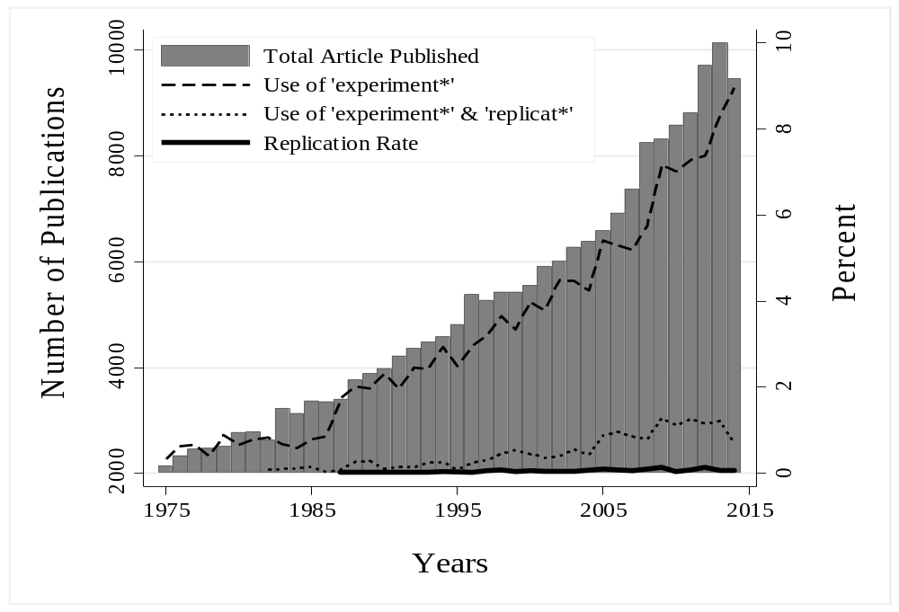
Replication rates in the top 150 journal in Economics according to the Eigenfactor Score
Notes:
Bars represent number of articles published yearly in top 150 econ journals. Dashed line reports percentage that used term “experiment*.” Dotted line represents percentage that used both “experiment*” and “replicat*.”
Solid line describes replication rate of yearly publications in top 150 economic journals of articles using both the term “experiment*” and the term “replicat*” that turned out to be actual replications.
Among the 7754 papers who have the root experiment* (but not replicat*) we estimated that only half were actual experiment. We examine randomly a very large set of 2000 papers to find this estimate (and found only 1038 actual experiments).
Actually, among the 1159 papers with term “experiment*” and the term “replicat*”, only 655 were actual experiments.
Among those true experiments that have the term replicat*
So, in general the fraction of papers that provide new experimental data is about half from the one presented in the graph.
Only 100/655 actual experimental papers with the term replicat* turned out to be actual replications.

Slide 22

Replication type (N=76) | Overall | 1975-1999 | 2000-2014
All |  | 16% | 84%
Failed | 11% | 0% | 13%
Mixed | 47% | 67% | 44%
Successful | 42% | 33% | 44%
Notes:
There are only 76 actual replications, because the other ones are quasi-replications

Slide 23

Replication type | Overall | 1975-1999 | 2000-2014
Conceptual (N=35) |  | 23% | 77%
Failed | 11% | 0% | 15%
Mixed | 51% | 50% | 52%
Successful | 37% | 50% | 33%

Slide 24

Replication type | Overall | 1975-1999 | 2000-2014
Direct (N=41) |  | 10% | 90%
Failed | 10% | 0% | 11%
Mixed | 44% | 100% | 38%
Successful | 46% | 0% | 51%

Slide 25
Replication type | Overall | 1975-1999 | 2000-2014
By same authors (N=13) |  | 31% | 69%
Failed | 8% | 0% | 11%
Mixed | 46% | 75% | 33%
Successful | 46% | 25% | 56%
By same journal (N=10) |  | 40% | 60%
Failed | 10% | 0% | 17%
Mixed | 40% | 75% | 17%
Successful | 50% | 25% | 67%

Slide 26

Much more research is needed using meta-research methods in economics
We conducted a study to see how prevalent replication in experimental economics is. We found that about 2.6% are replications
Success rate (37%) similar to Open Science Initiative (36-39%) and Duvendack, Palmer-Jones and Reed (2015) (22%)
Makel et al (2012) found 67%

