Slide 1


Slide 2
Financial Deregulation and its Effect on Economic Growth: A Meta-Analysis
By: Joseph Korkames

Slide 3
Motivations for Research
To explore the effects of international financial policies in the hopes of influencing international development
To evaluate the validity of the McKinnon-Shaw hypotheses based on the magnitude and direction of these effects
To provide evidence to support certain policy agendas that will promote global economic growth and welfare

Slide 4
Purpose of the Paper
To report a summary of the scholarly literature
To estimate the true effect of financial deregulation on economic growth through a comprehensive WLS multivariate meta-regression analysis

Slide 5
What is Financial Deregulation?
Financial deregulation (FD) = Financial liberalization
FD consists of the removal of interest rate controls, capital account restrictions, and/or any other laws or regulations that restrict the actions of financial institutions.

Slide 6
The Study
Meta-Analysis Based on 374 estimates from 53 studies examining the effect of financial deregulation on economic growth rates
Positive long-run prediction interval found with smaller short-run effects also shown

Slide 7
What is a Meta-Analysis?
provides econometricians with an objective statistical method to combine many estimates into one “meta-estimate” to more accurately estimate the phenomena.
Can weigh each study estimate by its relative accuracy to come up with a powerful estimate of a population parameter

Slide 8
Problems with measure of effect
Need for WLS
Need for Partial Correlation Coefficient Conversion

Slide 9
Theoretical Economic Relation
Theoretically ambiguous
McKinnon-Shaw Hypotheses
Keynesian Arguments

Slide 10
McKinnon-Shaw Hypotheses
Based on Efficient Market Hypothesis
Both explain a reason for deregulation having a positive effect on growth rates
Difference lies in use of internal financing argument and External financing arguments

Slide 11
Theory Behind McKinnon-Shaw
Capital allocation can be more efficiently performed, bank competition increases interest rates on deposits, national savings increases, investment increases, GDP increases.
Mckinnon: internal financing
Shaw: external Financing

Slide 12
How the Theories Differ
The internal financing argument - firms can more easily raise capital
The external financing argument - firms can get financed more easily with debt and at better rates
Whether financing is done externally or internally, the deregulation causes financing constraints of firms to be reduced. This means higher investment and economic growth.

Slide 13
Keynesian Arguments
Instability due to inexperienced banks taking on excessive risk in newly liberalized/more sophisticated market in which it doesn’t understand
Asymmetric information- new relations between lender and borrow can lead to confusion, misinformation, etc.
Asymmetric information can lead to excessive bank competition leading to excessive risk taking in the SR in inefficient institutions

Slide 14
The Deregulation Literature
Mostly qualitative
Most attempting to validate Mckinnon-Shaw hypothesis
Heavily focused on capital account deregulation
Not significantly separated into various forms of deregulation

Slide 15
Significant Literature
McKinnon Shaw Hypothesis developed further by: Maxwell Fry, Paul Krugman, Frederic Mishkin, and Maurice Obstfeld
Howard 2001 had success in both hypothesis validations for Jamaican Economy
Moore 2010 utilized panel data to validate McKinnon’s Complementarity hypothesis

Slide 16
Conduction of Meta-Analysis
First gather studies
Next compile data and code variables
Then use meta-regression to test for publication bias and find a model that explains the wide variation of reported research results
For a more detailed overview of meta-regression techniques, see Stanley and Doucouliagos (2012).

Slide 17
WLS Meta-Regression
Weight regression by dividing by precision^2 (1/SE^2) or (one/variance)
Allows meta regression to account for accuracy of each study estimate to provide accuracy weighted estimate

Slide 18
Funnel Graph
Visible representation of research results for all studies coded representing an entire research literature
Graph of 1/se (precision) on the vertical and measure of effect (partial cc) on horizontal
Publication bias free literature should have a symmetric funnel-like set of points
Most accurate studies are at the top of funnel (highest y value)

Slide 20
FAT-PET
Performed by running a WLS regression on the measure of effect regressed against its standard error as the predictor.
The statistician hopes that this meta-regression is ‘bad’, statistically, this indicates that there is no evidence of publication selection bias.
An insignificant t-value on the coefficient for the standard error as a predictor shows that there is no clear evidence of publication bias. While a significant t-value on the constant term shows that there is a genuine non-zero empirical effect beyond the reach of publication bias. The value of the constant is an estimate of the true overall effect present in the research literature after correcting for publication selection bias

Slide 21
Conversion to Partials
Traditional MRA starts with a measure of effect that is meaningfully comparable across research studies.
financial deregulation effects are measured quite differently from study to study due to wide differences in how deregulation is undertaken and which economic effects are observed.
T values cannot be used as they do not account for differences in statistical power when different metrics are used to measure deregulation – why Bumann et. al. needed to be changed to partials for making analysis

Slide 22
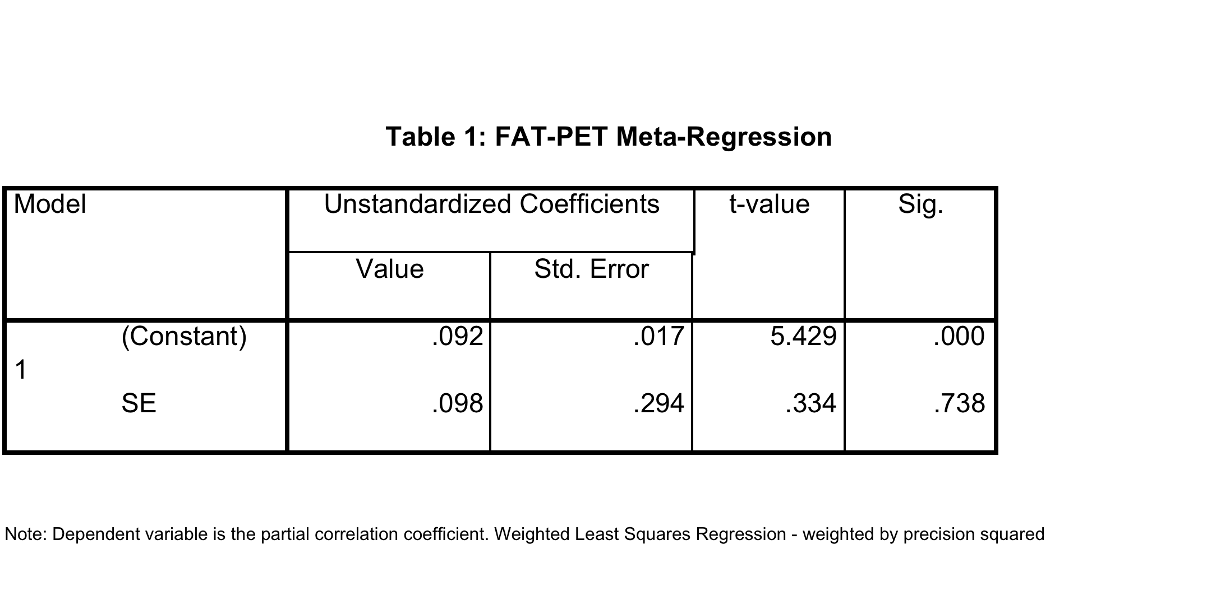
FAT-PET Results

Slide 23
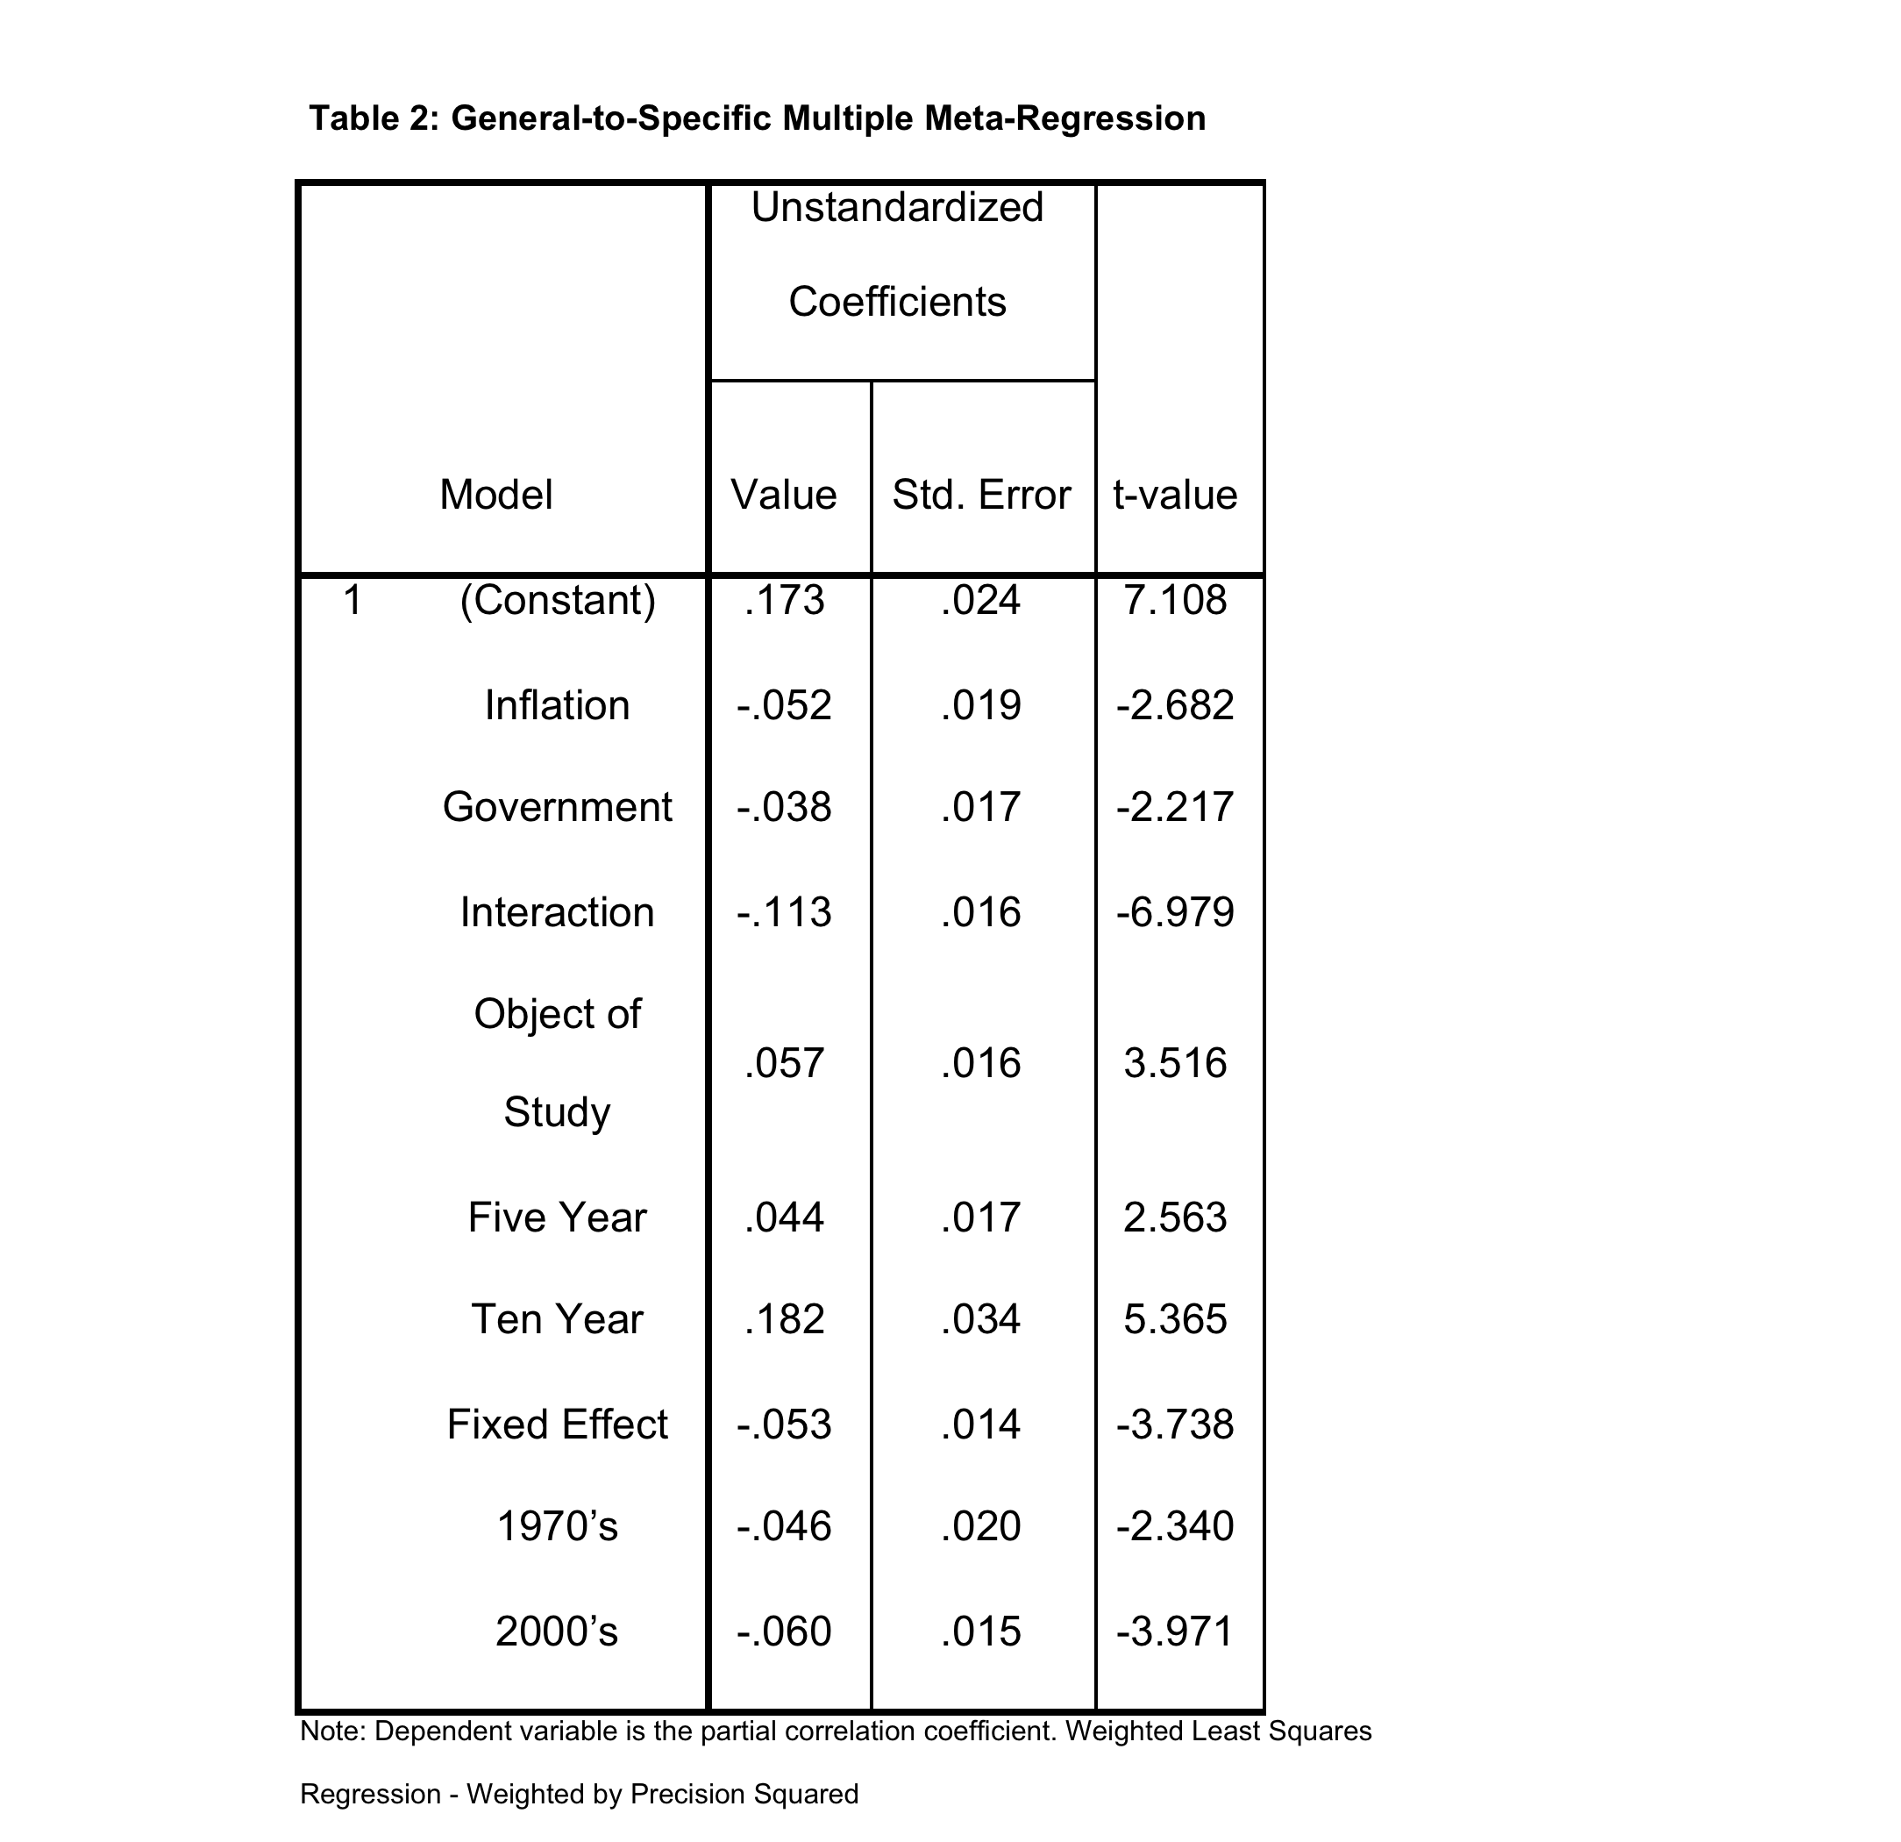
Multivariate meta-regression

Slide 24
Variables Explained
The variables found to be relevant included a number of dummy or dichotomous variables
Inflation = 1 if the inflation rate was included in the original study
Government = 1 if a measure of the size of the government was included in the original study
Interaction = 1 if a variable representing an interaction between the financial liberalization indicator and other variables is accounted for
Object of Study = 1 if the link between deregulation and growth was the only object of the study
Five Year = 1 if 5 year growth estimates are used
Ten Year = 1 if 10 year growth estimates are used
Fixed Effect = 1 if fixed effects are included in a panel model
1970’s = 1 if deregulation occurred in the 1970’s
2000’s = 1 if deregulation occurred in the 2000’s. The multivariate regression results are shown in Table 2 below.

Slide 25
Results
Variable values selected to represent closest to current real world circumstances
Substituting these values into the multiple meta-regression reported above gives a positive prediction interval for the long-run effect that ranges from .011 to .181, with a mean prediction of .096.
This ends 40-year debate on deregulation-growth nexus

Slide 26
Results continued
However, this research also provides evidence that the effect financial deregulation on growth is mitigated by other factors.
this same meta-regression model predicts an ambiguous or slightly negative intermediate-run effect, ranging from -.100 to .016 with a mean prediction value of -.042 when Five Year is set equal to one rather than Ten Year.
This is consistent with the original hypothesis that long-run positive results may be dampened or even reversed in the short-run, and it can explain why variations are seen in this area of research.

Slide 27
Final Results – OECD vs DC
When adding in the variables OECD and DC and making predictions, different results are added. If OECD is added and 1 selected for the prediction, the value of the effect, the partial goes from .096 to .13; this shows that deregulation is more effective in the long-run for developed countries as opposed to less developed ones, this contrasts most theory.

Slide 28
Conclusions
No publication/selection bias found in research literature
While the literature is quite ambiguous, both theoretically and empirically, this meta-analysis ended the 40 year debate by providing significant quantitative empirical evidence that the effect is positive
Short run results are smaller and/or negative

Slide 29
Policy Implications
While this effect accounts for a small portion of the overall growth rate, it is our view that these effects could be made even larger if financial deregulation is conducted with care and prudential financial industry regulations.
Consequently, if no care for prudential practices is in place during deregulation, the consequences could be quite larger also. Purposeful financial repression is likely to stifle economic progress, and careful and continual deregulation is ideal for the long-run success of domestic markets in their current state.

Slide 30
References (1 of 5)
Abiad A., & Mody A. (2005). Financial reform: What shakes it? what shapes it?, American Economic Review, 95(1), 66-88. doi: 10.1257/0002828053828699
Abiad A., Detragiache E., & Tressel T. (2010). A new database of financial reforms, IMF Staff Papers, 57(2) , 281–302. http://dx.doi.org/10.5089/9781451871241.001
Bumann, S., Niels, H., & Lensink, R. (2012). Financial liberalisation and economic growth: A meta-anaylsis, Journal of International Money and Finance, 33. http://dx.doi.org/10.1016/j.jimonfin.2012.11.013
Fry, M. J. (1978). Money and capital or financial deepening in economic development?" Journal of Money, Credit and Banking, 10, 464-75. doi:10.2307/1991576

Slide 31
References (2 of 5)
Fry, M. J. (1995). Money, interest, and banking in economic development (2nd ed.), Balitmore, MD: The Johns Hopkins University Press.
Fry, M. J. (1980). Savings, investment and the cost of financial repression, World Development, 8(4), 317-27. doi:10.1016/0305-750X(80)90030-3
Gemech, F., & Struthers, J. (2003). The McKinnon -Shaw hypothesis: Thirty years on: A review of recent developments in financial liberalization theory. Retrieved from http://citeseerx.ist.psu.edu/viewdoc/summary?doi=10.1.1.202.265
Gurley, J., and Shaw, E. S. (1967). Financial structure and economic development, Economic Development and Cultural Change, 15(3), 257-68. doi:10.2307/1152277

Slide 32
References (3 of 5)
Howard, M. (2001). Financial liberalization in Jamaica, Savings and Development: Quarterly Reivew, 25(4), 457-473. doi:10.2307/25830776
Krugman, P. (1979). A model of balance of payments crises, Journal of Money, Credit, and Banking, 11, 311-325. Retrieved from www.econ.umn.edu/~tkehoe/classes/Krugman1.pdf
Krugman, P. (1999). Balance sheets, the transfer problem and financial crises, paper prepared for the festschrift volume in honor of Rober Flood, Retrieved from http://web.mit.edu/krugman/www/#other
Krugman, P. (1999). What happened to Asia?, Global Competition and Integration Research Monographs in Japan-U. S. Business & Economics, 4, 315-327. Retrieved from http://web.mit.edu/krugman/www/DISINTER.html

Slide 33
References (4 of 4)
McKinnon, R. I. (1973). Money and capital in economic development, The Brookings Institution
Mishkin, F. (2001). Financial policies and the prevention of financial crises in emerging market countries, NBER Working Papers, 8087. http://dx.doi.org/10.1596/1813-9450-2683
Moore, T. (2010). A critical appraisal of McKinnon 's complementary hypothesis: Does the real rate of return on money matter for investment in developing countries?, World Development, 38(3), 260-69. http://dx.doi.org/10.1016/j.worlddev.2009.09.010
Obstfeld, M. (1996). Models of currency crises with self-fulfilling features, European Economic Review, 40(12), 103-147. doi:10.3386/w1486

Slide 34
References (5 of 5)
Obstfeld, M. (1998). The global capital market: Benefactor or menace?, Journal of Economic Perspectives, 12(4), 9-30. doi:10.3386/w6559
Shaw, E. S. (1973). Financial deepening in economic development, New York: Oxford University Press.
Stanley, T. D., & Doucouliagos, H. (2012). Meta-regression Analysis in Economics and Business. New York: Routledge.

