Slide 1


Sources of Reporting Bias in Social Sciences
Katja Rost

Slide 2
Reporting bias in social science
Reporting bias arises when the selection of studies for publication is made either on the basis of the statistical significance of results or on the basis of whether the results satisfy preconceived theoretical expectations (Doucouliagos, 2005; Stanley, 2005a). This conditions lead to a truncated pool of published studies with the consequent suppression of some empirical findings.
Such biases can occur in positive research paradigms that try to uncover correlations and causal relationships in the social world by using the empirical methods of (natural) science.
Reporting biases are a serious concern because the conclusions of systematic reviews and meta-analyses can be misleading.

Slide 3
Outline
How I started to get interested in reporting bias
Sources of reporting bias in social sciences

Slide 4
The example of Corporate Social Responsibility
We show that published evidence in win-win corporate social responsibility (CSR) research tends to overestimate efficiency.
The research field expects to find a positive association between corporate social performance (CSP) and corporate financial performance (CFP), and findings meet that expectation.
The authors explain how this pattern may reflect reporting bias. The empirical results show strong tentative evidence for a positive reporting bias in the CSP–CFP literature but only weak tentative evidence for CSP efficiency.
The study also examines which factors, such as time trends, publication outlet, and study characteristics, are associated with higher reporting biases within this literature.

Slide 5
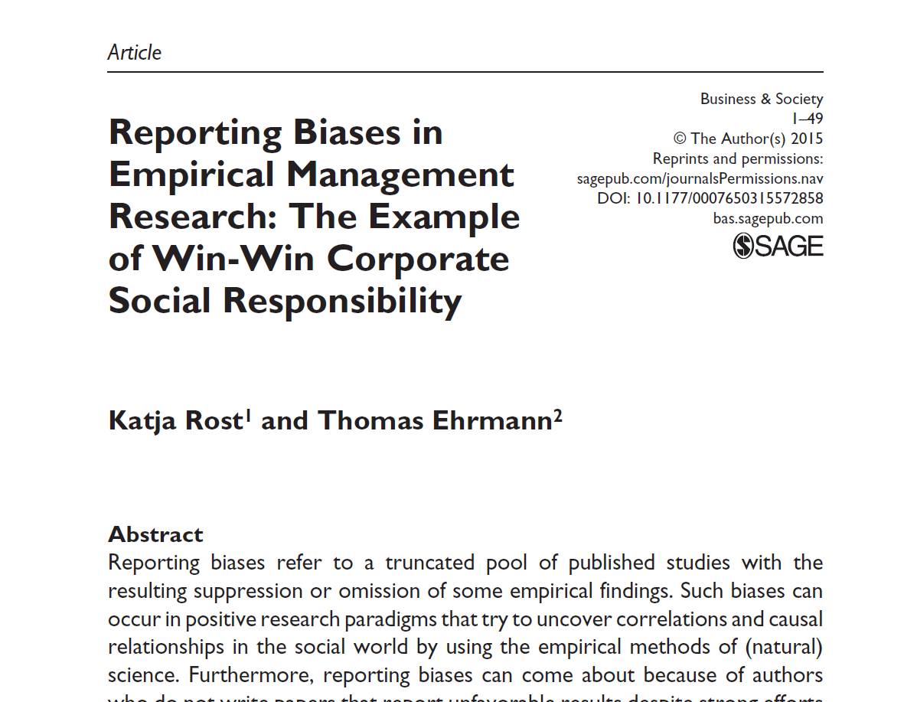
Reporting biases in management research
14 rejections before publication

Slide 6
Why so many rejections?
Orlitzky, M., Schmidt, F. L., & Rynes, S. L. (2003). Corporate social and financial performance: A meta-analysis. Organization Studies, 24, 403-441.
More than 1000 Web-of-Science citations
Most influential meta-analysis and paper in business administration
We reject the findings of the Orlitzky et al. in our meta-analysis

Slide 7
Method
Meta-analysis of 282 studies; 162 usable studies with 2,263 sub-effects
Measurement of publication year, underlying CSP-CFP hypothesis, use of industry-fixed effect, firm-fixed effect, and time-lagged-effect, underlying theory, pro and contra arguments discussion
Control for CSP and CFP measures, analyzed time period, number of years, sample size, dependent variable, kind of analysis

Slide 8
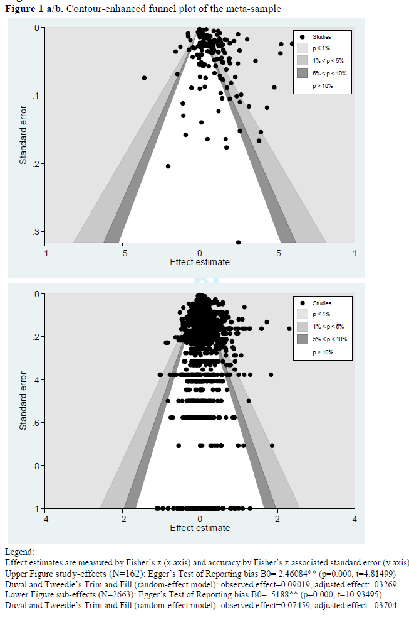
Key-Findings (I)

Slide 9
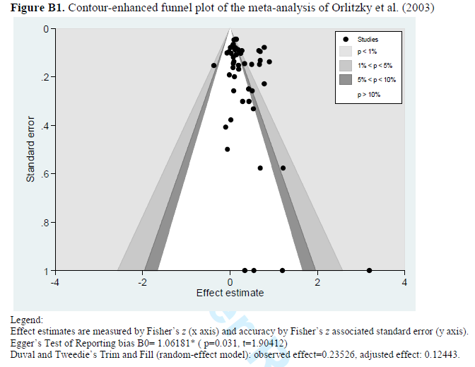
Key-Findings (II)

Slide 10
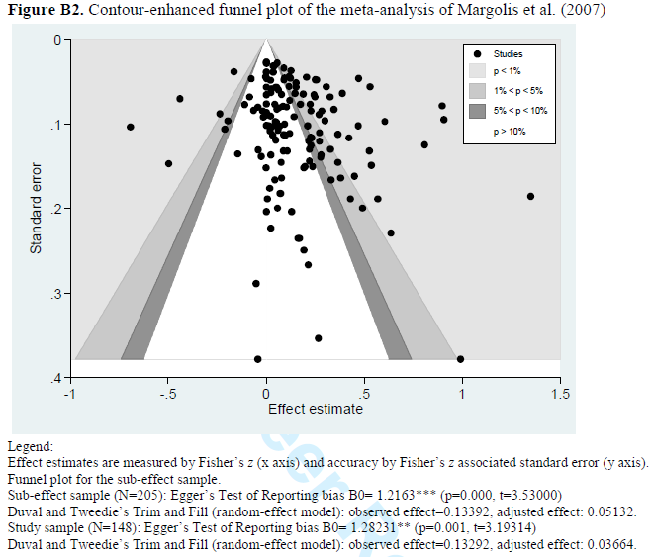
Key-Findings (III)

Slide 11
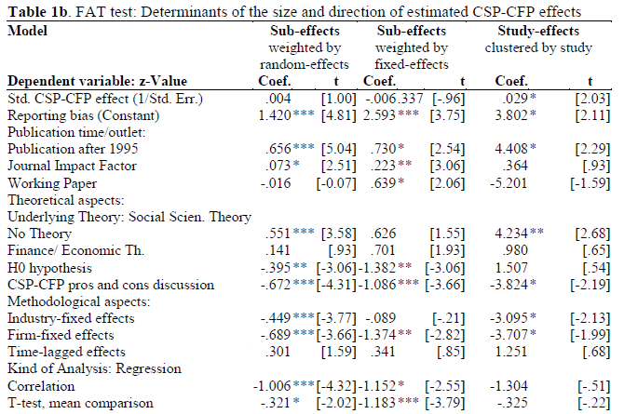
Key-Findings (IV)

Slide 12
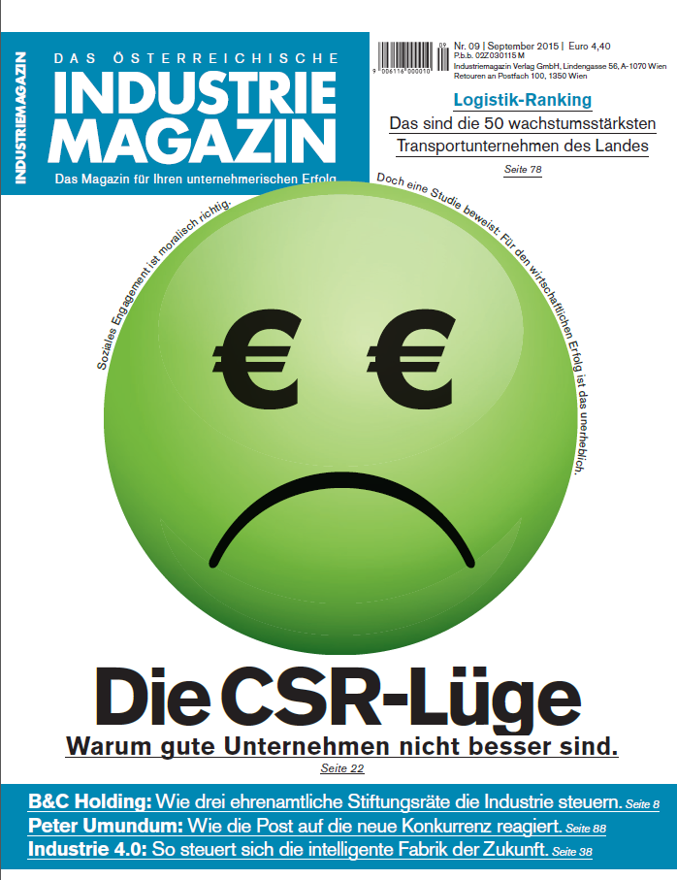
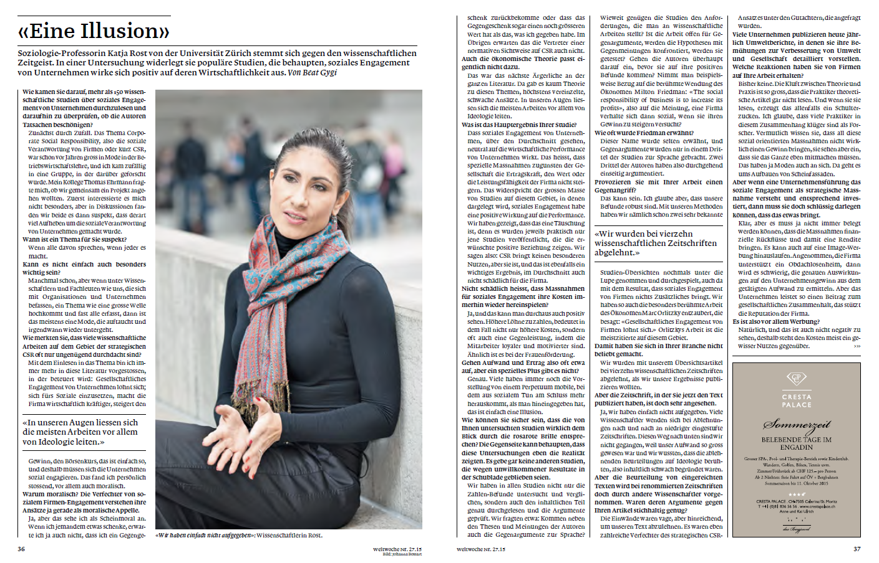
How did the public react?

Slide 13
Outline
How I started to get interested in reporting bias
Sources of reporting bias in social sciences

Slide 14
Former evidence on reporting bias
73% of all positive clinical trials are published, but only 41% of all negative clinical trials are published (Hopewell et al., 2009).
Analyzing more than 4,600 papers published in all disciplines a study shows that the overall frequency of positive support has grown by more than 22% between 1990 and 2007 (Fanelli, 2012). The increase was stronger in the social disciplines (Fanelli, 2010b) and in publish-or-perish environments such as the United States (Fanelli, 2010a).
Reporting bias exist in areas such as aid effectiveness on growth (Doucouliagos & Paldam, 2008), minimum-wage studies (Card & Krueger, 1995; Doucouliagos & Stanley, 2009), economic freedom and economic growth literature (Doucouliagos, 2005; Doucouliagos et al., 2005), the estimates of returns from education (Ashenfelter et al., 1999), the productivity effects of multinationals (Gorg & Strobl, 2001), and the price elasticity of water (Stanley, 2005a).

Slide 15
Source 1: Mainstream theory
H. Doucouliagos et al. (2005) hypothesized that reporting bias can be found in particular areas of research where mainstream theory supports a specific effect. Authors, referees, and editors may disproportionately select significant positive results reflecting the majority view in the field.
Example: Instrumental stakeholder theory in CSP–CFP research, the mainstream theory for researchers in Social Issues in Management, promotes a social justice view of the world that strives to align with shareholder wealth maximization. The lack of a research paradigm which expects a clear negative CSP–CFP relationship can lead to an overdominance of positive research findings.

Slide 16
Source 2: Dominant institutional logic
The dominant institutional logic in which authors are embedded, for example the professional school environment where many researchers are employed, shapes their cognitions and behaviors and frames their conclusions. Researchers secure funding and establish legitimacy as consultants, as lecturers, or as authors of books etc.. These audiences encourage researchers to create success stories.
Example: This logic may result in the fact that researchers do not write and submit papers on negative results contradicting the conventionally expected result. (Author surveys have shown that the most common reasons for not submitting papers are negative results and a lack of interest, time, or other resources (Callaham et al., 1998)).

Slide 17
Source 3: Reviewers and editors
Reviewers and editors may be predisposed to accept papers consistent with a conventional view having a higher probability of being read and cited and not destroying former investments.
Example: “Social networking effects and interpersonal connections sometimes explain publication decisions much better than the objective characteristics of submissions” (Orlitzky, 2011, p. 412).

Slide 18
Interplay of the three sources
Authors may find it difficult to publish not significant results. Null findings are perceived as less interesting and most scholars will not even write a working paper on such results. Authors may be encouraged by reviewers to locate an effect by, for example, changing the sample size, changing the empirical methodology, altering the set of control variables, or using a different estimation technique.
Researchers who find a negative effect choose not to submit these results to journals or other publication outlets because they believe the results to be incorrect, they expect that they will have a low probability of being accepted, or their preferred literature does not offer accepted theories to explain negative findings.

Slide 19
Characteristics moderators of reporting biases (I)
Publication time: Before the dominant design has been established, we will find a small publication bias. With a research field moving toward a dominant design, authors will find it more and more costly to produce unconventional views, both because the conventional view gets more and more empirical support, and because its theoretical underpinnings come to be more elaborated upon.
Journal impact factor: Positive and favorable results are read and cited to a greater extent, which is important to maintain and extend the competitive advantage with respect to the journal impact factor.
Working papers: The results of accepted journal articles contain larger reporting bias compared with the findings of published working papers.

Slide 20
Characteristics moderators of reporting biases (II)
Studies testing no theory: Often, researchers follow the conventional view because research is perceived as “marketable.” In this case, the underlying research motivation may not be the investigation of a specific theory, but more the desire to participate in the new research trend. Typically, the research field in these papers is poorly understood. Authors may, therefore, decide to publish their results only if they support the conventional view.
H0 hypothesis: Most studies deduce directed hypotheses. However, directed hypotheses are vulnerable because arguments both for and against a link can be made. It may, therefore, be advisable to formulate a H0 hypothesis, to test whether no link can be determined.

Slide 21
Characteristics moderators of reporting biases (III)
Pros and cons discussion: Reporting bias should more often occur when the discourse in professional networks does not lend itself to conjecture and refutation but, instead, uncritically supports the conventional view.
Methodological problems: Social science research is characterized by methodological problems such as performance instability, retrospective recall, or simple models of complex worlds. In particular, studies that face many of these problems will be modeled after the conventional view. By definition, the presentation of contradictory evidence requires a deep theoretical and methodological understanding of the investigated research field.

Slide 22
Characteristics moderators of reporting biases (VI)
Multivariate empirical methods: Reporting bias results from authors finding it difficult to publish non-significant positive results. Authors may be encouraged to locate this effect by, for example, changing the sample size, changing the empirical methodology, altering the set of control variables, or using a different estimation technique. The incentive to apply “permitted” manipulations is particularly strong for authors using multivariate empirical methods, such as regression analysis. They can alter the set of control variables or use a different estimation technique to obtain the desired result.

Slide 23
Therefore…
KEEP
CALM
AND TEST YOUR RESEARCH AREA FOR
REPORTING BIAS

