Slide 1

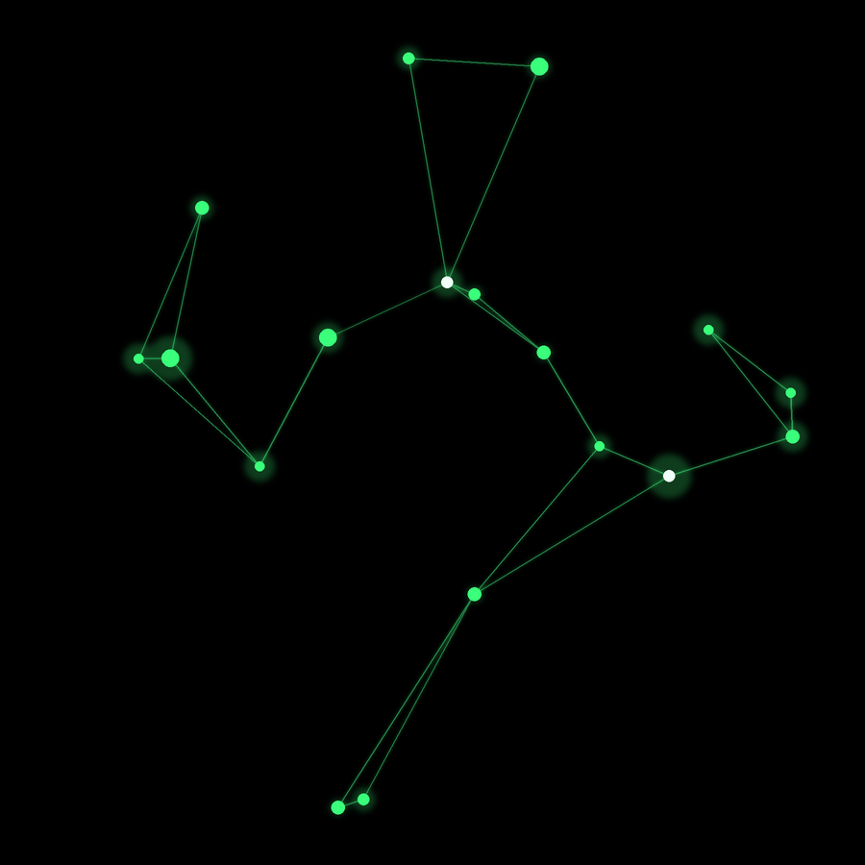

KLH EDUCATION FOUNDATION
DSA-3 SUBMISSION
DATA STRUCTURES & ALGORITHMS — 3
DICTIONARY-BASED
MISSPELLED WORD
DETECTION SYSTEM
Text → Keyword (Misspelled Word): a ready-to-use dictionary-driven spellchecking report engine
PROJECT TEAM
Hansika Reddy Gunapati — 2520030237
Teja Hasini Reddy — 2520030048
Anthony Nissy — 2520030064
Team Number: 16
Section: 7
Guide: Dr. S. Madhavi
www.klh.edu.in

Slide 2



DSA-3 // KLH EDUCATION FOUNDATION
TEAM 16 · SECTION 7
ABSTRACT
Clean, error-free text is essential for readability, downstream NLP pipelines, and large-scale document processing, yet manual proofreading does not scale to modern text volumes. This project designs and implements a Dictionary-Based Misspelled Word Detection System that compares input text against a predefined dictionary using efficient string-matching data structures — Trie, Aho–Corasick automaton, and suffix arrays — to locate misspelled words with near-linear-time lookups. Detected errors are ranked and corrected using edit-distance and phonetic algorithms, then consolidated into a structured, ready-to-use report. The system is built to handle large text datasets and Unicode / multilingual content, with performance benchmarked against naive scanning to quantify the efficiency gained from dictionary-based indexing.
OBJECTIVES
Implement dictionary lookup for misspelled-word detection
Use Trie, Aho–Corasick, or suffix arrays for string matching
Identify misspelled words across large text datasets
Provide suggested corrections via edit distance / phonetics
Generate structured reports summarizing errors & fixes
Support Unicode characters and multilingual dictionaries
Benchmark performance against naive scanning methods
DSA-3 | DICTIONARY-BASED MISSPELLED WORD DETECTION SYSTEM
2

Slide 3




DSA-3 // KLH EDUCATION FOUNDATION
TEAM 16 · SECTION 7
PROBLEM STATEMENT
Why It Matters
Large Text Datasets
Misspelled words in documents, log files, or user input cause misinterpretation, reduced readability, and downstream processing errors. Traditional spellcheckers rely on naïve scanning or limited word lists — too slow and rigid for large, real-world datasets that must also handle Unicode text and support text-analytics or NLP workloads.
Documents, logs & corpora at scale
Unicode Characters
Multilingual dictionary support
The Challenge
Develop a dictionary-based application that identifies misspelled words using efficient string-matching algorithms — comparing input text against a predefined dictionary, locating errors, suggesting corrections, and generating structured reports.
Text Analytics & NLP
Feeds downstream language pipelines
DSA-3 | DICTIONARY-BASED MISSPELLED WORD DETECTION SYSTEM
3

Slide 4




DSA-3 // KLH EDUCATION FOUNDATION
TEAM 16 · SECTION 7
PROPOSED FUNCTIONALITIES
Core objectives the system will deliver, mapped to the algorithms that implement them
Dictionary Lookup
Efficient Matching
Error Identification
Implement fast, prefix-based dictionary lookup so every scanned token can be checked in near constant time.
Use Trie, Aho–Corasick automata, or suffix arrays for multi-pattern string matching across full documents.
Flag misspelled words across large text datasets in a single linear pass over the input stream.
Smart Corrections
Report Generation
Unicode Support
Suggest ranked corrections via Levenshtein edit distance and Soundex / Metaphone phonetic matching.
Auto-generate structured, ready-to-use reports summarizing every detected error and applied fix.
Support UTF-8 Unicode characters and multilingual dictionaries for real-world, multi-language text.
DSA-3 | DICTIONARY-BASED MISSPELLED WORD DETECTION SYSTEM
4

Slide 5



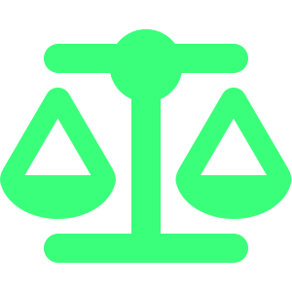
DSA-3 // KLH EDUCATION FOUNDATION
TEAM 16 · SECTION 7
SYSTEM ARCHITECTURE
End-to-end processing pipeline, from raw text input to a ready-to-use error report
1. Input Text
2. Tokenization
3. Dictionary Lookup
Raw text ingested from documents, log files, or direct user input.
Text split into words; Unicode-aware normalization is applied.
Trie / Aho–Corasick scan matches tokens against the predefined dictionary.
4. Error Detection
5. Correction Ranking
6. Report Generation
Words absent from the dictionary are flagged as misspelled.
Edit-distance + phonetic scoring generates ranked correction suggestions.
A structured, ready-to-use error & correction report is produced.
DSA-3 | DICTIONARY-BASED MISSPELLED WORD DETECTION SYSTEM
5

Slide 6
DSA-3 // KLH EDUCATION FOUNDATION
TEAM 16 · SECTION 7
CORE ALGORITHMS & COMPLEXITY
Data structures compared for dictionary lookup and pattern matching
Approach | Role in the System | Time Complexity | Space | Why It's Used
Trie | Prefix-based dictionary storage & word lookup | O(L) per word | O(A·N) | Instant prefix search; simple insert/delete
Aho–Corasick | Multi-pattern matching across full text, one pass | O(n + m + z) | O(m) | Finds every dictionary match in a single scan
Suffix Array | Substring / partial-word pattern search | O(log n) per query | O(n) | Handles partial matches missed by exact lookup
Naive Scan (baseline) | Linear search through the word list | O(n × m) | O(m) | Simple baseline used to benchmark speed-up
n = length of input text m = number of dictionary words L = length of a word z = number of matches found A = alphabet size
DSA-3 | DICTIONARY-BASED MISSPELLED WORD DETECTION SYSTEM
6

Slide 7
DSA-3 // KLH EDUCATION FOUNDATION
TEAM 16 · SECTION 7
CORRECTION & RANKING TECHNIQUES
Two complementary techniques rank the best correction candidates
Levenshtein Edit Distance
Phonetic Matching
Counts the minimum insertions, deletions, or substitutions needed to turn a misspelled word into a valid dictionary word. Lower distance means a closer, more likely correction.
Algorithms like Soundex and Metaphone encode words by how they sound, catching phonetic misspellings that edit distance alone can miss — e.g. “fone” for “phone”.
Example — misspelled: “recieve”
Example — Soundex encoding
Candidate | Edit Dist. | Rank
receive | 1 | ★ Best match
relieve | 3 | 2nd
deceive | 3 | 3rd
Word | Soundex Code
Smith | S530
Smyth | S530
fone → phone | P500 (match)
DSA-3 | DICTIONARY-BASED MISSPELLED WORD DETECTION SYSTEM
7

Slide 8




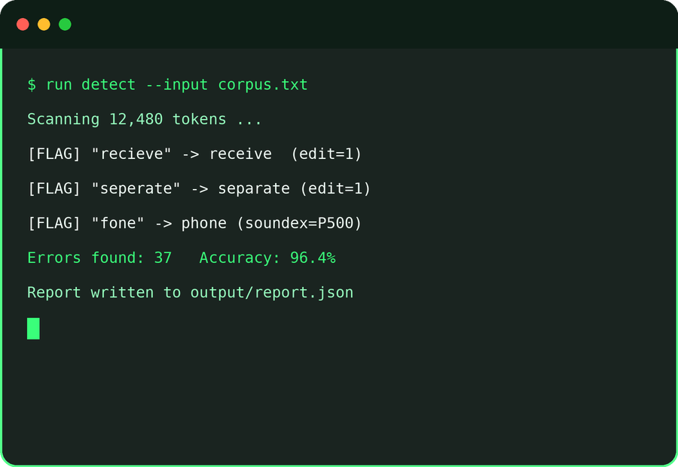
DSA-3 // KLH EDUCATION FOUNDATION
TEAM 16 · SECTION 7
TOOLS & TECHNOLOGIES
Languages
Algorithms & Structures
Data & Storage
Python / Java for core logic and data-structure implementation.
Trie, Aho–Corasick automaton, Suffix Arrays, Levenshtein Edit Distance, Soundex / Metaphone.
Curated dictionary word-lists, CSV / text corpora for large-dataset testing.
Unicode & I/O
Reporting
Benchmarking
UTF-8 text processing libraries for multilingual dictionary support.
Automated report generation (console / file output) summarizing detected errors.
Performance profiling to compare dictionary-based vs. naïve scanning approaches.
DSA-3 | DICTIONARY-BASED MISSPELLED WORD DETECTION SYSTEM
8

Slide 9
DSA-3 // KLH EDUCATION FOUNDATION
TEAM 16 · SECTION 7
IMPLEMENTATION ROADMAP
Planned phases from dictionary setup to final benchmarking
Week 1–2
Week 5–6
Week 8
Requirements & Dataset
Correction Engine
Testing & Benchmarking
Finalize scope; curate the predefined dictionary and multilingual test corpora.
Build edit-distance ranking and Soundex / Metaphone phonetic matching.
Validate accuracy and benchmark against naive scanning for the final report.
1
2
3
4
5
Week 3–4
Week 7
Core Data Structures
Reporting & Unicode
Implement the Trie and Aho–Corasick automaton for dictionary lookup.
Add the report generation module and Unicode / multilingual support.
DSA-3 | DICTIONARY-BASED MISSPELLED WORD DETECTION SYSTEM
9

Slide 10



DSA-3 // KLH EDUCATION FOUNDATION
TEAM 16 · SECTION 7
PERFORMANCE EVALUATION PLAN
How the dictionary-based approach will be measured against naive scanning
Expected Lookup Time Trend (illustrative, ms)
Detection Accuracy
Precision & recall of correctly flagged misspelled words.
Correction Accuracy
Top-1 / Top-3 hit rate of the ranked suggestion list.
Lookup Latency
Average time to scan and flag words per dataset size.
Scalability
Performance trend as dictionary and input size grow.
Values are illustrative targets to validate during testing, not final results.
DSA-3 | DICTIONARY-BASED MISSPELLED WORD DETECTION SYSTEM
10

Slide 11
DSA-3 // KLH EDUCATION FOUNDATION
TEAM 16 · SECTION 7
SAMPLE DETECTION REPORT
A preview of the structured, ready-to-use report the system generates for each run
Detected Errors & Ranked Corrections
Misspelled | Suggested | Method | Score
recieve | receive | Edit Distance | 1
seperate | separate | Edit Distance | 1
fone | phone | Soundex | P500
definately | definitely | Edit Distance | 2
acheive | achieve | Edit Distance | 1
thier | their | Edit Distance | 1
Summary — Errors found: 37 Accuracy: 96.4% Report written to output/report.json
DSA-3 | DICTIONARY-BASED MISSPELLED WORD DETECTION SYSTEM
11

Slide 12

DSA-3 // KLH EDUCATION FOUNDATION
TEAM 16 · SECTION 7
EXPECTED OUTCOME
What the completed system will demonstrate
A working dictionary-based spellchecker built on Trie / Aho–Corasick indexing for fast lookups over large text datasets.
Accurate misspelling detection with ranked correction suggestions using edit-distance and phonetic matching.
Auto-generated, ready-to-use reports summarizing detected errors and applied corrections.
Quantified performance gains over naïve scanning, proving the efficiency of dictionary-based string matching.
Robust Unicode and multilingual dictionary support, enabling use in real-world text analytics and NLP pipelines.
DSA-3 | DICTIONARY-BASED MISSPELLED WORD DETECTION SYSTEM
12

Slide 13

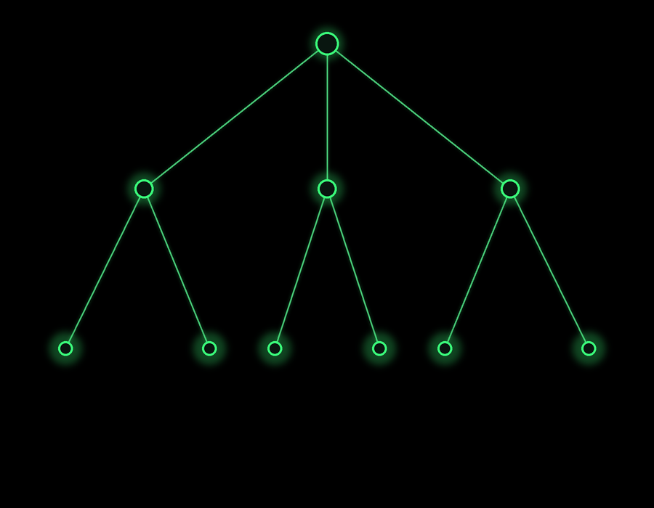
THANK YOU
Team 16 · DSA-3 · Dictionary-Based Misspelled Word Detection System
Hansika Reddy Gunapati · Teja Hasini Reddy · Anthony Nissy | Guide: Dr. S. Madhavi | Section 7

