Slide 1
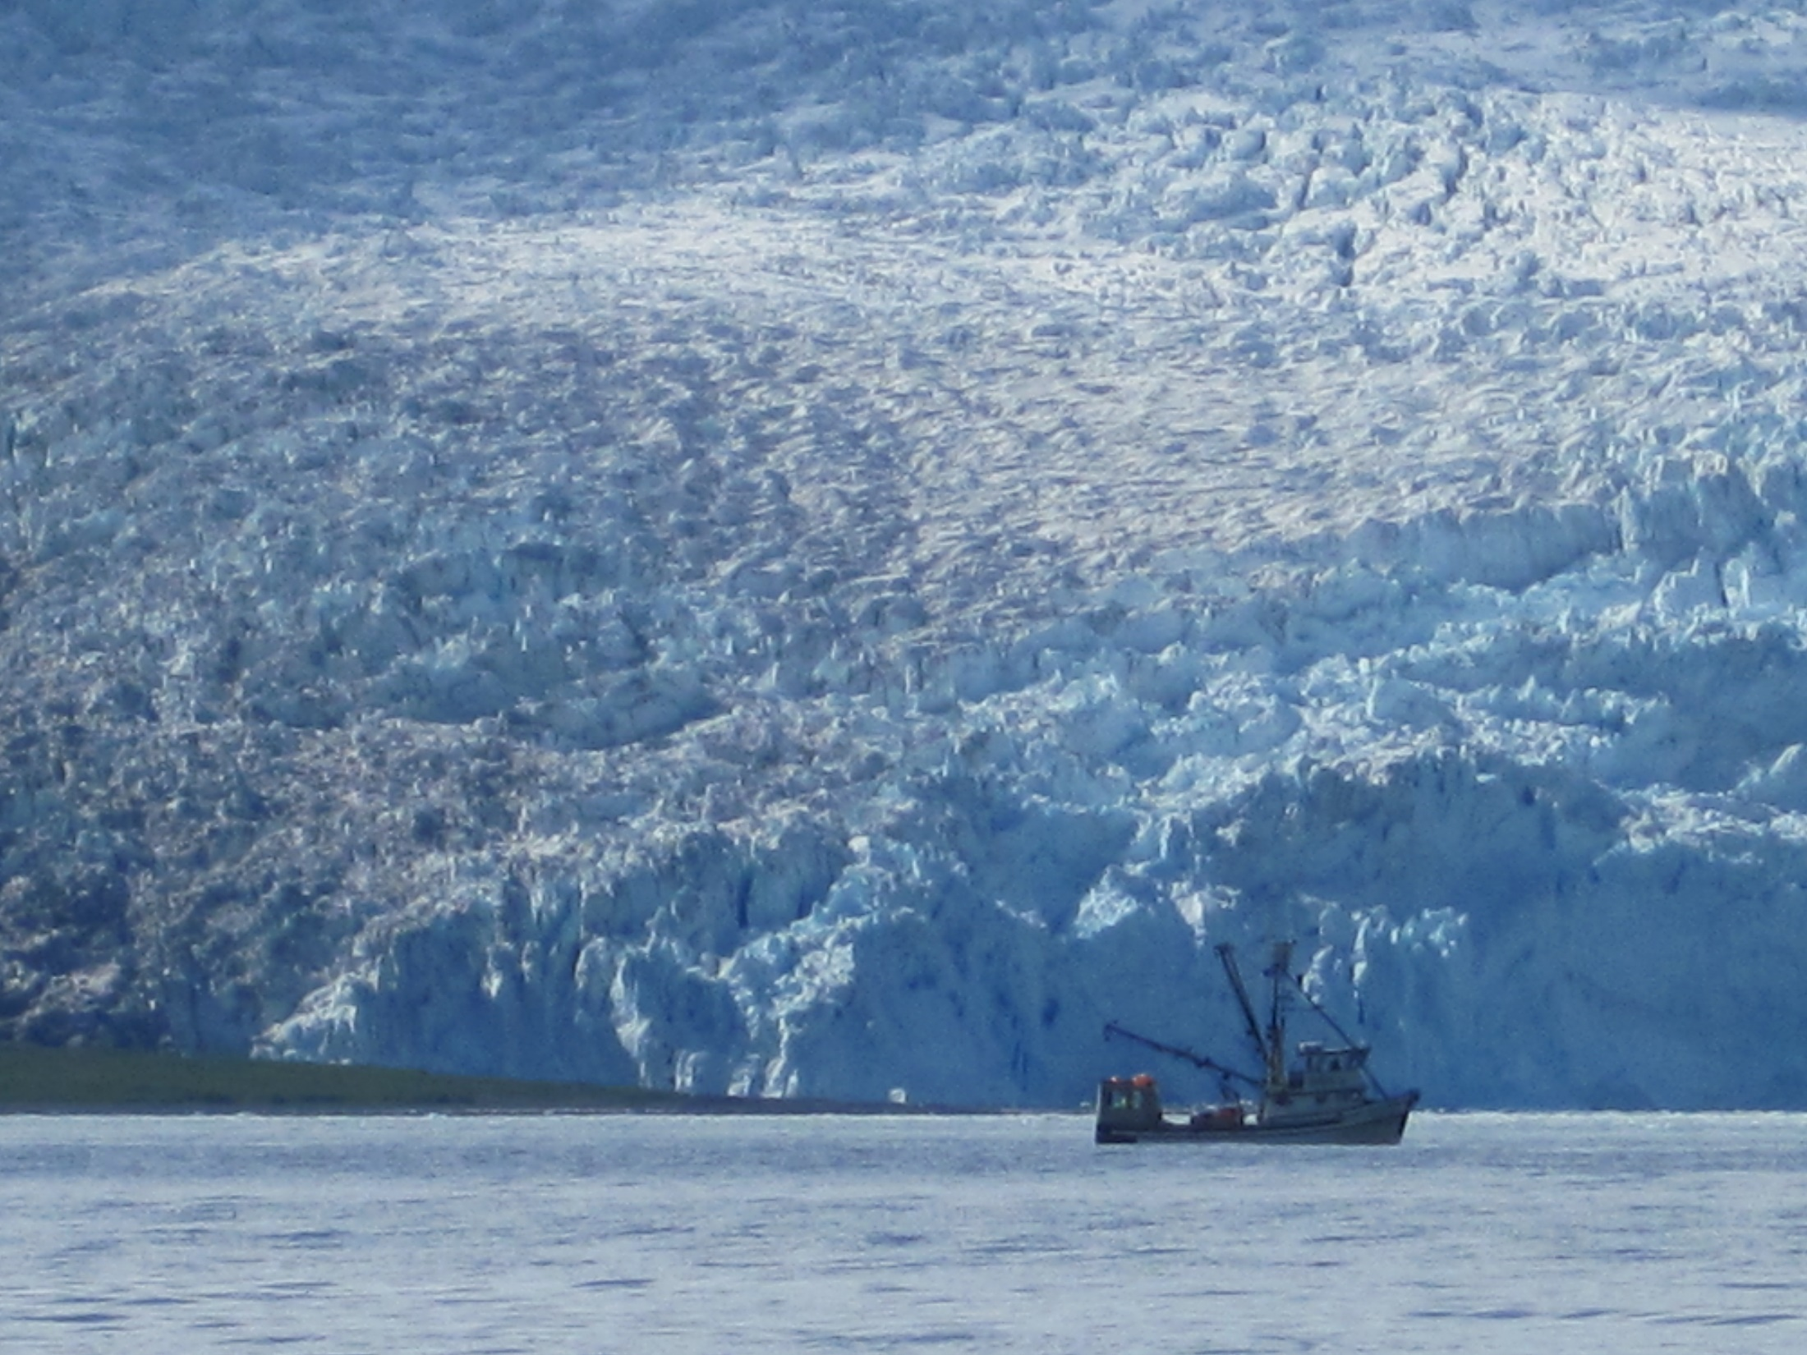
Mapping Seabirds & Marine mammals around Kenai Fjords, Alaska
Tjibbe Stelwagen

Slide 2
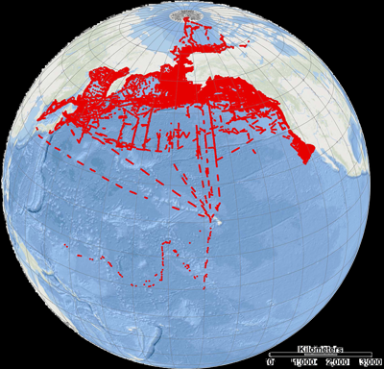
Introduction
Dataset ‘North Pacific Pelagic Seabird Database 2.0’
Retrieved from http://alaska.usgs.gov/products/data.php?dataid=1
Contains observations of 16,988,138 birds and 235,545 marine mammals between 1973 and 2012
For this project: Interest in Kenai Fjords region, Alaska
Goal of the project: Present maps with species of interest by year of interest

Slide 3
Methods: Building Blocks
Draft workflow and identify building blocks
Extraction of data from .mdb format (Ms Access)
Preparing the data
making it ‘R-friendly’
select relevant data, including trimming for geographic region
Build Python script to allow user to select species and year of interest
Project resulting file on a map with R marmaps
Integrate into a single shell function

Slide 4
Extraction of data
Attempts to read the file with MySQL failed
Missed opportunity to interact with database through Python
Plan B: Invent a way to match seperate textfiles into one by using Key
Hitting the wall: file too large, Gedit crashes, using grep in Gedit no option
Grep in the shell + cat worked, but then what…?
Make a query in Access and export as text

Slide 5
Extraction of data
R friendly settings: tab delimited, no “”, period as decimal separator
Trimming the data geographically:
manager@bl8vbox:~/NORTH_PACIFIC$ sort -k 1 cutalldata.txt > sortedcutalldata.txt
manager@bl8vbox:~/NORTH_PACIFIC$ tail -n +673190 sortedcutalldata.txt > sortedcutalldata2.txt
manager@bl8vbox:~/NORTH_PACIFIC$ head -n 76477 sortedcutalldata2.txt > sortedcutalldata3.txt
Making a species list
manager@bl8vbox:~/NORTH_PACIFIC$ cut -f 2,3,4,5 alldata.txt | sort -k3 > speciessorted.txt | cut -f 3 speciessorted.txt | uniq -c > specieslist.txt

Slide 6
Python
Integer or not?
Species_select = raw_input("Enter species name: ")
Year_select = int(raw_input("Enter Year: "))
Space issue
if Species == Species_select and Year == Year_select:
OutputString = str(Lat) + '\t' + str(Long) + '\t' + Species.replace(" ","_") + '\t' + str(Year) + '\n'
print OutputString
OutFile.write(OutputString)
Naming the output file: OutFileName = '/home/manager/NORTH_PACIFIC/' + Species_select+ '_' + str(Year_select) +'.txt'

Slide 7
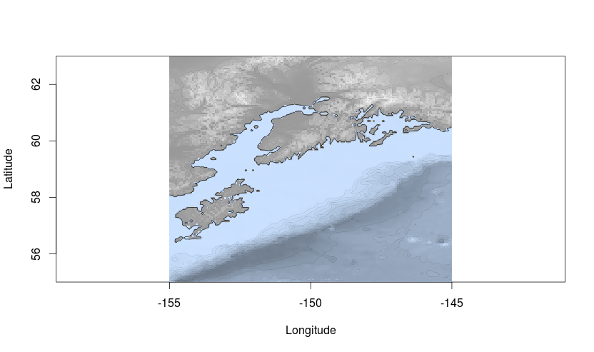
R marmap
 | Long | Lat | Species
55.54 | -145.34 | Common | Murre
Did initially not accept the files made with Python
Caused by space in ‘Common Murre’
Setting Lon Lat critical

Slide 8
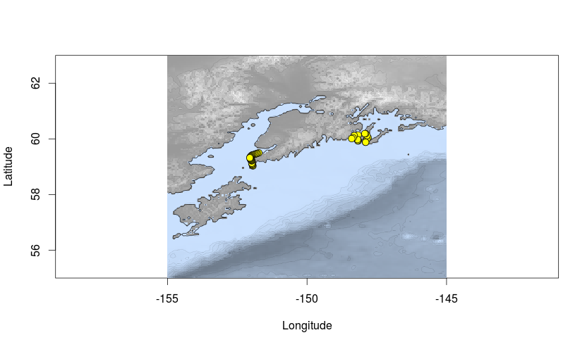
Results

Slide 9
Conclusion / Discussion
Efficiency
Trimming the dataset in retrospect not necessary c.q. smart:
Include selection of geographic range in Python instead
Python raw input: Making dictionary (species 1, 2, 3,)
Marmap possibilities, such as time series, multiple species plotting
The Shell function

Slide 10
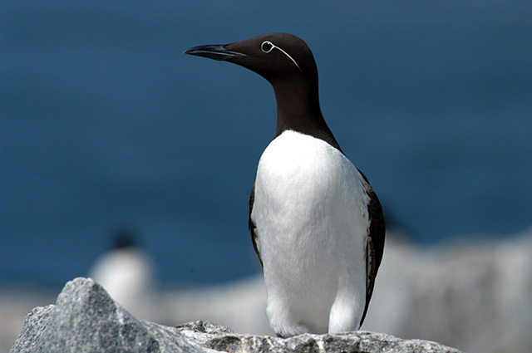
Picture retrieved from: http://www.1000birds.com/reports_Common-Murre.htm

