Slide 1
Midterm Project
Building a linear regression ML Model predicting housing prices
Thomas Doherty & Spencer Fargey

Slide 2
Goals
Build a ML Model to predict Real Estate housing prices:
Join together a large number of JSON files with real estate data from many different states
Clean the data and look for relationships with the sold price of the home
Build a Linear ML model to predict housing prices.
Tune hyperparameters and build a pipeline to accept new data

Slide 3
1 – Data Cleaning & EDA
67 column of data in original unified dataframe
17 completely empty and removed; % null of columns varied but many rows with empty latitude & longitude had many empty columns elsewhere and rows removed
Removed dupes – some records had 5 copies of property_id. Approximately ~1700 unique records
Fill null with 0 for garages, baths, 0 beds (studio apts)
Fill null with median for sqft, lot_sqft (avoid small apartments being skewed by large empty plots / farms)

Slide 4
1 – Data Cleaning & EDA
Tags – One Hot Encoding (OHE) of all tags which were amenities of the property
State / City – OHE which lead to an extremely large number of columns. State/city were ignored in the MVP model
Some tags were very rare (5-10 properties out of 1700 total) and dropped from the model data
Encoded property type e.g. condo, family_home but some categories had very few records – condos, multi_family, single_family kept

Slide 5
1 – Data Cleaning & EDA
Feature Engineering
Days_listed – difference between list date and sold date. Do longer listings lead to discounts / lower sold price?
Number of Rooms – sum of n_baths and n_bedrooms. Expecting a strong correlation with sold_price
N_amenities - Sum of all 0/1 encoded tags. More amenities → higher sold price?
N_high_amenities – sum of all 0/1 encoded tags which individually had >= 0.1 corr() with sold_price.
Individual tags removed from the data moving forward to reduce complexity in the model

Slide 6
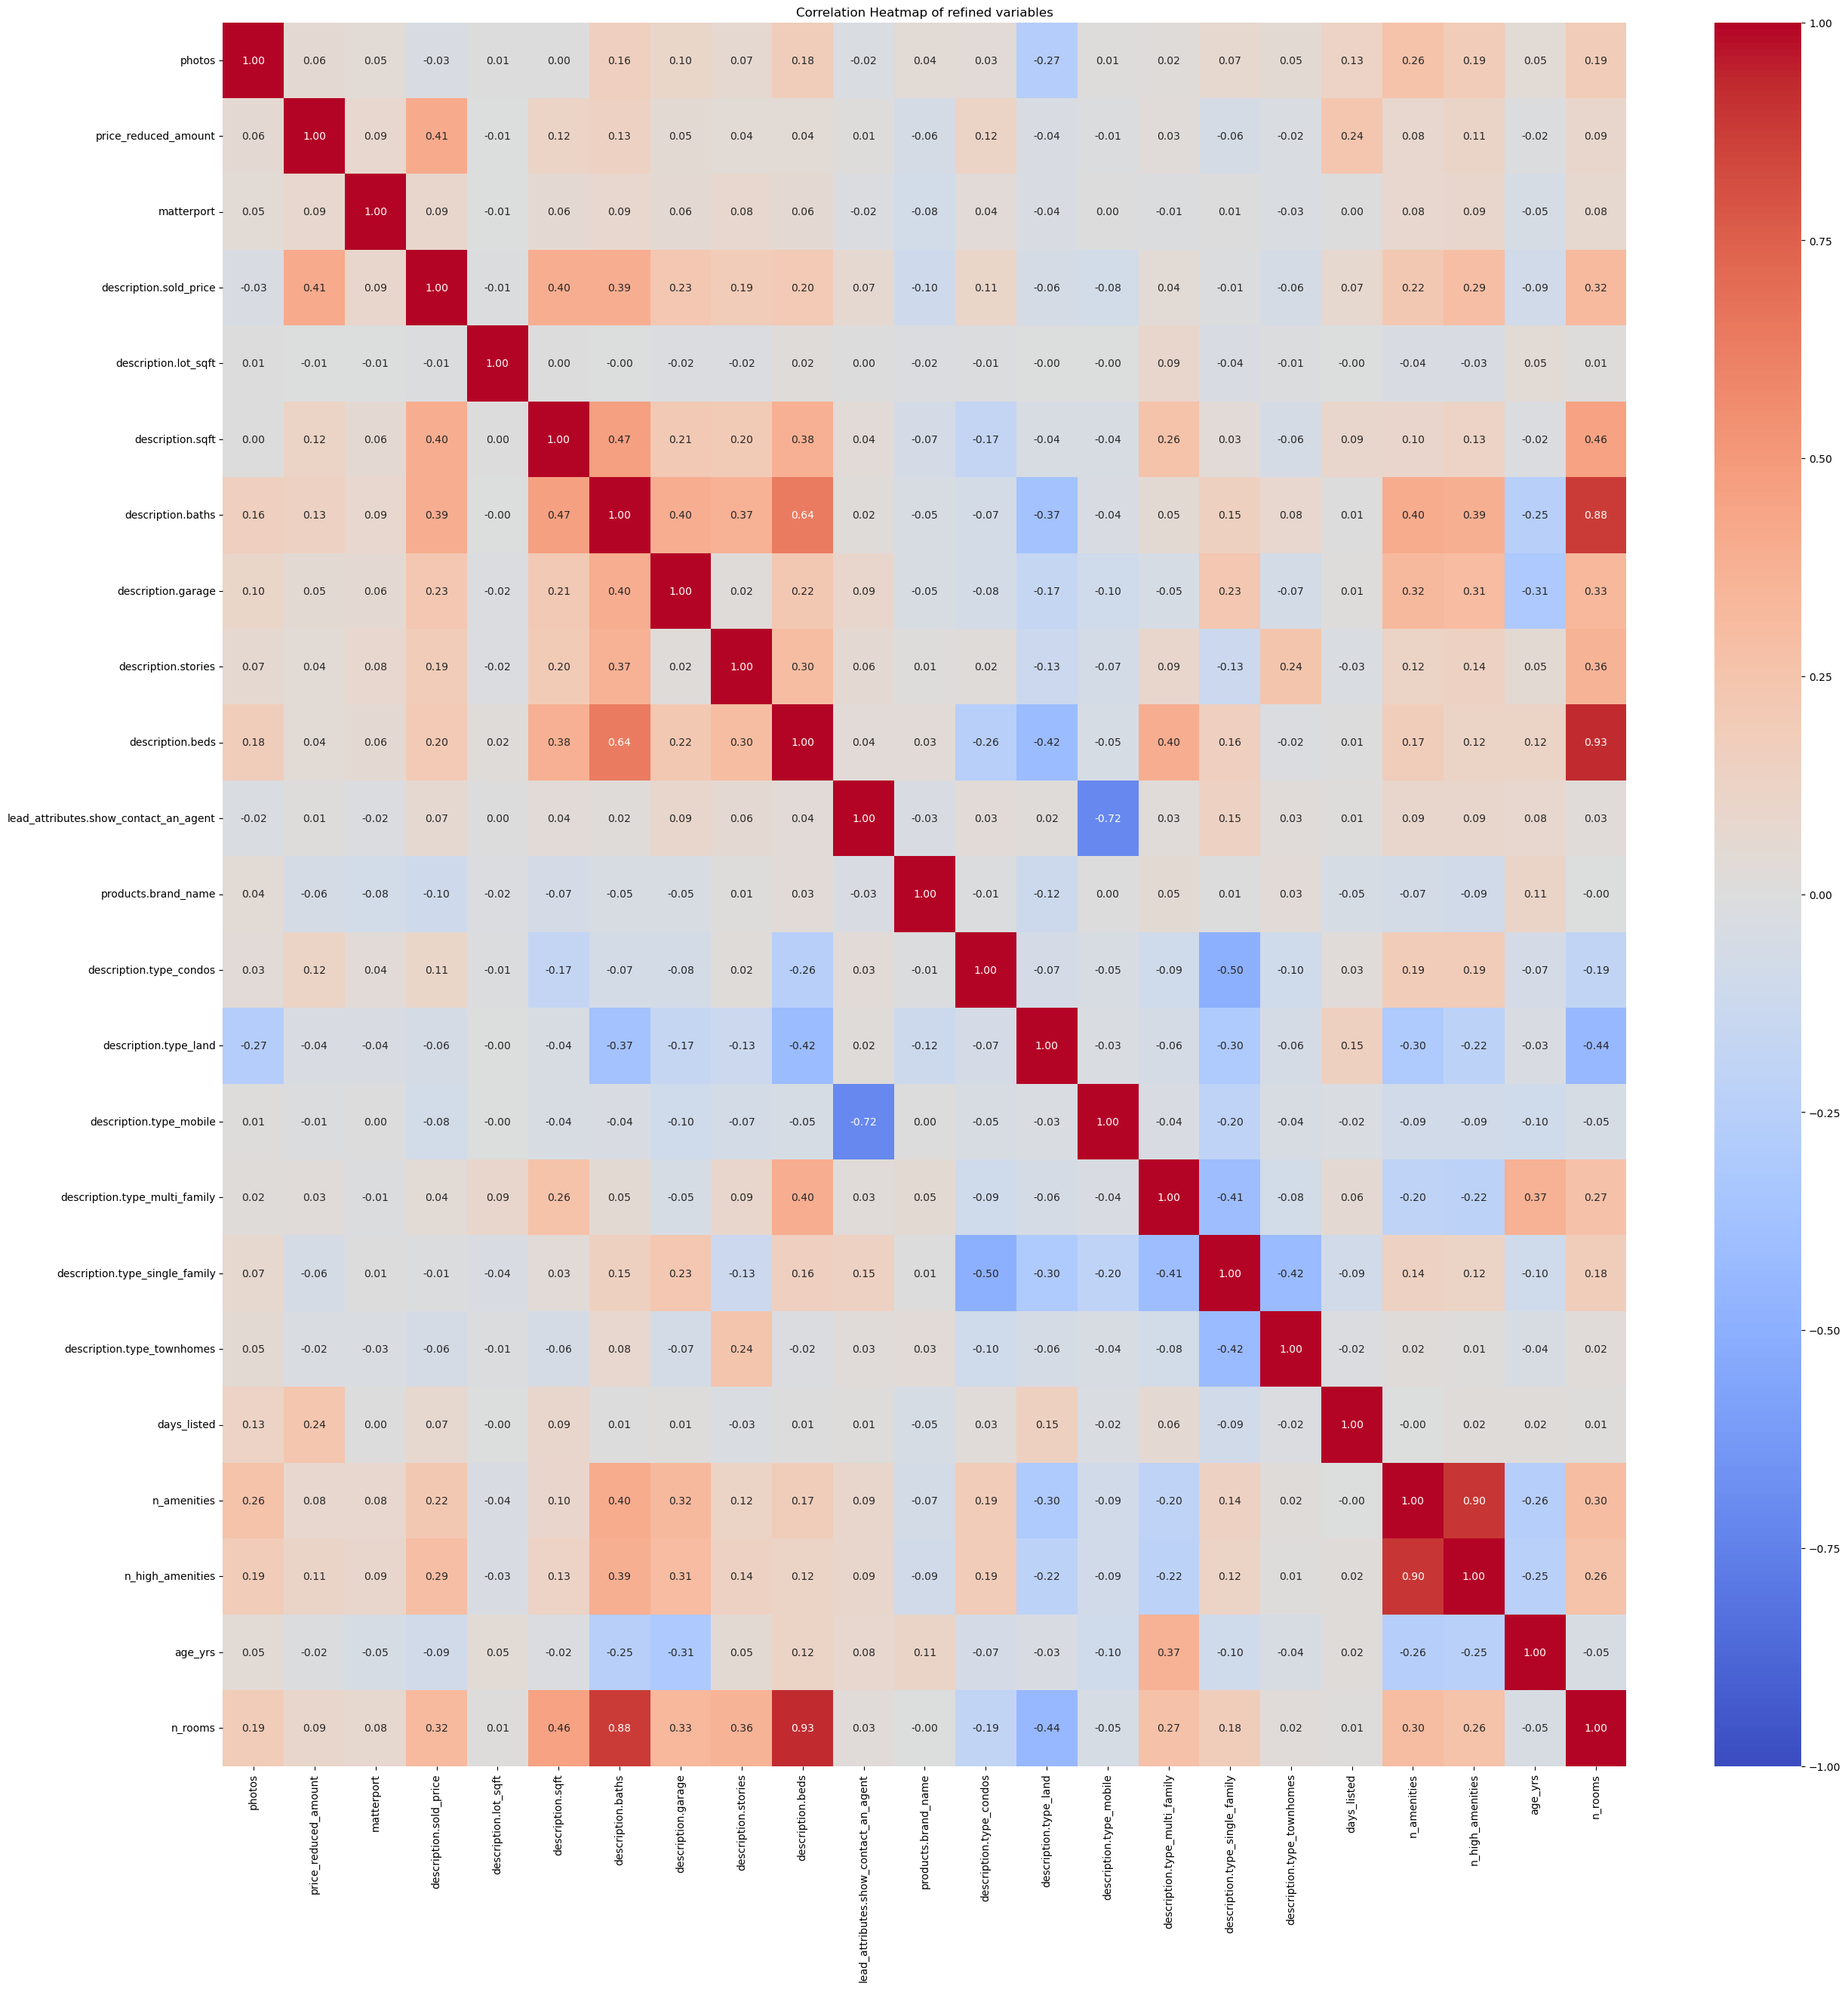
Red boxes, Descending:
Price.reduced_amount (0.41); Description.sqft (0.4); Description.baths (0.39); Description.garage (0.23); n_amenities (0.22); n_high_amenities (0.29)

Slide 7
2 – Model Selection
Linear Regression model predicting sold_price of the real estate
Vanilla Linear Regression: 0.34 R² (Train), 0.64 R² (Test) which is likely anomalous (new random state generated 0.36 R² Test
Ridge Regression: R² Train = 0.506; R² Test = 0.509, Test RMSE: $227,331.0
10-fold cross validation (R² from cross-val = 0.411)
0.01 and 0.99 lower/upper bounds capped to remove extreme outliers
RobustScaler

Slide 8
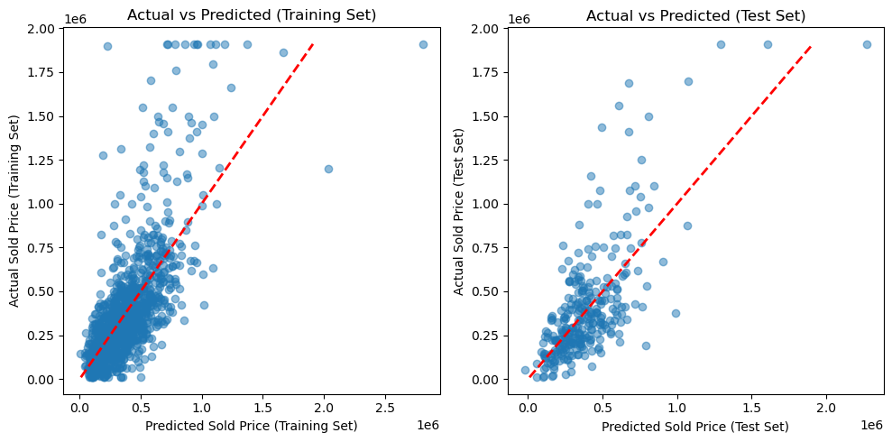
Test vs Training – what does the relationship look like?

Slide 9
2 – Model Selection
XGBoost – R² Train 0.76; R² Test 0.56
Suggests a lot of overfitting, but XGBoost is our strongest performing model so this was taken forward to tune hyperparameters
Test RMSE (XGBoost): $ 215,347.0
This is still not an effective model

Slide 10
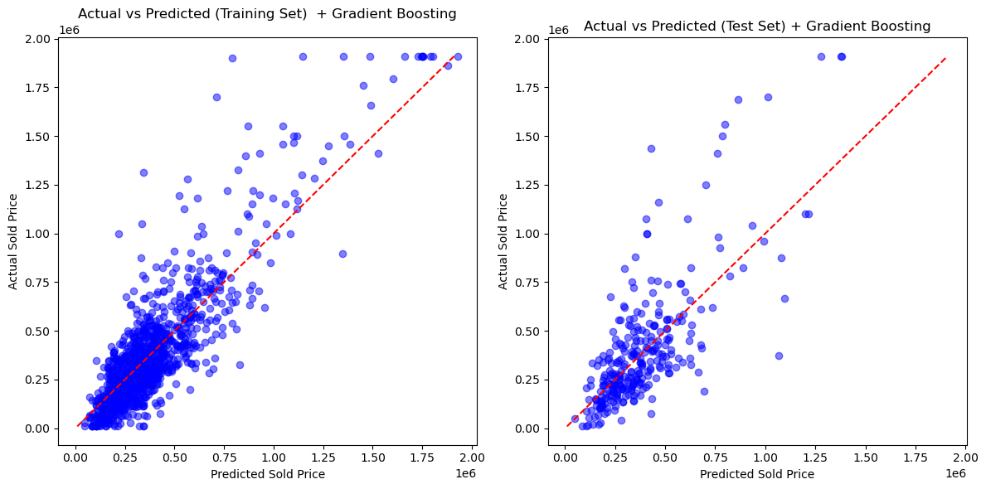
Test vs Training - XGBoost

Slide 11
3 – Tuning & Pipeline
GridSearchCV for XGBoost model
Best hyperparameters (select):
alpha: 0.5
lambda: 2
learning_rate: 0.1
max_depth: 5
n_estimators: 200

Slide 12
Challenges & Next Steps
XGBoost is our best model so far but it still has very high RMSE
Very likely that State & City is impacting sold_price but this was removed from our model to reduce complexity
How do we use OHE’d states and cities which would make the # of combinations of features enormous?
PCA could be used to reduce down number of features
Build a pipeline with data cleaning, feature engineering & scaling in custom functions and then fit model
Custom function e.g. if col.isnull % > 95 then drop…

Slide 13
Feature engineering & next steps ideas
Correction factor to apply to sold_price depending on city or state (e.g. California = 2 * sold_price; Nebraska = 0.5 * sold_price)
Sold date - did we examine sold_date?
Categorize states/cities by COL: 1 = low, 2 = med, 3 = high?

