Slide 1
Midterm Project
Building a linear regression ML Model predicting housing prices
Thomas Doherty & Spencer Fargey

Slide 2
Goals
Join together a large number of JSON files with real estate data from many different states
Clean the data and look for relationships with the sold price of the home
Build a Linear ML model to predict housing prices.
Tune hyperparameters and build a pipeline

Slide 3
1 – Data Cleaning & EDA
67 column of data in original unified dataframe
17 completely empty and removed; % null of columns varied but many rows with empty latitude & longitude had many empty columns elsewhere and rows removed
Removed dupes – some records had 5 copies of property_id. Approximately ~1700 unique records
Fill null with 0 for garages, baths, 0 beds (studio apts)
Fill null with median for sqft, lot_sqft (avoid small apartments being skewed by large empty plots / farms)

Slide 4
1 – Data Cleaning & EDA
Tags – One Hot Encoding (OHE) of all tags which were amenities of the property
State / City – OHE which lead to an extremely large number of columns. State/city were ignored in the MVP model
Some tags were very rare (5-10 properties out of 1700 total) and dropped from the model data
Encoded property type e.g. condo, family_home but some categories had very few records – condos, multi_family, single_family kept

Slide 5
1 – Data Cleaning & EDA
Feature Engineering
Days_listed – difference between list date and sold date. Do longer listings lead to discounts / lower sold price?
Number of Rooms – sum of n_baths and n_bedrooms. Expecting a strong correlation with sold_price
N_amenities - Sum of all 0/1 encoded tags. More amenities → higher sold price?
N_high_amenities – sum of all 0/1 encoded tags which individually had >= 0.1 corr() with sold_price.
Individual tags removed from the data moving forward to reduce complexity in the model

Slide 6
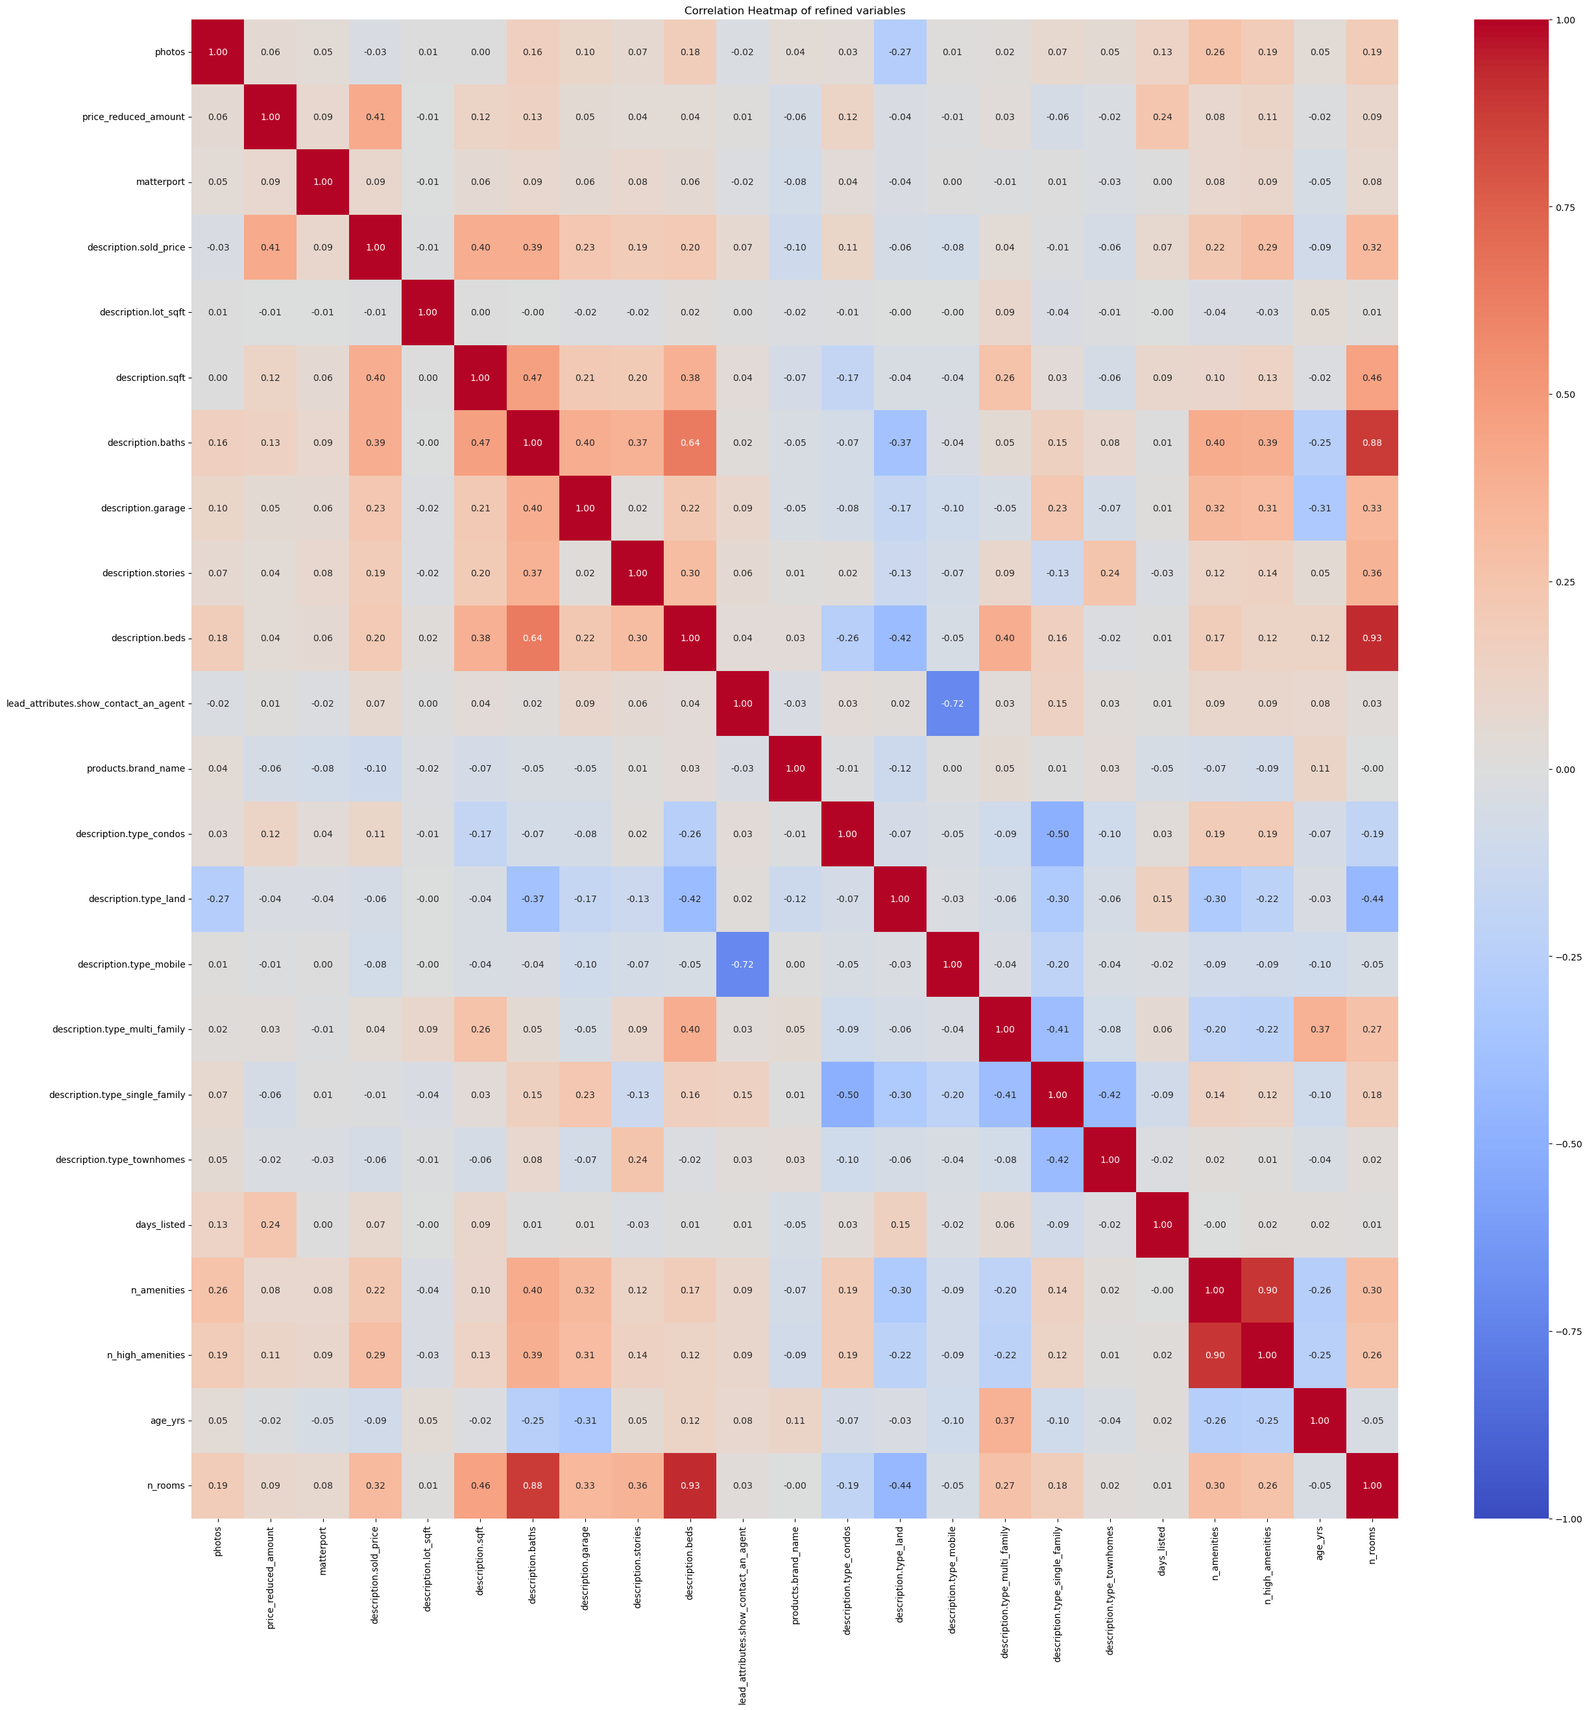
Red boxes,Descending:
Price.reduced_amount (0.41); Description.sqft (0.4); Description.baths (0.39); Description.garage (0.23); n_amenities (0.22); n_high_amenities (0.29)

Slide 7
2 – Model Selection
Linear Regression model predicting sold_price of the real estate
Vanilla Linear Regression: 0.34 R² (Train), 0.64 R² (Test) which is likely anomalous (new random state generated 0.36 R² Test
Ridge Regression: R² Train = 0.506; R² Test = 0.509
10-fold cross validation (R² from cross-val = 0.411)
0.01 and 0.99 lower/upper bounds capped to remove extreme outliers
RobustScaler

