Slide 1
MG 226 Final Project
TJ Augustine

Slide 2
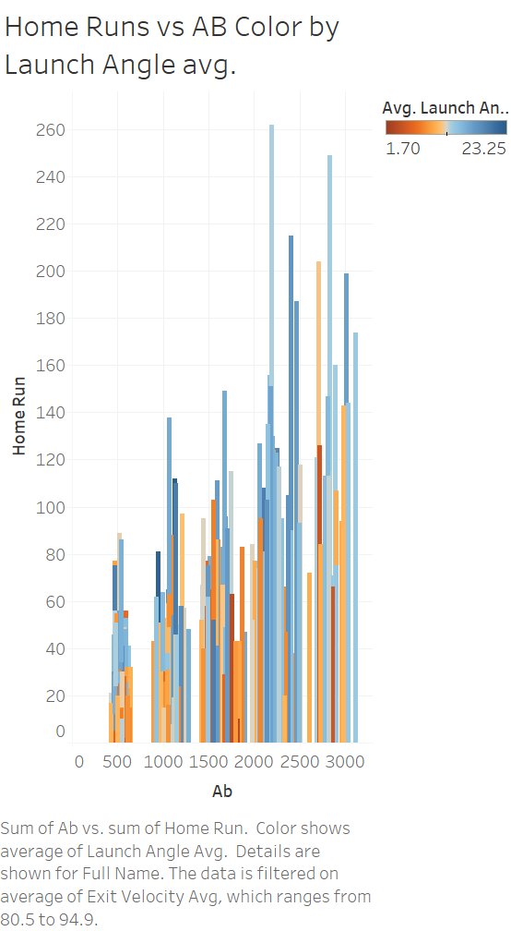
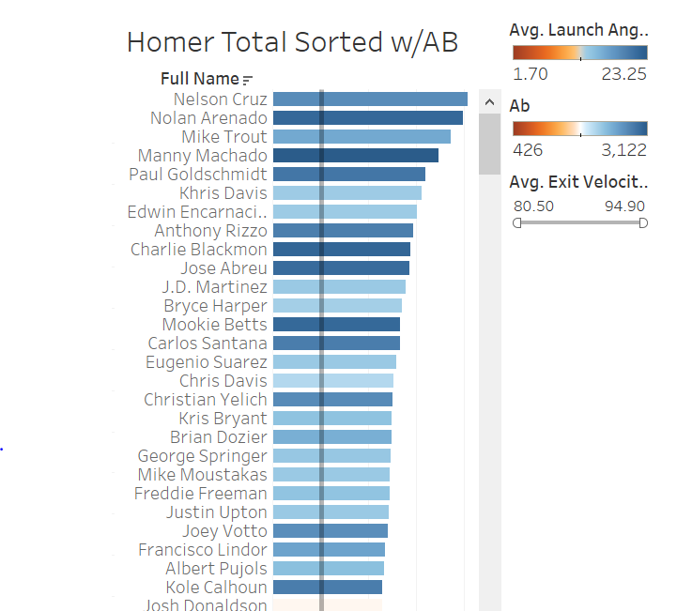

Slide 3


Slide 4
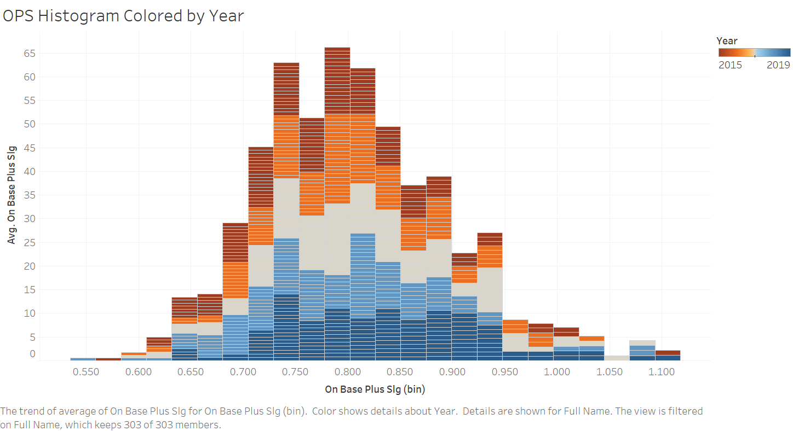

Slide 5
