Slide 1

Flatiron School Capstone Project: Clickbait Headline Detector
By: TaeJoon Kim

Slide 2
Business Problem and Approach
Clickbait is annoying! With NLP and ML algorithms, it may be possible to identify headlines that are very likely to be one.
The approach will be broken down into five steps:
Obtain: importing from kaggle, webscraping, API’s
Scrub: clean data for easy use
EDA: identify distributions and patterns in data
Model: apply various ML algorithms
Interpret: present key features and prediction outcomes

Slide 3

Obtain Data
Kaggle dataset – contains 16,000 clickbait and 16,000 non-clickbait headlines
clickbait sources: BuzzFeed, Upworthy, ViralNova, Thatscoop, Scoopwhoop, and ViralStories, clickhole, worldtruth
Non-clickbait sources: WikiNews, New York Times, The Guardian, The Hindu
More clickbait headlines webscraped from clickhole.com and worldtruth.tv
More non-clickbait headlines from New York Times and The Guardian APIs
All combined: 32,707 and 32,660 clickbait and non-clickbait headlines

Slide 4

Scrub/Explore Data
Remove stop words
Remove special characters
Tokenizing
Feature Engineering using word embeddings (SpaCy)

Slide 5
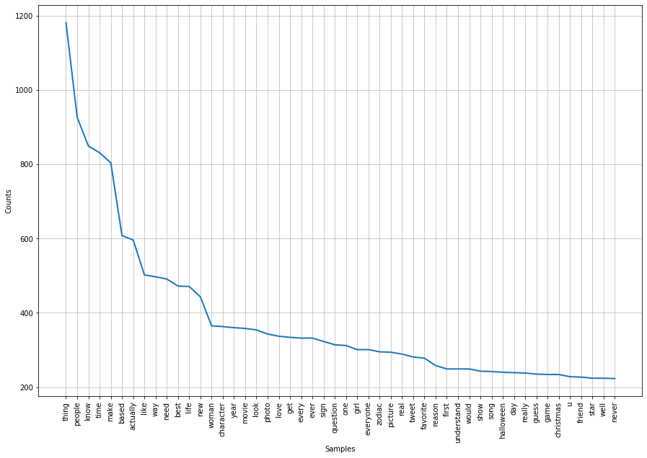
Explore Data – Word Frequency

Slide 6
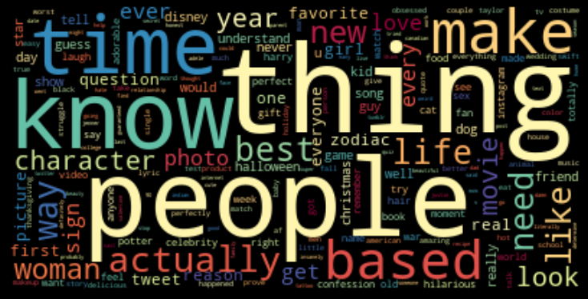
Explore Data – Word clouds

Slide 7
Model/Interpret
ML algorithms used: Logistic Regression, KNN, SVM, Naïve Bayes, and Random Forest
Most models performed with accuracy scores of around mid 80’s and low 90’s
Best model was SVM combined with SpaCy
runtime was less than a minute
92% F1 score

Slide 8
Future works
Include more feature engineering (i.e. does the headline start with a word or a number? How long is the headline?)
Use Principal Component Analysis (PCA) to improve runtime of random forest model
Include more headline data from a variety of sources

Slide 9

Thank You!
Contact:
TaeJoon Kim
tjkim614@gmail.com
https://github.com/tjkim614/clickbait_headline_detector
https://www.linkedin.com/in/taejoon-kim-309878164/

