Slide 1

Zillow Real Estate Recommender
By: TaeJoon Kim

Slide 2
OVerview
PURPOSE: This notebook aims to suggest potential locations for investing in U.S. real estate, based on historical data on the average housing prices.
BUSINESS PROBLEM: The clients utilizing this notebook are people who intend to buy houses purely for investment purposes and not for residence. For this reason, in-depth considerations for each region and neighborhood are not included - only monthly price movements will be considered.

Slide 3

Zillow Data
Data used in this notebook contains the average monthly house prices from April 1996 to April 2018 (22-year span), organized by zip code.
The DataFrame contains 14722 rows and 272 columns.
This data can be accessed on the Zillow website (https://www.zillow.com/research/data/).

Slide 4

Data Selection
The data was sorted by the following criteria:
Size Rank (20%)
Price Range (20%)
Coefficient of Variance (60%)
Then, the data was selected by highest ROI (Return on Investment)
The top five zip codes that were selected were: 11211, 11222, 11216, 07302, and 11215. All five zip codes were areas within the New York City Metropolitan Area.

Slide 5
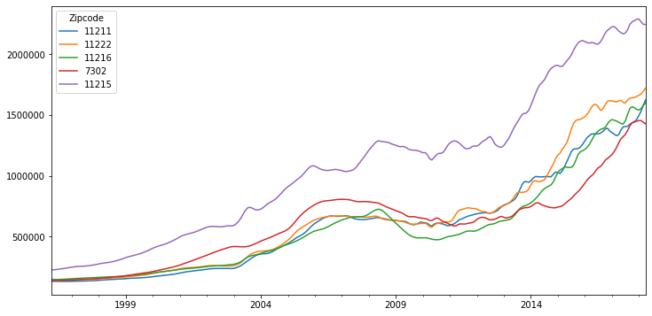
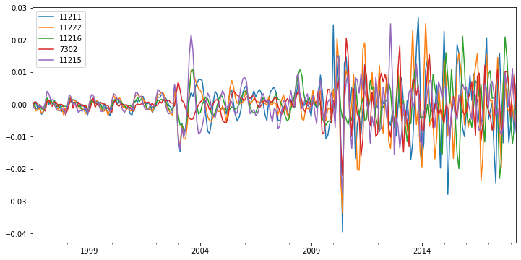
Selected Data
Above graph is the price change over the 22-year span
Below graph is the monthly returns, with differencing applied.
Resulting p-values for the Dickey-Fuller Test were all less than 0.01%.

Slide 6
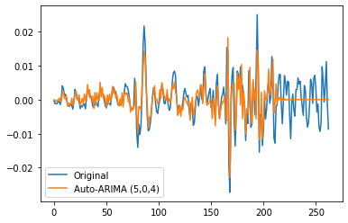
Auto-Arima
Best model performance was achieved by applying auto-ARIMA, then using those parameters to run an ARMA model.
Most of the graphs looked the same – the graph shown on the right is the prediction for the zip code 11215.

Slide 7
Results
Zip Code | Train RMSE | Test RMSE | Average Test Predictions
11211 | 0.00466 | 0.01077 | -0.000257
11222 | 0.00448 | 0.01046 | -0.000068
11216 | 0.00240 | 0.00942 | -0.000183
7302 | 0.00332 | 0.00629 | -0.000084
11215 | 0.00375 | 0.00573 | 0.000031
All five zip codes had relatively small RMSE values
The best out of the five zip codes was zip code 11215, which has a small RMSE value and the highest return.

Slide 8
Future Works and Recommendations
Incorporating stronger nonlinear models, such as Facebook Prophet will increase the model’s predictive power.
Including exogenous variables such as tax rates, median income of the population, monthly housing cost, cost of living, crime grade, and more.
The fact that the top five zip codes all came from the New York City Metropolitan Area may suggest that other areas that has not seen high growth yet may yield high returns in the coming years

Slide 9
Thank YOU!
GitHub link: https://github.com/tjkim614/zillow
Contact: tjkim614@gmail.com
LinkedIn: https://www.linkedin.com/in/taejoon-kim-309878164/

