Slide 1
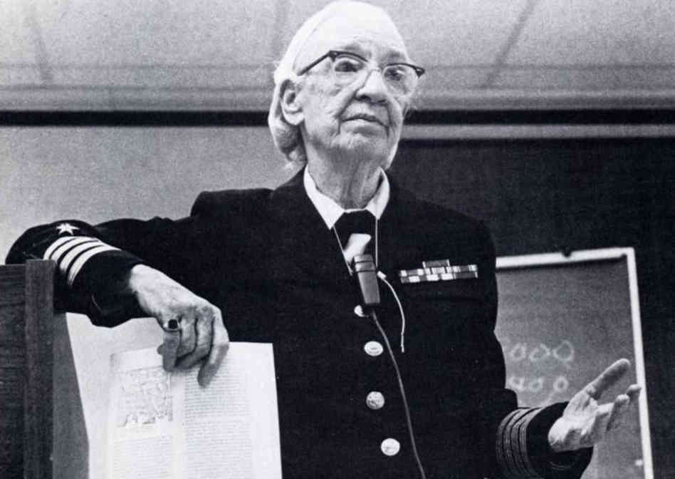
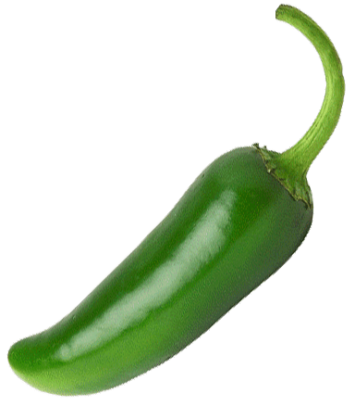
Hopper’s Heapin’ Jalapenos
Recipe Generation Application
Theodore J. LaGrow
Je Min Son
Randy Chen
Daniel Su

Slide 2
Design of Application
User Input
Back End Process
User Interaction

Slide 3

Flask
Image Input
User Input
User Input
Back End Process
User Interaction

Slide 4
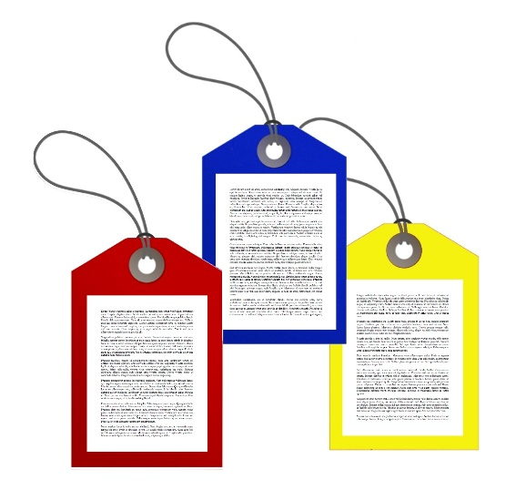
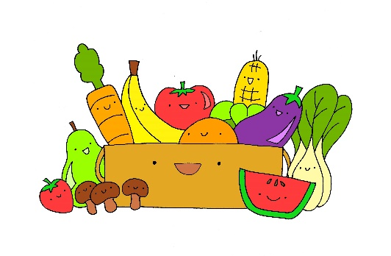
Back End Process
Image Tagging
Recipe Calls
User Input
Back End Process
User Interaction

Slide 5
Flask
Choose recipe
Display for cooking
User Interaction
User Input
Back End Process
User Interaction

Slide 6

MVP
Back End
Image Tagging
Recipe Calls
Filter with type of meal
Front End
Pictures, interface, input
Check/confirm valid food
Display results

Slide 7

Ideal Product
Suggestion if more food
More user delineation
Local Food Store

Slide 8


Timeline
Week 5
Finding limitations of APIs
Week 6
Implement tags on Images
Mock up front end
Input/output for recipes
Week 7
Evaluate progress
Connect Images -> Recipes
Front end with toy data
Week 8
Evaluate progress
Check MVP
Add extra features
Week 9
Polish application
Documentation
Week 10
Presents the product

Slide 9
Thank you

