Slide 1
C++11 and ……
Liu Peng

Slide 2
Agenda
Pre C++11
C++11
Post C++11

Slide 3
ISO/IEC/JTC1/SC22/WG21
International Organization
for Standardization
The C++ Standards Committee
Working Group 21
International Electrotechnical Commission
International standardization subcommittee for programming languages, their environments and system software interfaces
SubCommittee22
Joint Technical Committee

Slide 4
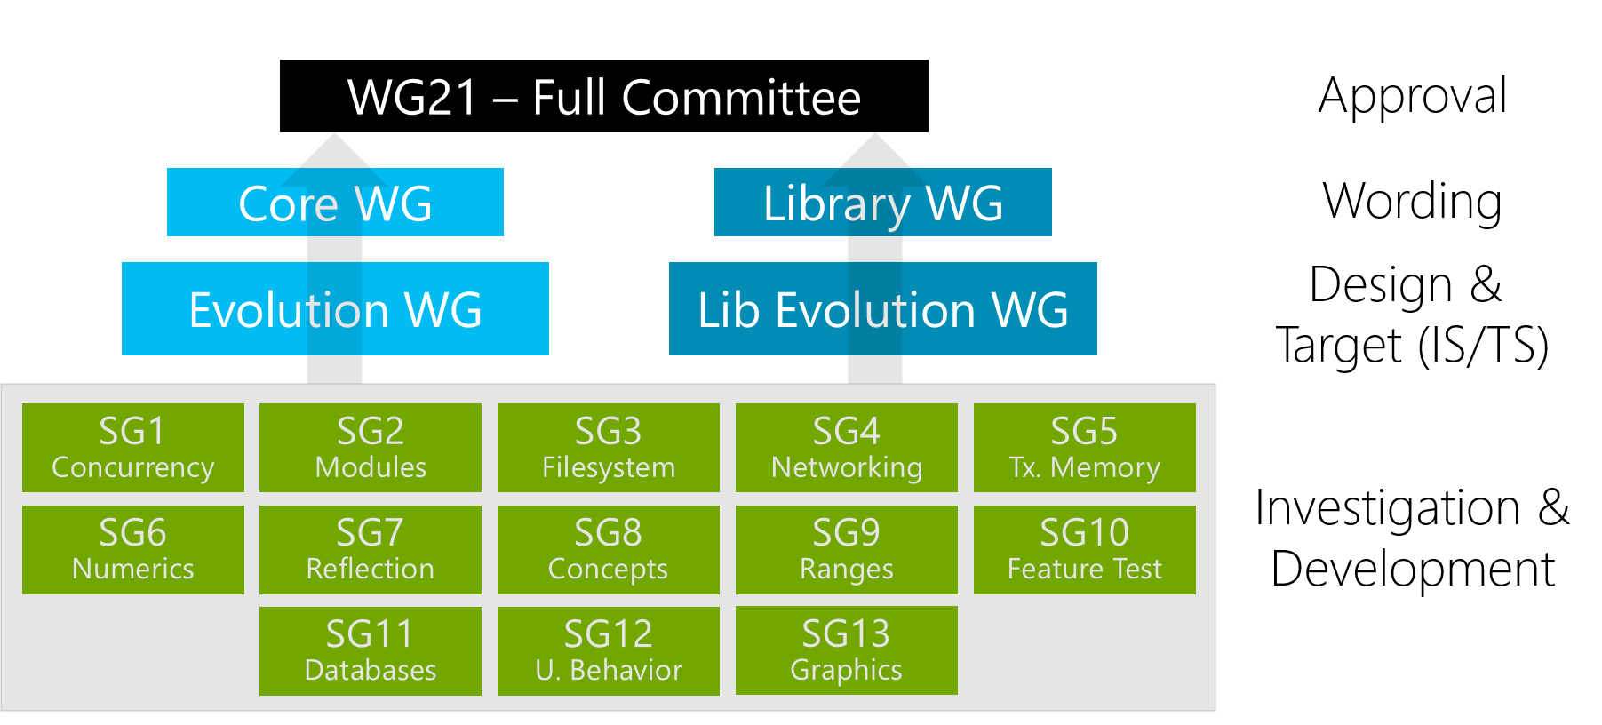
Notes:
http://isocpp.org/std/the-committee
Hans Boehm from HP leads SG1 Concurrency Study Group

Slide 5
…… Before C++11

Slide 6
C++ Standard Progress before C++11
1998 ISO/IEC 14882:1998 C++98
2003 ISO/IEC 14882:2003 C++03, only bug fix for C++98
2007 ISO/IEC TR 19768:2007, TR1, C++ Library Extension
2008 C++0x Committee Draft SC22 Balloting
2010 C++0x Final Committee Draft SC22 Balloting
2011 ISO/IEC 14882:2011 C++11
C++0x

Slide 7
Current C++11

Slide 8
Development Directives for C++11
Maintain stability and compatibility with C++98 and possibly with C
Prefer introduction of new features through the standard library, rather than extending the core language
Prefer changes that can evolve programming technique
Improve C++ to facilitate systems and library design, rather than to introduce new features useful only to specific applications
Increase type safety by providing safer alternatives to earlier unsafe techniques
Increase performance and the ability to work directly with hardware
Provide proper solutions for real-world problems
Implement “zero-overhead” principle (additional support required by some utilities must be used only if the utility is used)
Make C++ easy to teach and to learn without removing any utility needed by expert programmers

Slide 9
C++11 Changes
C++ core language extension
Runtime performance enhancement
Build time performance enhancement
Usability enhancement
Functionality enhancement
C++ Standard Library changes

Slide 10
C++ core language runtime performance enhancement

Slide 11
Rvalue Reference and move constructor
Lvalue and Rvalue
Rvalue in C++03 is undistinguished from const T&
Rvalue in C++11
prvalue (pure rvalue): same as rvalue in C++03
xvalue (eXpiring value): to be moved
Rvalue reference: T&&
“Extend” the life cycle of rvalue
std::move(): lvalue -> rvalue reference
Helper templates
std::is_rvalue_reference<>::value
std::is_lvalue_reference<>::value
std::is_reference<>::value
T a = ReturnRvalue();
T&& a = ReturnRvalue();

Slide 12
No garbage collection needed – B.J
For general, simple, implicit, and efficient resource management
Apply these techniques in order:
Store data in containers
The semantics of the fundamental abstraction is reflected in the interface
Including lifetime
Manage all resources with resource handles
RAII
Not just memory: all resources
Use “smart pointers”
They are still pointers
Plug in a garbage collector
For “litter collection”
C++11 specifies an interface
Can still leak non-memory resources

Slide 13
After C++11……

Slide 14
C++ Standard meeting Feb 2012
The first meeting since the ratification of C++11
No new Standard before 2017, with a 2022 follow-on standard, every five years
Discuss public Open Source Library – Portable C++ Library
Processes over 120 defects, discuss some issues
Potential features for future standard
Advanced abstractions of concurrency

Slide 15
C++ Standard meeting Oct 2012
C++ is technically 27 years old
C++14 is proposed to address C++11 annoyances and a bug fix release
Pick up some drafts dropped in C++11 due to time constraint
Processes over 120 defects, discuss some issues
Potential features for future standard
Advanced abstractions of concurrency
Notes:
C++ is 27 years old, if you count it as the day that Stroustrup’s original C++ book was published on Oct 14, 1985 based on this picture.

Slide 16
C++14
C++14 Committee Draft (CD) published at isocpp.org in May, 2013
National Body (NB) Balloting at SC22 level: 3 months
Many issues are solved at C++ Standard Meeting, Chigago in Sept. 2013
Draft International Standard (DIS) balloting at the JTC level: 5 months
Valid International Standard (IS) balloting at the JTC level: 2 months
A ratified C++14 will be released summer 2014, likely at the Rapperswill, Switzerland meeting
If any of the step fails because some NB comment could not be addressed, then a second CD may need to be issued, which would push the process back, likely until end of 2014, or even past it.

Slide 17
C++14
Clang is (draft) C++14 feature-complete at Nov. 7 2013
It appears that the next release of Clang and LLVM, expected in December or January, will be draft C++14 feature-complete.

Slide 18
What will C++14 look like?
Clang is (draft) C++14 feature-complete at Nov. 7 2013
It appears that the next release of Clang and LLVM, expected in December or January, will be draft C++14 feature-complete.

Slide 19
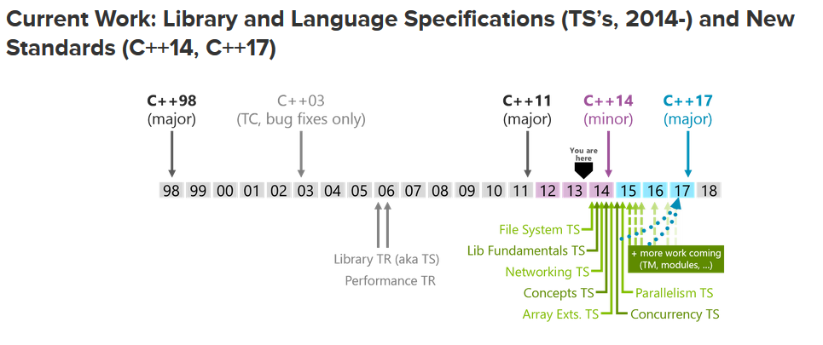

Slide 20
Title (28 pt. HP Simplified bold)
Subtitle (18 pt. HP Simplified)
Put your first-level bullet here. Try to keep bullet lists simple. (14 pt. HP Simplified)
Put your second-level bullet here. Use no more than you need to explain your point. (14 pt. HP Simplified)
Put your third-level of copy here. Use no more than you need to explain your point. (14 pt. HP Simplified)
Put your fourth-level of copy here. Use no more than you need to explain your point. (14 pt. HP Simplified)
Put your fifth-level of copy here. Use no more than you need to explain your point. (14 pt. HP Simplified)

Slide 21
Title (28 pt. HP Simplified bold)
Subtitle (18 pt. HP Simplified)
Heading (18 pt. HP Simplified bold HP blue)
Body copy (16 pt. HP Simplified)
Put your first-level bullet here. (14 pt. HP Simplified)
Put your second-level bullet here. (14 pt. HP Simplified)
Put your third-level of copy here. (14 pt. HP Simplified)
Heading (18 pt. HP Simplified bold HP blue)
Body copy (16 pt. HP Simplified)
Put your first-level bullet here. (14 pt. HP Simplified)
Put your second-level bullet here. (14 pt. HP Simplified)
Put your third-level of copy here. (14 pt. HP Simplified)

Slide 22
Title (28 pt. HP Simplified bold)
Heading (18 pt. HP Simplified bold HP blue)
Body copy (16 pt. HP Simplified)
Put your first-level bullet here. (14 pt. HP Simplified)
Put your second-level bullet here. (14 pt. HP Simplified)
Put your third-level of copy here. (14 pt. HP Simplified)
Heading (18 pt. HP Simplified bold HP blue)
Body copy (16 pt. HP Simplified)
Put your first-level bullet here. (14 pt. HP Simplified)
Put your second-level bullet here. (14 pt. HP Simplified)
Put your third-level of copy here. (14 pt. HP Simplified)

Slide 23
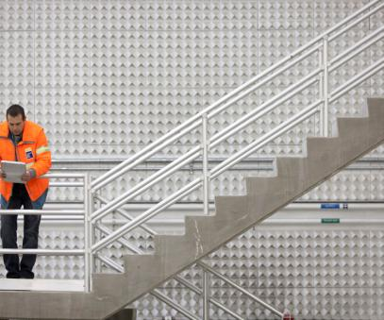
Title (28 pt. HP Simplified bold)
Subtitle (18 pt. HP Simplified)
Heading (18 pt. HP Simplified bold HP blue)
Body copy (16 pt. HP Simplified)
Put your first-level bullet here. (14 pt. HP Simplified)
Put your second-level bullet here. (14 pt. HP Simplified)
Put your third-level of copy here. (14 pt. HP Simplified)

Slide 24

Title (28 pt. HP Simplified bold)
Heading (18 pt. HP Simplified bold HP blue)
Body copy (16 pt. HP Simplified)
Put your first-level bullet here. (14 pt. HP Simplified)
Put your second-level bullet here. (14 pt. HP Simplified)
Put your third-level of copy here. (14 pt. HP Simplified)

Slide 25
Title (28 pt. HP Simplified bold)
Subtitle (18 pt. HP Simplified)
Heading (18 pt. HP Simplified bold HP blue)
Body copy (16 pt. HP Simplified)
14 pt. HP Simplified
14 pt. HP Simplified
14 pt. HP Simplified
Heading (18 pt. HP Simplified bold HP blue)
Body copy (16 pt. HP Simplified)
14 pt. HP Simplified
14 pt. HP Simplified
14 pt. HP Simplified
Heading (18 pt. HP Simplified bold HP blue)
Body copy (16 pt. HP Simplified)
14 pt. HP Simplified
14 pt. HP Simplified
14 pt. HP Simplified

Slide 26
Title (28 pt. HP Simplified bold)
Heading (18 pt. HP Simplified bold HP blue)
Body copy (16 pt. HP Simplified)
14 pt. HP Simplified
14 pt. HP Simplified
14 pt. HP Simplified
Heading (18 pt. HP Simplified bold HP blue)
Body copy (16 pt. HP Simplified)
14 pt. HP Simplified
14 pt. HP Simplified
14 pt. HP Simplified
Heading (18 pt. HP Simplified bold HP blue)
Body copy (16 pt. HP Simplified)
14 pt. HP Simplified
14 pt. HP Simplified
14 pt. HP Simplified

Slide 27
Table style
Columns and rows may be added, but colors must be maintained.
 | Heading | Heading | Heading | Heading
12 pt. HP Simplified | Content | Content | Content | Content
Content | Content | Content | Content | Content
Content | Content | Content | Content | Content
Content | Content | Content | Content | Content
12 pt. HP Simplified bold HP blue | Content | Content | Content | Content
Content | Content | Content | Content | Content

Slide 28
Organization chart style (condensed)
Boxes size and quantity may vary, but colors must be maintained.
Insert Name Title goes here (12 pt. HP Simplified)
This level is all the same color
11 pt. HP Simplified
This level is all the same color
11 pt. HP Simplified
This level is all the same color
Insert Name Title Goes Here
Insert Name Title Goes Here
Insert Name Title Goes Here
11 pt. HP Simplified
Insert Name Title Goes Here
Insert Name Title Goes Here
11 pt. HP Simplified
Insert Name Title Goes Here
11 pt. HP Simplified
Insert Name Title Goes Here
Insert Name Title Goes Here
11 pt. HP Simplified
Insert Name Title Goes Here
11 pt. HP Simplified
Insert Name Title Goes Here

Slide 29
Organization chart style (expanded)
Boxes size and quantity may vary, but colors must be maintained.
Insert Name Title goes here (12 pt. HP Simplified)
This level is all the same color
11 pt.
HP Simplified
This level is all the same color
This level is all the same color
11 pt.
HP Simplified
This level is all the same color
Insert name
Title here
11 pt.
HP Simplified
Insert name
Title here
Insert name
Title here
11 pt.
HP Simplified
Insert name
Title here
Insert name
Title here
11 pt.
HP Simplified
Insert name
Title here
Insert name
Title here
11 pt.
HP Simplified
Insert name
Title here
Insert name
Title here
11 pt.
HP Simplified
Insert name
Title here
Insert name
Title here
11 pt.
HP Simplified
Insert name
Title here
Insert name
Title here
11 pt.
HP Simplified
Insert name
Title here
Insert name
Title here
11 pt.
HP Simplified
Insert name
Title here
Insert name
Title here
11 pt.
HP Simplified
Insert name
Title here
Insert name
Title here
11 pt.
HP Simplified
Insert name
Title here

Slide 30
Flow chart style
Boxes size and quantity may vary, but colors must be maintained.
12 pt. bold
HP Simplified
12 pt. bold
HP Simplified
12 pt. bold
HP Simplified
12 pt. bold
HP Simplified
12 pt. bold
HP Simplified
A percentage of or solid black may be used
11 pt. HP Simplified
A percentage of or solid black may be used
11 pt. HP Simplified
A percentage of or solid black may be used
11 pt. HP Simplified
A percentage of or solid black may be used
11 pt. HP Simplified
A percentage of or solid black may be used
11 pt. HP Simplified

Slide 31
Chart style with bulleted copy
Boxes size and quantity may vary, but colors must be maintained.
Attend these sessions
12 pt. HP Simplified bold
After the event
Demo name, Demo number
11 pt. HP Simplified
Demo name, Demo number
Demo name, Demo number
11 pt. HP Simplified
Demo name, Demo number
Contact your sales rep
Visit the website / Facebook /Twitter at: <insert URL here>
Download the whitepaper at: <insert URL here>
Your feedback is important to us. Please take a few minutes to complete the session survey.

Slide 32
Pie chart sample
Segments may vary, but the only color can be HP blue and the permitted values of black.
Accent color is limited to HP blue.
Black and percentages of black may be used.
All other copy is black.
Bullets are 14 pt. HP Simplified.
Pie segment percentages are 14 pt. HP Simplified.
Pie legend is 14 pt. HP Simplified.

Slide 33
Bar chart sample
Entries may vary, but the only color can be HP blue and the permitted values of black.

Slide 34
New Edition of Classic C++ Books
The C++ Programming Language, 4th Edition, Bjarne Stroustrup
C++ Primer, 5th Edition, Stanley B. Lippman, Josée Lajoie, Barbara E. Moo
The C++ Standard Library - A Tutorial and Reference, 2nd Edition, Nicolai M. Josuttis

Slide 35
Thank you

