Slide 1
C++11
Liu Peng

Slide 2
Agenda
Pre C++11
C++11
Post C++11

Slide 3
ISO/IEC/JTC1/SC22/WG21
International Organization
for Standardization
The C++ Standards Committee
Working Group 21
International Electrotechnical Commission
International standardization subcommittee for programming languages, their environments and system software interfaces
SubCommittee22
Joint Technical Committee

Slide 4
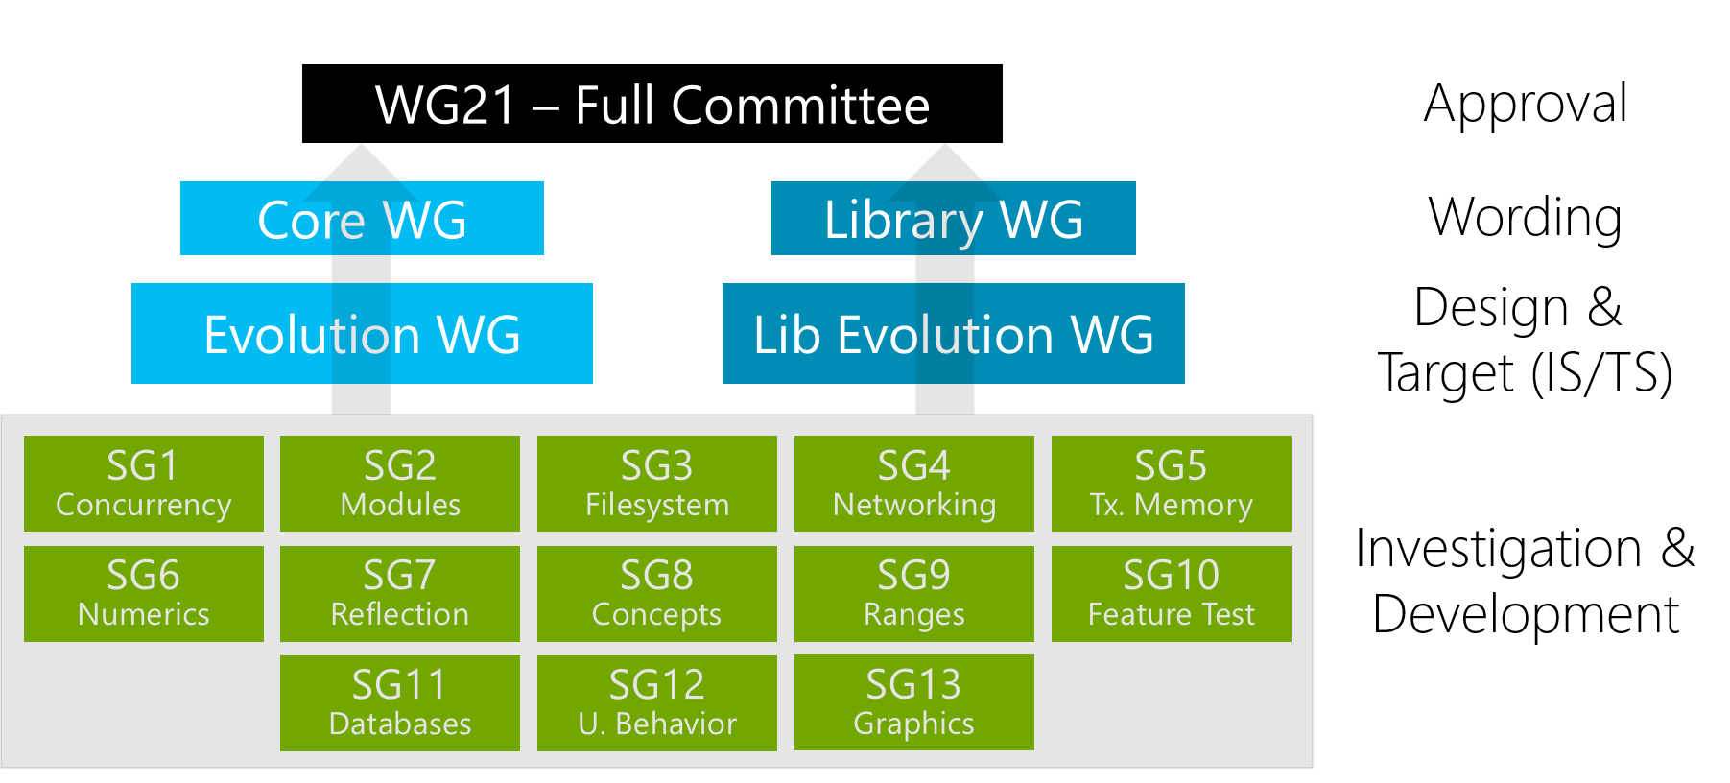
Notes:
http://isocpp.org/std/the-committee
Hans Boehm from HP leads SG1 Concurrency Study Group

Slide 5
…… Before C++11

Slide 6
C++ Standard Progress before C++11
1998 ISO/IEC 14882:1998 C++98
2003 ISO/IEC 14882:2003 C++03, only bug fix for C++98
2007 ISO/IEC TR 19768:2007, TR1, C++ Library Extension
2008 C++0x Committee Draft SC22 Balloting
2010 C++0x Final Committee Draft SC22 Balloting
2011 ISO/IEC 14882:2011 C++11
C++0x

Slide 7
Current C++11

Slide 8
Development Directives for C++11
Maintain stability and compatibility with C++98 and possibly with C
Prefer introduction of new features through the standard library, rather than extending the core language
Prefer changes that can evolve programming technique
Improve C++ to facilitate systems and library design, rather than to introduce new features useful only to specific applications
Increase type safety by providing safer alternatives to earlier unsafe techniques
Increase performance and the ability to work directly with hardware
Provide proper solutions for real-world problems
Implement “zero-overhead” principle (additional support required by some utilities must be used only if the utility is used)
Make C++ easy to teach and to learn without removing any utility needed by expert programmers

Slide 9
C++11 Changes
C++ core language extension
Runtime performance enhancement
Build time performance enhancement
Usability enhancement
Functionality enhancement
C++ Standard Library changes

Slide 10
C++ core language runtime performance enhancement

Slide 11
Rvalue Reference and move semantic
Lvalue and Rvalue
Rvalue in C++03 is undistinguished from const T&
Rvalue in C++11
prvalue (pure rvalue): same as rvalue in C++03
xvalue (eXpiring value): to be moved
Rvalue reference: T&&
“Extend” the life cycle of rvalue
std::move(): lvalue -> rvalue reference
Helper templates
std::is_rvalue_reference<>::value
std::is_lvalue_reference<>::value
std::is_reference<>::value
T a = ReturnRvalue();
T&& a = ReturnRvalue();

Slide 12
Move Semantics
class String{
public:
……
String (String&& rhs) : data_(rhs.data_)
{
rhs.data_ = nullptr;
}
String& operator=(String&& rhs)
{
swap(rhs);
return *this;
}
private:
char* data_;
};
rhs.data_:
data_:
……..

Slide 13
New std::swap() with higher performance
template<class _Ty> inline //Code from Windows STL
void swap(_Ty& _Left, _Ty& _Right)
{ // exchange values stored at _Left and _Right
_Ty _Tmp = _Move(_Left);
_Left = _Move(_Right);
_Right = _Move(_Tmp);
}
type&& ≠ Rvalue Reference
Universal Reference
Notes:
Universal reference proposed by Scott Meyers
http://channel9.msdn.com/Shows/Going+Deep/Cpp-and-Beyond-2012-Scott-Meyers-Universal-References-in-Cpp11

Slide 14
Perfect forwarding
Pass the parameters to the functions called in function template according to the type of parameters
std::forward()
Reference Collapsing
A& & becomes A&
A& && becomes A&
A&& & becomes A&
A&& && becomes A&&
template<typename T, typename Arg> shared_ptr<T> factory(Arg& arg)
{ return shared_ptr<T>(new T(arg)); }
factory<X>(hoo()); // error if hoo returns by value
factory<X>(41); // error
template<typename T, typename Arg> shared_ptr<T> factory(Arg&& arg)
{ return shared_ptr<T>(new T(std::forward<Arg>(arg))); }

Slide 15
Const expression
New keyword: constexpr
Provide optimization opportunity to compiler
compilers frequently execute them at compile time and hardcode the results in the program
int get_five() {return 5;}
int some_value[get_five() + 7]; //error in C++03
constexpr int get_five() {return 5;}
int some_value[get_five() + 7]; //ok in C++11

Slide 16
Const expression (cont)
constexpr function
the function must have a non-void return type
the function body cannot declare variables or define new types
the body may contain only using and typedef declarations, null statements and a single return statement
The return type of constexpr function is not necessary to be const expression
constexpr constructor
function body must be null
Initializer list should use const expession
struct MyType{
constexpr MyType(int x):i(x){}
int i;
}
Constexpr MyType mt = {0}
Notes:
C++11 standard doesn’t specify that compiler must evaluate the constexpr function during compilation. Compiler possibly call the constexpr function at runtime.

Slide 17
Definition of POD
POD of C++03
Scalar type
POD class type
Class, struct, union
No user-defined constructor, desctructor, assignment operator, no inheritance, no virtual function, no non-static data member of any pointer-to-member type, non-POD type, reference, private or protected type
POD of C++11
Trivial POD
Trivial constructor and destructor
Trivial copy and move constructor
Trivial copy and move assignment operator
No virtual function and virtual base class

Slide 18
Definition of POD (cont.)
Standard-layout POD
No virtual function and virtual base class
All non-static data members have the same access control (public, private, protected)
All non-static data members, including any in its base classes, are in the same one class in the hierarchy
The above rules also apply to all the base classes and to all non-static data members in the class hierarchy
It has no base classes of the same type as the first defined non-static data member
A class/struct/union is considered POD if it is trivial, standard-layout, and all of its non-static data members and base classes are PODs.
template<typename T> struct std::is_trivial
template<typename T> struct std::is_standard_layout
template<typename T> struct std::is_pod
Notes:
C++11 standard doesn’t specify that compiler must evaluate the constexpr function during compilation. Compiler possibly call the constexpr function at runtime.

Slide 19
C++ core language build time performance enhancement

Slide 20
Extern template
C++03
A template must be instantiated when a fully specified template is encountered in a translation unit
C++11
Use extern to tell compiler not to instantiate the template
Increase the compiling time and decrease the compiled binary size
extern template class std::vector<MyClass>;

Slide 21
C++ core language usability enhancement

Slide 22
Initializer list
C++03: only POD type can use initializer list.
C++11: initializer list can be used for all classes including standard containers.
std::initializer_list
class SequenceClass {
public:
SequenceClass(std::initializer_list<int> list);
};
SequenceClass some_var = {1, 4, 5, 6};
void function_name(std::initializer_list<float> list);
function_name({1.0f, -3.45f, -0.4f});
std::vector<std::string> v({ "xyzzy", "plugh", "abracadabra" });

Slide 23
Uniform initialization
C++03: several ways to initialize types. Only aggregates and POD types can be initialized with aggregate initializers (using SomeType var = {/*stuff*/};).
C++11: expands on the initializer list syntax and allows for fully uniform type initialization that works on any object.
An initializer list constructor takes priority over other forms of construction
struct BasicStruct { int x; double y; };
struct AltStruct {
AltStruct(int x, double y) : x_{x}, y_{y} {}
private:
int x_; double y_; };
BasicStruct var1{5, 3.2};
AltStruct var2{2, 4.3};

Slide 24
Type inference
C++03: the type of a variable must be explicitly specified in order to use it.
C++11: define auto and decltype for automatic type inference.
auto: type inference during variable initialization.
variable with auto must be initialized.
double foo();
auto x = 5; //x is int
auto y = foo(); // y is double
//auto z;
std::vector<string> vs;
for(auto I = vs.begin; i < vs.end(); i++){…}
unsigned int a = 4294967295; //max value of unsigned int
unsigned int b = 1;
auto c = a + b; //c is unsigned int

Slide 25
Type inference (cont.)
4 cases type can not be deduced by auto
Can not be used for function parameter
Can not be used for non-static member type in struct
Can not be used for array
Can not be used for template parameter
decltype: type inference by expression
vector<int> vec;
typedef decltype(vec.begin()) vectype;
for(vectype iter = vec.begin(); iter < vec.end(); iter++ ){……}
int i;
decltype(i) a; //int
decltype((i)) b; //int&, fail to build

Slide 26
Type inference (cont.)
Rules of decltype type inference decltype(e)
If e is an unparenthesized id-expression or an unparenthesized class member access, decltype(e) is the type of the entity named by e. If there is no such entity, or if e names a set of overloaded functions, the program is ill-formed.
Otherwise, if e is an xvalue, decltype(e) is T&&, where T is the type of e
Otherwise, if e is an lvalue, decltype(e) is T&, where T is the type of e
Otherwise, decltype(e) is the type of e
Trailing return type by auto and decltype: flexible return type for function template
template<class Lhs, class Rhs>
auto adding_func(const Lhs &lhs, const Rhs &rhs) -> decltype(lhs+rhs)
{return lhs + rhs;}
Notes:
Rules of decltype type inference: https://www.ibm.com/developerworks/community/blogs/5894415f-be62-4bc0-81c5-3956e82276f3/entry/c_11_the_decltype_specifier_part_ii?lang=en

Slide 27
Range-based for loop
int my_array[5] = {1, 2, 3, 4, 5};
// double the value of each element in my_array:
for (int &x : my_array) { x *= 2; }
Notes:
Rules of decltype type inference: https://www.ibm.com/developerworks/community/blogs/5894415f-be62-4bc0-81c5-3956e82276f3/entry/c_11_the_decltype_specifier_part_ii?lang=en

Slide 28
Lambda function
λ
Anonymous function of C++ (closure)
Capture variable of enclosing scope
[] Capture nothing
[&] Capture any referenced variable by reference
[=] Capture any referenced variable by making a copy
[=, &foo] Capture any referenced variable by making a copy, but capture variable foo by reference
[bar] Capture bar by making a copy; don't copy anything else
[this] Capture the this pointer of the enclosing class
int childs = 4, boys = 3;
auto getgirls = [] (int x, int y) { return x-y; }
return getgirls(childs, boys);
[capture](parameters) mutable -> return-type {statement}

Slide 29
Lambda function (cont)
Lambda function and functor
Lambda is syntax sugar for functor
Currently compiler implements Lambda by functor
Lambda and STL
Lambda greatly ease the usage of STL algorithms.
Discussion about Lambda
Not completely replace functor: can only capture the variables of enclosing scope
It is local encapsulation and sharing. Still need function or functor for global code sharing.
vector<int> v;
for_each( v.begin(), v.end(), [] (int val)
{ cout << val; } );
Notes:
a line from Herb Sutter, you should get used to seeing "} );" This is the standard end-of-function-taking-lambda syntax, and the more you start seeing and using lambda in your own code, the more you'll see little piece of syntax.
Lambda function is in-place written and use.

Slide 30
Lambda function in C++14
Generalized lambda-capture
Variable in capture list could have initialize expression
Generic lambda
Function parameters can use auto for type declaration
Lambda function with parameter can be converted to function pointer.
int x = 4;
auto y = [&r = x, x = x+1]()->int { r += 2; return x+2; }(); // x to 6, y to 7
auto Identity = [](auto a) { return a; };
int three = Identity(3);
char const* hello = Identity("hello");
auto Identity = [](auto a) { return a; };
int (*fpi)(int) = Identity;
Notes:
a line from Herb Sutter, you should get used to seeing "} );" This is the standard end-of-function-taking-lambda syntax, and the more you start seeing and using lambda in your own code, the more you'll see little piece of syntax.
Lambda function is in-place written and use.

Slide 31
Object construction improvement
Constructor inheritance
Inherited constructor only initialize member variables of base class
Default parameters of inherited constructor causes multiple constructors
Name conflict of inherited constructors from multiple base classes
struct A{
A(int i){}
A(double d, int i){}
A(float f, double d, int i){}
};
struct B: A { //what if B needs the constructors like A in C++03
using A::A;
int d{0}
};

Slide 32
Object construction improvement(cont)
Constructor Delegation
Constructor delegation can’t be used with initialize list
Constructor delegation chain ----avoid delegation circle
class Info{
public:
Info(){Init();}
Info(int i): Info(){……}
Info(char e): Info(){……}
private:
void Init();
};

Slide 33
Explicit override and final
override and final are not language keywords, only gain special meaning in specific contexts
In other locations, they are still valid identifiers for new declarations
struct Base { virtual void some_func(float); };
struct Derived : Base { virtual void some_func(int) override;}; // Error
struct Base1 final { };
struct Derived1 : Base1 { }; //Error
struct Base2 { virtual void f() final; };
struct Derived2 : Base2 { void f(); }; // Error
Notes:
the recognized and accepted declarator attributes may be extended in future versions of C++

Slide 34
Null pointer constant
C++98 uses 0 as null pointer constant
foo(0) calls foo(int) or foo(char*)?
C++11: nullptr -> type: nullptr_t
enum class or enum struct
Their values can’t be implicitly converted to integers and compared with integer
>> in C++98 is right shift operator and is apt to cause syntax error for nested template declaration
C++11 improves it and multiple right angle brackets will be interpreted as closing the template argument list where it is reasonable.
Strongly typed enumeration
Right angle bracket >>
Notes:
the recognized and accepted declarator attributes may be extended in future versions of C++

Slide 35
Explicit conversion operators
Similar to explict in C++98 for constructor and avoid unintended conversion
Alias templates
template <typename First, typename Second, int Third> class SomeType; template <typename Second> using TypedefName = SomeType<OtherType, Second, 5>; #Error in C++03 even with typedef
typedef void (*FunctionType)(double); // Old style using FunctionType = void (*)(double); // New introduced syntax
Notes:
the recognized and accepted declarator attributes may be extended in future versions of C++

Slide 36
Unrestricted unions
C++11 relaxes some restrictions of union in C++03
struct Point {
Point() {}
Point(int x, int y): x_(x), y_(y) {}
int x_, y_; };
union U {
double w;
Point p; // Illegal in C++03; legal in C++11.
U() {new(&p) Point();} // Due to the Point member, a constructor definition is now required. };
Notes:
the recognized and accepted declarator attributes may be extended in future versions of C++

Slide 37
C++ core language functionality enhancement

Slide 38
Variadic templates
template<typename... Values> class tuple;
class tuple<int, std::vector<int>, std::map<std::string, std::vector<int>>> someInstanceName;;
class tuple<> someInstanceName; // no template parameter
template<typename First, typename... Rest> class tuple; //parameter number > 1
//type-safe printf() version in C++11
template<typename... Params> void printf(const std::string &strFormat, Params... parameters);

Slide 39
New string literals
C++11 add char16_t and char32_t for UTF-16 and UTF-32
u8"I'm a UTF-8 string.“ //const char[]
u"This is a UTF-16 string." //const char16_t[]
U"This is a UTF-32 string.“ //const char32_t[]
u"This is a bigger Unicode Character: \u2018.“
R"(The String Data \ Stuff " ) “ //avoid character escape
R"foo( (Hello World) )foo" //equal to (Hello World)
UR"(This is a "raw UTF-32" string.)"

Slide 40
User defined literals
OutputType operator "" _suffix(const char * literal_string);
OutputType some_variable = 1234_suffix;
inline constexpr long double operator"" _deg ( long double deg )
{ return deg*3.141592/180; }
double x = 90.0_deg; // x = 1.570796
void operator"" _print ( const char* str )
{ std::out << str; }
0x123ABC_print;//outputs '0x123ABC'

Slide 41
Multithreading memory model
A memory model which allows multiple threads to co-exist in a program
A memory model describes the interactions of threads through memory and their shared use of the data.
A memory model allows a compiler to perform many important optimizations.
The Java Memory Model was the first attempt to provide a comprehensive threading memory model for a popular programming language.
Most research in the area of memory models revolves around:
Designing a memory model that allows a maximal degree of freedom for compiler optimizations while still giving sufficient guarantees about race-free and (perhaps more importantly) race-containing programs.
Proving program optimizations that are correct with respect to such a memory model.
Library support for interaction between threads
Notes:
Memory model semantics have been standardized in C and C++ since the following revisions the languages C++11 and C11.

Slide 42
Atomic Type and Operation
Atomic type: Objects of atomic types are the only C++ objects that are free from data races
Atomic Operation:
manipulate memory in a way that appears indivisible: No thread can observe the operation half-complete
std:: atomic<T> t;
load store exchange compare_exchange_weak compare_exchange_strong
fetch_add fetch_sub fetch_or fetch_and fetch_xor
std::atomic::load( memory_order = std::memory_order_seq_cst )
Notes:
Memory model semantics have been standardized in C and C++ since the following revisions the languages C++11 and C11.

Slide 43
Memory order
Define how the regular memory accesses are ordered
Acquire and Release Semantic:
Read-Acquire
Write-Release
enum memory_order { memory_order_relaxed, memory_order_consume, memory_order_acquire, memory_order_release, memory_order_acq_rel, memory_order_seq_cst
};
Notes:
Memory model semantics have been standardized in C and C++ since the following revisions the languages C++11 and C11.

Slide 44
Sequential Consistency and Memory reordering
Sequential Consistency
all threads agree on the order in which memory operations occurred, and that order is consistent with the order of operations in the program source code.
Memory reordering
Changes to memory ordering are made both by the compiler (at compile time) and by the processor (at run time), all in the name of making your code run faster.
Cardinal rule: Thou shalt not modify the behavior of a single-threaded program
Notes:
Memory model semantics have been standardized in C and C++ since the following revisions the languages C++11 and C11.

Slide 45
Thread Local Storage
int thread_local t;
It is guaranteed to be at least as large as a long int, and have no fewer than 64 bits. The type was originally introduced by C99.
C++11 introduces static_assert to test assertions at compiling time and template.
Type long long int
static assertions
static_assert((pi > 3.14) && (pi < 3.15), “pi is inaccurate!");
template<class T> struct Check {
static_assert(sizeof(int) <= sizeof(T), "T is not big enough!"); };
Notes:
Memory model semantics have been standardized in C and C++ since the following revisions the languages C++11 and C11.

Slide 46
Explicitly defaulted and deleted member functions
struct NonCopyable {
NonCopyable() = default;
NonCopyable(const NonCopyable&) = delete;
NonCopyable & operator=(const NonCopyable&) = delete;
};
struct OnlyDouble {
void f(double d);
template<class T> void f(T) = delete; //can’t call this method
};

Slide 47
sizeof works on members of classes without an explicit object
alignof and alignas
Before C++11, compiler uses #pragma directive or vendor-specific keywords(like __attribute__ for GNU and __declspec for Microsoft) to define extended attributes.
C++11 provides a standardized syntax for compiler/tool extensions to the language.
Predefined attributes: [[noreturn]] and [[carries_dependency]]
struct SomeType { OtherType member; };
sizeof(SomeType::member); // Does not work with C++03. Ok with C++11
Object alignment
Attributes
int [[attr1]] i [[attr2, attr3]];
Notes:
Memory model semantics have been standardized in C and C++ since the following revisions the languages C++11 and C11.

Slide 48
noexcept
For exception specification
noexcept operator:
performs a compile-time check that returns true if an expression is declared to not throw any exceptions.
void bar() noexcept(true) {}
void baz() noexcept { throw 42; } // noexcept is the same as noexcept(true); at runtime this calls std::terminate
template <class T> void self_assign(T& t) noexcept(noexcept(t = t)) {
// self_assign is noexcept if and only if T::operator= is noexcept
t = t;
}
template <class T> void foo() noexcept(noexcept(T())) {}

Slide 49
Minimal GC support
GC proposal for C++ is by Hans Boehm from HP and Spertus from Symantec
Safely derived pointer:
point to the object allocated by new
the result of taking the address of a subobject of an lvalue resulting from dereferencing a safely-derived pointer value
the result of well-defined pointer arithmetic using a safely-derived pointer value
the result of a well-defined pointer conversion of a safely-derived pointer value
the result of a reinterpret_cast of a safely-derived pointer value
the result of a reinterpret_cast of an integer representation of a safely-derived pointer value
Basic API for GC
void declare_reachable(void *);
template <class T> T* undeclare_reachable(T* p) noexcept;
void declare_no_pointers(char *p, size_t n) noexcept;
void undeclare_no_pointers(char *p, size_t n) noexcept;

Slide 50
No garbage collection needed – B.S
For general, simple, implicit, and efficient resource management
Apply these techniques in order:
Store data in containers
The semantics of the fundamental abstraction is reflected in the interface
Including lifetime
Manage all resources with resource handles
RAII
Not just memory: all resources
Use “smart pointers”
They are still pointers
Plug in a garbage collector
For “litter collection”
C++11 specifies an interface
Can still leak non-memory resources

Slide 51
C++ Standard Library Changes

Slide 52
Upgrades to STL components
Threading support: std::thread, std::mutex, std::condition_variable, future, promise, std:async
Tuple: template <class ...Types> class tuple;
Hash tables: unordered_set unordered_map
Regular expression: std::regex std::match_results
Smart pointer: std::unique_ptr std::shared_ptr std::weak_ptr
Random number facility: a generator engine and a distribution.
Wrapper reference: std:ref.
Polymorphic wrappers for function objects: std::function<>
Type traits for metaprogramming: <type_traits> header
Uniform method for computing the return type of function objects: std::result_of

Slide 53
Deprecated features in C++

Slide 54
The meaning of auto keyword is changed
The meaning of register keyword is changed
The use of export keyword is removed, but reserve for potential future use
The term sequence point is removed
The behavior of generating default copy constructor and copy assignment operator is changed
auto_ptr is replaced by unique_ptr
Function object base classes (std::unary_function, std::binary_function), adapters to pointers to functions and adapters to pointers to members, and binder classes are all deprecated.
Dynamic exception specifications are deprecated.

Slide 55
Compiler supporting C++11

Slide 56
Clang 3.3: first compiler supporting full C++11
GCC 4.8: support most of the C++11 features
VS 2013: less C++11 features supporting than Clang and GCC
Notes:
http://clang.llvm.org/cxx_status.html
http://gcc.gnu.org/projects/cxx0x.html
http://msdn.microsoft.com/en-us/library/vstudio/hh567368.aspx

Slide 57
After C++11……

Slide 58
C++ Standard meeting Feb 2012
The first meeting since the ratification of C++11
No new Standard before 2017, with a 2022 follow-on standard, every five years
Discuss public Open Source Library – Portable C++ Library
Processes over 120 defects
Discuss advanced abstractions of concurrency
Discuss potential features for future standard: transactional memory, rich pointer, concepts, static_if, module

Slide 59
C++ Standard meeting Oct 2012
C++ is technically 27 years old
C++14 is proposed to address C++11 annoyances and a bug fix release
Pick up some drafts dropped in C++11 due to time constraint
6 study groups: concurrency, modules, file system, networking, transactional memory, numeric
Discuss various features for C++14
C++ Standard meeting April 2013

Slide 60
C++14
C++14 Committee Draft (CD) published at isocpp.org in May, 2013
National Body (NB) Balloting at SC22 level: 3 months
Many issues are solved at C++ Standard Meeting, Chigago in Sept. 2013
Draft International Standard (DIS) balloting at the JTC level: 5 months
Valid International Standard (IS) balloting at the JTC level: 2 months
A ratified C++14 will be released summer 2014, likely at the Rapperswill, Switzerland meeting
If any of the step fails because some NB comment could not be addressed, then a second CD may need to be issued, which would push the process back, likely until end of 2014, or even past it.
Notes:
http://meetingcpp.com/index.php/br/items/isocpp-papers-for-chicago-part-1-concurrency.html
http://meetingcpp.com/index.php/br/items/c-papers-for-chicago-part-2-core-concepts-evolution.html
http://meetingcpp.com/index.php/br/items/c-papers-for-chicago-part-3-library.html
http://www.meetingcpp.com/index.php/br/items/c-papers-for-chicago-part-4-library-network-reflection-and-c14.html

Slide 61
What new features in C++14?
Binary literals
decltype(auto)
Return type deduction for normal functions
Initialized lambda captures
Generic lambdas
Variable templates
Relaxing requirements on constexpr functions
Member initializers and aggregates
Shared mutexes and locking
Heterogeneous lookup in associative containers
Standard user-defined literals
Runtime-sized fixed length array container
Tuple addressing via type

Slide 62
C++14
Clang is (draft) C++14 feature-complete at Nov. 7 2013
It appears that the next release of Clang and LLVM, expected in December or January, will be draft C++14 feature-complete.

Slide 63
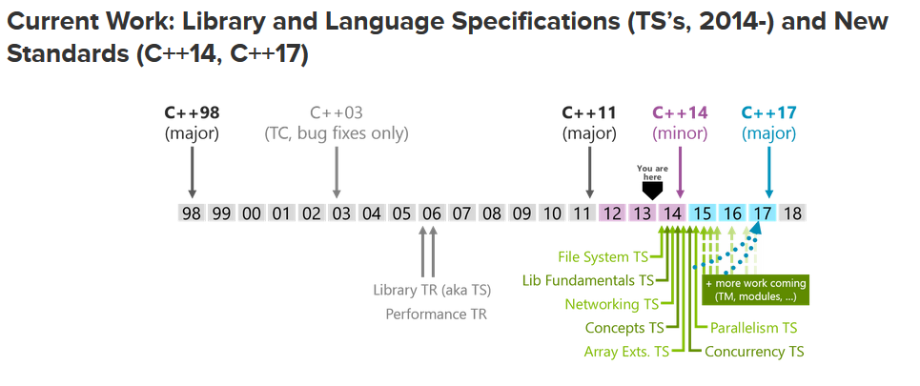

Slide 64
What does C++ offer? – B.S
C++ offers:
Map to hardware
Classes
Inheritance
Parameterized types
If you understand int and vector, you understand C++
Notes:
Borrow from B. S’s talk: The essence of C++

Slide 65
New Edition of Classic C++ Books
The C++ Programming Language, 4th Edition, Bjarne Stroustrup
C++ Primer, 5th Edition, Stanley B. Lippman, Josée Lajoie, Barbara E. Moo
The C++ Standard Library - A Tutorial and Reference, 2nd Edition, Nicolai M. Josuttis

Slide 66
Thank you

