Slide 1
C++11 and ……
Liu Peng

Slide 2
Agenda
Pre C++11
C++11
Post C++11

Slide 3
ISO/IEC/JTC1/SC22/WG21
International Organization
for Standardization
The C++ Standards Committee
Working Group 21
International Electrotechnical Commission
International standardization subcommittee for programming languages, their environments and system software interfaces
SubCommittee22
Joint Technical Committee

Slide 4
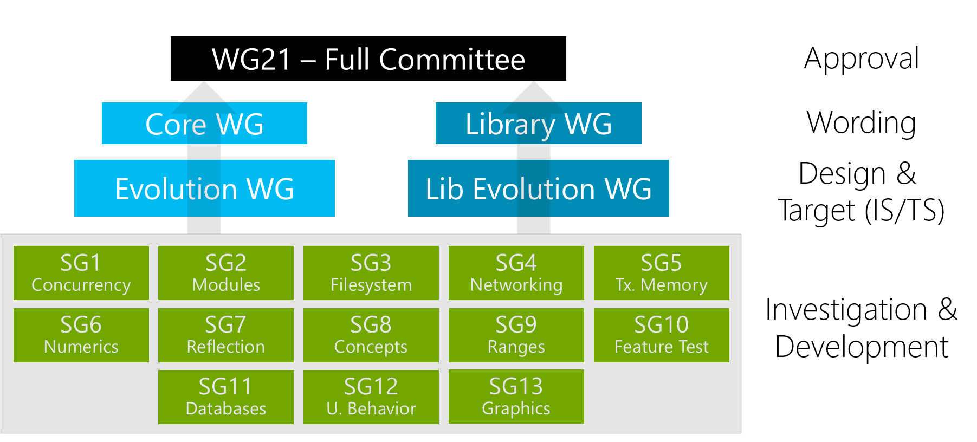
Notes:
http://isocpp.org/std/the-committee
Hans Boehm from HP leads SG1 Concurrency Study Group

Slide 5
…… Before C++11

Slide 6
C++ Standard Progress before C++11
1998 ISO/IEC 14882:1998 C++98
2003 ISO/IEC 14882:2003 C++03, only bug fix for C++98
2007 ISO/IEC TR 19768:2007, TR1, C++ Library Extension
2008 C++0x Committee Draft SC22 Balloting
2010 C++0x Final Committee Draft SC22 Balloting
2011 ISO/IEC 14882:2011 C++11
C++0x

Slide 7
Current C++11

Slide 8
After C++11……

Slide 9
C++ Standard meeting Feb 2012
The first meeting since the ratification of C++11
No new Standard before 2017, with a 2022 follow-on standard, every five years
Discuss public Open Source Library – Portable C++ Library
Processes over 120 defects, discuss some issues
Potential features for future standard
Advanced abstractions of concurrency

Slide 10
C++ Standard meeting Oct 2012
C++ is technically 27 years old
C++14 is proposed to address C++11 annoyances and a bug fix release
Pick up some drafts dropped in C++11 due to time constraint
Processes over 120 defects, discuss some issues
Potential features for future standard
Advanced abstractions of concurrency
Notes:
C++ is 27 years old, if you count it as the day that Stroustrup’s original C++ book was published on Oct 14, 1985 based on this picture.

Slide 11
C++14
C++14 Committee Draft (CD) published at isocpp.org in May, 2013
National Body (NB) Balloting at SC22 level: 3 months
Many issues are solved at C++ Standard Meeting, Chigago in Sept. 2013
Draft International Standard (DIS) balloting at the JTC level: 5 months
Valid International Standard (IS) balloting at the JTC level: 2 months
A ratified C++14 will be released summer 2014, likely at the Rapperswill, Switzerland meeting
If any of the step fails because some NB comment could not be addressed, then a second CD may need to be issued, which would push the process back, likely until end of 2014, or even past it.

Slide 12
C++14
Clang is (draft) C++14 feature-complete at Nov. 7 2013
It appears that the next release of Clang and LLVM, expected in December or January, will be draft C++14 feature-complete.

Slide 13
What will C++14 look like?
Clang is (draft) C++14 feature-complete at Nov. 7 2013
It appears that the next release of Clang and LLVM, expected in December or January, will be draft C++14 feature-complete.

Slide 14
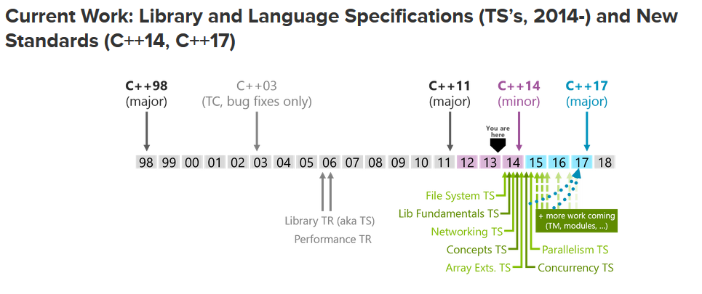

Slide 15
Title (28 pt. HP Simplified bold)
Subtitle (18 pt. HP Simplified)
Put your first-level bullet here. Try to keep bullet lists simple. (14 pt. HP Simplified)
Put your second-level bullet here. Use no more than you need to explain your point. (14 pt. HP Simplified)
Put your third-level of copy here. Use no more than you need to explain your point. (14 pt. HP Simplified)
Put your fourth-level of copy here. Use no more than you need to explain your point. (14 pt. HP Simplified)
Put your fifth-level of copy here. Use no more than you need to explain your point. (14 pt. HP Simplified)

Slide 16
Title (28 pt. HP Simplified bold)
Subtitle (18 pt. HP Simplified)
Heading (18 pt. HP Simplified bold HP blue)
Body copy (16 pt. HP Simplified)
Put your first-level bullet here. (14 pt. HP Simplified)
Put your second-level bullet here. (14 pt. HP Simplified)
Put your third-level of copy here. (14 pt. HP Simplified)
Heading (18 pt. HP Simplified bold HP blue)
Body copy (16 pt. HP Simplified)
Put your first-level bullet here. (14 pt. HP Simplified)
Put your second-level bullet here. (14 pt. HP Simplified)
Put your third-level of copy here. (14 pt. HP Simplified)

Slide 17
Title (28 pt. HP Simplified bold)
Heading (18 pt. HP Simplified bold HP blue)
Body copy (16 pt. HP Simplified)
Put your first-level bullet here. (14 pt. HP Simplified)
Put your second-level bullet here. (14 pt. HP Simplified)
Put your third-level of copy here. (14 pt. HP Simplified)
Heading (18 pt. HP Simplified bold HP blue)
Body copy (16 pt. HP Simplified)
Put your first-level bullet here. (14 pt. HP Simplified)
Put your second-level bullet here. (14 pt. HP Simplified)
Put your third-level of copy here. (14 pt. HP Simplified)

Slide 18
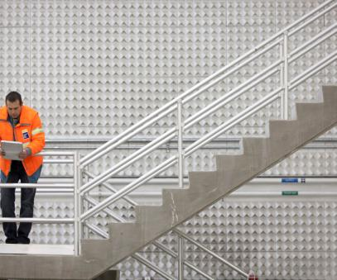
Title (28 pt. HP Simplified bold)
Subtitle (18 pt. HP Simplified)
Heading (18 pt. HP Simplified bold HP blue)
Body copy (16 pt. HP Simplified)
Put your first-level bullet here. (14 pt. HP Simplified)
Put your second-level bullet here. (14 pt. HP Simplified)
Put your third-level of copy here. (14 pt. HP Simplified)

Slide 19

Title (28 pt. HP Simplified bold)
Heading (18 pt. HP Simplified bold HP blue)
Body copy (16 pt. HP Simplified)
Put your first-level bullet here. (14 pt. HP Simplified)
Put your second-level bullet here. (14 pt. HP Simplified)
Put your third-level of copy here. (14 pt. HP Simplified)

Slide 20
Title (28 pt. HP Simplified bold)
Subtitle (18 pt. HP Simplified)
Heading (18 pt. HP Simplified bold HP blue)
Body copy (16 pt. HP Simplified)
14 pt. HP Simplified
14 pt. HP Simplified
14 pt. HP Simplified
Heading (18 pt. HP Simplified bold HP blue)
Body copy (16 pt. HP Simplified)
14 pt. HP Simplified
14 pt. HP Simplified
14 pt. HP Simplified
Heading (18 pt. HP Simplified bold HP blue)
Body copy (16 pt. HP Simplified)
14 pt. HP Simplified
14 pt. HP Simplified
14 pt. HP Simplified

Slide 21
Title (28 pt. HP Simplified bold)
Heading (18 pt. HP Simplified bold HP blue)
Body copy (16 pt. HP Simplified)
14 pt. HP Simplified
14 pt. HP Simplified
14 pt. HP Simplified
Heading (18 pt. HP Simplified bold HP blue)
Body copy (16 pt. HP Simplified)
14 pt. HP Simplified
14 pt. HP Simplified
14 pt. HP Simplified
Heading (18 pt. HP Simplified bold HP blue)
Body copy (16 pt. HP Simplified)
14 pt. HP Simplified
14 pt. HP Simplified
14 pt. HP Simplified

Slide 22
Table style
Columns and rows may be added, but colors must be maintained.
 | Heading | Heading | Heading | Heading
12 pt. HP Simplified | Content | Content | Content | Content
Content | Content | Content | Content | Content
Content | Content | Content | Content | Content
Content | Content | Content | Content | Content
12 pt. HP Simplified bold HP blue | Content | Content | Content | Content
Content | Content | Content | Content | Content

Slide 23
Organization chart style (condensed)
Boxes size and quantity may vary, but colors must be maintained.
Insert Name Title goes here (12 pt. HP Simplified)
This level is all the same color
11 pt. HP Simplified
This level is all the same color
11 pt. HP Simplified
This level is all the same color
Insert Name Title Goes Here
Insert Name Title Goes Here
Insert Name Title Goes Here
11 pt. HP Simplified
Insert Name Title Goes Here
Insert Name Title Goes Here
11 pt. HP Simplified
Insert Name Title Goes Here
11 pt. HP Simplified
Insert Name Title Goes Here
Insert Name Title Goes Here
11 pt. HP Simplified
Insert Name Title Goes Here
11 pt. HP Simplified
Insert Name Title Goes Here

Slide 24
Organization chart style (expanded)
Boxes size and quantity may vary, but colors must be maintained.
Insert Name Title goes here (12 pt. HP Simplified)
This level is all the same color
11 pt.
HP Simplified
This level is all the same color
This level is all the same color
11 pt.
HP Simplified
This level is all the same color
Insert name
Title here
11 pt.
HP Simplified
Insert name
Title here
Insert name
Title here
11 pt.
HP Simplified
Insert name
Title here
Insert name
Title here
11 pt.
HP Simplified
Insert name
Title here
Insert name
Title here
11 pt.
HP Simplified
Insert name
Title here
Insert name
Title here
11 pt.
HP Simplified
Insert name
Title here
Insert name
Title here
11 pt.
HP Simplified
Insert name
Title here
Insert name
Title here
11 pt.
HP Simplified
Insert name
Title here
Insert name
Title here
11 pt.
HP Simplified
Insert name
Title here
Insert name
Title here
11 pt.
HP Simplified
Insert name
Title here
Insert name
Title here
11 pt.
HP Simplified
Insert name
Title here

Slide 25
Flow chart style
Boxes size and quantity may vary, but colors must be maintained.
12 pt. bold
HP Simplified
12 pt. bold
HP Simplified
12 pt. bold
HP Simplified
12 pt. bold
HP Simplified
12 pt. bold
HP Simplified
A percentage of or solid black may be used
11 pt. HP Simplified
A percentage of or solid black may be used
11 pt. HP Simplified
A percentage of or solid black may be used
11 pt. HP Simplified
A percentage of or solid black may be used
11 pt. HP Simplified
A percentage of or solid black may be used
11 pt. HP Simplified

Slide 26
Chart style with bulleted copy
Boxes size and quantity may vary, but colors must be maintained.
Attend these sessions
12 pt. HP Simplified bold
After the event
Demo name, Demo number
11 pt. HP Simplified
Demo name, Demo number
Demo name, Demo number
11 pt. HP Simplified
Demo name, Demo number
Contact your sales rep
Visit the website / Facebook /Twitter at: <insert URL here>
Download the whitepaper at: <insert URL here>
Your feedback is important to us. Please take a few minutes to complete the session survey.

Slide 27
Pie chart sample
Segments may vary, but the only color can be HP blue and the permitted values of black.
Accent color is limited to HP blue.
Black and percentages of black may be used.
All other copy is black.
Bullets are 14 pt. HP Simplified.
Pie segment percentages are 14 pt. HP Simplified.
Pie legend is 14 pt. HP Simplified.

Slide 28
Bar chart sample
Entries may vary, but the only color can be HP blue and the permitted values of black.

Slide 29
New Edition of Classic C++ Books
The C++ Programming Language, 4th Edition, Bjarne Stroustrup
C++ Primer, 5th Edition, Stanley B. Lippman, Josée Lajoie, Barbara E. Moo
The C++ Standard Library - A Tutorial and Reference, 2nd Edition, Nicolai M. Josuttis

Slide 30
Thank you

