Slide 1
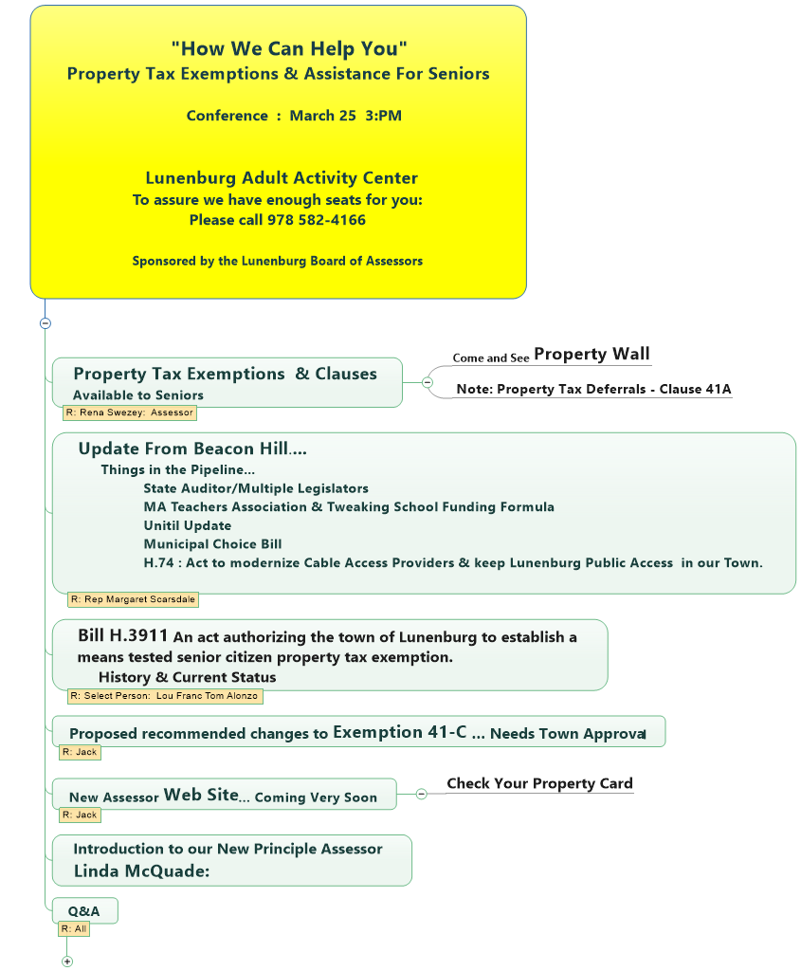

Fact: More then 9 million Americans likely qualify for property tax relief, but only 8% apply for it. Your AARP: March 2023
Fact: 8.3% of All Lunenburg Residents Live below the Poverty Line. A total 263 or 26.7% of these people are Seniors 65 & older.
American Community Survey : Fed Census 2022
Join Zoom Meeting https://us02web.zoom.us/j/7927370353?omn=89833530788 Meeting ID: 792 737 0353

Slide 2
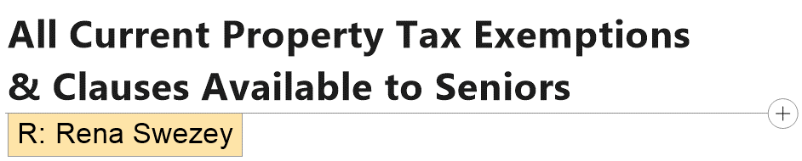
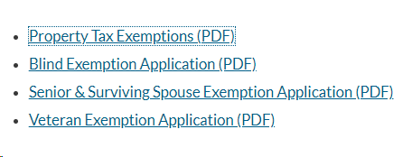
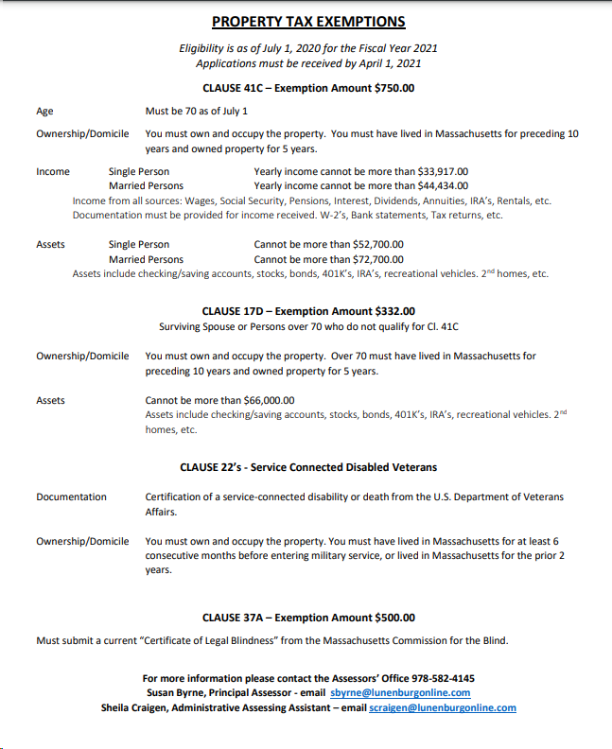
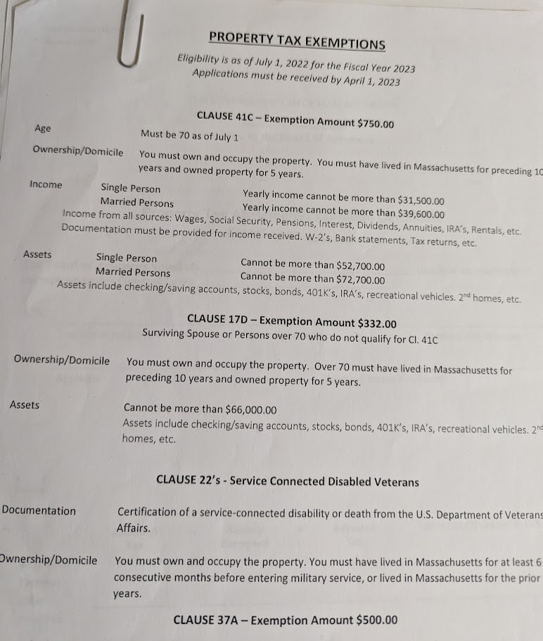
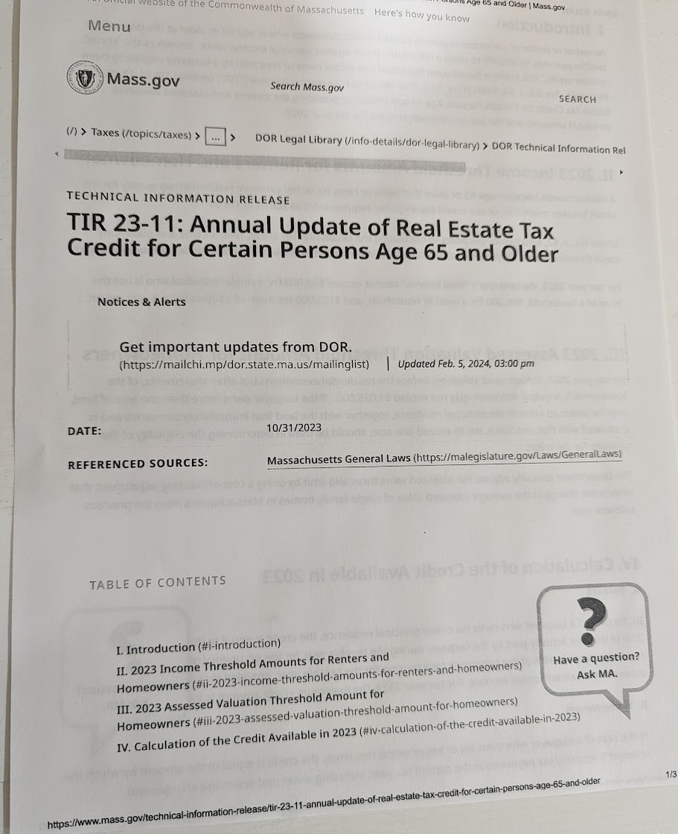
Exemptions

Slide 3
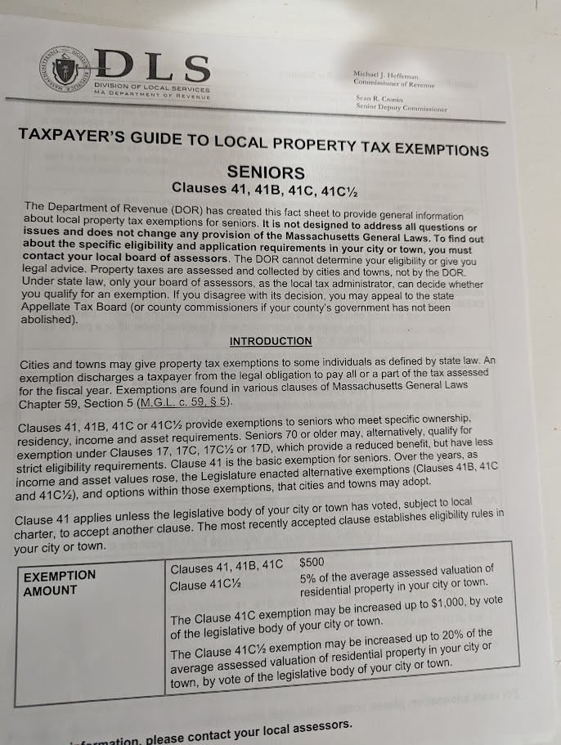
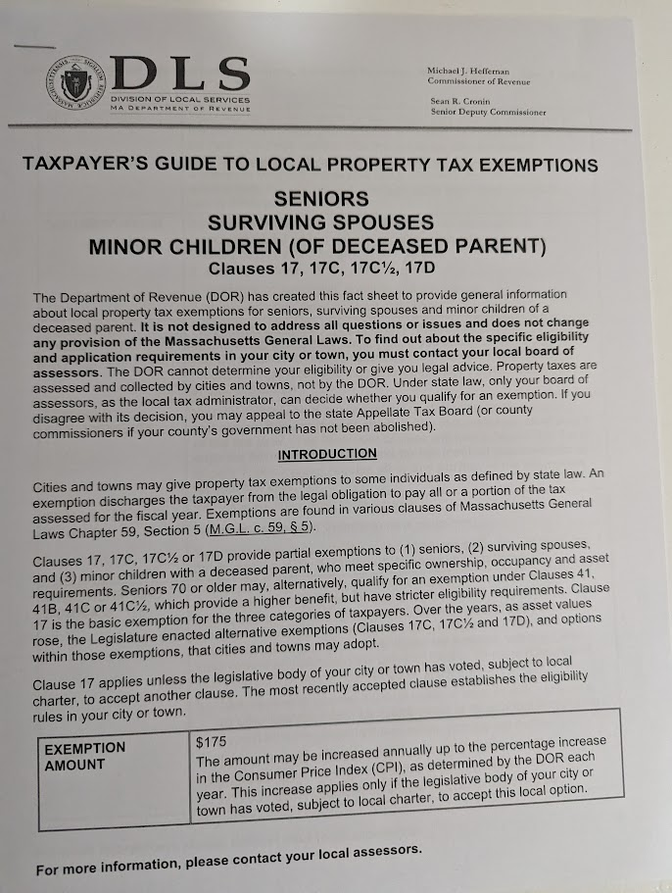
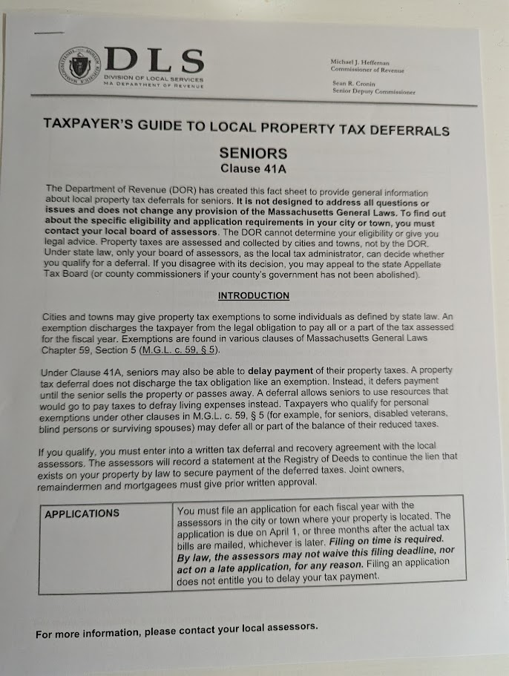
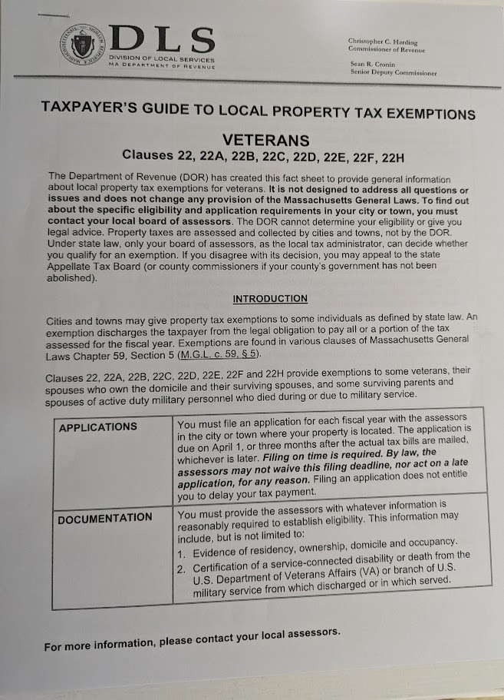
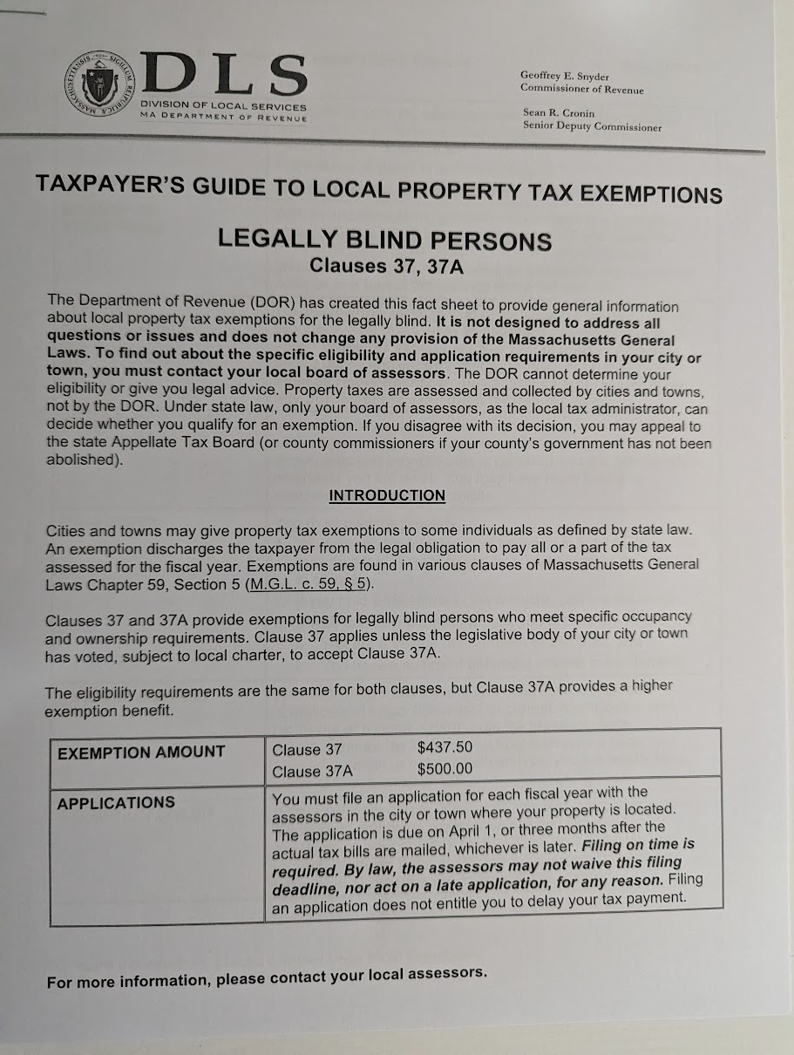
Exemptions

Slide 4
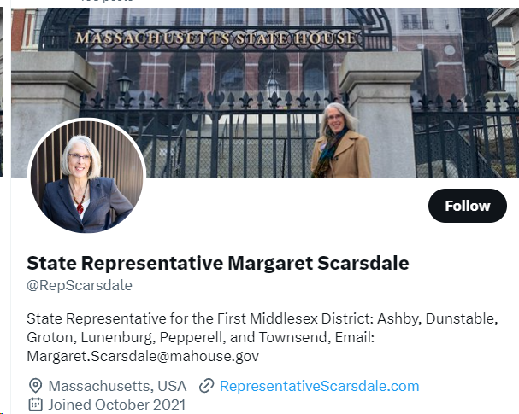
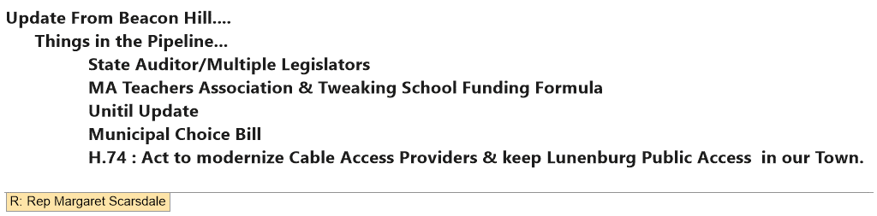

Slide 5
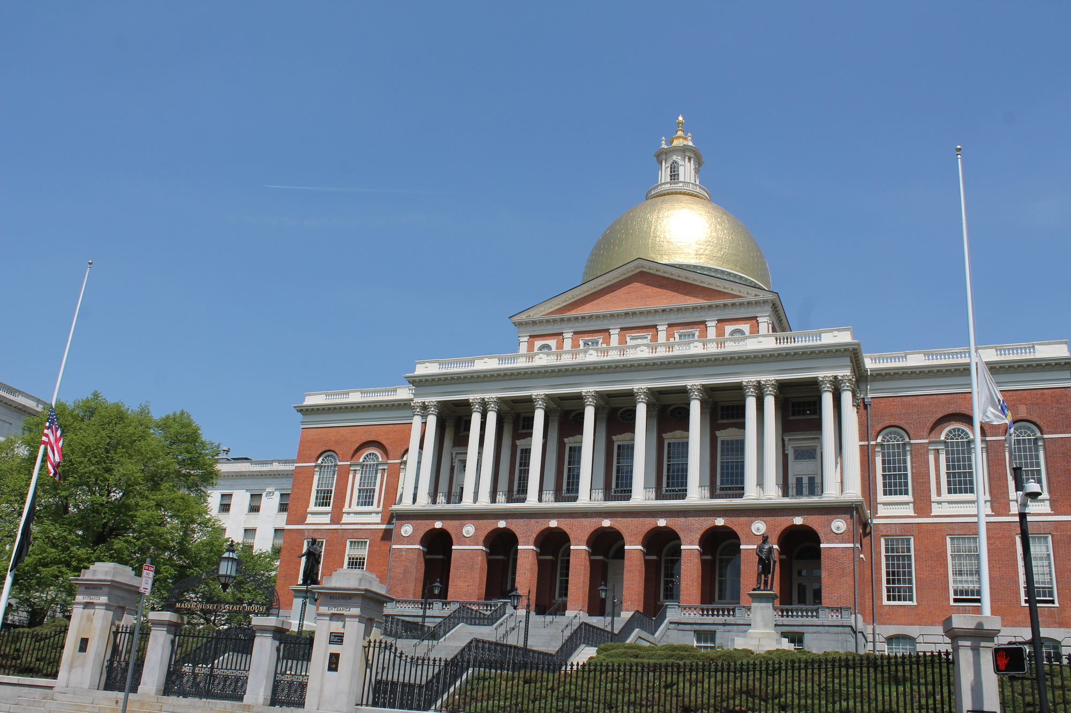
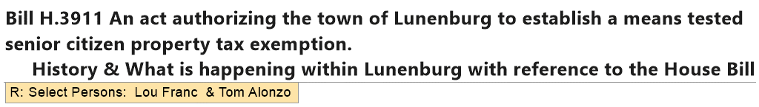
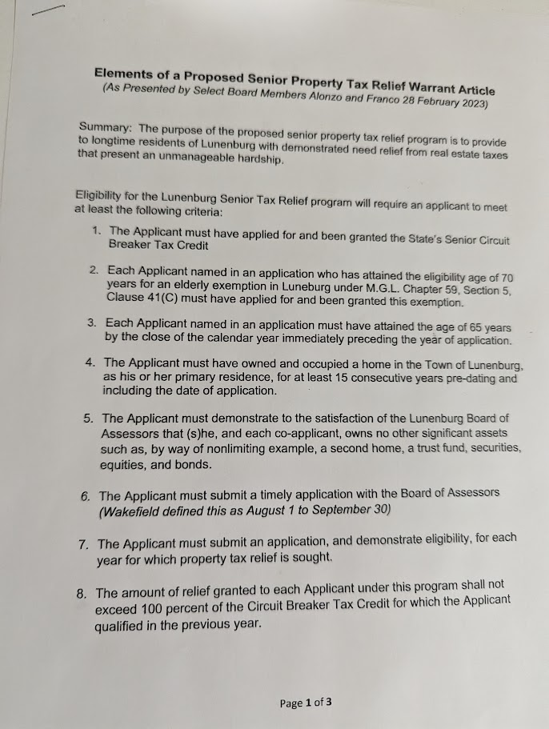
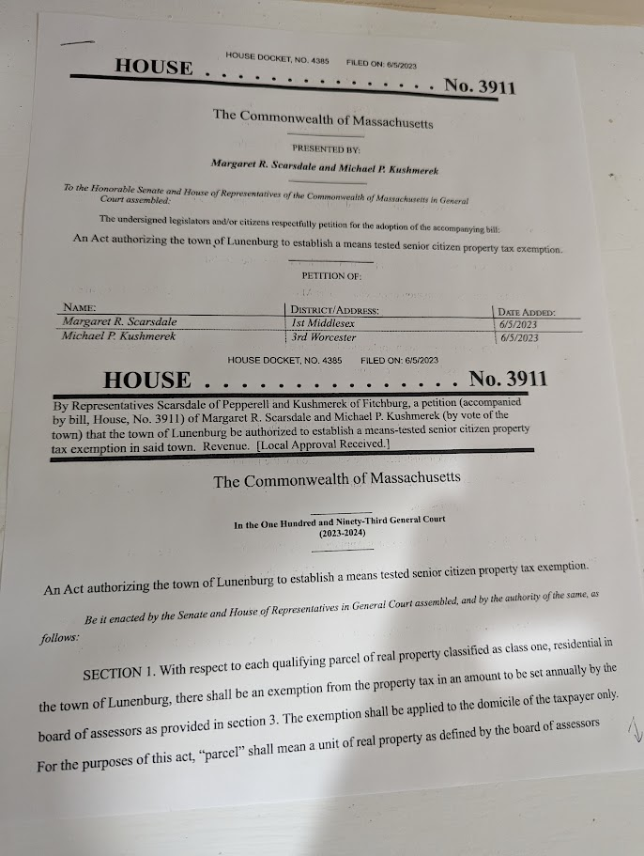
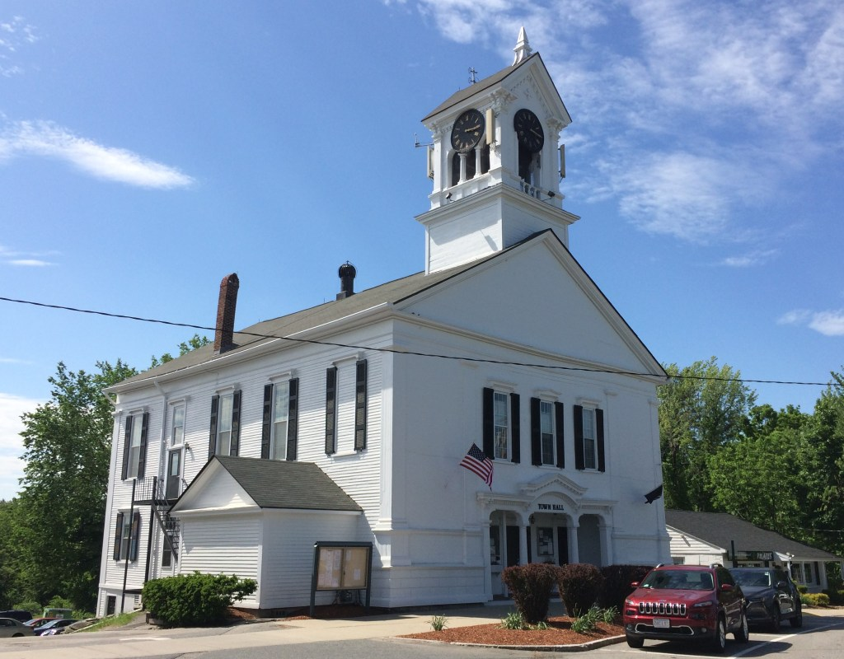
Awaiting State House Approval Means-Tested Senior Tax Relief

Slide 6


Slide 7
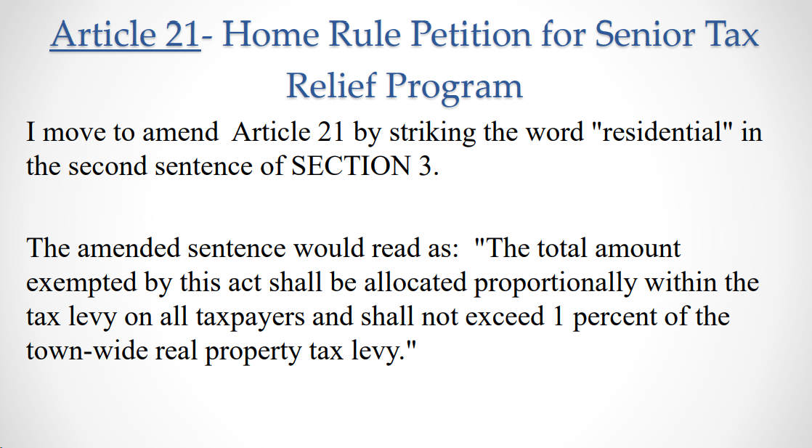

Slide 8
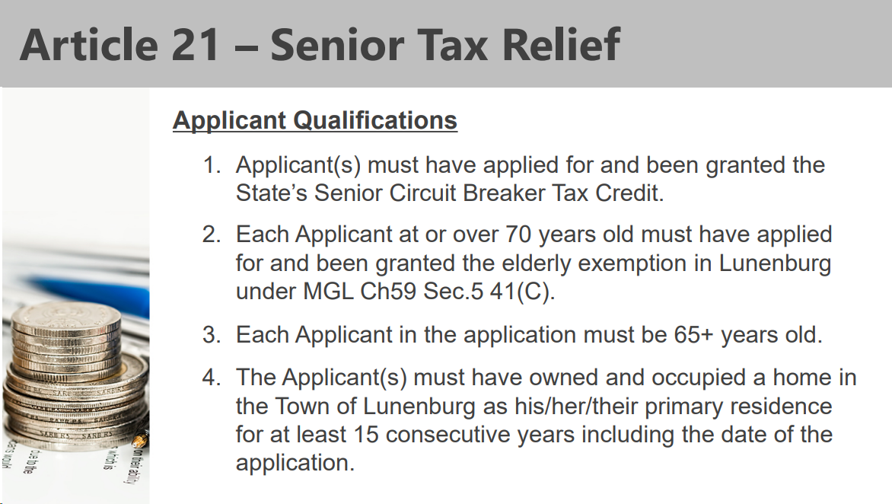

Slide 9
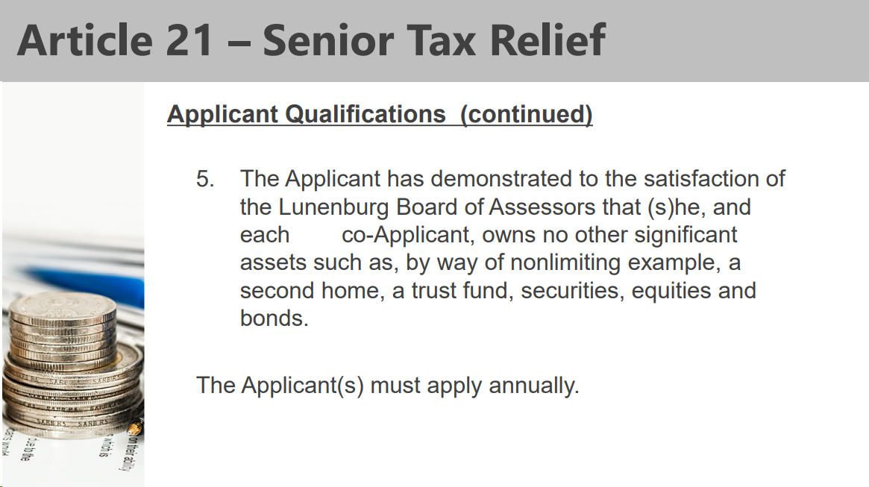

Slide 10
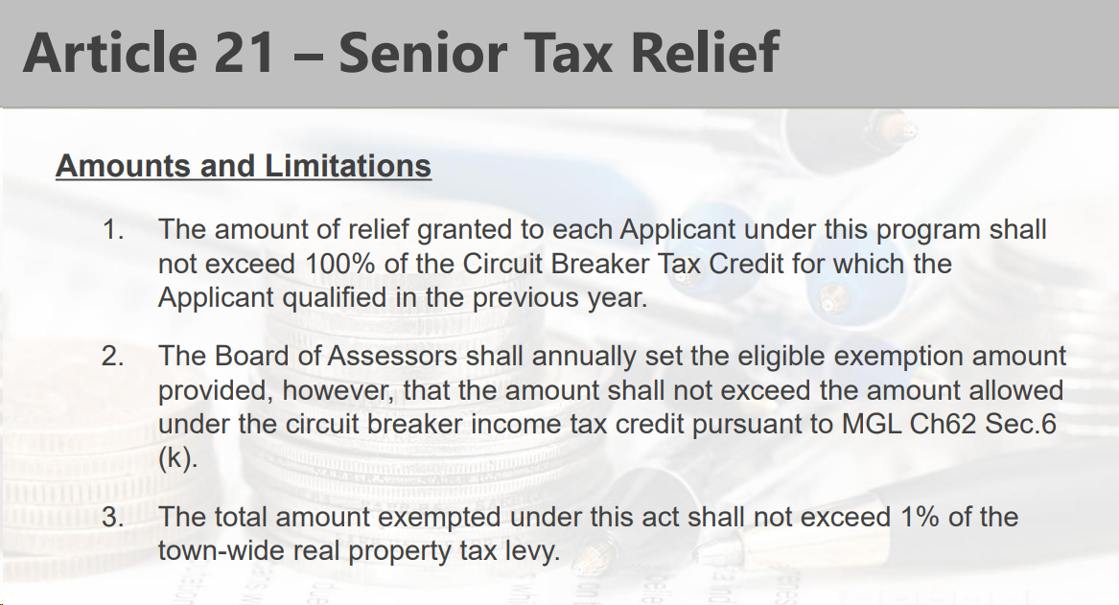

Slide 11
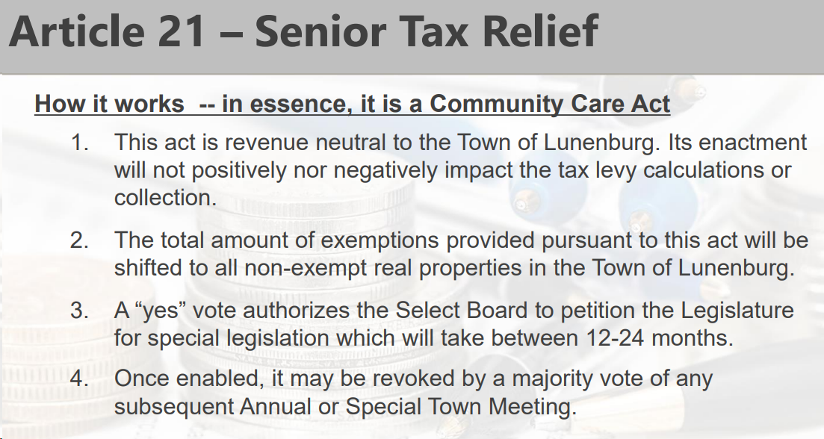

Slide 12
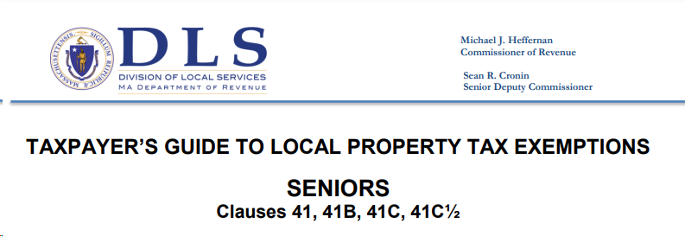
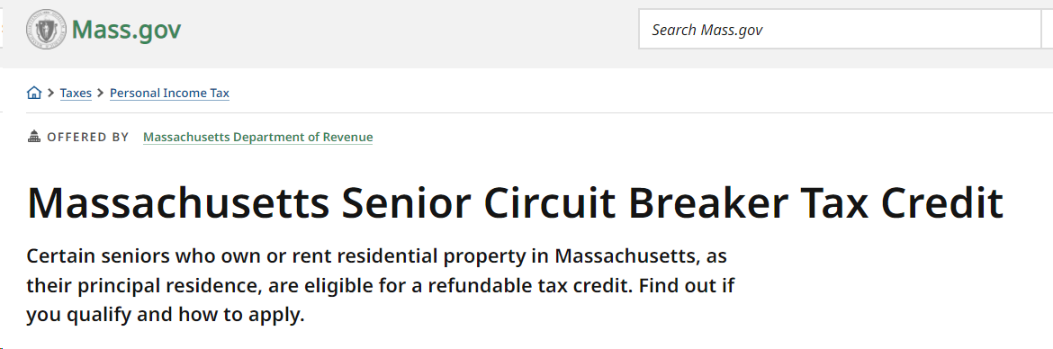
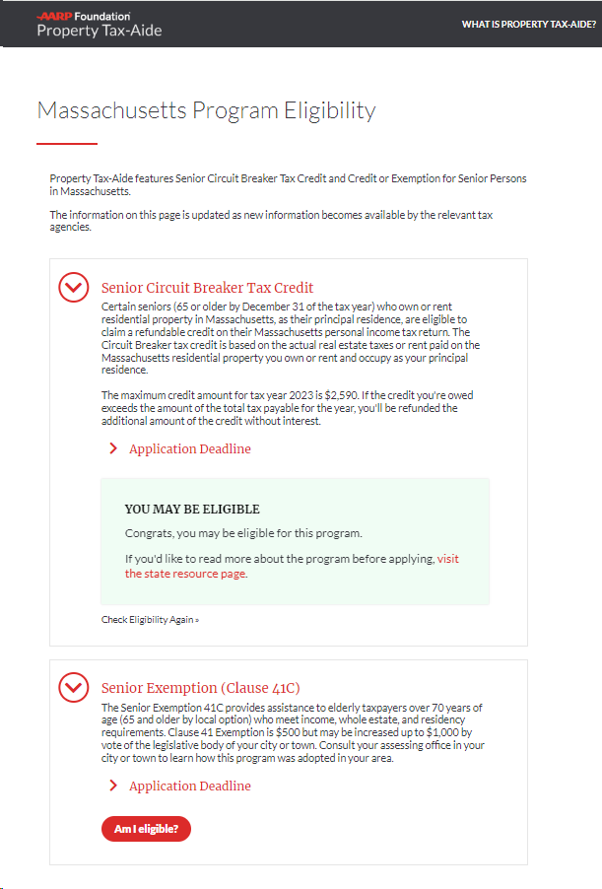
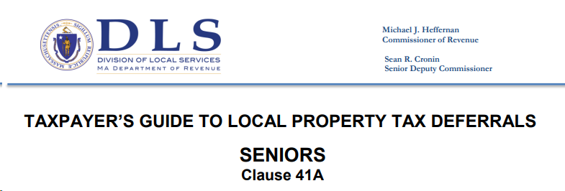
Exemption 41C : Modification & Town Vote
Senior Circuit Breaker (Also Tied into Bill H.3911)
How to Verify Eligibility for Both Senior Circuit
Braker & 41C Senior Exemptions: Easily & Quickly!!!!
4. Clause 41A: PropertyTax Deferrals

Slide 13
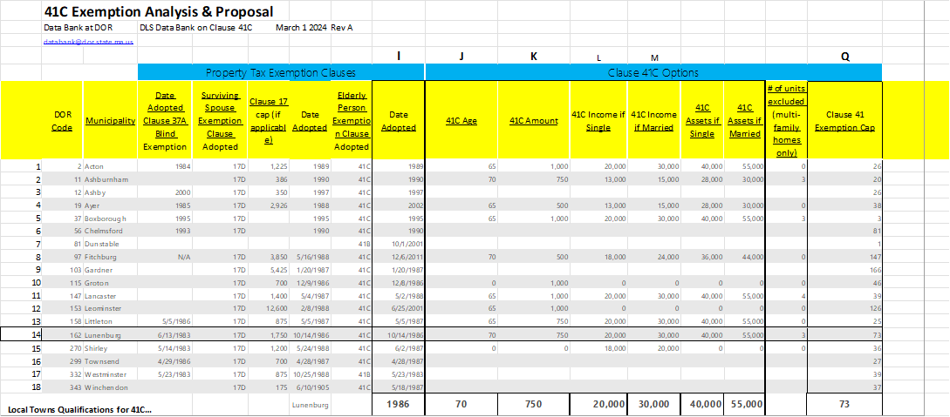
Exemption 41C : Modification & Town Vote
Background: As a result of last years the BOA member review and approvals of multiple Individual Senior Citizen Tax Exemptions; Conducting the the Overlay Planning Analysis and a full review of State Reimbursement Policies; The Assessor team has determined a closer look at State Refunded Senior Exemption options was warranted. Methodology Used: The Assessor Team chose to fully explore and understand Exemption Options (41, 41B, 41C, 41C1/2 and Clause 41A Deferrals). See Table #1 State Reimbursements opportunities were also evaluated. This exploration also included an analysis of local towns/cities exemption practices, actual Lunenburg Senior Exemption Participation levels (Primarily 41C), Federal Census Age Profiles & Life Expectancy Tables, as well as the American Community Survey Poverty Data, NAR (Nat. Assoc. of Realtors) Home Tenure Tables, Median Household Income and Senior Poverty Levels within Lunenburg We also worked closely with the Director of the Lunenburg Adult Activity Center (Ms. Sue Doherty), and gained further insight into the needs of our Senior Population. We incorporated her valuable thoughts into our deliberations.
Result of Current State Analysis: We were able to project Senior Participation Levels, Average Financial Cost Impacts to Households, Total Costs to the Town and Impacts on our Senior Citizens. Conclusion: The BOA team Concluded there were 4 significant exemption change options and each with its own unique impacts.

Slide 14
Table # 5
Note: Federal Poverty Income Level: Single = $ 45,180 Mass Max Allowable Income 41C : Single = $20,000 Married = $ 61,320 Married= $30,000
Table # 6

Slide 15
Support Tables
Local Town Comparison for 41C
Table # 1
Local Town Age Qualification 70 years (3 of 9) = 33% 65 years (6 of 9) = 66%
Local Town Reimbursement 2 of 10 were $500= 20% 3 of 10 were $750= 30%
5 of 10 were $1000 = 50%

Slide 16
Table #3
Table #4

Slide 17
Change Options Available: Option 0: Do Nothing! Maintain Existing Age Requirement at 70 and no change in Exemption Compensation from $750.
Option 1: Only Raise Exemption Compensation an additional $250, to total household compensation $1000
Option 2: Lower Eligibility Age to 65 from 70. Would Increase citizen participation from average of 20 to 30 per year.
Option 3: Combined Option 1&2
Impacts Calculated Total Cost per Household, by Option:
Option 0: Do nothing: Continue Current Level: Total Household Cost stays the same = $1.12 Annually. (No Change - Current) Option 1: Raise Exemption Comp by additional $250: Total Household Average Cost Increased to $2.26 Annually, (Up $1.14 from Current)
Option 2: Reduce Age of Eligibility to 65: Total Household Average Cost Increased to $1.69 annually, (Up $.57 from Current)
Option 3: Combine Option 2 & 3 = Combined Average Cost Increased to $3.38 annually, (Up $2.26 from Current))
Total Cost to Town Option 0: $5,000… Current Cost
Option 1: $10,000
Option 2: $7,500 Option 3: $15,000
For Details. (Ref Table #4)

Slide 18
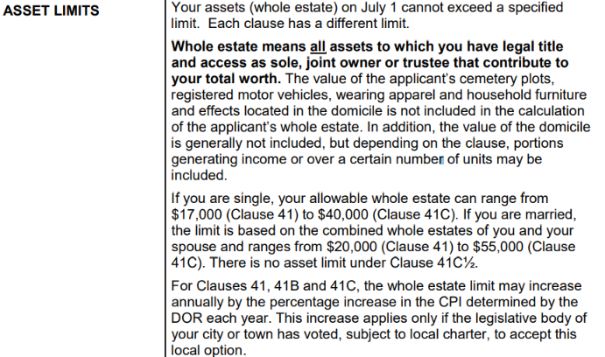
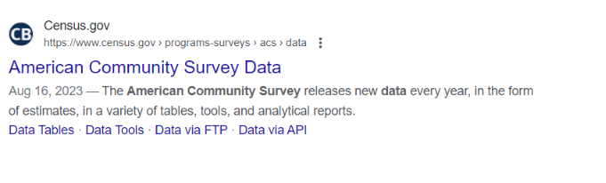
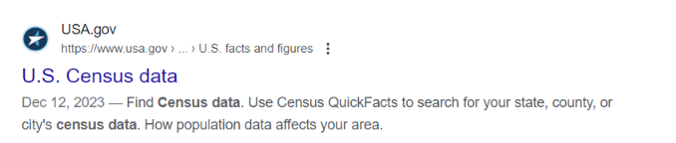
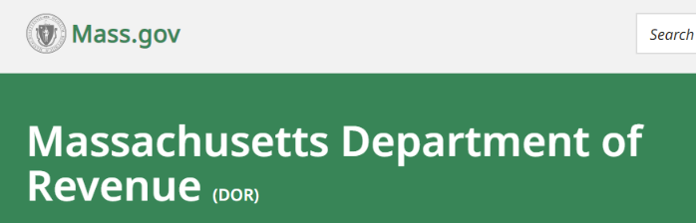
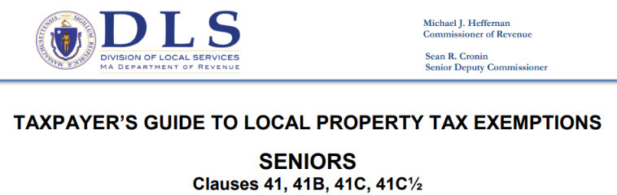
Table #6
Additional References
END

Slide 19

Summary BOA Team Unanimously chose Option 3. = Lower Age Eligibility to 65 & Raise Total Reimbursement to $1000. (State Contributes $500 & Lunenburg Matches the $500) Option 3 brings Lunenburg parity with our surrounding Communities, while assisting our most vulnerable Senior citizens.
Option 3 would be consistent with buying a full Cup of Coffee, once a year per Household. Cost to Town = $3.38
Q & A

Slide 20
Request for Article 41C Change to be placed on Town Warrant and voted upon in Town May Meeting
Warrant Article: To see if the Town will vote to amend M.G.L c> 59, SS5 – Clause 41C ,as previously approved by the Town of Lunenburg on 10-14-1986.
The Lunenburg Board of Assessors would move the following:
1. Amend Exemption 41C Age Eligibility from 70 Years of age to 65 Years of Age. 2. Amend Exemption 41C Amount of Total Reimbursement to a $1000. (With Contributions of $500 from State Of Mass and a Matching contribution of $500 from Town
Lunenburg.)

Slide 21
2. Senior Circuit Breaker ( Also Tied into Bill H.3911 & Deferrals Clause 41)
Who is eligible
You must be a Massachusetts resident or part-year resident.
You must be 65 or older by December 31 of the tax year.
You must file a Schedule CB with your Massachusetts personal income tax return.
You must own or rent residential property in Massachusetts and occupy it as your primary residence.
For tax year 2023, your total Massachusetts income doesn't exceed:
$69,000 for a single individual who is not the head of a household.
$86,000 for a head of household.
$103,000 for married couples filing a joint return.
If you are a homeowner, your Massachusetts property tax payments, together with half of your water and sewer expense, must exceed 10% of your total Massachusetts income for the tax year.
If you are a renter, 25% of your annual Massachusetts rent must exceed 10% of your total Massachusetts income for the tax year.
The assessed valuation of the homeowner's personal residence as of January 1, 2023, before residential exemptions but after abatements, cannot exceed $1,025,000.
The Schedule CB must be completed within 3 years from the last day for filing the return, without regard to any extension of time to file.
You Get A Check….Not a Credit!!!
https://www.mass.gov/info-details/massachusetts-senior-circuit-breaker-tax-credit
Circuit Breaker Video … Politicians https://www.youtube.com/watch?v=PN9U2FVR5FI

Slide 22


How to Verify Eligibility for Both Senior Circuit Braker & 41C Senior Exemptions:
Easily & Quickly!!!!
AARP- Free
https://aarpfoundation.org/propertytaxaide
$ave Your Time & Money on

Slide 23
Under Clause 41A, seniors may also be able to delay payment of their property taxes. A property tax deferral does not discharge the tax obligation like an exemption. Instead, it defers payment until the senior sells the property or passes away. A deferral allows seniors to use resources that would go to pay taxes to defray living expenses instead. Taxpayers who qualify for personal exemptions under other clauses in M.G.L. c. 59, § 5 (for example, for seniors, disabled veterans, blind persons or surviving spouses) may defer all or part of the balance of their reduced taxes.
If you qualify, you must enter into a written tax deferral and recovery agreement with the local assessors. The assessors will record a statement at the Registry of Deeds INCOME LIMITS Your income (gross receipts) for the previous calendar year cannot exceed $20,000. If you are married, the combined gross receipts of you and your spouse cannot exceed $20,000. The gross receipts limit may be increased up to the income limit allowed for the “circuit breaker” state income tax credit for single non-head of household filers, by vote of the legislative body of your city or town

Slide 24
DEFERRAL AMOUNT: You may defer payment of all or a part of the taxes owed each year so long as (1) you continue to qualify, and (2) the cumulative deferred taxes and accrued interest are not more than 50% of your proportional ownership
DEFERRAL AMOUNT INTEREST: Interest on deferred taxes accrues at 8%, or a lower rate voted by the legislative body of your city or town before July 1 of the tax year SURVIVING SPOUSE: Your surviving spouse who qualifies may continue to defer taxes but must enter into a new deferral and recovery agreement.
PAYMENT: The payment of deferred taxes and accrued interest is due when the property is sold or you pass away, unless your surviving spouse continues to defer. As of that date, the interest rate goes up to 16%.

Slide 25
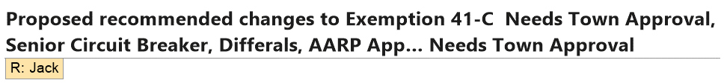
NEW Assessors WEB Site Check those Property Cards See New Booklet on How to Read Cards

Slide 26
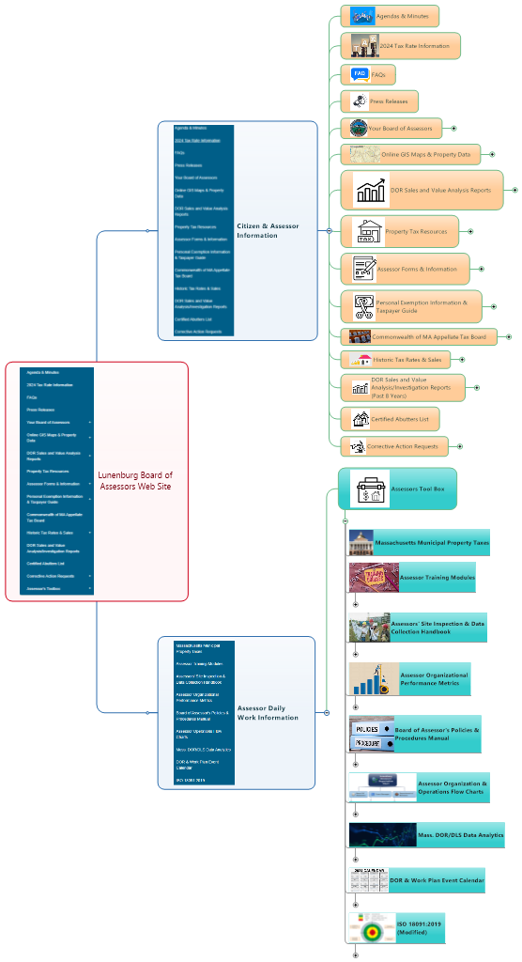
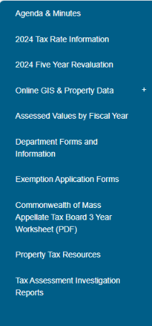
Lunenburg Assessor Web Sites
https://www.lunenburgma.gov/164/Assessors-Department
Open to General Public
April Release
Group 1 15 Core Groups
Current
1 Group 10 Core Elemental Groups 1 Secondary Site 2 Items
2 Groups 24 Core Elemental Groups 37 Secondary Sites ? Items…. God only knows!
Check Your Property Cards!!!!
Group 2 10 Core Groups
25 Cores

Slide 27
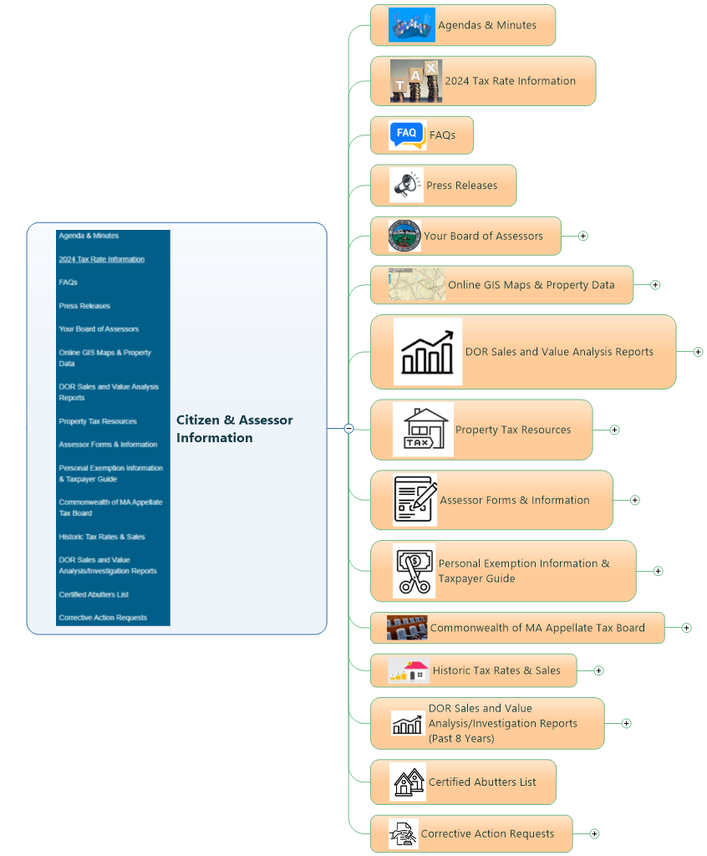
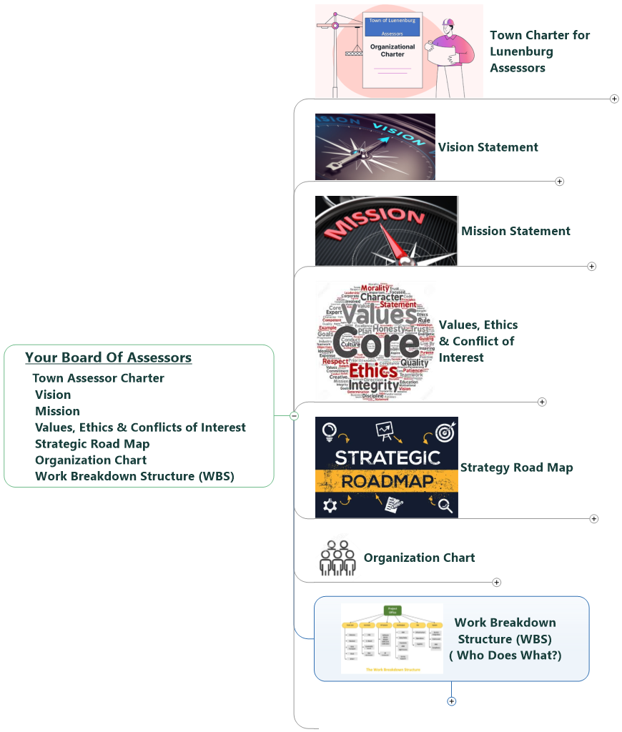
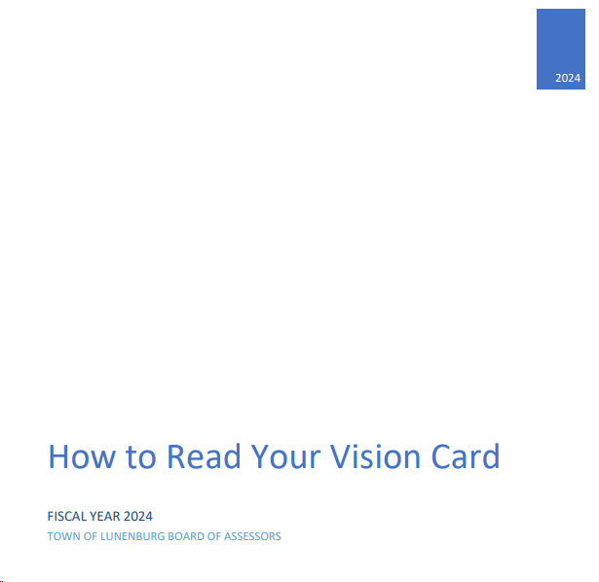
Lunenburg Assessor Web Sites
Secondary Site
Check Your CAI & Vision Property Cards!!!!
Group 1 15 Core Elemental Groups
10 Additional Secondary Sites

Slide 28
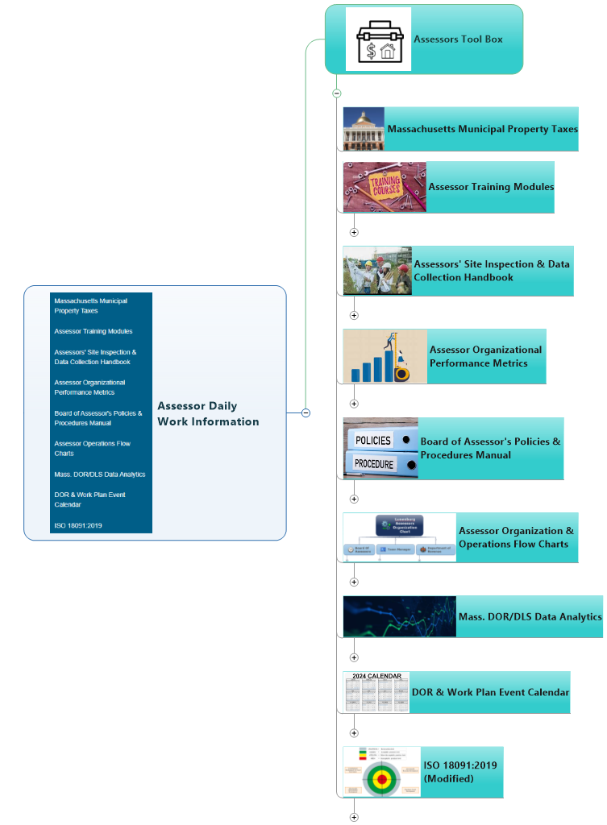
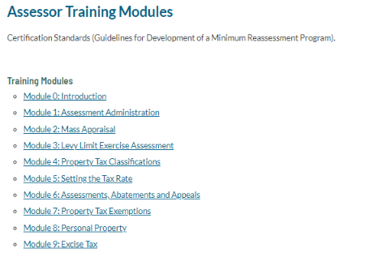
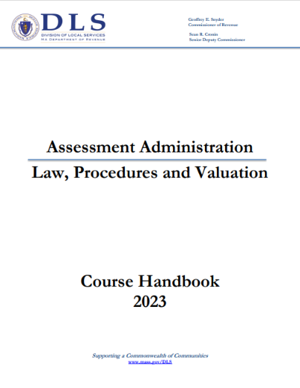
Lunenburg Assessor Web Sites
Secondary
Group 2 9 Cores
8 Additional Secondary Sites
Check Your Property Cards!!!!

Slide 29


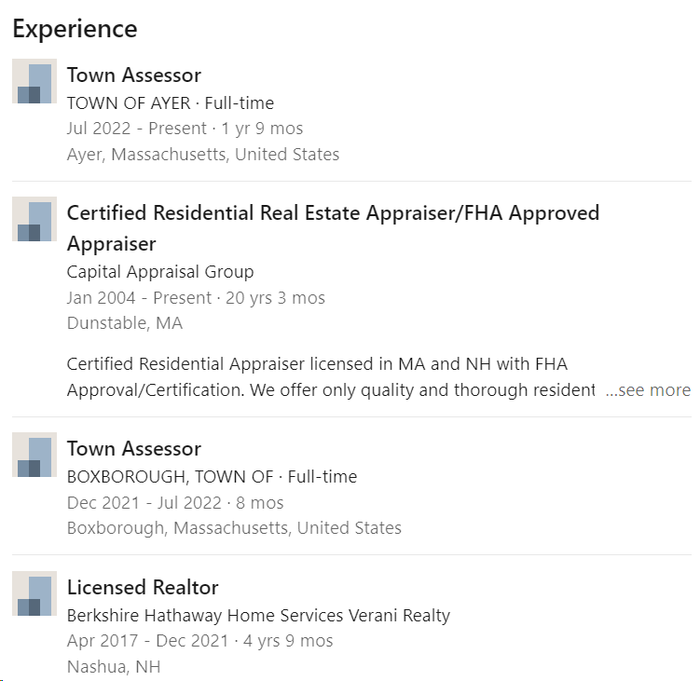

Welcome to Lunenburg
Your New Working Home!!

Slide 30
Q & A

