Slide 1
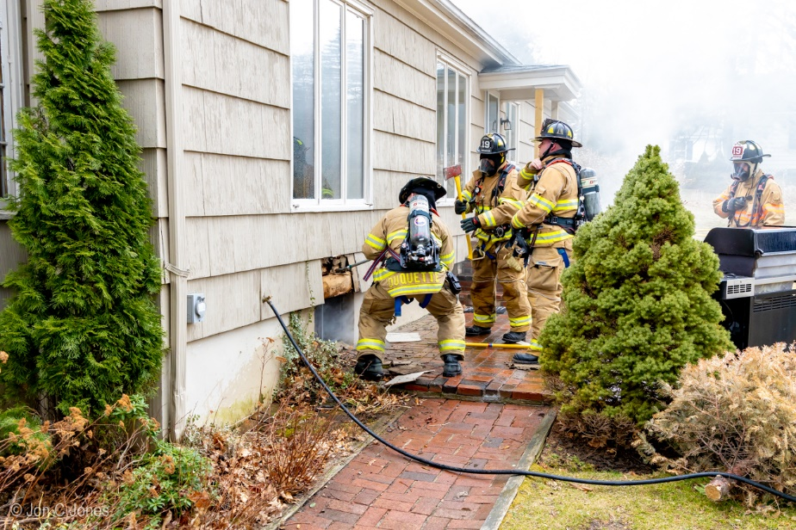
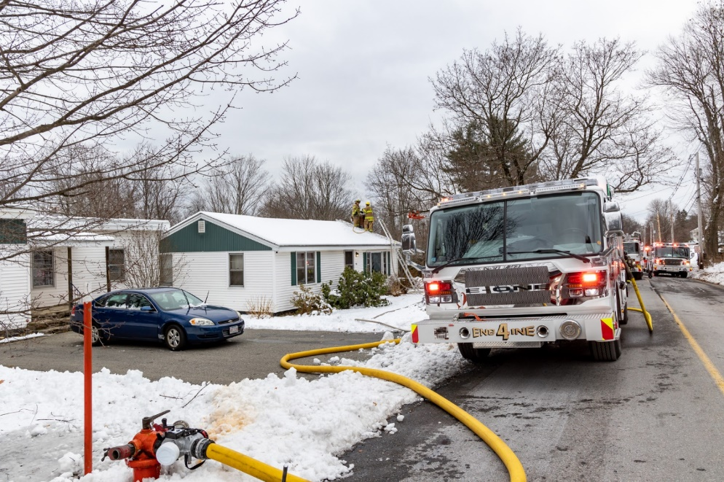
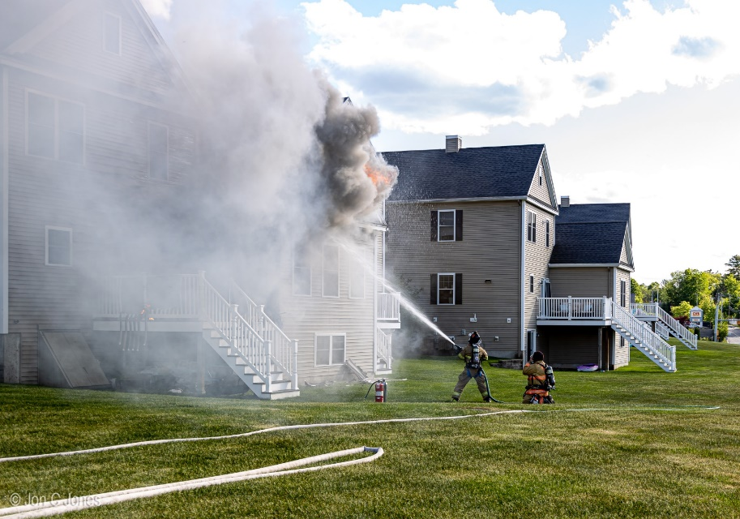
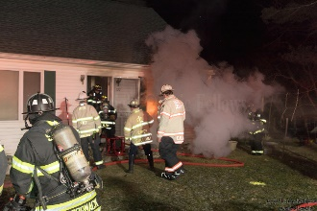
Lunenburg Fire-Rescue

Slide 2
Fire Department
Personnel (Proposed)
Chief
1 Administrative Asst.
4 Career Officers
5 Call Fire Officers (3 EMT’s)
8 Career Firefighter/Paramedics
34 Call Firefighters and EMTs

Slide 3
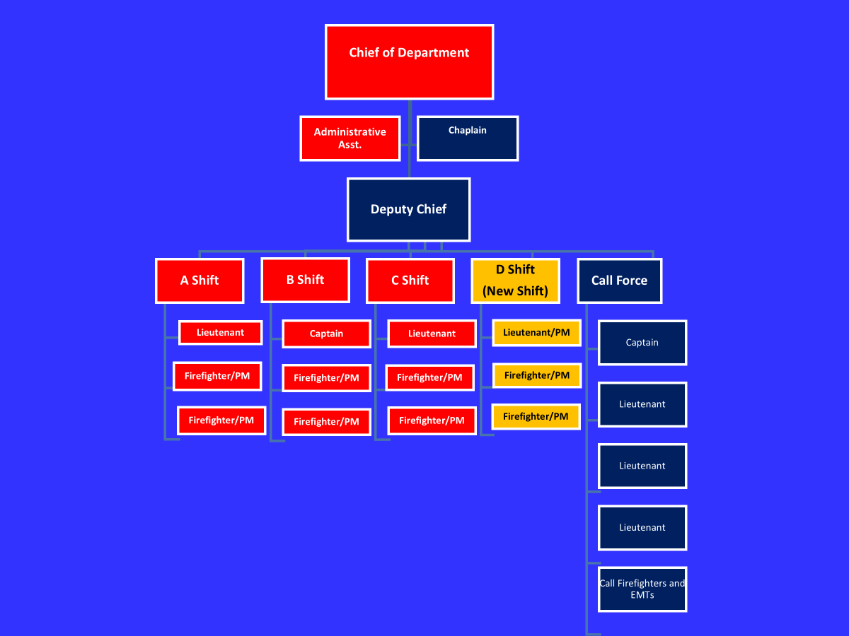
Department Structure

Slide 4
Response Breakdown 2024
Call Type | Number
Fires/ Hazardous Cond. | 163
Alarms | 171
Service/Good Intent | 113
EMS/Rescue | 1193
Inspections | 414
Other | 29
Total | 2083

Slide 5
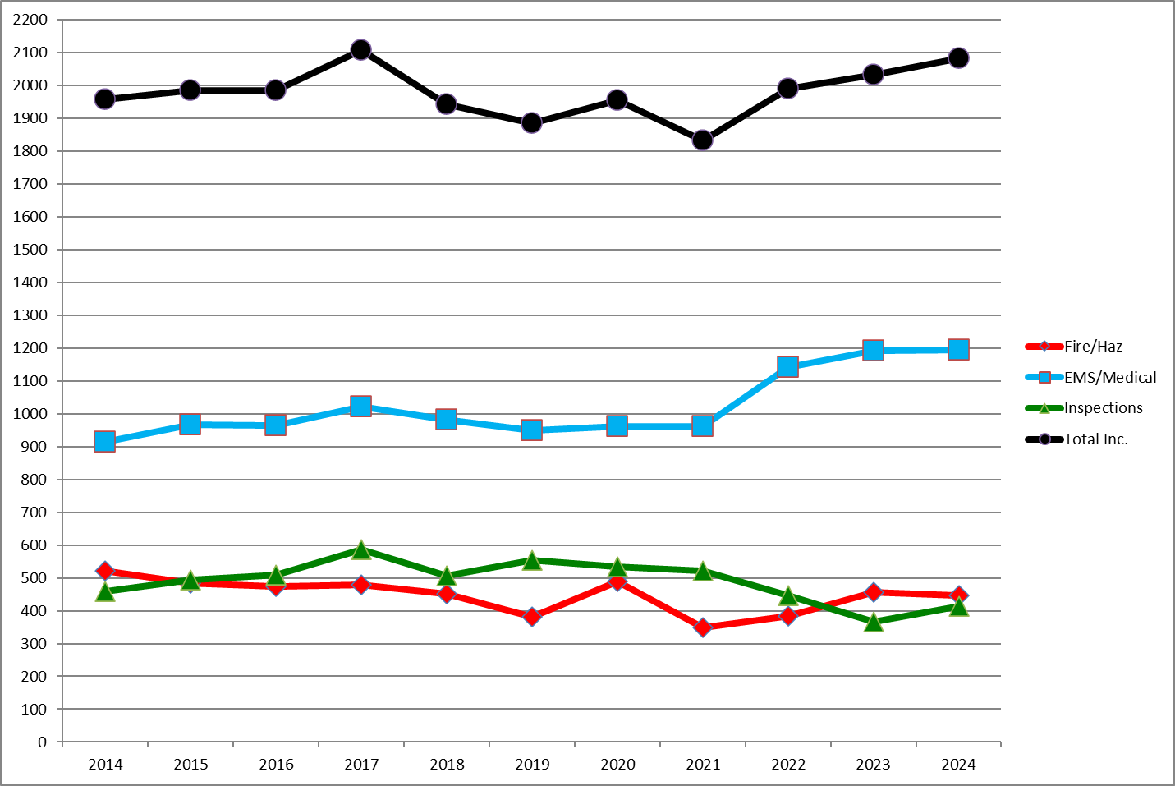
Responses by Year 2014-2024

Slide 6
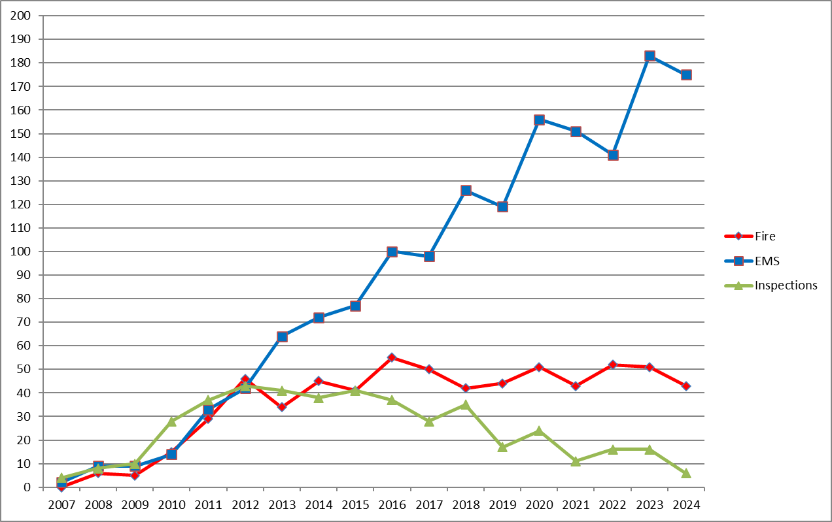
Effects of New Growth (Large Scale Projects in the last 17 years)

Slide 7
FY’27 Budget Summary
Addition of 4th Career shift to the FD
42 hour week
3 additional Firefighter/Paramedics
7 Day/week coverage
Per diem shifts adjusted to add 4th FF 16 hrs/day
Increases in Operating Budget
EMS Supply/Capital Replacement (Fire)
Radio and Vehicle Maintenance
2024

Slide 8
FY’27 Salary
Career FF Salary-
$981,393.04 (+221,088.35)
3 Step 2 FF/PM
1 Promotion to Lt/PM
Based on current yearly salary

Slide 9
FY’ 27 Salary
Career Overtime
$255,677.72 (+80,386.02)
Increased based on:
Increase in average OT Rate
Additional Estimated ETO for new Staff
Vacation
Personal/Comp Time
Sick Leave
Call back & Training

Slide 10
FY’27 Salary
Call Fire/EMS Salary
$291,070.34 9 (+ from FY’26)
Per diem Staffing
Call Firefighter & EMT Responses
Holiday
$69,572.64 (+22,325.33)
Increase in hourly OT rate
Additional 3 Staff

Slide 11
FY’27 Salary
Training
$60,953 (+ from FY’26)
Department and outside training for staff
Can vary from year to year
Large part is for funding for Paramedic Training
Have not had to sent anyone to Paramedic School in last couple years
It is anticipated that we will need to train at least one new hire as a Paramedic.

Slide 12
FY’ 27 Salary
Contractual items
Chief’s Salary
Career FF Longevity
Career FF Uniform allowance
$3300 increase for 3 new Staff
EMS/ALS Coordinators
Training Coordinator
Fire Prevention Officers
SAFE Coordinator

Slide 13
FY’27 Salary Total Increase
Estimated
$327,099.27
3 New Hires
Anticipated increases in OT Lines
OPEB costs
$137,269.57
Based on top end Family Plan insurance
TOTAL-
464,369.27

Slide 14
FY’27 Expense Summary
Level Funded from FY’26 except as noted
EMS Maintenance & Equipment
Capital Replacement Equipment (Fire)
Radio Maintenance
Vehicle Maintenance

Slide 15
FY’27 Expense
EMS Supply/Equipment
$39,000 (+12,000)
Covers Medications, oxygen, disposable supplies and maintenance of equipment
Cost has run above expectations since we transitioned to Paramedic
Increased Call Volume
Increased number of ALS Calls
Annual maintenance agreements for medical equipment have increased dramatically
$5000 increase this year
Request puts budget inline with expenses

Slide 16
FY’ 27 Expense
Capital Replacement Equipment
$15000 (+ $5000)
This is replacement of Firefighting hardware (Hose, nozzles, hand tools, etc)
Have received $15,000-19,000/year in State Grant funding for the last 5 years.
That Grant program has ceased and it is doubtful it will return

Slide 17
FY’ 27 Expense
Radio Maintenance
$15000 (+$5000)
Covers replacement of portable radios and maintenance of existing equipment
Repairs, batteries, annual service, etc.
Line has not increased in over 15 years
Portable fire ground radio runs $4300/unit

Slide 18
FY’27 Expense
Vehicle Maintenance- POS
$27000 (+10,000)
Covers maintenance/repairs that are beyond the scope of DPW Mechanic
Have had to request Reserve Fund Transfers in more than one FY to cover unexpected repairs
Pump Repairs
Engine/Transmission issues
Fire Apparatus specific components
Request is to keep budget in line with anticipated repairs

Slide 19
FY’ 27 Expense
Total Increase- Expenses
-$32,000

Slide 20
Impact of Budget as Recommended
Increases career coverage to 24/7/365
Boosts coverage to 4 FF’s 16 hours/day (Can cover both ambulances + Better fire response)
Properly Funds EMS Supply & Equipment support needs
Increases funding for radio replacement
Increases funding to properly maintain emergency vehicle fleet

Slide 21
Expectations for the next 3-5 years
Salary/Staffing
Step increases for new staff
Challenges in Recruiting/Retaining Call Firefighters
Ability to continue to supplement staffing with per diem vs. additional career staff
Should consider independent staffing study to look at best options

Slide 22
Expectations for the next 3-5 years
Expenses
Federal Grant funding VERY uncertain
EMS Supply and Vehicle maintenance costs may increase
Run Volume increases
Future Development
Strains on local EMS
Additional wear and tear of vehicles
More complex vehicles
Inflationary costs

Slide 23
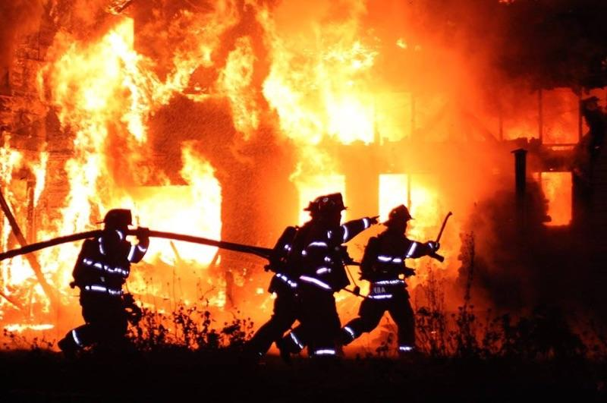
Thank You

