Slide 1

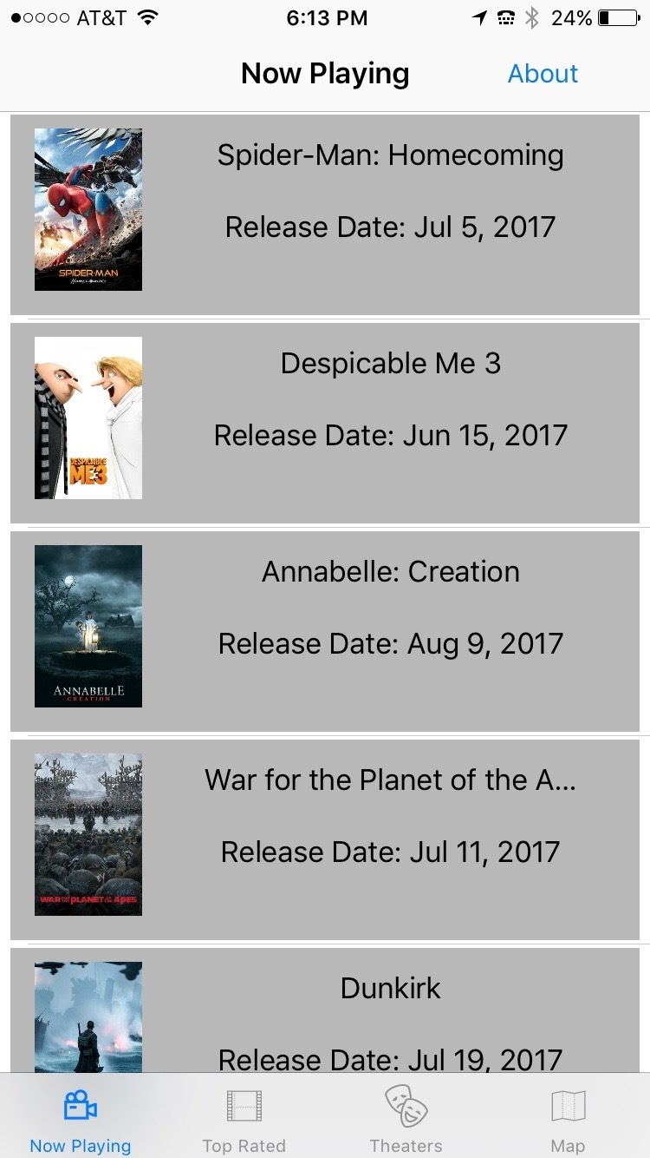
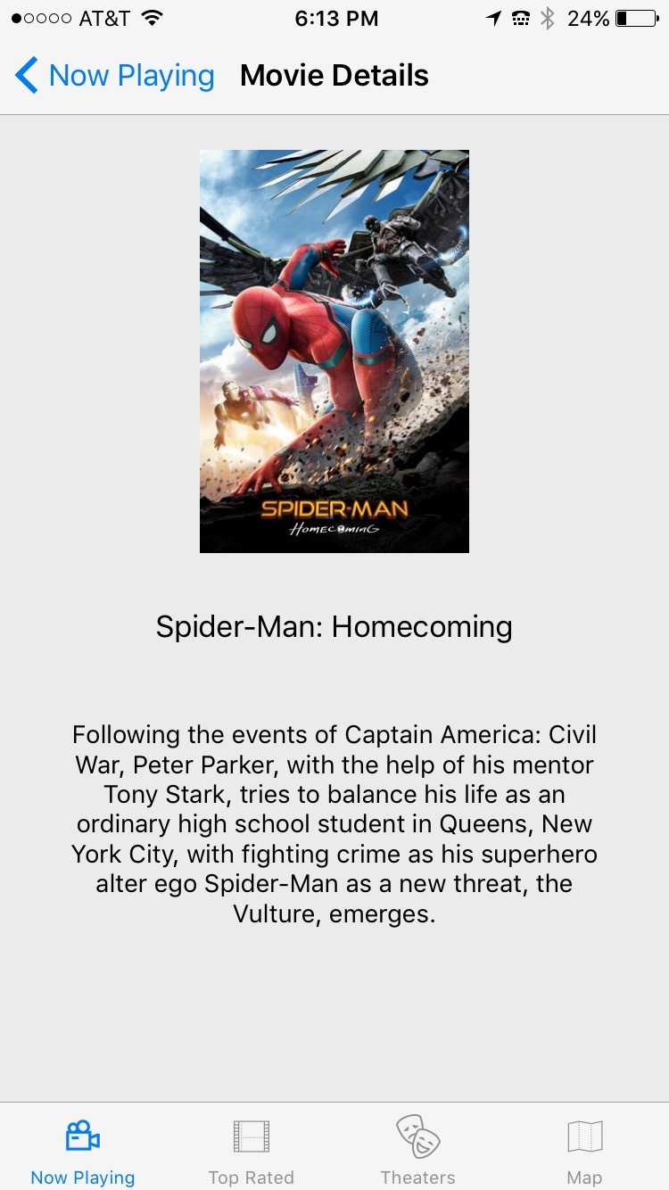

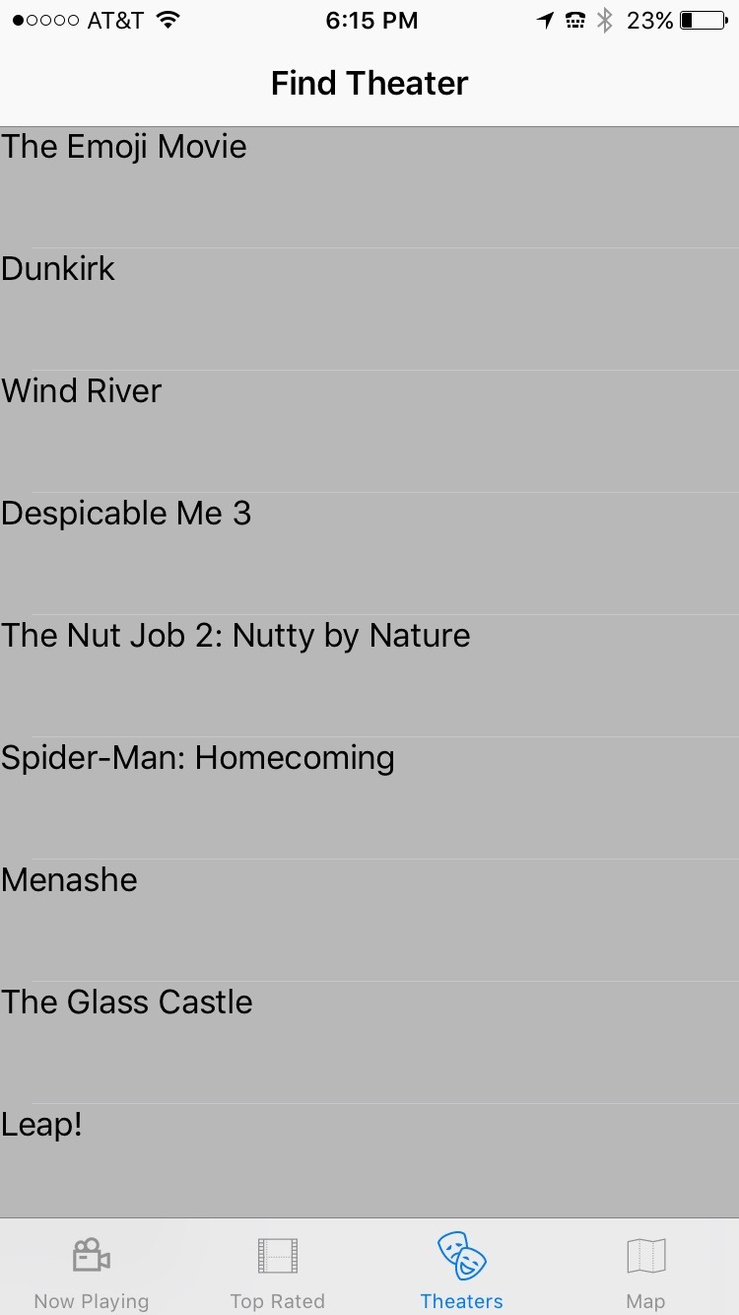
Movie Night
Created by: Terry Lynch
Category: Entertainment
Five key views
Objective
The main view provides a list of movies currently playing in theaters, along with a thumbnail image of the movie poster and the date the movie was released. From here the user can navigate to the description of the movie. This view is intended to help the user find a movie of interest. The main view has a navigation button “about” that provides a drop down with a guide to the app.
The objective of this project was to create a self contained application for users planning a night at the movies. This application enables the user to search for information about movies currently playing in theaters, as well as top rated movies (more of a feature for users interested in viewing top rated movies at home). One of the key features of the app uses the user’s current location to obtain information on movies playing nearby, including the name of the theater and time of showing. The user can then select the specific theater/show-time to purchase tickets. Finally, the app enables the user to view the theater location on a map, and obtain directions to the theater.
From the Now Playing view above, the user can navigate to a full description of the movie, including a larger poster view.
The third button on the tab bar controller opens a view with a list of movies playing within a specified radius of the user. The application uses Core Location to obtain the user’s coordinates, and queries the Gracenote database for information on movies playing within a specified radius of those coordinates on the current date. The current date is obtained using NSDate.

Slide 2
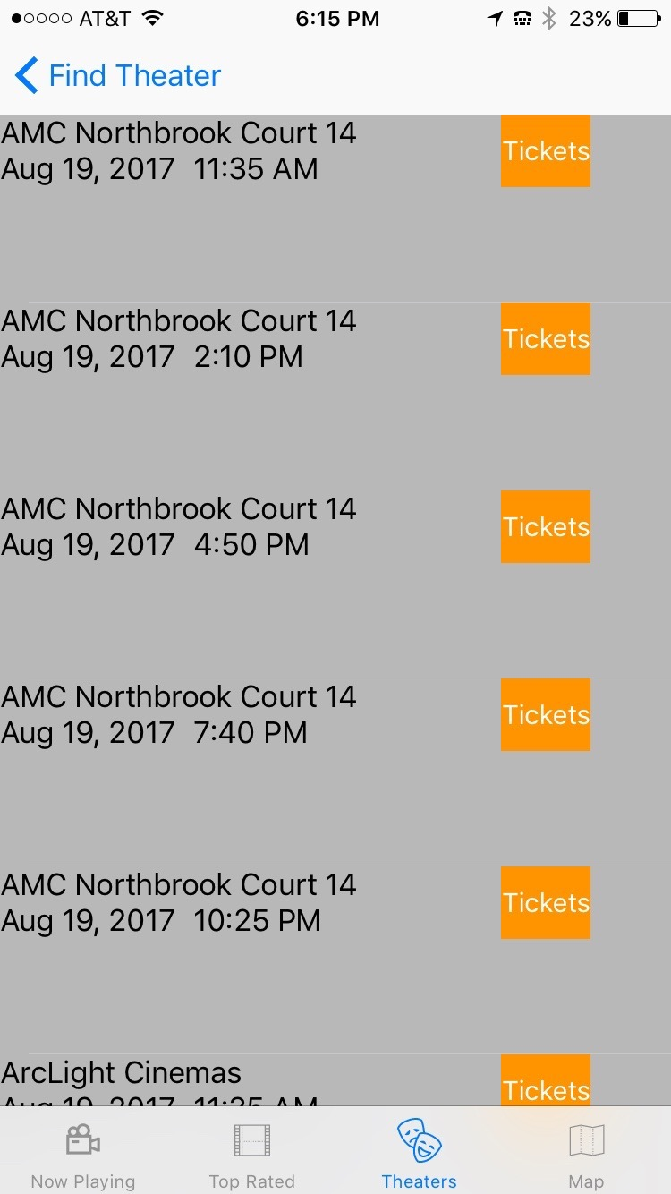
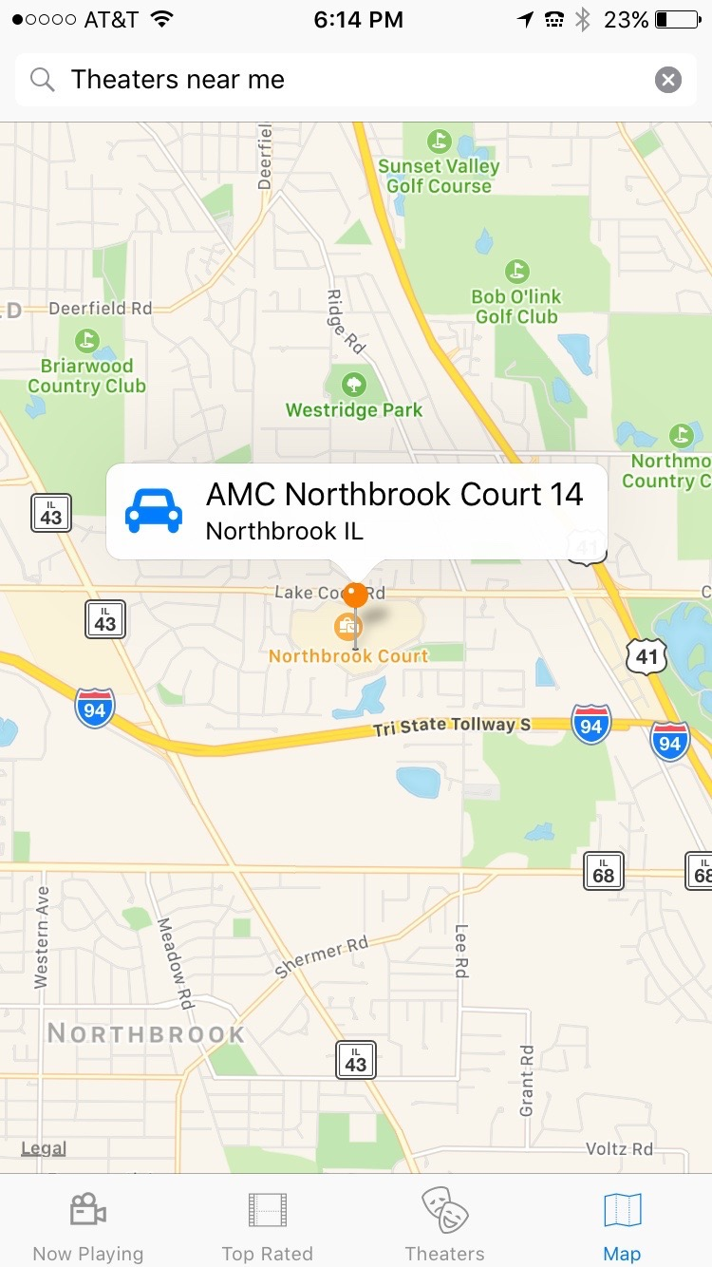
Implementation
Five key views continued…
Movie information displayed in the “Now Playing” and “Top Rated” views is obtained via a URL call to The Movie DataBase. The information returned is in JSON format. The app parses this data and displays the information in a tableview. Images are obtained via additional calls using the URI for the poster view returned from the initial call.
The app uses Core Location to obtain the user’s current location. This information is used to query the Gracenote database for information regarding movies playing within a specified radius of the user’s location. The radius is set in the app’s settings menu. The app allows the user to navigate to a web page to purchase tickets. MapKit is is used to display the location of and directions to a specific theater.
From the list of movies above, the user can select a movie to navigate to a tableview showing a list of show-time information. Each cell displays the name of the theater, and the date and time of the showing. Each cell also includes a “Ticket” button. Selecting the button will navigate to a Fandango webpage enabling the user to purchase tickets for that specific showing.
The fifth button on the tab bar controller navigates to a map view with the users current location and a search bar pre -populated with “Theaters near me”. Selecting the search icon reveals a tableview with a list of theaters near the user’s current location. Selecting a theater will show a map view with a pin drop for the location of that theater. Selecting the pin will show a pop-up with a car icon and a location description. Selecting the car icon will open the directions function in Apple maps.

