Slide 1
Premier League Match Classifier By: Tyler Miller

Slide 2
Agenda
Dataset Introduction
Objective, features, domain knowledge
Statistical Methods
Results
Limitations, improvement, future ideas

Slide 3
Dataset Overview
Kaggle dataset including historical matchday data from 2000-2018 of the English Premier League.
6840 Matches/data records
Data was mostly clean. Converted FTR to binary 1 or 0 instead of string “H” vs “NH”
Manually added a head-to-head win percentage to improve performance. HTHW% represented the previous 3 years if available (default .5)
Proportion of classes is about even (H vs NH)

Slide 4
Can team statistics and recent form predict the outcome of Premier League matches?
Variable | Description
FTR | Final match result: originally "H", “NH”, converted to binary (1 = Home win, 0 = Not home win)
HTGS, ATGS | Total goals scored by Home and Away team (season-to-date)
HTGC, ATGC | Total goals conceded by Home and Away team (season-to-date)
HTP, ATP | Season-to-date points for Home and Away teams
HTFormPts, ATFormPts | Recent form points from last 5 matches (W=3, D=1, L=0)
HTGD, ATGD | Goal difference (scored - conceded) for Home and Away
DiffPts | Difference in points between the teams (HTP - ATP)
DiffFormPts | Difference in form points (HTFormPts - ATFormPts)
HTWinStreakX, ATWinStreakX | Whether a team has a win streak of length X (3 or 5)
HTLossStreakX, ATLossStreakX | Whether a team has a loss streak of length X (3 or 5)
HMxW, AMxL, etc. | Encoded results of previous matches (e.g., "HM1W" = Home team won 1 match ago)
HTHWinPct | Historical win percentage of home team against away team in the last 3 years
Date | Match date (cleaned and converted to Date format)

Slide 5
Statistical Methods
Elastic net regularization is used for feature selection and handling collinearity
Correlation matrix also used to avoid collinearity
P-values to determine statistical significance
Logistic regression for classification of home win or not home win
Linear regression to predict goal difference of a matchday and thus the winner
Evaluation metrics include accuracy score and confusion matrix
To ensure fair evaluation data split randomly into 70/30 train/test

Slide 6
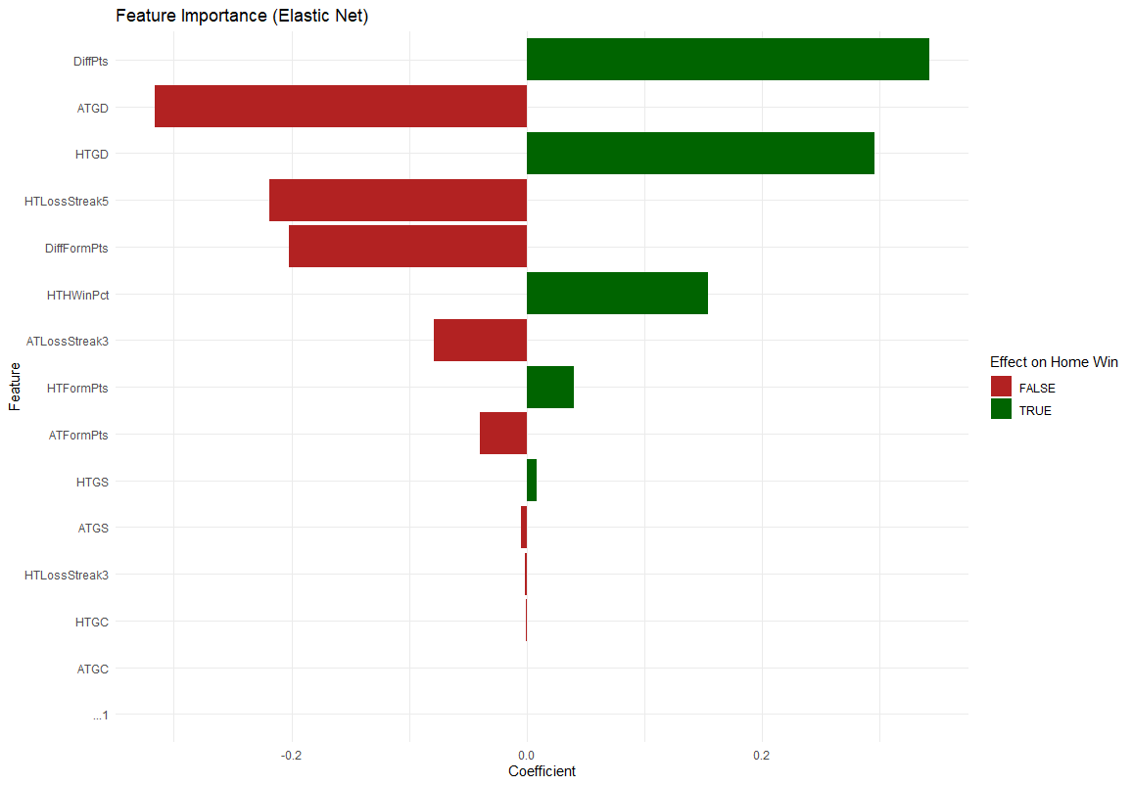
Elastic Net
Elastic net regularization is used for feature selection and handling collinearity
Used to discover and get a feel for the data

Slide 7
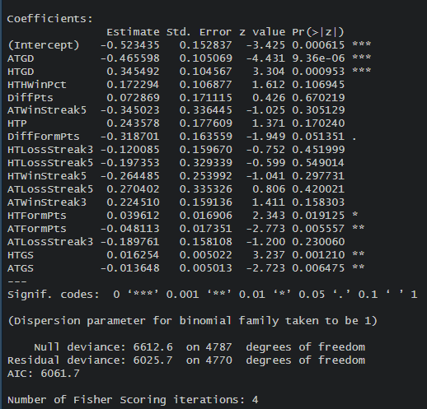
Logistic Regression
Logistic regression ran multiple times to narrows down features further
Used p-values and correlation matrix to determine which features to drop
First run with elastic net selected features →
Accuracy: .62

Slide 8
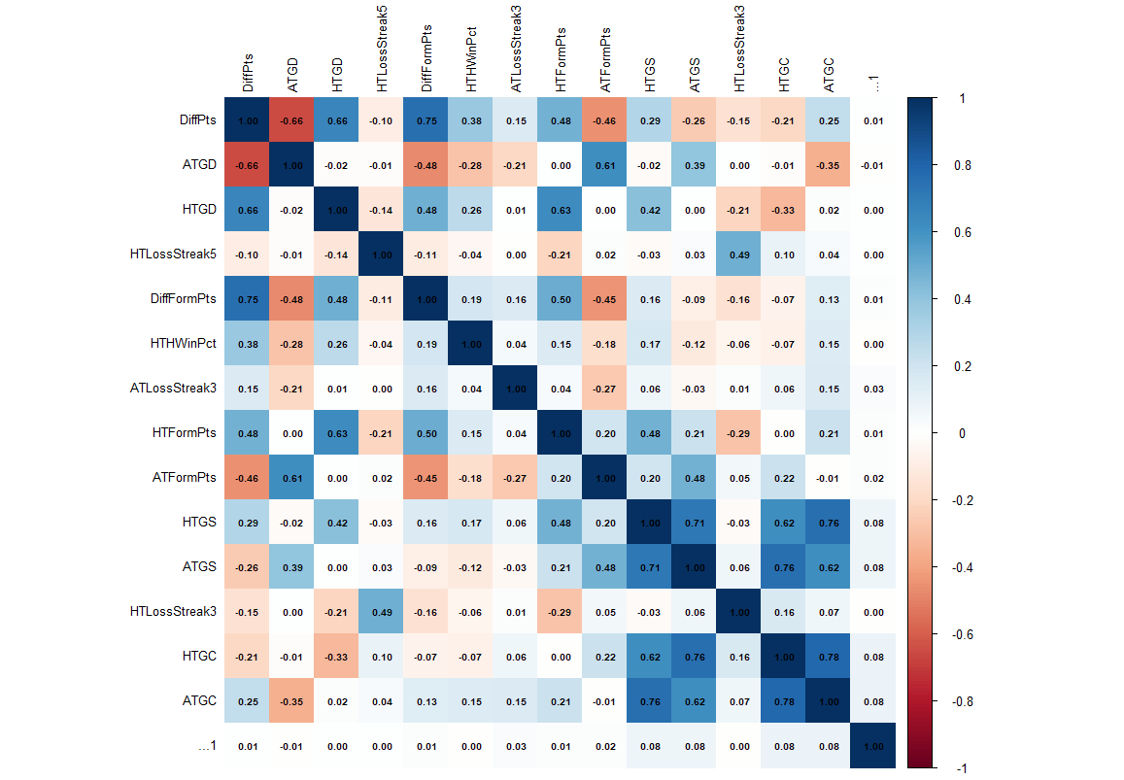
Correlation Matrix
Created correlation matrix to help decide which features to drop since performance was bad
Combined with p-values from previous slide to drop features

Slide 9
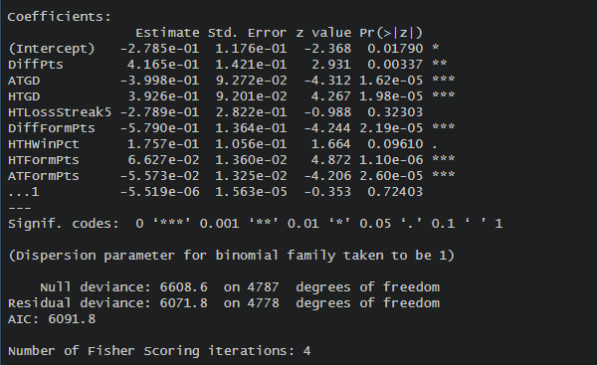
Logistic Regression Part 2
Final logistic run after dropping out features carefully to determine best accuracy
Accuracy = .64
Still not the best accuracy but better than random guessing

Slide 10
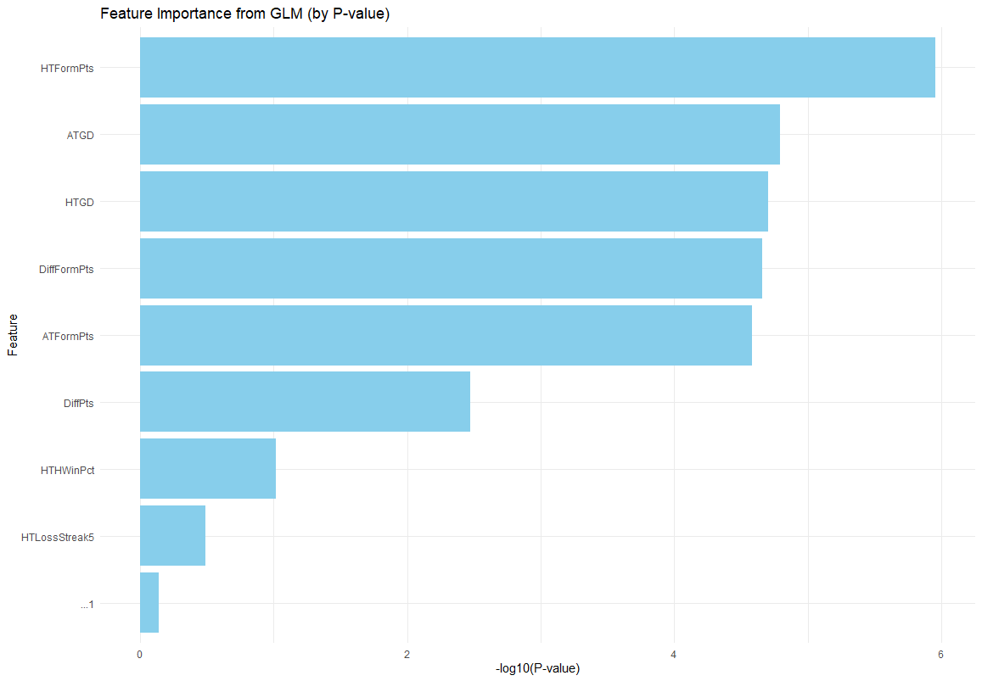
Feature Importance
Final feature importance by p-value represented as a graph

Slide 11
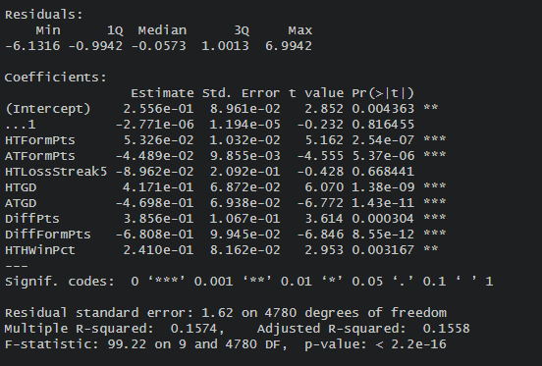
Linear Regression
Ran linear regression based on the logistic features
Linear regression is predicting the goal difference given the matchday
If GD > 0 = Home win
Else = Not Home win

Slide 12

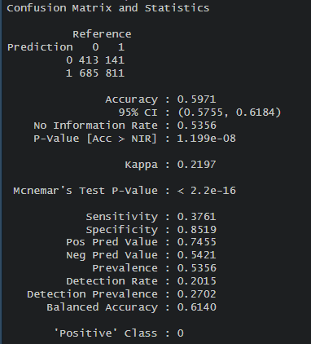
Linear Regression
Linear regression performed worse but relatively similar
Positive class = 0 which is not home
Predicted more home wins than not home (Home == 1, Not home == 0)
Predicted not home more accurately but also predicted less

Slide 13
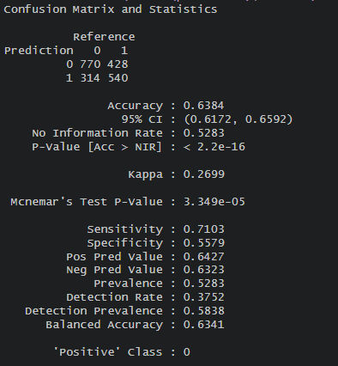
Linear Logistic

Slide 14
Conclusion
Both methods were better than random chance however, neither model was particularly impressive
Logistic is the better model in this scenario with an accuracy of .64 vs linear .60

Slide 15
Future Ideas, Limitations, Improvements
Incomplete data and not enough features could improve models:
Features for player lineups or aggregated statistics for the lineups. This would account for rotating squads which is common and injuries
Weather/Home team advantage would be a useful feature
Non-binomial labels could improve performance. Due to draws being common in soccer it could change the performance to have a draw class
More complex models such as random forest, naïve bayes and SVM could produce better results for this complex problem.

Slide 16
Thank you
Tyler Miller

