Slide 1
Project A
Terrence Maas & Eduardo Romero

Slide 2
APEX URL:
https://apex.oracle.com/pls/apex/f?p=42748:1:267697655868

Slide 3
Order of Presentation:
A very abstract conceptual overview of how our app is set up.
A more detailed tour of the app.
A demo.

Slide 4
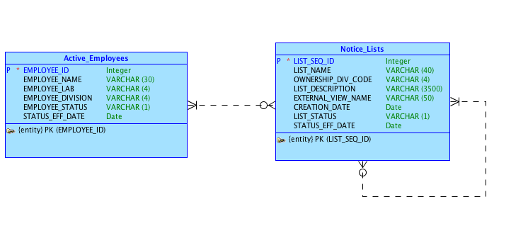
This was our original conceptual model.

Slide 5
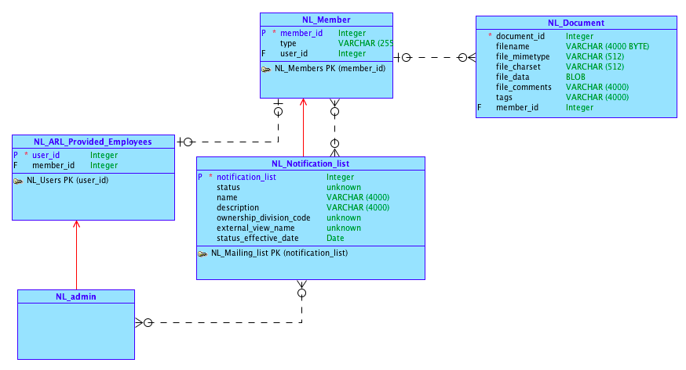
But we decided to redo it, more oriented around Dr. Cannata’s model:

Slide 6
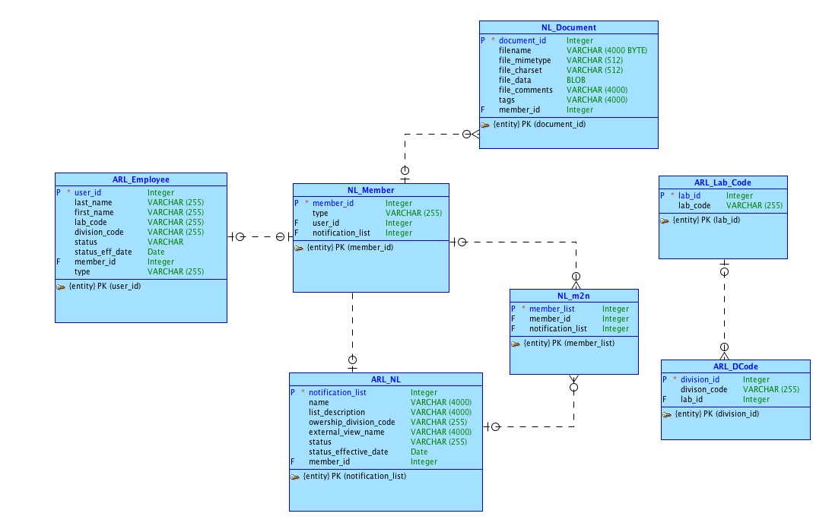
Logical Model

Slide 7
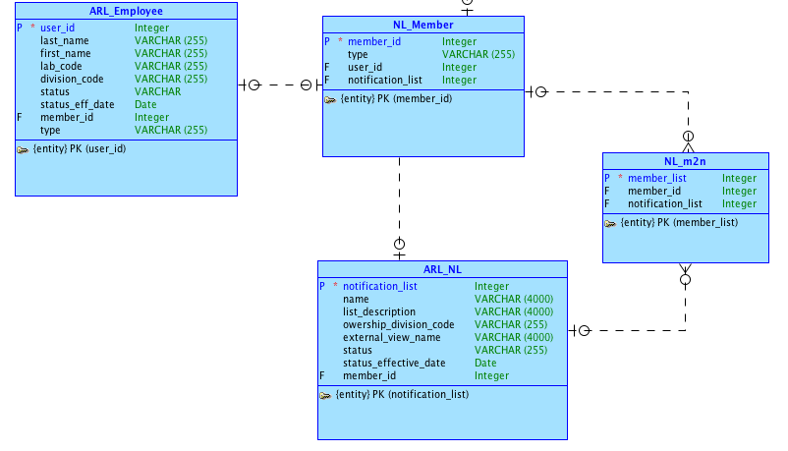
“Independent tables”

Slide 8
List
Management

Slide 9
Employee OR Notice List
Stage 1
Member
Notice List
Stage 2
Member-List connections (M2N)

Slide 10
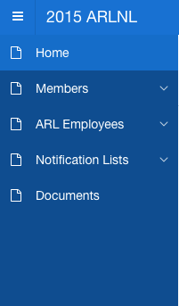
App Navigation
List/Member management
“Independent” tables

Slide 11
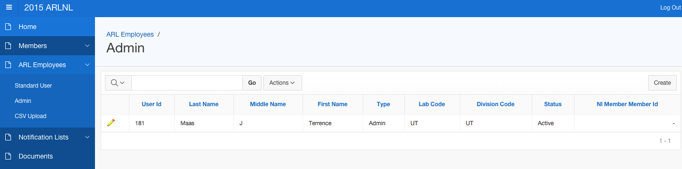
The ARL_Employees page shows all admin employees:
And the Standard User page does the same for standard users.

Slide 12
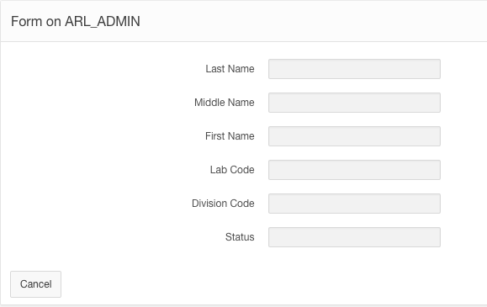
The “Create” button for employees leads to this form:

Slide 13
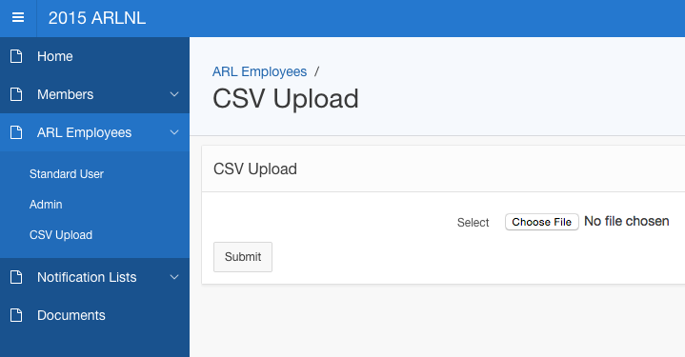
Or you can use the CSV Upload page to add new employees from a csv file in bulk:

Slide 14
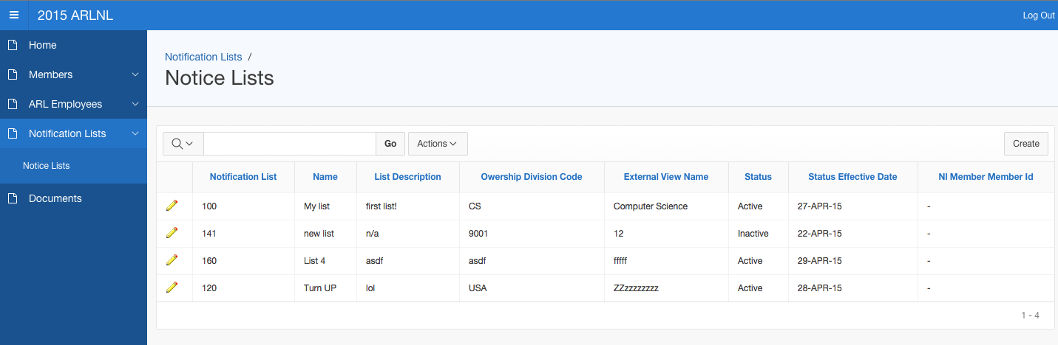
The Notice Lists page, like the Employee pages, contains an interactive form for managing notice lists.

Slide 15
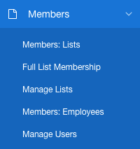
Now, moving on...
The Members navigation header contains all the pages that we use for list management, as opposed to the standalone pages we just covered.

Slide 16
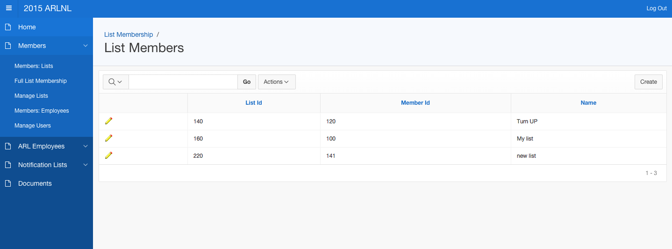
The “Members: Lists” page displays all members that are notice lists. Hitting the create button… (next slide)

Slide 17
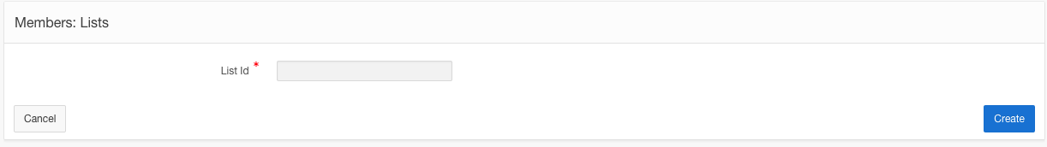
… takes you here! Enter the list id for which you want to create a member, and it is created.

Slide 18
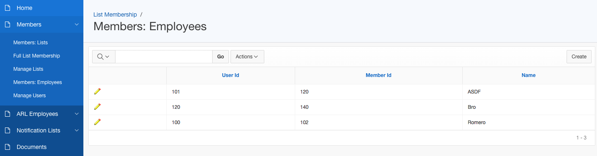
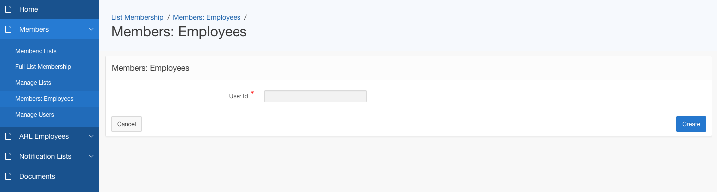
The Member creation process for Employees is the same.

Slide 19
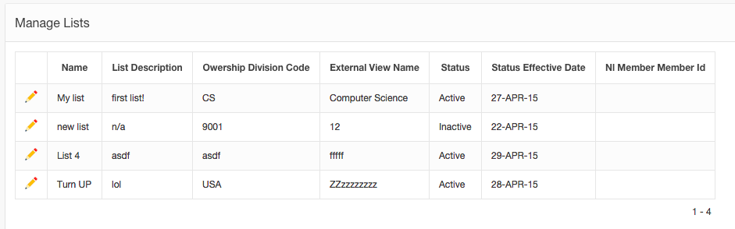
The “Manage Lists” and “Manage Users” pages go further: they let you manage the lists that a member belongs to or the members that a notice list holds. Click this...

Slide 20
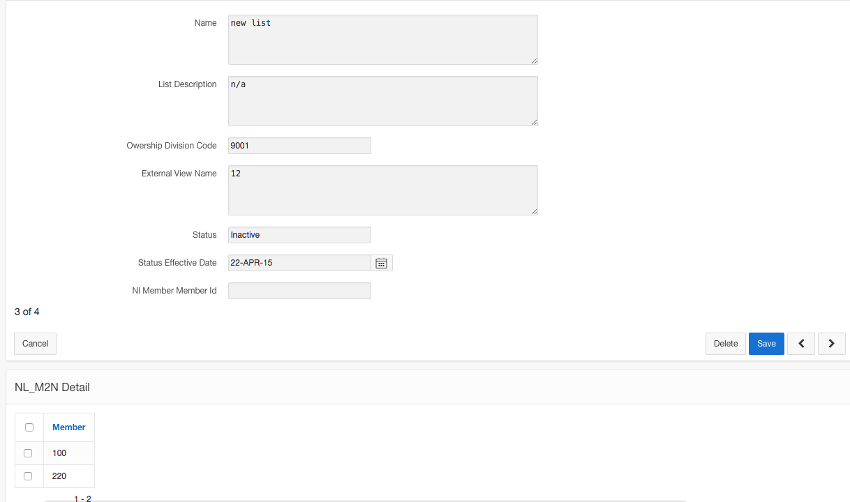
And you get to that list’s (or member’s) individual management page

Slide 21
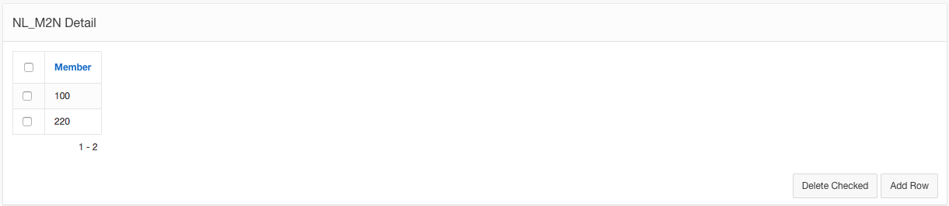
Focusing more closely on the bottom of the page, you find a list of all members that belong to this notice list. Clicking “Add Row” leads you to the Notice List-Member connection creator, while checking the boxes of the members will enable you to delete however many you would like to at once.

Slide 22
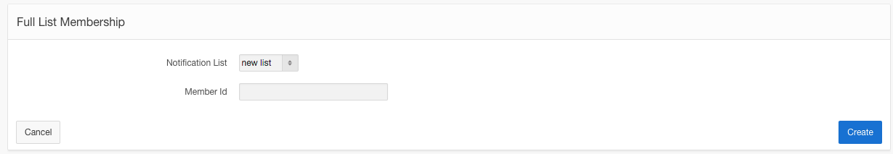
That “Add Row” button leads you here, where you connect a member and a notice list. Because you came from a specific notice list’s management page, the notice list field is already filled out for you.

Slide 23
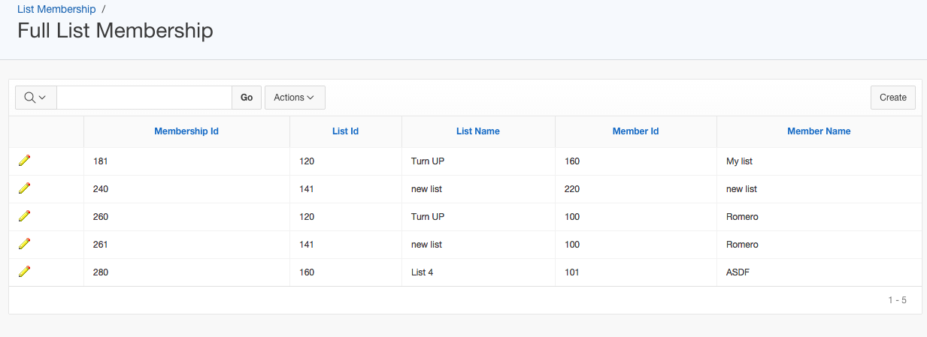
The “Full List Membership” page displays the all member-notice list connections and lets you create new ones.

Slide 24
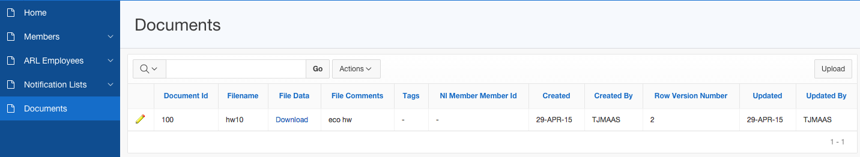
Our Documents page lets you upload, store, and download files of whatever type.
Clicking upload...

Slide 25
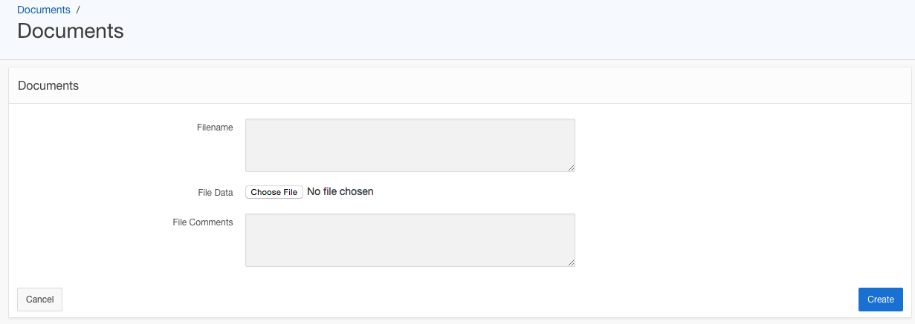
...Brings you here, where you can select, name, and add comments to the file you are choosing to upload.

Slide 26
Back on the Documents page, clicking “Download” will download the file.

