Slide 1
Decision Trees
Nathaniel Choe
Rohan Suri

Slide 2
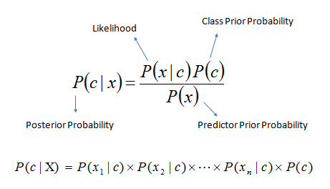
Quick Recap: Naive Bayes

Slide 3
Example: determining the author of an email
Assume priors are equal:
Sarah
David
P(S) = 0.5
P(D) = 0.5
0.1
0.1
0.3
0.3
0.8
0.2
Live
Laugh
Love
Live
Laugh
Love
“Life Deal”
Who wrote it?

Slide 4
Example: determining the author of an email
Assume priors are equal:
Sarah
David
P(S) = 0.5
P(D) = 0.5
0.1
0.1
0.3
0.3
0.8
0.2
Live
Laugh
Love
Live
Laugh
Love
P(e | H)
“Laugh Love”
Sarah Hypothesis: 0.8 * 0.1 * 0.5
Prior probability
David Hypothesis: 0.2 * 0.3 * 0.5

Slide 5
Example: determining the author of an email
Assume priors are equal:
Sarah
David
P(S) = 0.5
P(D) = 0.5
0.1
0.1
0.3
0.3
0.8
0.2
Live
Laugh
Love
Live
Laugh
Love
“Laugh Love”
Sarah Hypothesis: 0.8 * 0.1 * 0.5 = 0.04 Normalized: 57%
David Hypothesis: 0.2 * 0.3 * 0.5 = 0.03 Normalized: 43%

Slide 6
Definition
Decision Tree:
A tool that uses a tree-like graph of decisions and their outcomes
Useful tool in machine learning

Slide 7
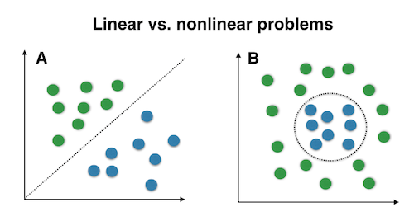
Types of Data
Linearly Separable Data
Two sets of data separable by a line
Nonlinearly Separable Data
Ideal Surfing time...

Slide 8
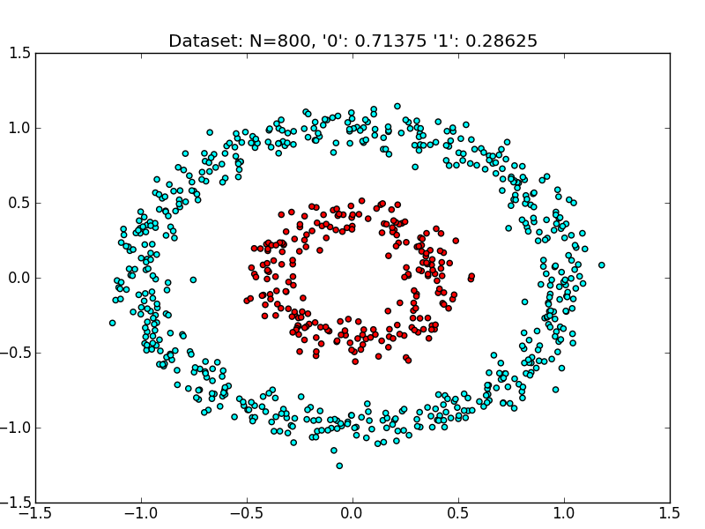
Nonlinearly Separable Data

Slide 9
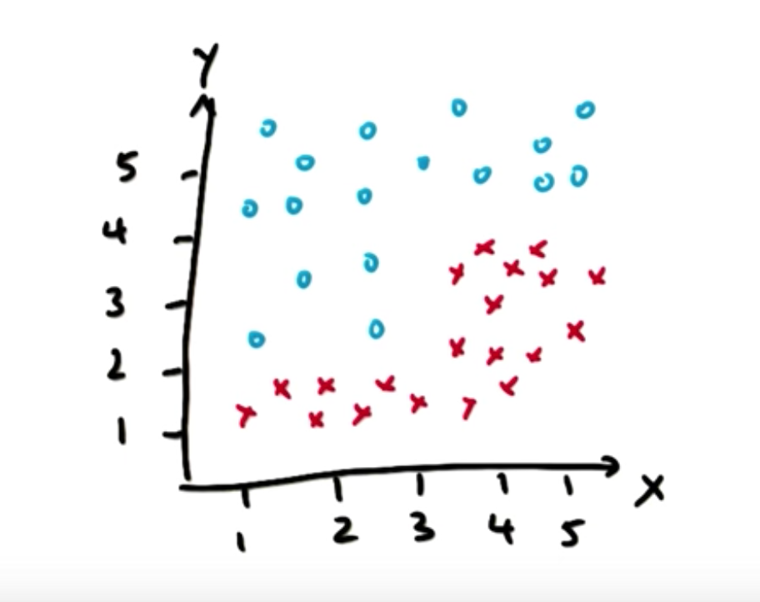
Example: Simple Data

Slide 10
CODE

Slide 11
Sample Splitting and Overfitting
Decision Tree Nodes
Excess Nodes due to Outliers
Overfitting
Parameter Tuning Options:
min_samples_split=2
min_samples_leaf=1

Slide 12
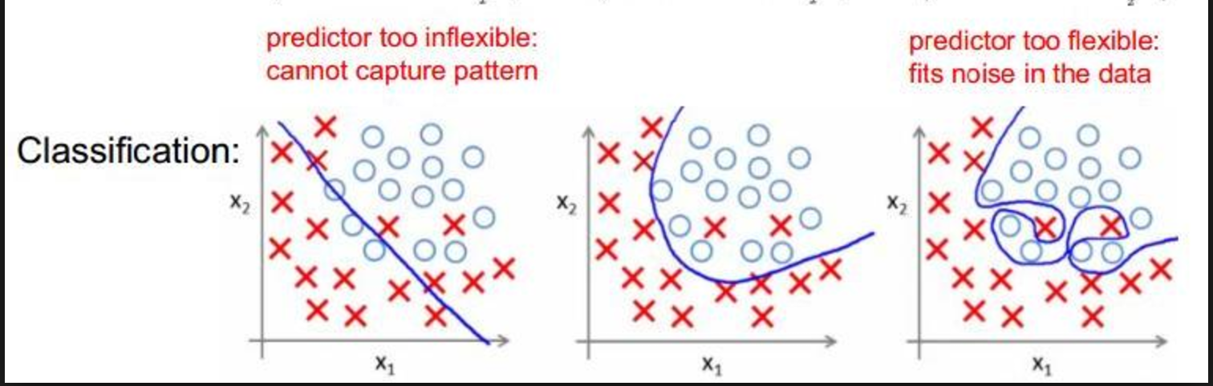

Slide 13
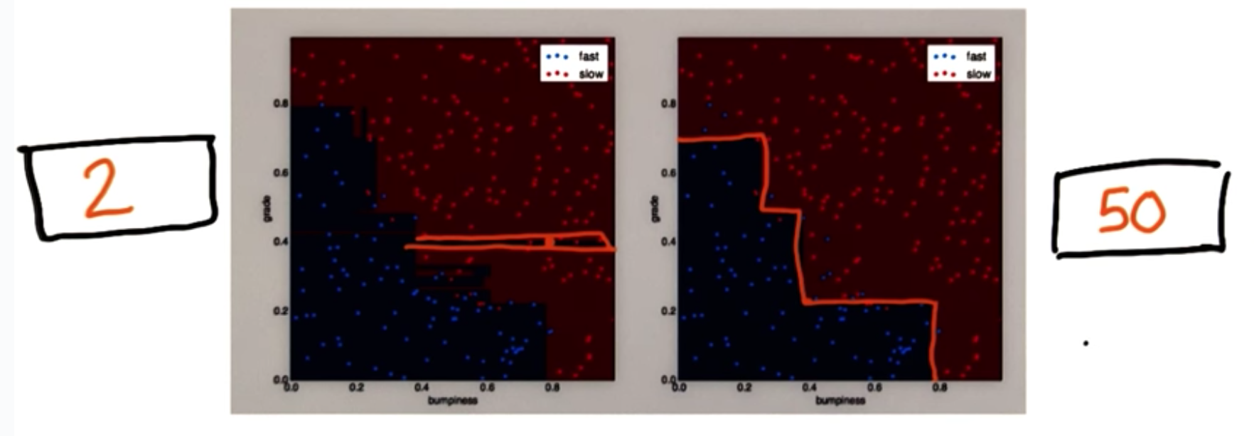

Slide 14
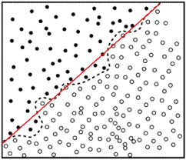
Entropy
Entropy measures IMPURITY in data
Controls data classification in decision trees

Slide 15
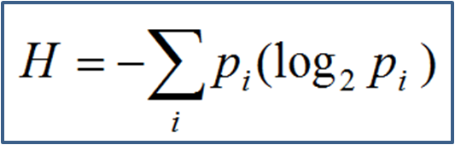

Slide 16
CODE

Slide 17
Information Gain
I.G: Entropy(Parent Data) - (Weighted Average) Entropy(Children)
Decision Tree Classifiers MAXIMIZE Information Gain

Slide 18
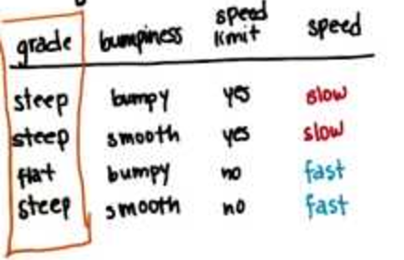
Problem: Parent Entropy (Speed): 1.0

Slide 19
Information Gain Calculations
Entropy Grade: (¾) * 0.9184 + (¼) * 0 = 0.3112
Entropy Bumpiness: (2/4) * 1.0 + (2/4) * 1.0 = 1.0
Entropy Speed Limit: (2/4) * (-1.0 * log(1.0)) + … = 0.0
Maximum I.G: Speed Limit

Slide 20
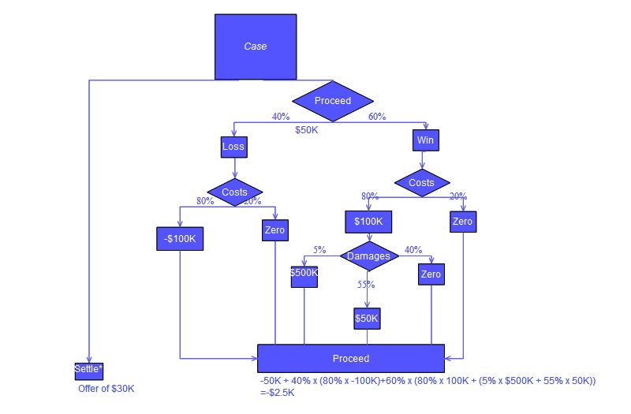
Problems… and Benefits
Overfitting with Complex Data
Use Proper Parameter Tuning!
Compile Decision Trees into larger Classifier

