Slide 1
Neural Networks Pt 2
Mihir Patel and Nikhil Sardana

Slide 2
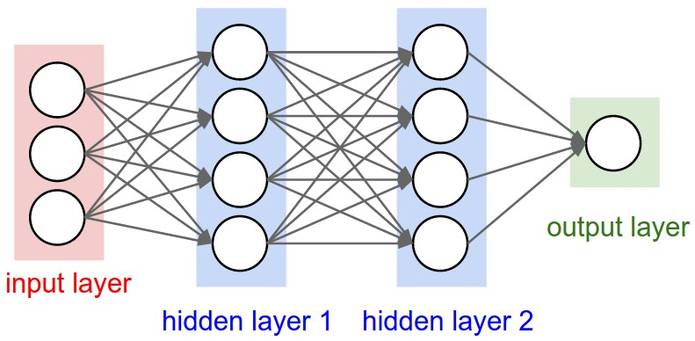
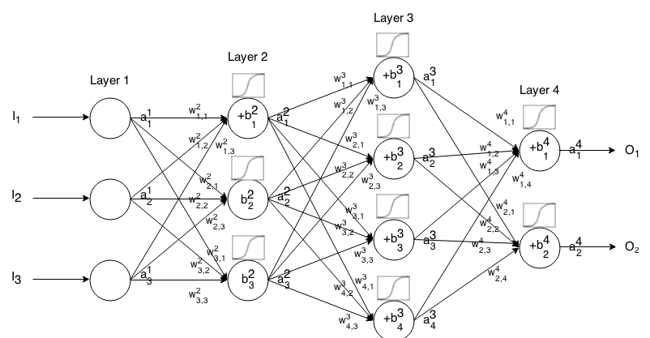
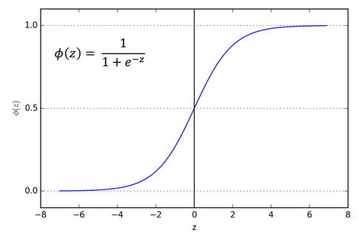
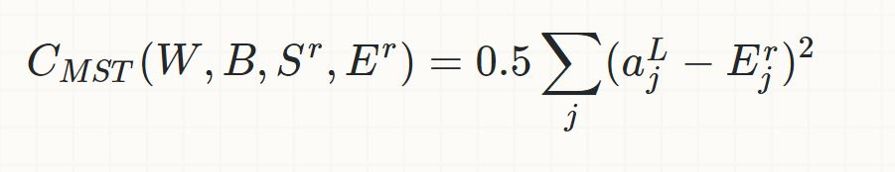
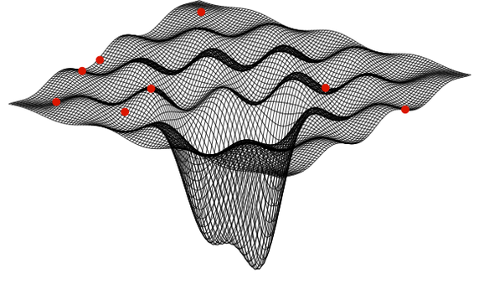
Synopsis

Slide 3
Data Techniques
Expanding datasets
Weight initialization
Narrow gaussian
Batching

Slide 4
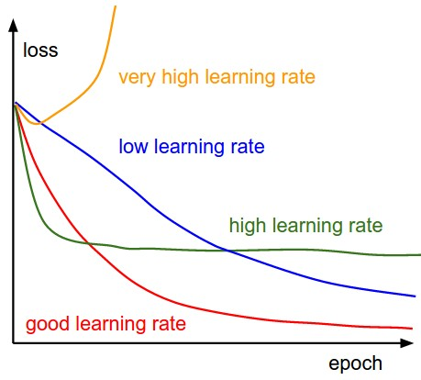

Learning Rate
Step size for backpropagation

Slide 5
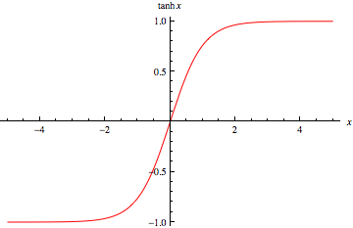
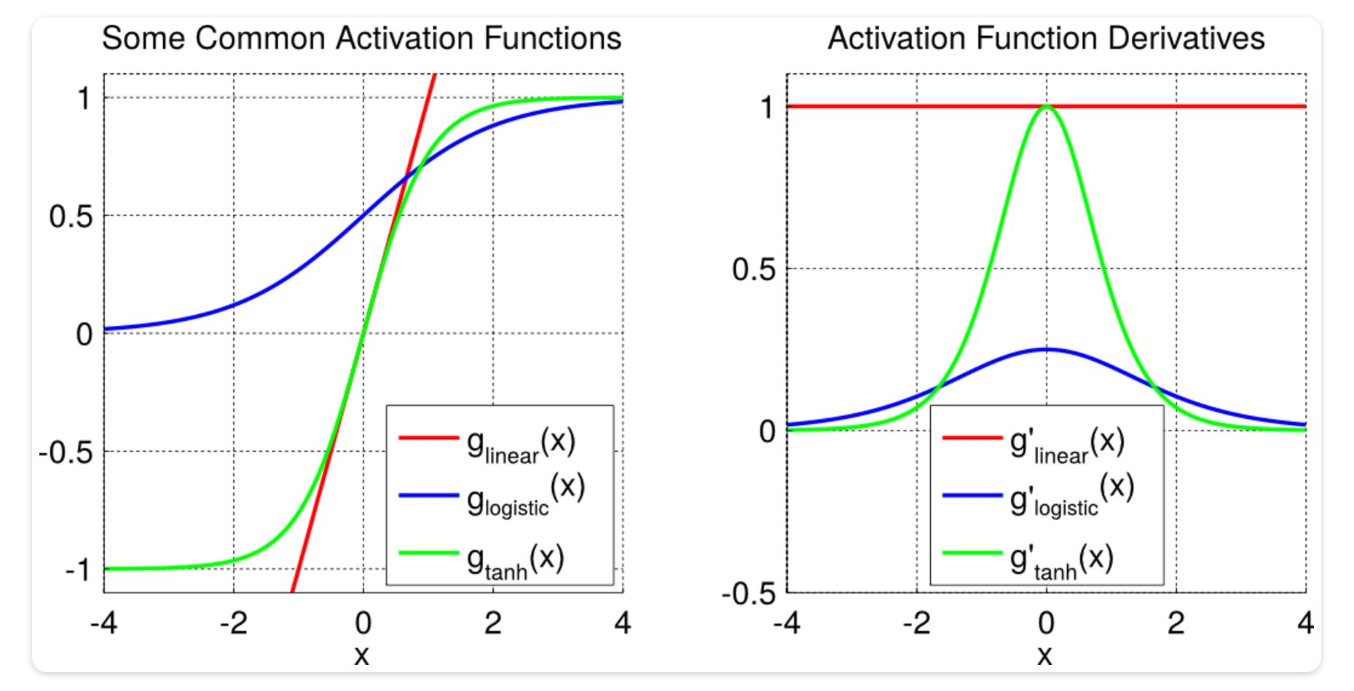
Activation Functions: tanh
y = (e^{x}-e^{-x})/(e^{x} + e^{-x})
Benefits
Greater derivative = faster learning
-1 vs. 0 prevents stagnation

Slide 6
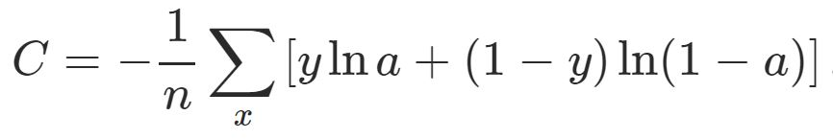
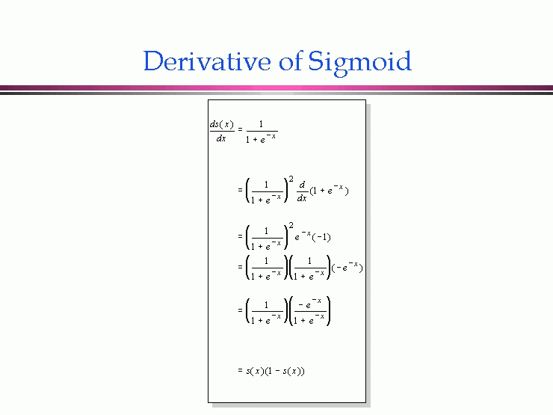
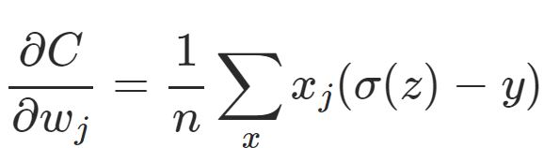
Cost Function: Cross-Entropy
http://neuralnetworksanddeeplearning.com/chap3.html#saturation2_anchor
Saturation
Needs
Approaches 0 when correct
Always has positive sign
Benefits
Doesn’t give 0 when incorrect

Slide 7
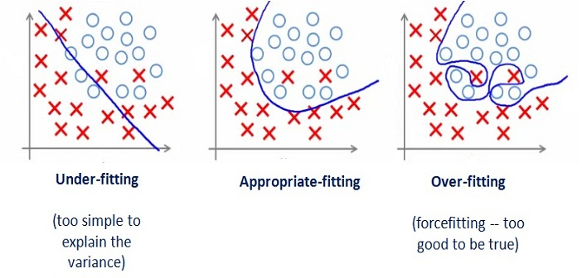
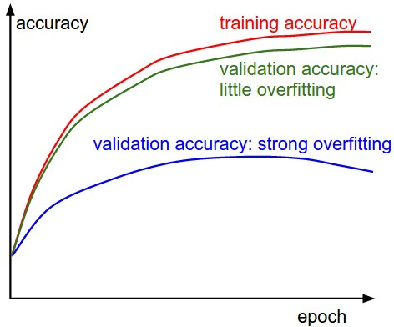
Overfitting
Over-matching dataset

Slide 8
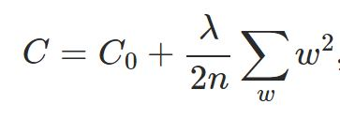
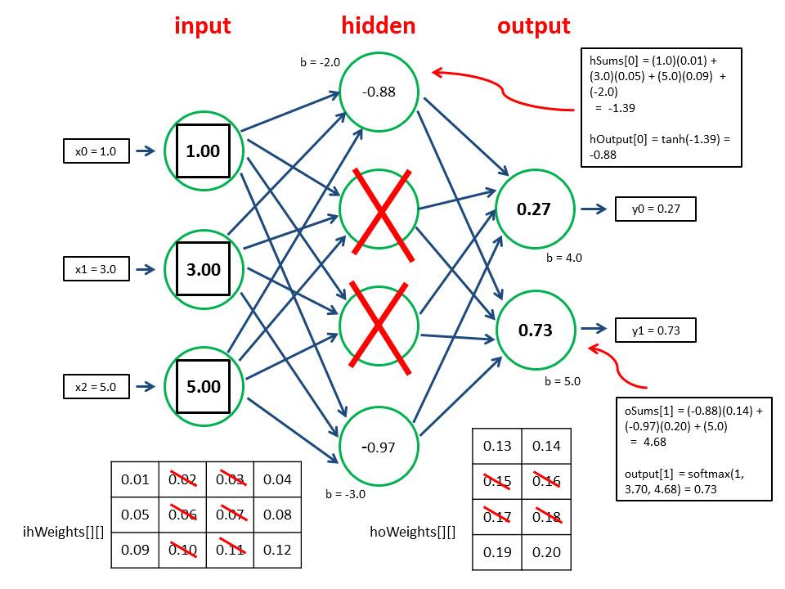
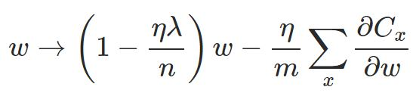
Solutions to Overfitting
Weight Decay
Punish larger weights
Dropout

