Slide 1
Recurrent Neural Networks
Nikhil Sardana and Mihir Patel

Slide 2
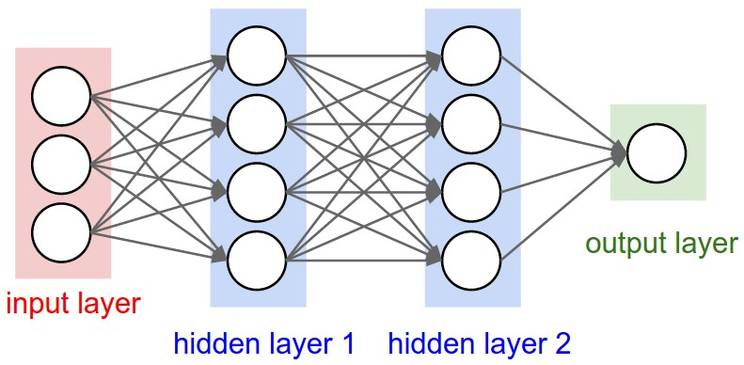
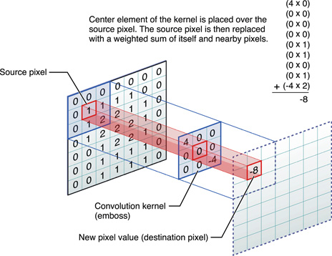
Other Networks
Standard NNs and CNNs
Fixed input vector size, fixed output vector size

Slide 3
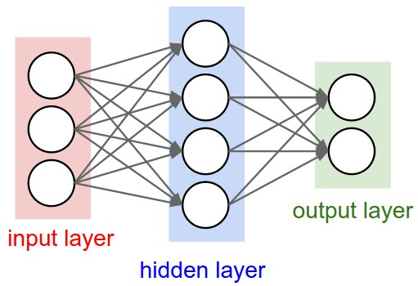
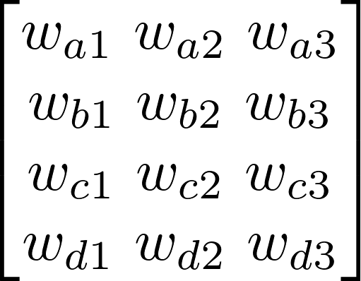
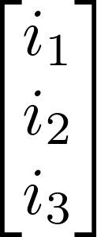
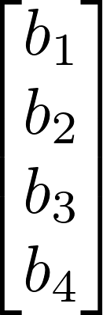
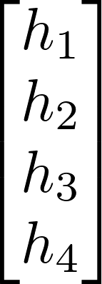
Standard Neural Networks - Forward Propagation
Input Vector
N x 1
Bias Vector
M x 1
Output Vector
M x 1
Weight Matrix
M x N
.
+
=
Apply activation function
Repeat for each layer

Slide 4
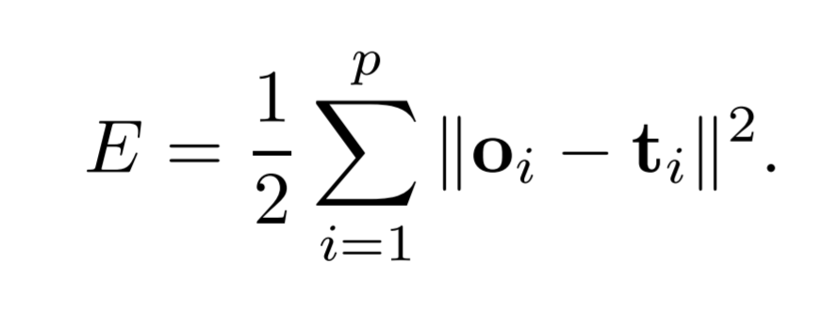
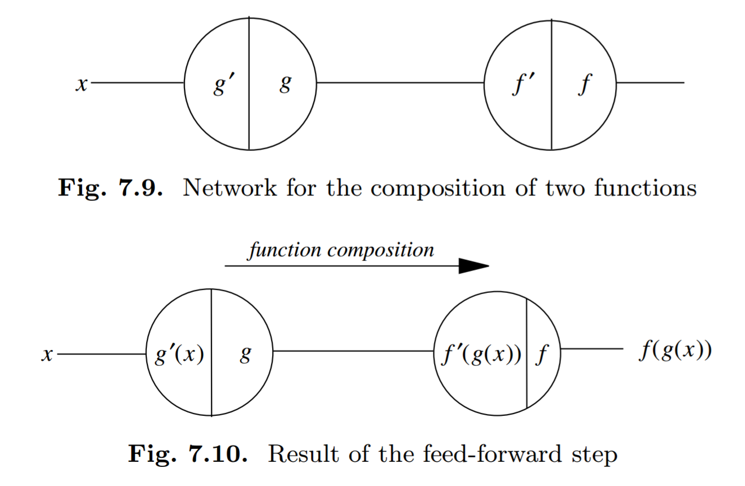
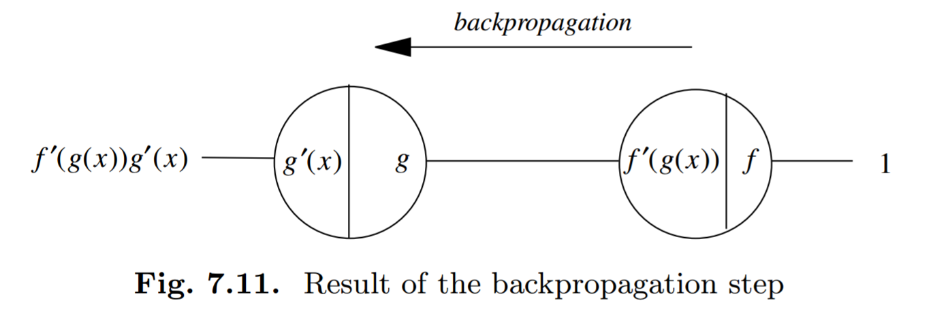
Standard Neural Networks - Backpropagation
Minimize Error between network output and truth

Slide 5
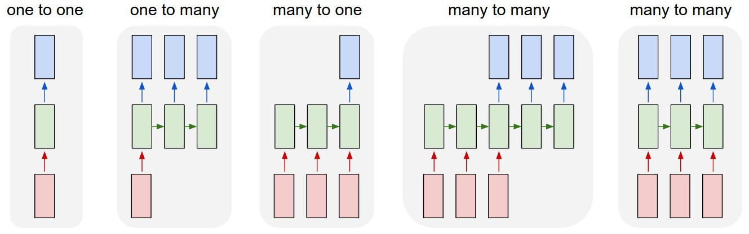
What Makes RNNs Unique
Standard NN
Image to sentence
Sentiment Analysis
Machine Translation
Per-Frame Video Classification

Slide 6
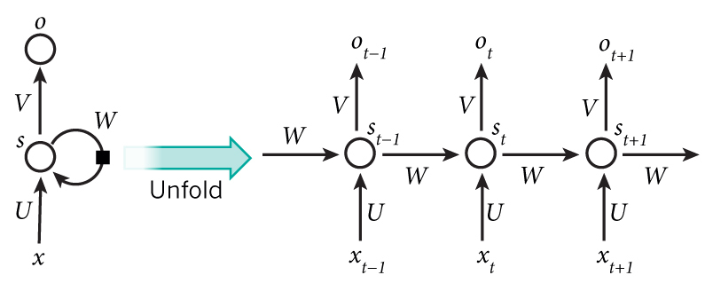
Time-Dependent Structure
X_{t} is the one-hot input vector for given time-step t
S_{t} = f(Ux_{t-1} + Ws_{t-1} + b) where f is tanh, ReLu
U and W are weight matrices
O_{t} = Vs_{t} + c → the output vector for a given t
S is usually initialized to all 0’s
b and c are bias vectors
Notes:
RNNs can operate over a sequence of vectors because they have a different input for each time step.
Why do we compute the hidden state with this formula?
This allows us to take into account the previous hidden state (which is dependent on say, the previous characters of the sequence), and the input vector (the newest character).
Thus, we can take into account a whole bunch of previous characters when computing our next one.

Slide 7
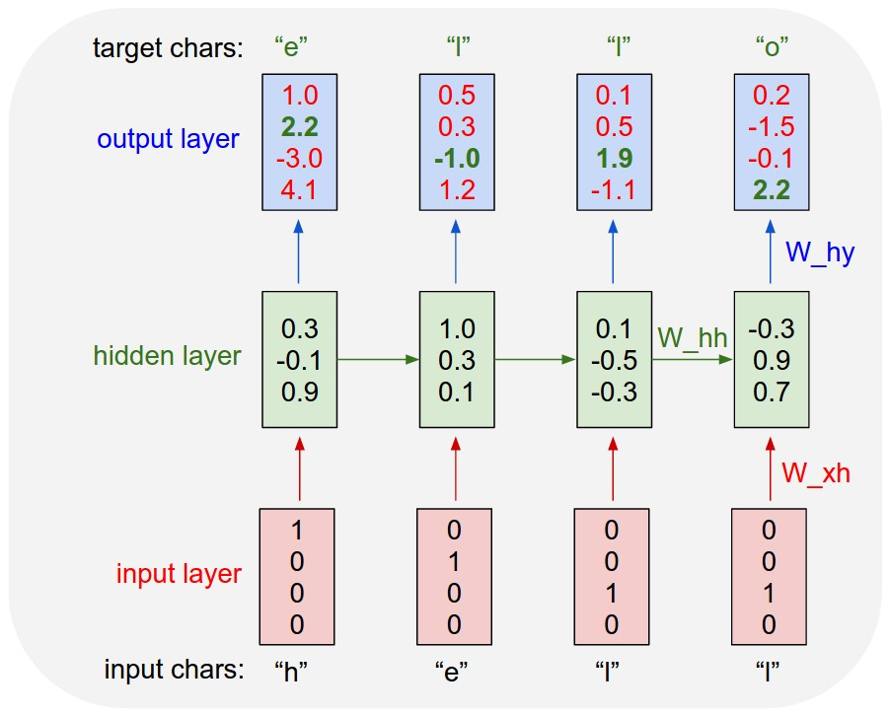
Example: Character-Based RNN
Notes:
This diagram shows why the horizontal hidden state vector movement is important. The first time, we want the “l” to return an “l”. The second time, an “o”.
Think of a function f(x) = x^2. When I input x=2, I will always get 4. It doesn’t matter what I gave the function I previously. If I ask for f(3) = 9, and then f(2), I still get 4. There is no time or previous answer dependency. RNNs allow us to base our next output on all the previous inputs, which makes them powerful.

Slide 8
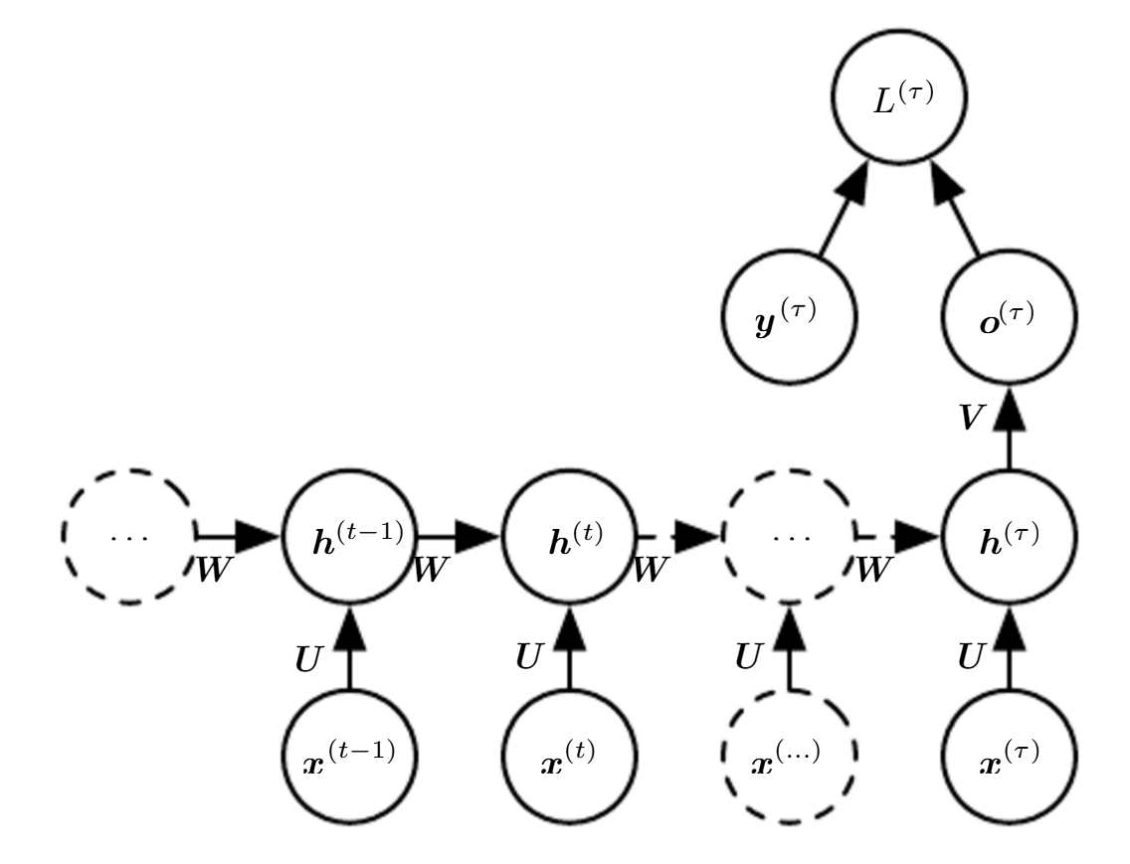
Backpropagation in RNNs
Where y^{(T)} = softmax
And L^{(T)} = loss
Iterate backwards through time applying normal backpropagation

Slide 9
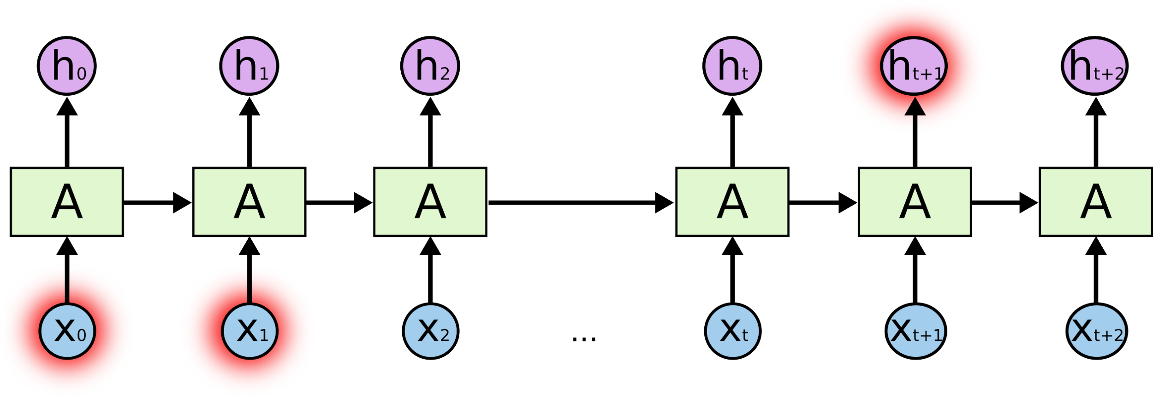
Drawbacks
Terrible Long-Term Memory because of Vanishing Gradient
Notes:
Consider a scalar multiplied by itself over and over. For x^n given x<1, x^n → 0 relatively quickly. The gradient is the same. Either it explodes or vanishes in a traditional RNN.

Slide 10

Long Short-Term Memory Units (LSTM)
Notes:
The key to the LSTM is the cell state. It runs along, relatively unchanged by interactions. Because it centers on addition rather than multiplication, the gradients remain constant throughout backpropagation. LSTMs allow us to add to or remove information in the cell state.

Slide 11
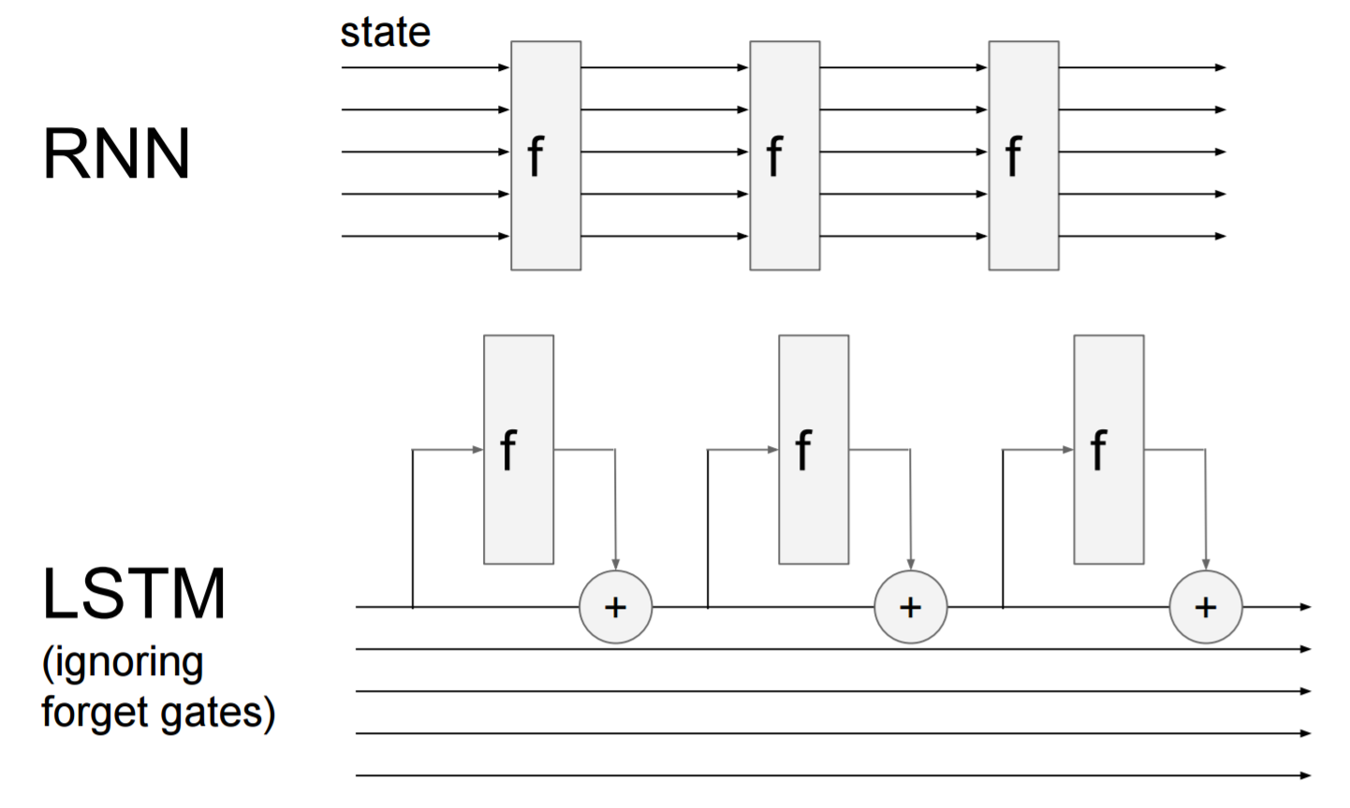
Solving the Vanishing Gradient

Slide 12
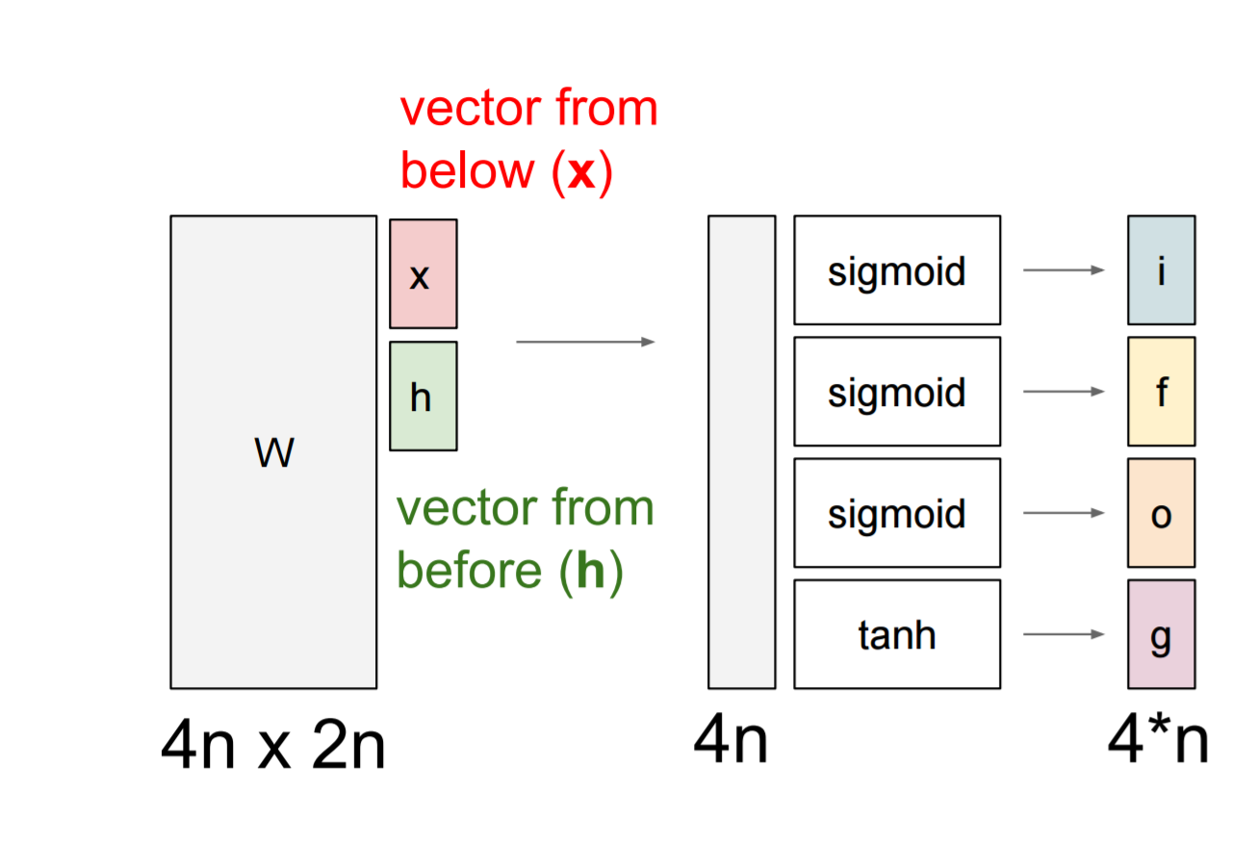
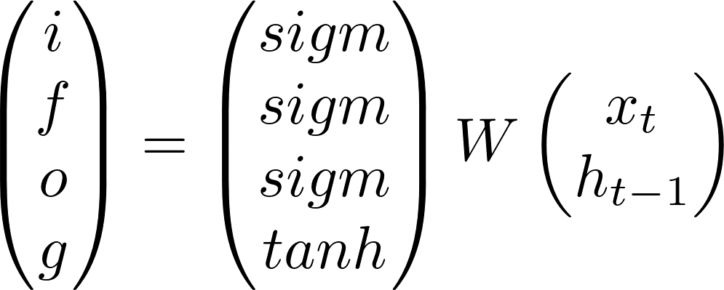


Long Short-Term Memory Units (LSTM)
Notes:
The f is the forget gate. When f is zero, the cell becomes zeroed out. The input determines what will be stored in the cell state. The output controls the information outflow.

Slide 13
Applications of RNNs
Natural Language Processing (e.g. Shakespeare)
PANDARUS: Alas, I think he shall be come approached and the day When little srain would be attain'd into being never fed, And who is but a chain and subjects of his death, I should not sleep. Second Senator: They are away this miseries, produced upon my soul, Breaking and strongly should be buried, when I perish The earth and thoughts of many states.
DUKE VINCENTIO: Well, your wit is in the care of side and that. Second Lord: They would be ruled after this chamber, and my fair nues begun out of the fact, to be conveyed, Whose noble souls I'll have the heart of the wars. Clown: Come, sir, I will make did behold your worship. VIOLA: I'll drink it.

Slide 14
Application: Text Generation
static void action_new_function(struct s_stat_info *wb) { unsigned long flags; int lel_idx_bit = e->edd, *sys & ~((unsigned long) *FIRST_COMPAT); buf[0] = 0xFFFFFFFF & (bit << 4); min(inc, slist->bytes); printk(KERN_WARNING "Memory allocated %02x/%02x, " "original MLL instead\n"), min(min(multi_run - s->len, max) * num_data_in), frame_pos, sz + first_seg); div_u64_w(val, inb_p); spin_unlock(&disk->queue_lock); mutex_unlock(&s->sock->mutex); mutex_unlock(&func->mutex); return disassemble(info->pending_bh); }

Slide 15
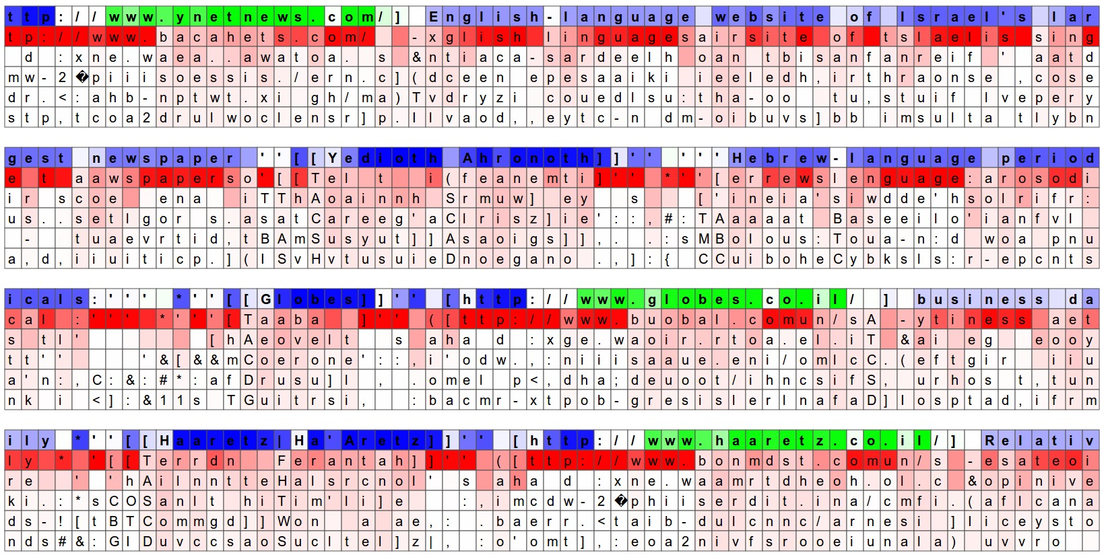
Visualizing Neurons

Slide 16
Application: Audio Generation
http://www.hexahedria.com/2015/08/03/composing-music-with-recurrent-neural-networks/
https://lyrebird.ai/demo

Slide 17
Practice Problem
Write an LSTM Unit given:
input vector
previous hidden vector
previous cell state vector.
Return:
new hidden vector
new cell state.

Slide 18
Questions?
Email tjmachinelearning@gmail.com
RNNs can be confusing.

Slide 19
Resources
http://cs231n.stanford.edu/slides/2016/winter1516_lecture10.pdf
https://web.stanford.edu/class/cs224n/lecture_notes/cs224n-2017-notes5.pdf
http://karpathy.github.io/2015/05/21/rnn-effectiveness/

