Slide 1
Neural Networks Pt 3
Mihir Patel and Nikhil Sardana

Slide 2
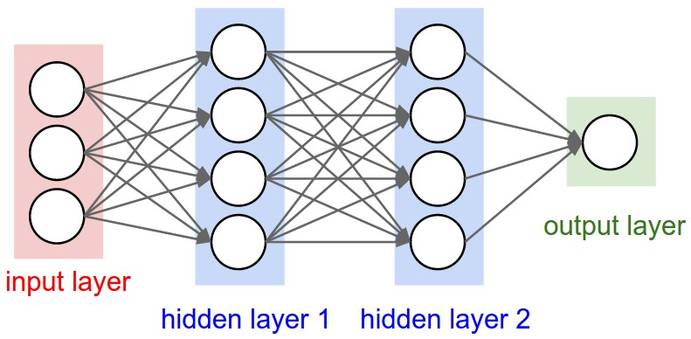
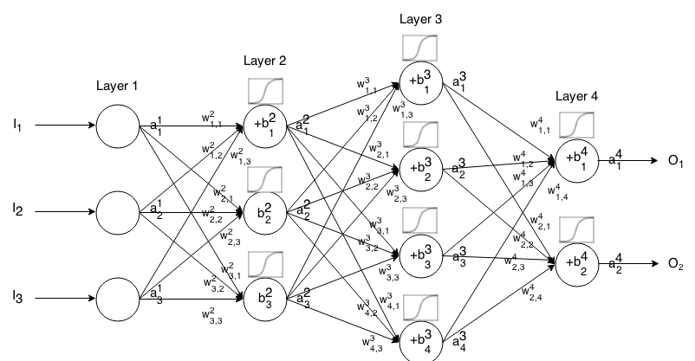
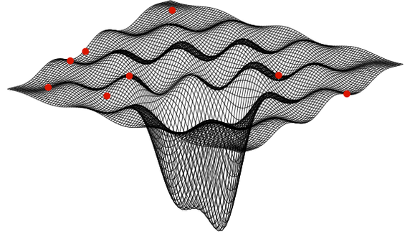
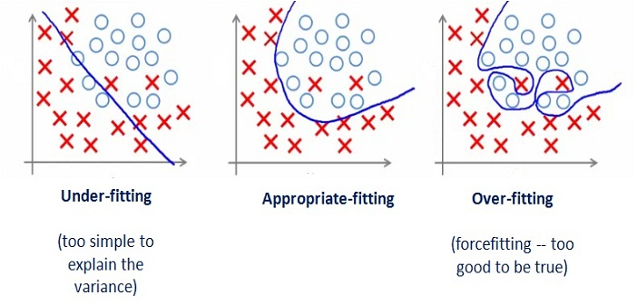
Synopsis

Slide 3
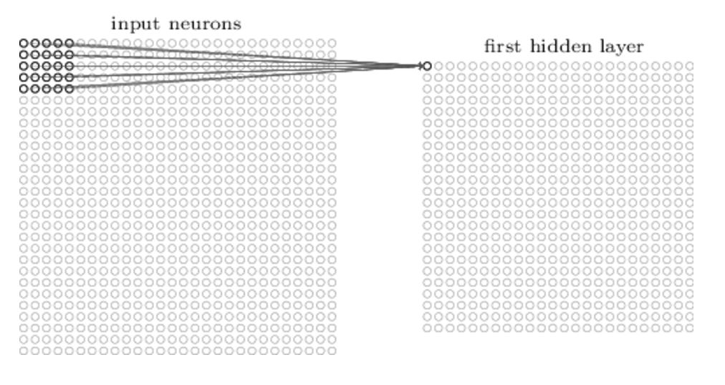
Convolutional Layers
Normal layers
Treat all inputs equally
Are densely connected
Can learn basically anything
Convolutional Layers
Utilize shared weights
Sparsely connected
Spatially oriented

Slide 4
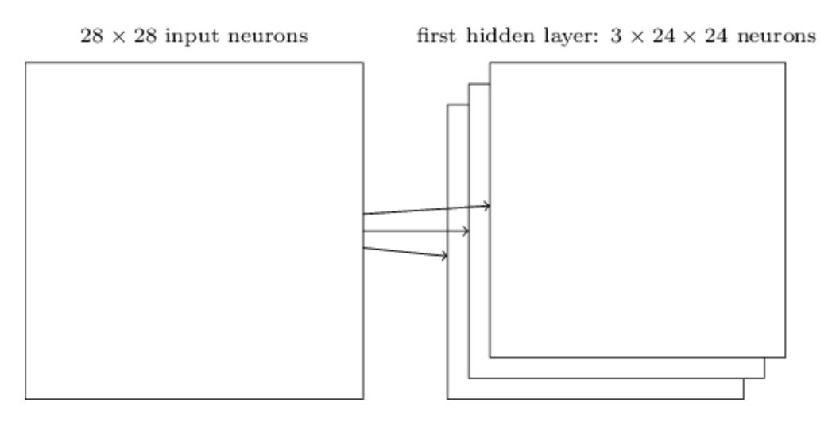
Convolutional Layers
Create feature maps
Each feature map has its own weights
A layer can have n feature maps
Size shrinkage based on filter size
Zero Padding
Stride length
Overfitting

Slide 5
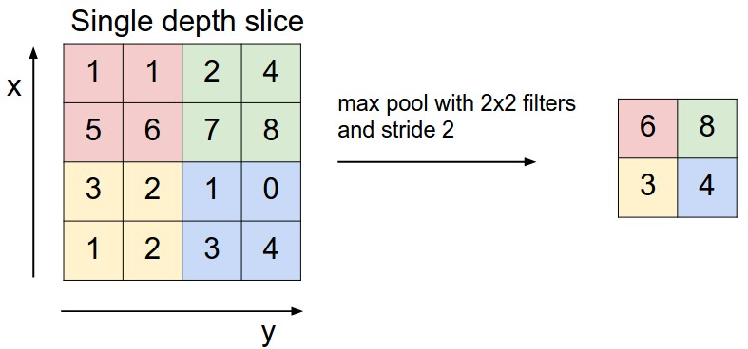
Pooling Layers
Max pooling
Takes highest value
Compresses feature maps
Average Pooling
Averages values
L2 Pooling
Square root of squares of values
Increases weightage of clusters

Slide 6
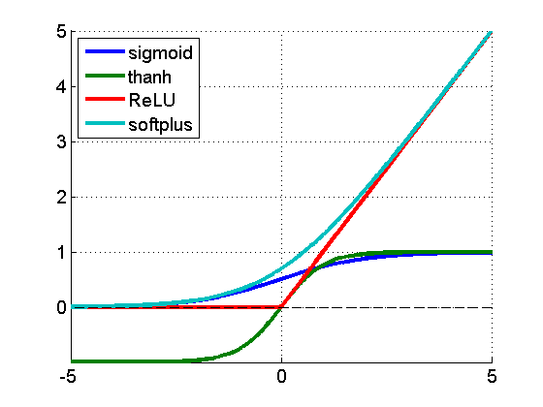
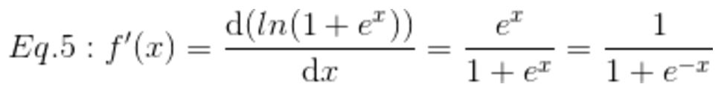
ReLU Function
Linear
Learns Faster
Vanishing Gradient Vanishes
Ignores negative values
Slightly less efficient -> Much faster

Slide 7
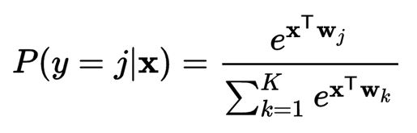
Softmax Layers
Probability for each output
Watson plays Jeopardy

