Slide 1
Neural Networks
Mihir Patel and Nikhil Sardana

Slide 2
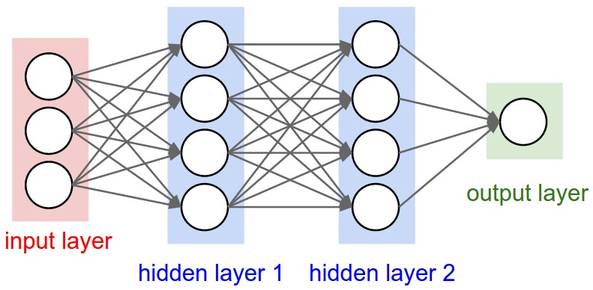
Introduction
Neural networks are modeled after the brain

Slide 3
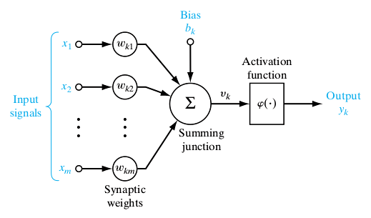
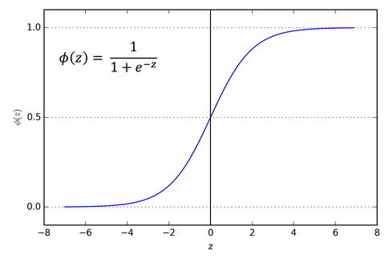
The Neuron
Each neuron takes in multiple inputs
Each one has an associated weight
These are summed
An activation function is run on the sum
This yields a standardized output

Slide 4
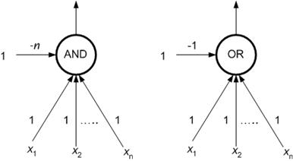
Biases
Biases give the default case

Slide 5
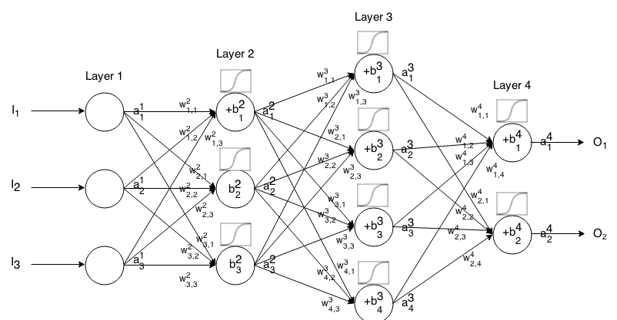
Full Network

Slide 6
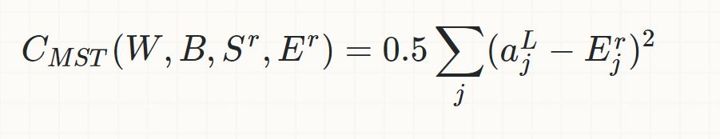
Cost Function
The cost function essentially is the difference between the actual output and the expected output
The squaring allows for removal of signs

Slide 7
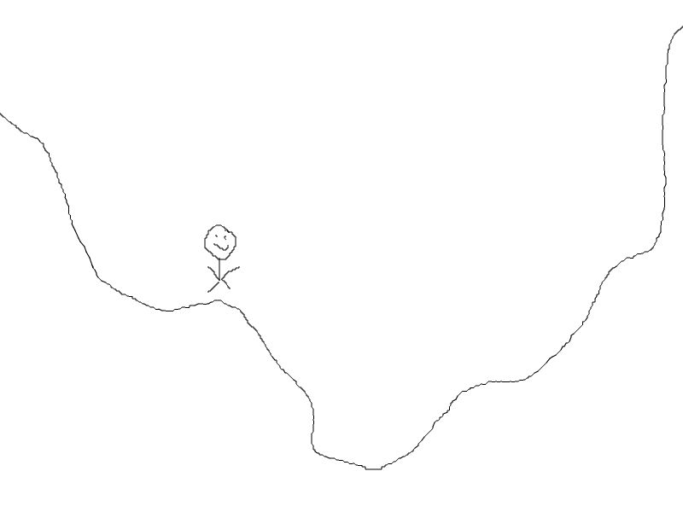
Minimizing the Cost Function: Hill Climbing
Run each direction to see if
It is a better move

Slide 8
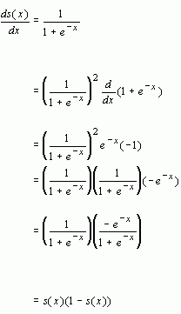
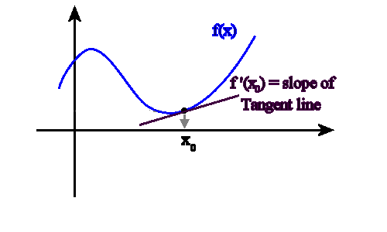
Minimizing the Cost Function: Derivatives
Derivatives allow you to know which direction is better instantly

Slide 9
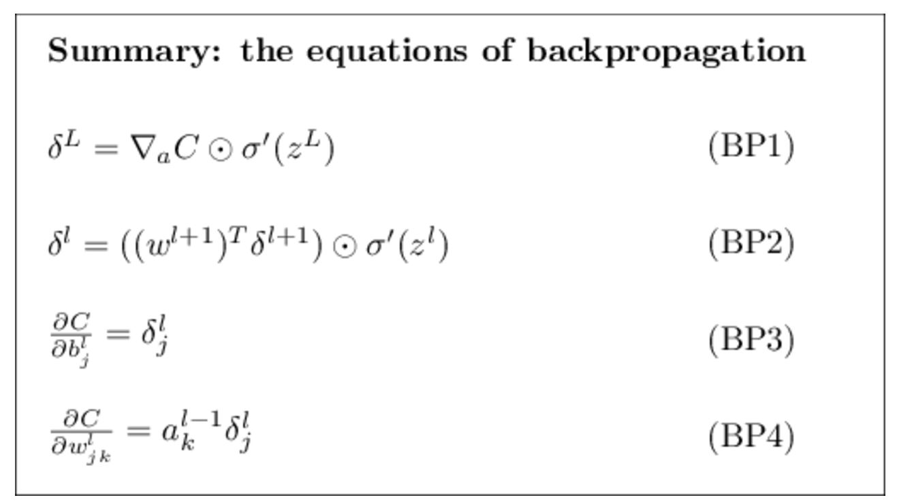
Backpropagation
You only know error in output
Backpropagate the error

Slide 10
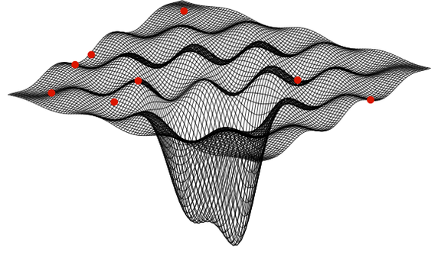
Why Don’t Networks Achieve the Same Results?
There are multiple local
minimums!

Slide 11
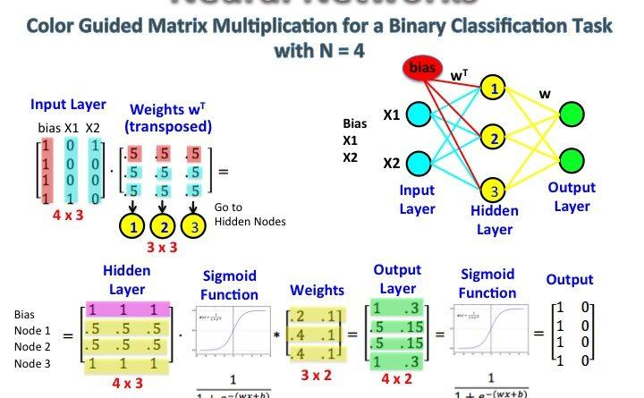
Matrix Representation
Forward propagation
can be simplified using
matrix math
Can be parallelized for
GPU based acceleration

Slide 12
Pros and Cons
Pros
Very powerful — can identify nearly any pattern even when a human cannot
With GPUs are now able to be trained in reasonable amounts of time
Flexible and adaptable to problem situations
Cons
Require large amounts of data
For these networks, they require a human to pre-identify the correct answer

