Slide 1
Support Vector Machines
Mihir Patel and Nikhil Sardana
Notes:
A simple binary classification method

Slide 2

Introduction
2 Dimensional Data
How do we classify (separate) the data?
A Line
How do we separate the data better?
Maximize margin between line and data
For n-dimensional data, we can find an n-1 dimensional plane (called a hyperplane) to separate the data
Notes:
Let us consider some 2 dimensional data
A simple way to classify the 2-dimensional data is a 1 dimensional line
The best line is one that maximizes the distance between the data points and the line (H3 in the image above)
Let us generalize this for any dimension n
If we have data points in n dimensions (x, y, z, a, b, c, … n)
Then we can find a n-1 dimensional plane (in the case with 2 dimensions, n-1 = 1 dimensional plane = line)
This plane separates the data
This is called a hyperplane

Slide 3
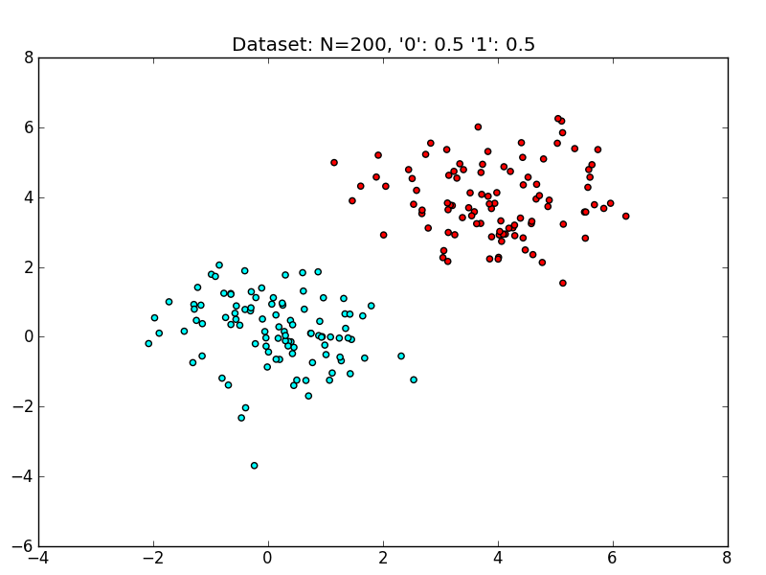
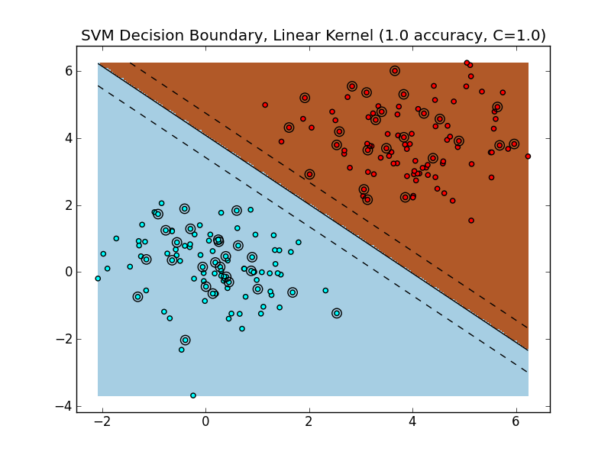
Linearly Separable Data
Notes:
Data that works well for this separation by n-1 dimensional hyperplane is called “linearly separable data”

Slide 4
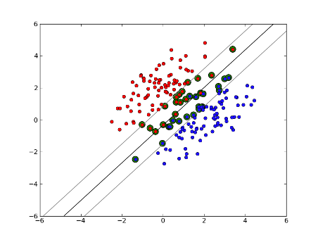
The Hyperplane
Computing the Hyperplane
Lots of Math (Unimportant)
Important: Can be solved computationally in quadratic time
Picking the Hyperplane
SVMs rely only on “difficult points” close to decision boundary called Support Vectors
Prevents overfitting
Notes:
How do we compute the hyperplane?
Lots of math that I don’t want to explain (because its hard and unnecessary for us)
What is important is that its is polynomial computationally

Slide 5
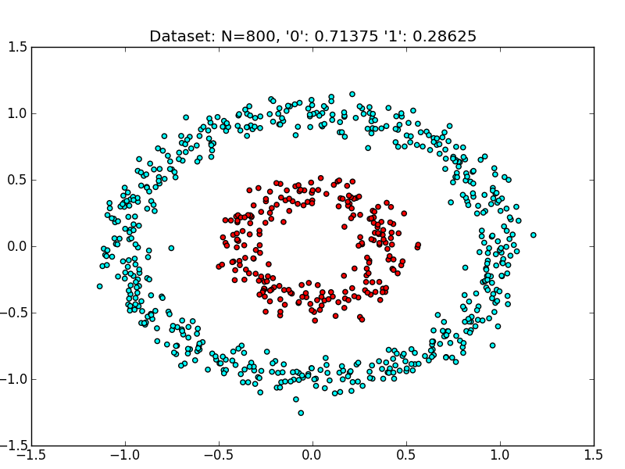
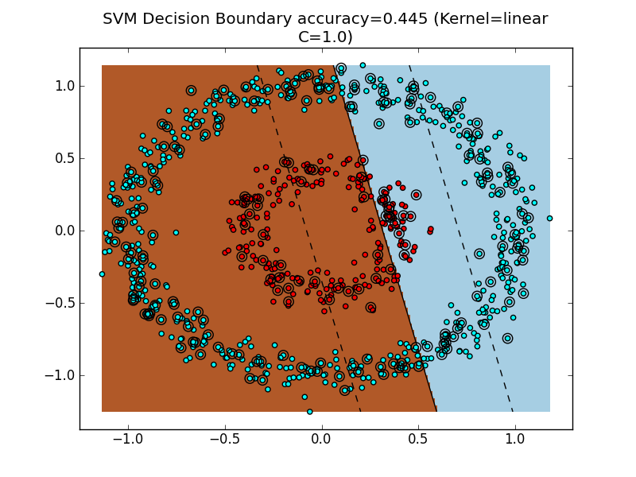
Non-Linearly Separable Data
Notes:
So thats all great for linearly separable data
But what about non-linearly separable data?
SVM’s dont work?
Well running what we have learned so far, we get terrible results
How do we solve this?

Slide 6
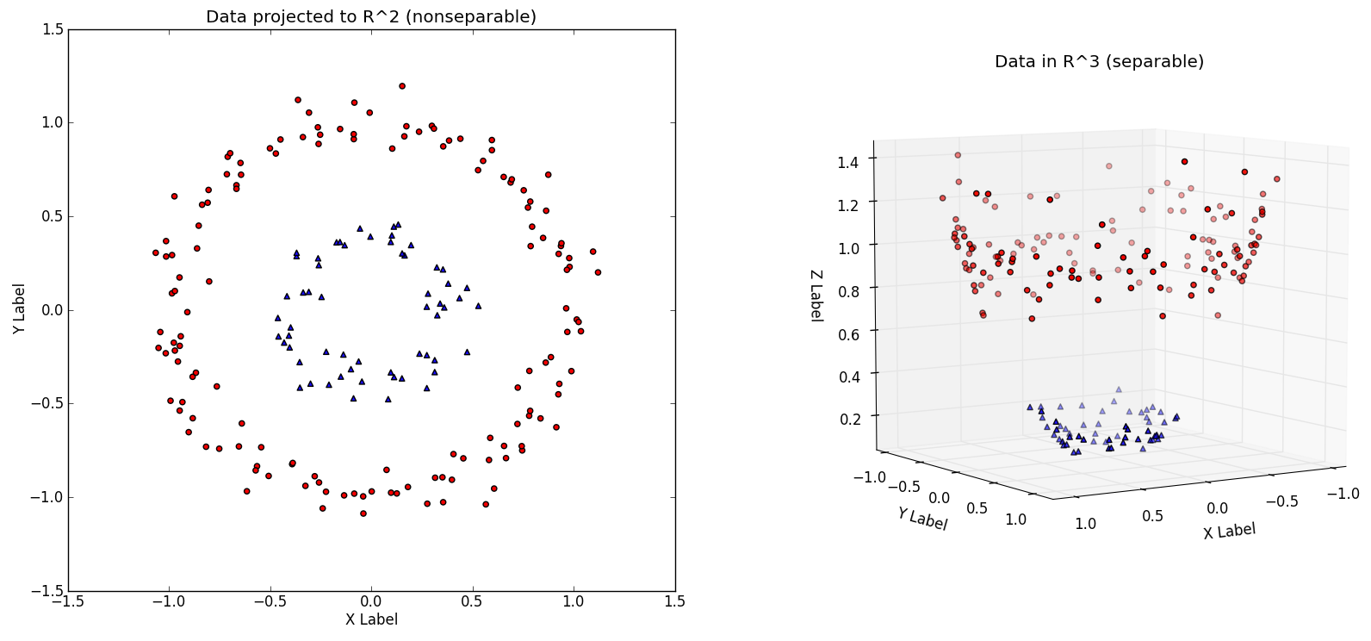
The Kernel Trick
Move data into higher dimensions to create linear separation
Example: transformation applied: (x, y) → (x, y, x² + y²)
x² + y² is the radius²
Results in linear separation
Blue Data: x²+y² ~ 0.2
Red Data: x²+y² ~ 1.0
Notes:
The kernel trick is a method of creating separability by transforming the data into higher dimensions
Lets consider the data in the image
Since they are in circles, the radius of the blue data is generally much smaller than the radius of the red data
So if we take the x^2 +y^2 of each data and graph it on the z-plane, we get the blue data points all clustered around z=0.2 (smaller radius = lower on z-plane)
And the red data around z = 1.0
Now we can easily find an n-1 dimensional plane (a 2 dimensional plane) that separates the data

Slide 7
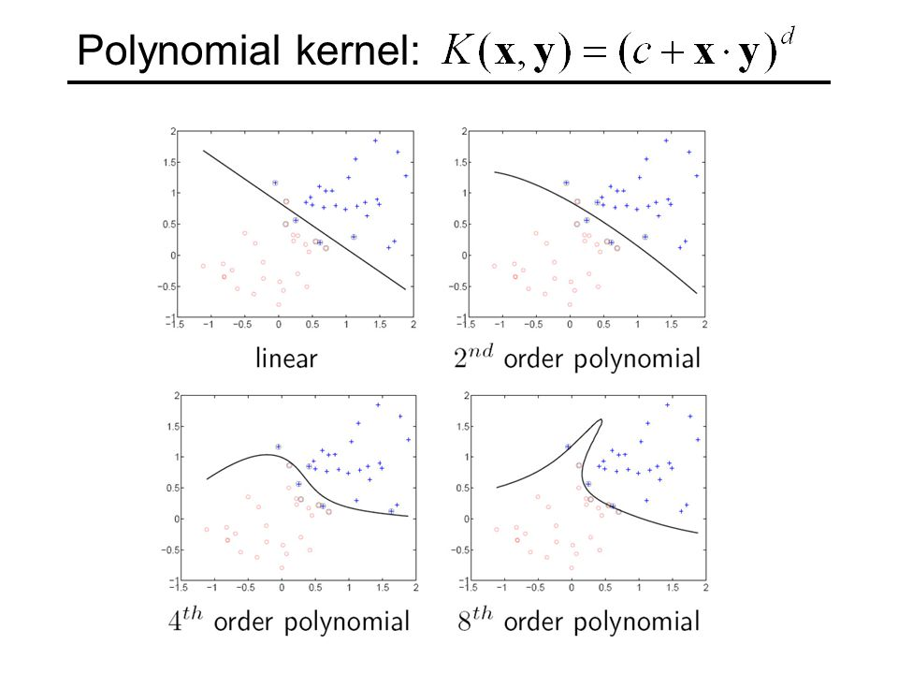
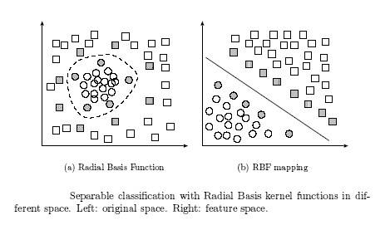
Common Transformations
Notes:
So thats great for circular data, but what do we do when we don’t know what shape the data is?
We can use some common kernels, which include polynomial and rbf

Slide 8
More Kernels
Linear Kernel
Polynomial Kernel
Gaussian Kernel
Exponential Kernel
Laplacian Kernel
ANOVA Kernel
Hyperbolic Tangent (Sigmoid) Kernel
Rational Quadratic Kernel
Multiquadric Kernel
Inverse Multiquadric Kernel
Circular Kernel
Spherical Kernel
13. Wave Kernel
14. Power Kernel
15. Log Kernel
16. Spline Kernel
17. B-Spline Kernel
18. Bessel Kernel
19. Cauchy Kernel
20. Chi-Square Kernel
21. Histogram Intersection Kernel
22. Generalized Histogram Intersection Kernel
23. Generalized T-Student Kernel
24. Bayesian Kernel
25. Wavelet Kernel
Notes:
Basically there are a ton of different kernels.
The default options in scikit-learn (the library which we are using) are sigmoid, rbf, linear, polynomial Just know that all these kernels do the same thing essentially: they transform the data into higher dimensions to create linear separability

Slide 9
Summary
Advantages
Always global minima (no local minima issues)
Minimal hyperparameter tuning
Minimal data - You can have more input than test data
Custom kernels
Cons
May not give as accurate results
Difficult to figure out which kernel is ideal
Notes:
It always reaches same percentage accuracy which is lowest possible (better than say neural networks)
Easy to make, little work
Good for small datasets
Adaptable
It's just not as good
Data is hard to display bc of the n-dimension thing

Slide 10
Applications
Text Categorization
Image Categorization
Medicinal Diagnosis Tests
Why Use SVMs?
Lots of features of input but not very large datasets
Minimal human hyperparameter tuning
Binary / few categories
Notes:
Sentiment
Is it X?
Do you have something or not
Why Use SVMS
Good for detailed objects with minimal data points
Easy to do
If its simple outcome state

Slide 11
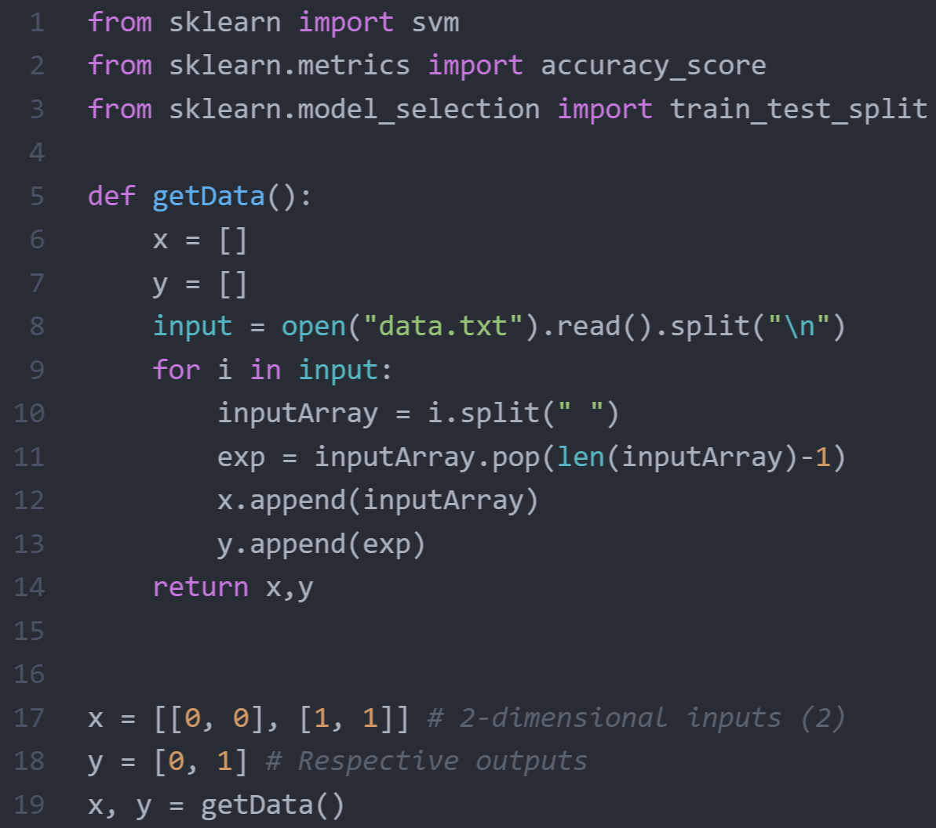
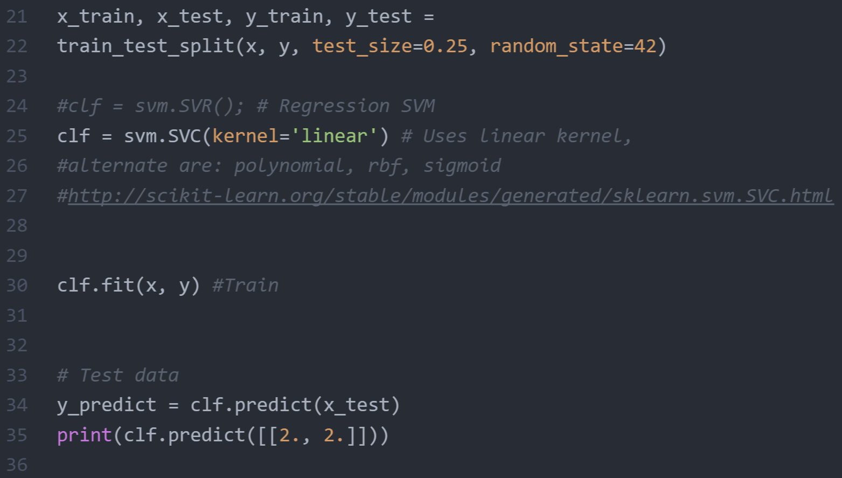
Code: Scikit-Learn
Notes:
Each x data point is an array of parameters
Each y output is classification
Scikit auto-splits for train vs. test data
You can set kernels through kernel = ...
Clf.fit trains
Clf.predict runs through network, accuracy gives accuracy

Slide 12
Contest
Breast Cancer Tumors
Key Things
The default kernels are cool, but they won’t give great results
If you want to win, graph the data to find better kernels: Plot.ly
Look at prior research!
Try the Liver Data again (You should be able to reach 100% accuracy)
http://tjmachinelearning.com/schedule.html
Actually do the contest (the first part takes 15 minutes)
Notes:
You MUST edit the data input shell to work with the data.
Using the default kernels (polynomial, rbf, etc.) you most likely won’t get >70% ish
If you get the default ones working, go ahead and submit that code (this should take 15 minutes)
Then, if you want to win the contest (or do well), graph some of the data and try to come up with your own kernel function
Submit again once you’ve got the custom kernels working
Submit everything by next wednesday meeting

