Slide 1
The Math of Machine Learning
Neil Thistlethwaite

Slide 2
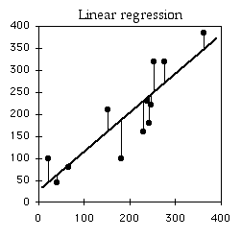

Linear Regression
θ represents our parameter vector for standard linear regression with a single feature it will be of size 2x1
h(x) is our hypothesis of the form
(with one feature)
X is the feature data, usually represented in the form of a mxn matrix, with m being the number of data points and n being the number of features
y is the known values or “actual” values that we’re trying to perform regression on in conjunction with the supplied x-values

Slide 3

Linear Regression Cost Function
The first thing we have to do to find an optimal “fit” for our line is come up with some kind of cost function to determine how good of a fit any given hypothesis is.
This particular cost function J(θ) is squared residuals, which we choose because it guarantees there will be exactly one local minimum, which will also be the global minimum, at which point we will have our line of best fit.

Slide 4
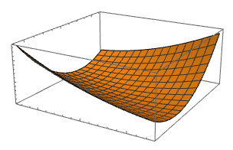
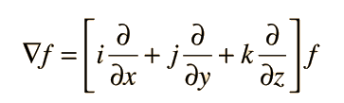
Linear Regression Gradient Descent
Gradient Descent is a technique for finding the global minimum where we calculate the gradient at a given point and try a new set of parameters in the direction of the gradient.
The gradient is an operator from multivariable calculus which represents the direction of greatest increase of a function, by subtracting it from our current estimate, we move in the direction of greatest decrease, down the “hill”.

Slide 5
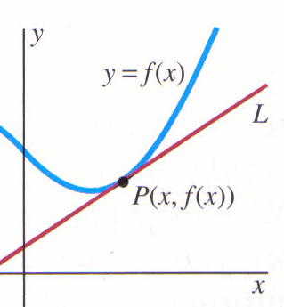

Gradient and Partial Derivatives
A derivative represents the instantaneous rate of change, or slope, of a function at a given point.
A partial derivative is much the same, except in
multiple dimensions; to find a partial derivative with
respect to a variable you do it the exact same way
but pretend that all the other variables are constants.

Slide 6
Acknowledgements
6th period Parallel so Neil could actually write this lecture
Thank kcheng
Thanks

