Slide 1
Basics of ML
Rohan Suri

Slide 2
Two main types of machine learning
Supervised
Unsupervised

Slide 3
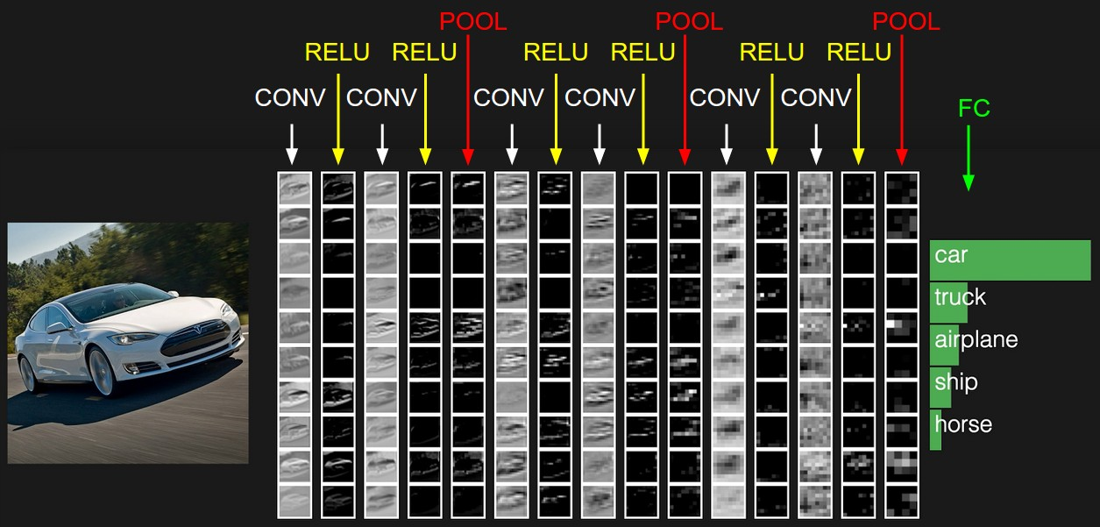
The problem of classification
F(Θ)

Slide 4
The problem of classification

Slide 5
The problem of classification
F(Θ)

Slide 6
Supervised Learning
Common problem is classification
Train on features and labels and predict a class

Slide 7
Binary Classification
Sensitivity (True positive rate)
Percent accurately classified positive
Specificity (1-false positive rate)
Percent accurately classified negative

Slide 8
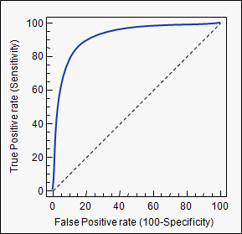
Receiver Operating Curve

Slide 9
Bayes Rule
Prior
Observation
Posterior

Slide 10
Bomb Search Example

Slide 11
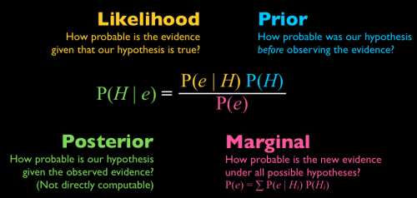
Bayes Rule

