Slide 1
Reinforcement Learning
Srinidhi Krishnamurthy

Slide 2

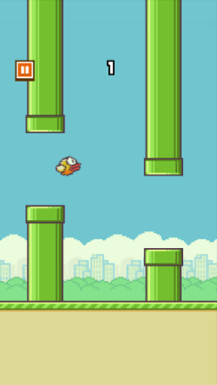
Basics

Slide 3
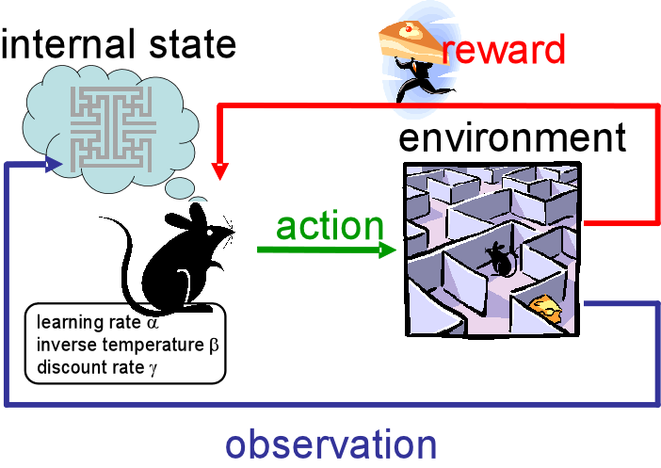
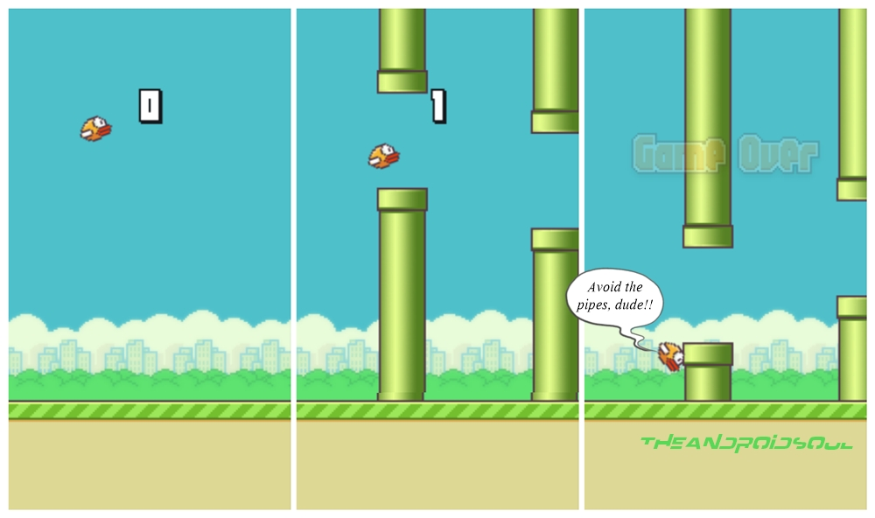
Reinforcement Learning
RL = feedback based system
Epsilon - ε
Every RL System has states, actions, and rewards

Slide 4
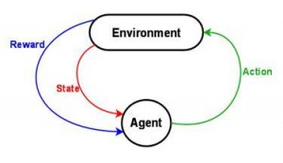
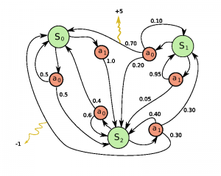
MDPs
Markov Decision Process
Similar to Markov Chains
Agent
Environment
Actions
Reward
Policy
Episode
Markov Assumption
the probability of the next state s_{i+1} depends only on current state s_{i} and performed action a_{i}
but not on preceding states or actions.

Slide 5
Discounted Future Reward
Total Reward for One Episode
The Discount Factor
γ (gamma)
Good ideas for gamma
γ = 0 for only immediate awards
γ = 0.9 for good balance
γ = 1 for deterministic problems

Slide 6
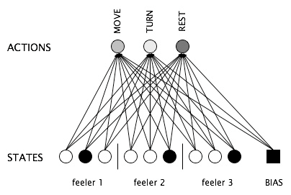
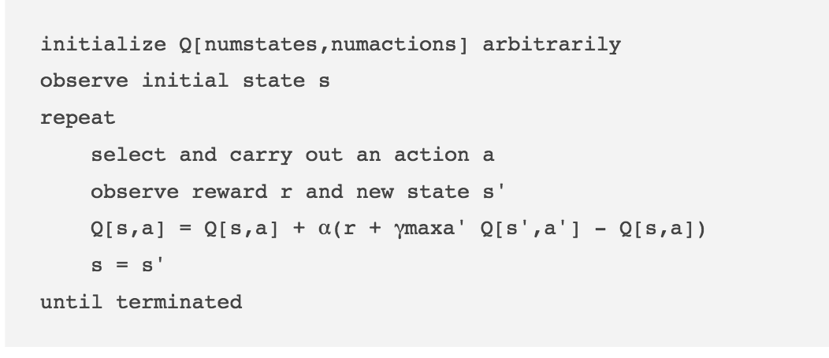
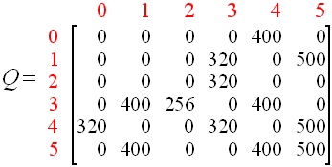
Q-Learning
Q-Value Network
Pseudocode
Q-Value Matrix

Slide 7
Proof of Q-Learning’s Convergence
http://users.isr.ist.utl.pt/~mtjspaan/readingGroup/ProofQlearning.pdf

Slide 8
SARSA
State-Action-Reward-State-Action
starts in state 1
performs action 1
gets a reward (reward 1)
Now, it’s in state 2
performs another action (action 2)
gets the reward from this state (reward 2)
before it goes back and updates the value of action 1 performed in state 1.

Slide 9
Q-learning vs SARSA
Q-learning
SARSA
https://studywolf.wordpress.com/2013/07/01/reinforcement-learning-sarsa-vs-q-learning/

Slide 10
Experience Replay
approximation of Q-values using non-linear functions is not very stable
During gameplay all the experiences <s,a,r,s′> are stored in a replay memory.
When training the network, random samples from the replay memory are used instead of the most recent transition
makes the training task more similar to supervised learning

Slide 11
Shortcoming and Solutions
credit assignment problem
it propagates rewards back in time
Exploration vs Exploitation
ε choose a random action
decreases ε over time from 1 to 0.1
So we continually get down to a fixed exploration space

Slide 12
Flappy Bird RL
https://sarvagyavaish.github.io/FlappyBirdRL/

Slide 13
Project/Problem
Implement Q-Learning in robot world such that it takes the optimal path every time. It should not take that long for the bot to learn what is right and what is wrong.
Also, I know that the solution can be found online so don’t cheat.
Have fun! You can probably get a solid amount of candy if you get it right.

