Slide 1
Title

Slide 2
Background & Motivation

Slide 3
Research Questions
1) How does dynamic cognitive control engagement affect ambiguity resolution in native bilinguals (i.e. trained language switchers, [+ cognitive control practice])?
2) How does dynamic cognitive control engagement affect ambiguity resolution in advanced learners (i.e. non-native, non-highly proficient language)?

Slide 4
Procedure

Slide 5
Target Structures (?)

Slide 6
Experiment 1

Slide 7
Participants (Experiment 1)

Slide 8
Materials

Slide 9
Materials: Other stuff

Slide 10
Coding & Scoring

Slide 11
Flanker scores separated for incongruent and congruent (no single flankers were analyzed in current data analysis)
Residuals were calculated (Incongruent – Congruent)
RTs for all items, RTs of Jegerski ítems and RTs of new ítems
Residuals calculated for each set
Only Jegerski ítems considered for current analysis

Slide 12
For all participants: Min: 100 ms // Max: 6000 ms or [Mean + 2.5 * SD], whichever was lower
168 replaced with max (no cases of <100ms)
Replaced data accounts for 2.54% of the total data points, well within the standard established by Jegerski (2014).
Reaction times plotted, y-intercept and line of best fit calculated to measure residuals or expected Reading times based on letters per región
Residual = RT – ExpectedRT

Slide 13
Participant 19 excluded as an outlier for multiple reasons
Participants with PercentCorrect < 60% excluded – did not understand structures (16 and 21) – these
60% threshold from Marijuan dissertation
Comprehension questions were also difficult in select distractors, so any close cases were considered individually for this reason
Items not completed
Items with ComprehensionCheck Correct = 0
8800 ítems – 800 ítems (participants 16, 21) – 2200 (100 ítems x 22 participants) – 1090 ítems = 4710 data points
4710 data points / five regions = 942 sentences total

Slide 14
Participant 19 excluded as an outlier for multiple reasons, leaving 2 intermediate students
Participants with PercentCorrect < 60% excluded – did not understand structures (16 and 21) – these
60% threshold from Marijuan dissertation
Comprehension questions were also difficult in select distractors, so any close cases were considered individually for this reason
Items not completed
Items with ComprehensionCheck Correct = 0
8800 ítems – 800 ítems (participants 16, 21) – 2200 (100 ítems x 22 participants) – 1090 ítems = 4710 data points
4710 data points – New stimuli = 2395 2395 / five regions = 479 sentences total
Participants 8 and 5 excluded upon analysis of Flanker residuals –
Participant 5 was also borderline sequential bilingual compared to other 4 native bilinguals and had much higher residuals than other native speaker bilinguals – no longer true, after finishing cleaning data, follow same pattern and 5 was NOT Leidy (who grew up in Colombia). Leidy behaves like other natives

Slide 15
Analyses
Repeated measures ANOVA 3 x 5

Slide 16
Results

Slide 17
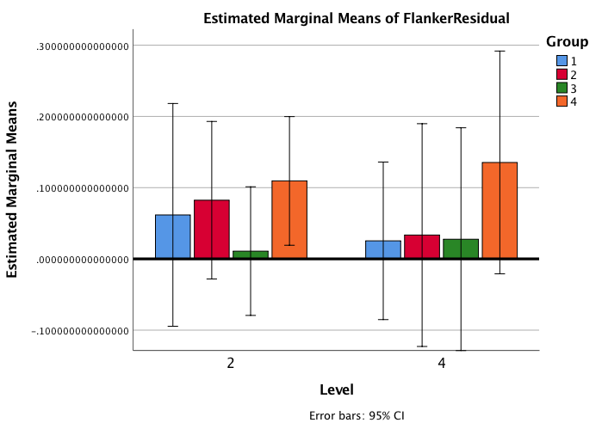
Results
Participant 8 actually had a negative residual, bringing down average of Group 3, as indicated in bar chart.
Participant 5 was the only native in Group 4 and was drastically different from other native bilinguals’ residuals. Participant 5 was also

Slide 18
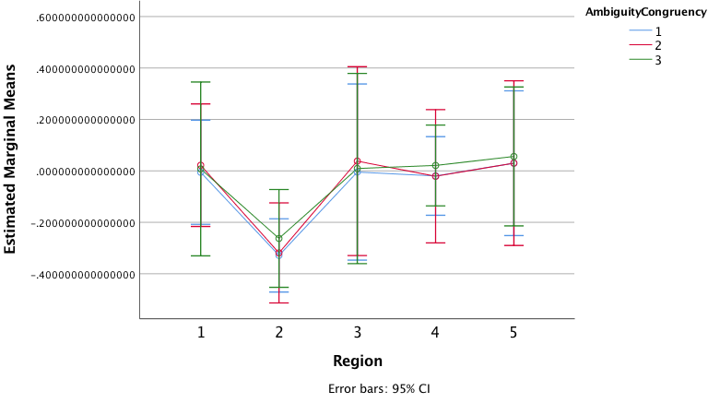
Results – Native bilinguals (All regions, with P5)
Ambiguous/Conflict
Ambiguous/No conflict
Unambiguous/Conflict
Slower than expected
Preceding conflict helps process ambiguity at Region 3, then the [+/- conflicto effect dissipates].
The 3rd condition, unambig/conflict, sees a slowing down at región 2 – I’ll argue that’s a mental comma after the intransitive verbs
Faster than expected

Slide 19
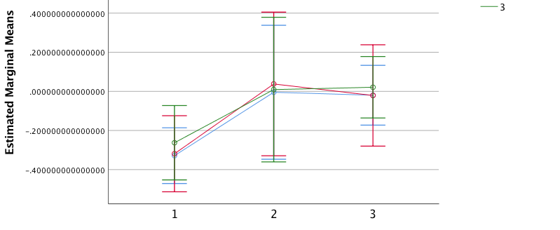
Results – Native bilinguals (regions 2, 3, 4, with P5)
Ambiguous/Conflict
Ambiguous/No conflict
Unambiguous/Conflict
Slower than expected
Faster than expected
2 3 4

Slide 20
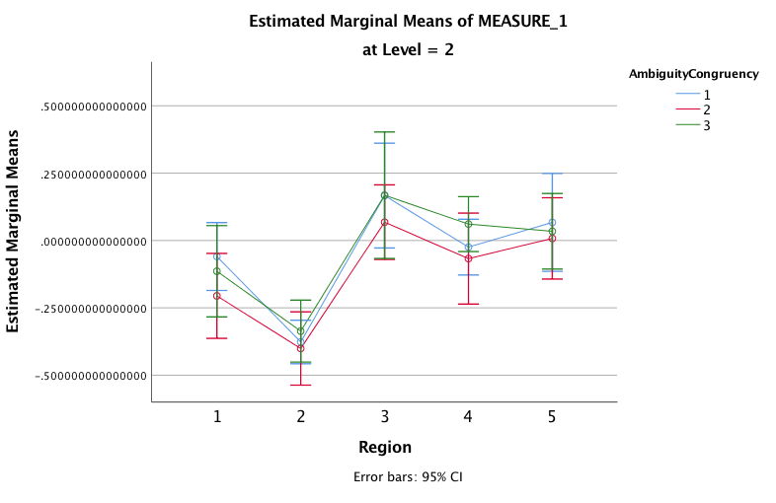
Results – Group 2 learners (All regions, with P8)
Ambiguous/Conflict
Ambiguous/No conflict
Unambiguous/Conflict
Slower than expected
Interpretation: Learners are slowed down by the mere conflict.
Are they understanding that the ambiguity exists? Why does Region 3 ambig/unambig map together in conflicto condition, and then ambiguous speeds up?
Resolution: Include more advanced learners, not Oral Review, no intermediate.
Post-study abroad? And graduates?
Faster than expected

Slide 21
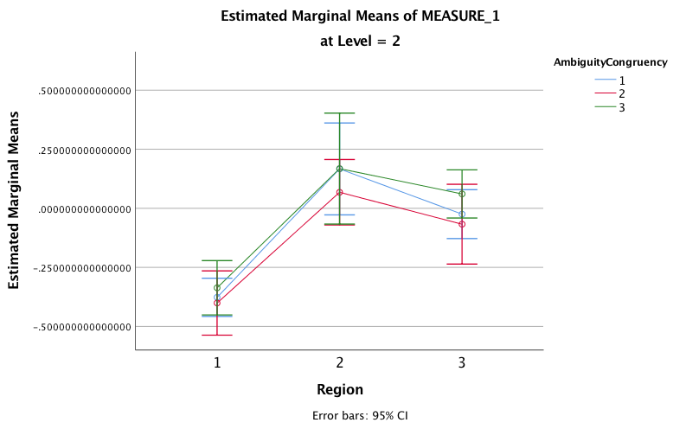
Results – Group 2 learners (regions 2, 3, 4, with P8)
Ambiguous/Conflict
Ambiguous/No conflict
Unambiguous/Conflict
Slower than expected
Faster than expected
2 3 4

Slide 22
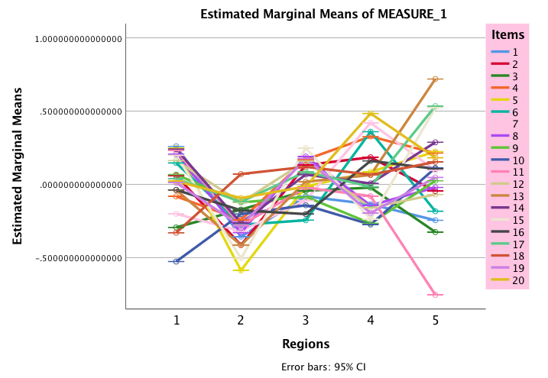
Results – Native bilinguals, unambiguous items
Slower than expected
Faster than expected

Slide 23
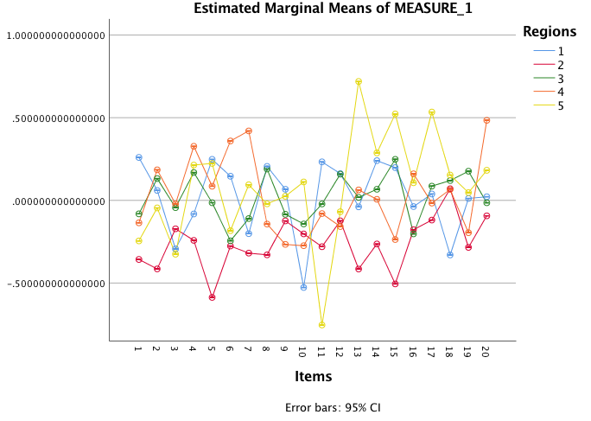
Results – Native bilinguals, unambiguous items
Slower than expected
Faster than expected

Slide 24
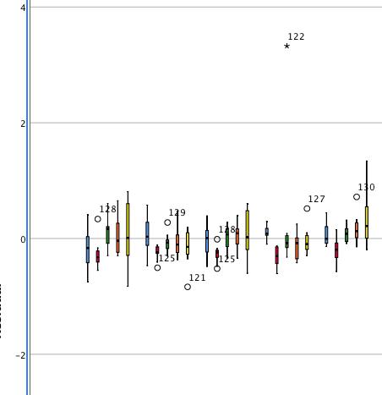
Results – Native bilinguals, unambiguous items
Slower than expected
Faster than expected

Slide 25
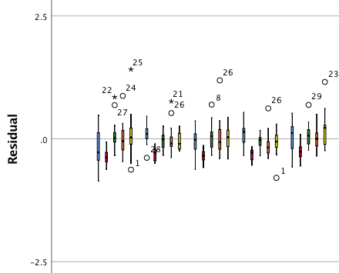
Results – Native bilinguals, ambiguous items
Slower than expected
Faster than expected

Slide 26
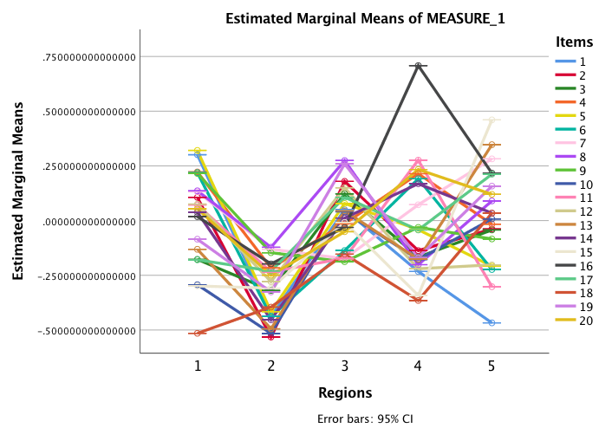
Results – Native bilinguals, ambiguous items
Slower than expected
Faster than expected

Slide 27
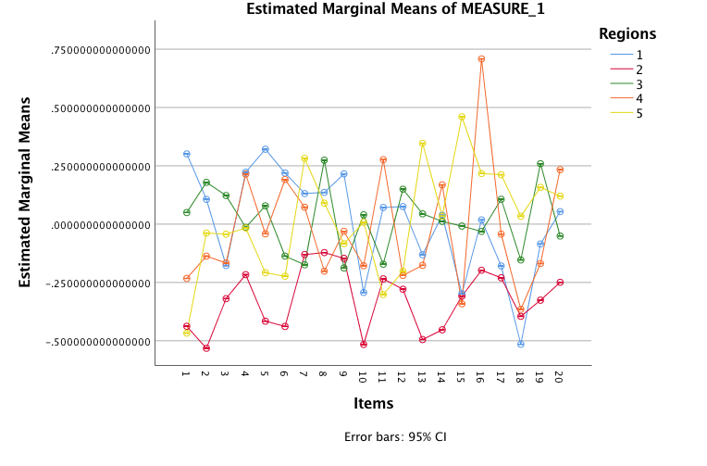
Results – Native bilinguals, ambiguous items
Slower than expected
Faster than expected

Slide 28
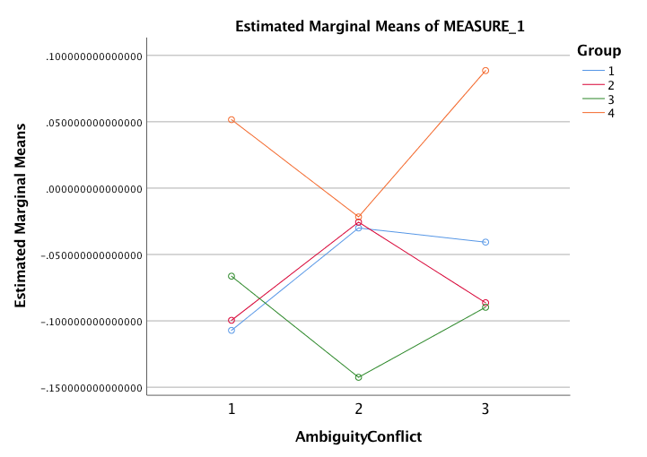
Results – Native bilinguals,

Slide 29
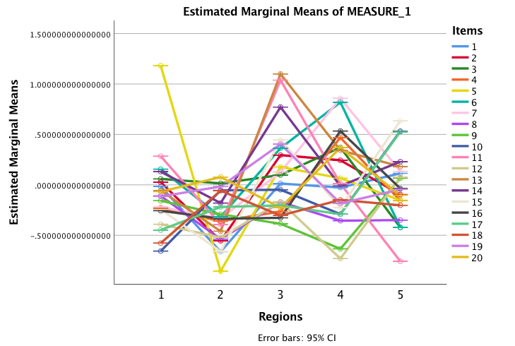
Results – Group 2 learners, unambiguous items
Slower than expected
Faster than expected

Slide 30
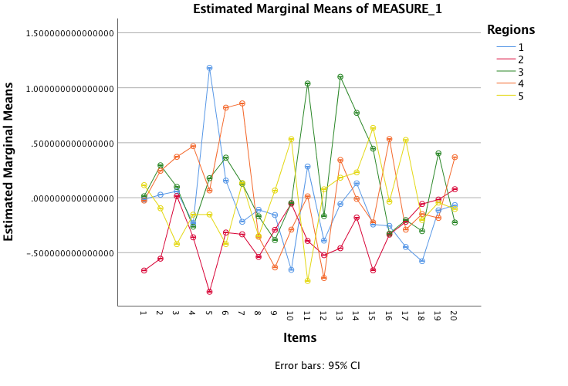
Results – Group 2 learners, unambiguous items
Slower than expected
Faster than expected

Slide 31
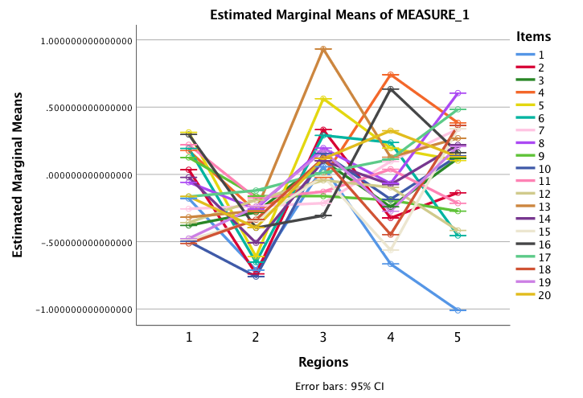
Results – Group 2 learners, ambiguous items
Slower than expected
Faster than expected

Slide 32
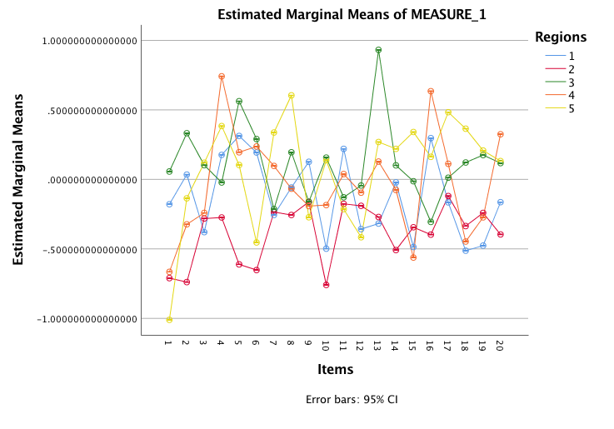
Results – Group 2 learners, ambiguous items
Slower than expected
Faster than expected

Slide 33
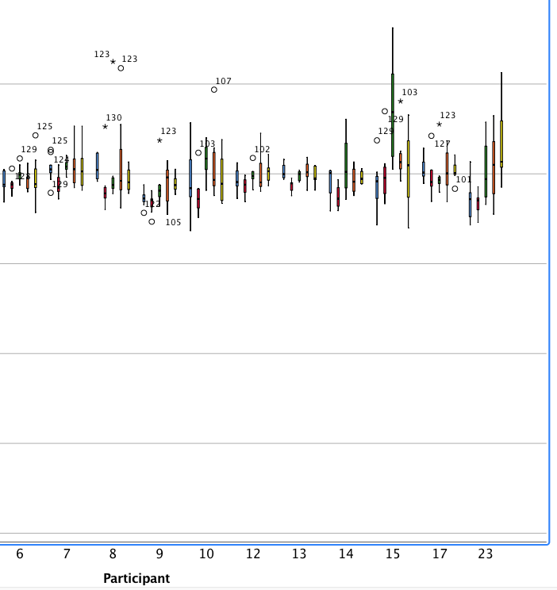
Results – Group 2 learners, unambiguous items

Slide 34
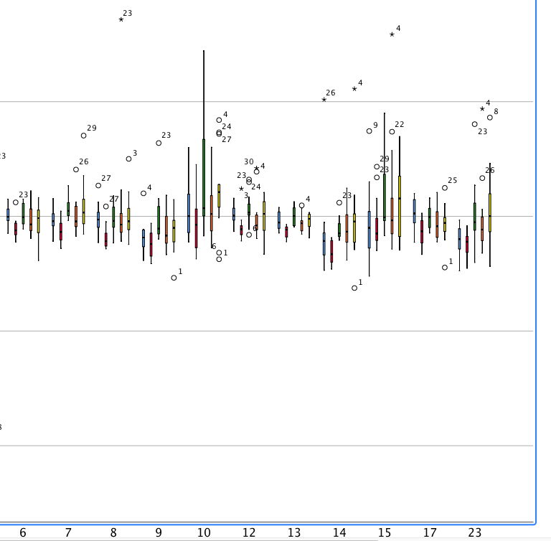
Results – Group 2 learners, ambiguous items

Slide 35
Results Summary

Slide 36
Discussion

Slide 37
Conclusions

Slide 38
Thank you

