Slide 1

Mathematical modelling for vaccine-preventable diseases
Epidemiology lecture 4
Environmental transmission
Katy Gaythorpe
School of Public Health
Imperial College London
k.gaythorpe@imperial.ac.uk
Notes:
Introduce who we are

Slide 2
Motivation
Environmental transmission is an important consideration for many common diseases
We model the system as having two populations, one human and one environmental pathogen
One key example is cholera, a bacterial gastrointestinal disease which can survive in water for long periods of time

Slide 3
Simple model

Slide 4
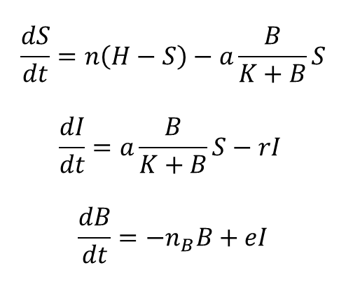
Simple model
$$\frac{dS}{dt}=n\left(H−S\right)−a\frac{B}{K+B}S$$
$$\frac{dI}{dt}=a\frac{B}{K+B}S−rI$$
$$\frac{dB}{dt}=−n_{B}B+eI$$
S
I
R
B
Codeço, Cláudia Torres. "Endemic and epidemic dynamics of cholera: the role of the aquatic reservoir." BMC Infectious diseases 1.1 (2001): 1.
Notes:
ID50

Slide 5
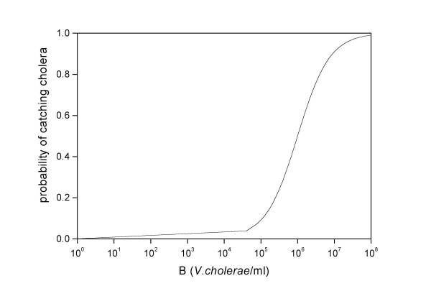
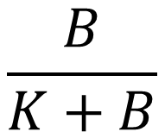
The environmental transmission term
$$\frac{B}{K+B}$$
= Probability of infection per contact with contaminated reservoir
Logistic dose response curve
Codeço, Cláudia Torres. "Endemic and epidemic dynamics of cholera: the role of the aquatic reservoir." BMC Infectious diseases 1.1 (2001): 1.
Notes:
dose response theory? Change title

Slide 6
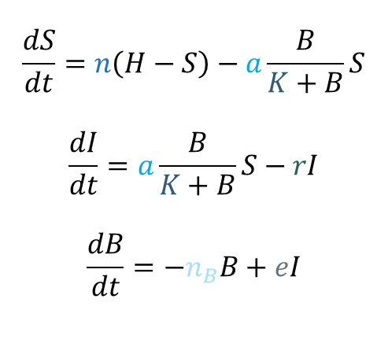

Simple model
$$n$$
$$a$$
$$K$$
$$r$$
$$n_{B}$$
$$e$$
Human birth/ death rates
Rate of exposure to contaminated water
Concentration of bacteria in water that yields 50% chance of infection
Recovery rate
Net growth rate of bacteria in environment
Contribution of each infected person to the population of bacteria in the environment
$$\frac{dS}{dt}=n\left(H−S\right)−a\frac{B}{K+B}S$$
$$\frac{dI}{dt}=a\frac{B}{K+B}S−rI$$
$$\frac{dB}{dt}=−n_{B}B+eI$$
Codeço, Cláudia Torres. "Endemic and epidemic dynamics of cholera: the role of the aquatic reservoir." BMC Infectious diseases 1.1 (2001): 1.
Notes:
K is ID50

Slide 7
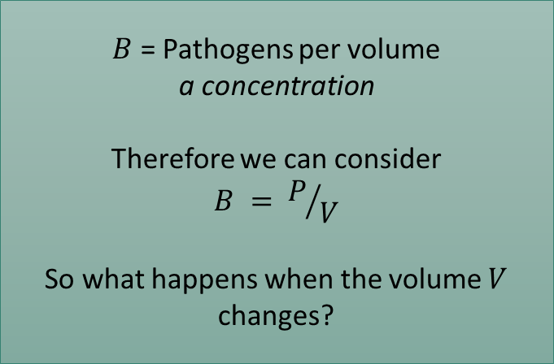
The environmental reservoir - individual level
$$\frac{B}{K+B}$$
= Probability of infection per contact with contaminated reservoir
Logistic dose response curve
$B$ = Pathogens per volume
a concentration
Therefore we can consider
$$B = P/V$$
So what happens when the volume $V$ changes?
Codeço, Cláudia Torres. "Endemic and epidemic dynamics of cholera: the role of the aquatic reservoir." BMC Infectious diseases 1.1 (2001): 1.
Notes:
dose response theory? Change title

Slide 8
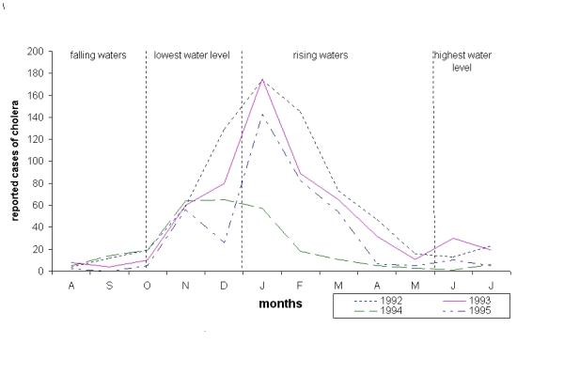
The environmental reservoir - volume
Periodicity of reported cases of cholera in the Brazilian Central Amazon region. This region is characterized by seasonal flooding of the Negro and Amazon Rivers, driven mainly by snow melt in the Andean headwaters of the Amazon River.
Codeço, Cláudia Torres. "Endemic and epidemic dynamics of cholera: the role of the aquatic reservoir." BMC Infectious diseases 1.1 (2001): 1.

Slide 9

The environmental reservoir - volume
Periodicity of reported cases of cholera in the Brazilian Central Amazon region. This region is characterized by seasonal flooding of the Negro and Amazon Rivers, driven mainly by snow melt in the Andean headwaters of the Amazon River.
$$V$$
Codeço, Cláudia Torres. "Endemic and epidemic dynamics of cholera: the role of the aquatic reservoir." BMC Infectious diseases 1.1 (2001): 1.

Slide 10
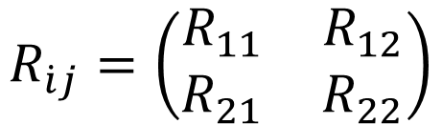
The environmental reservoir – R₀
Two infectious compartments:
We have to use a next generation matrix approach...
$$R_{\dot{i}j}=\left(\begin{matrix}R_{11} & R_{12} \\ R_{21} & R_{22}\end{matrix}\right)$$

Slide 11
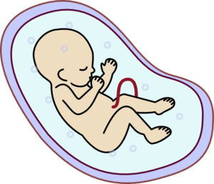

The environmental reservoir – R₀
Two infectious compartments:
We have to use a next generation matrix approach...
$$R_{\dot{i}j}=\left(\begin{matrix}R_{11} & R_{12} \\ R_{21} & R_{22}\end{matrix}\right)$$
Constructing the next generation matrix
Birth
Birth
Birth
Lifespan or generation
Notes:
disease fee equilibrium!

Slide 12
The environmental reservoir – R₀
Two infectious compartments:
We have to use a next generation matrix approach...
$$R_{\dot{i}j}=\left(\begin{matrix}R_{11} & R_{12} \\ R_{21} & R_{22}\end{matrix}\right)$$
Constructing the next generation matrix
Infection
Infection
Infection
Infectious lifespan or generation
Whole population susceptible except for one infected individual
Notes:
disease fee equilibrium!

Slide 13
The environmental reservoir – R₀
Two infectious compartments:
We have to use a next generation matrix approach...
$$R_{\dot{i}j}=\left(\begin{matrix}R_{11} & R_{12} \\ R_{21} & R_{22}\end{matrix}\right)$$
Infection
Infection
Infection
Infectious lifespan or generation

Slide 14
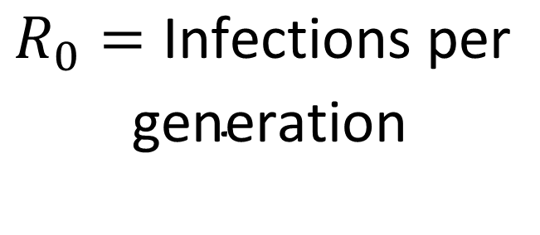
The environmental reservoir – R₀
Two infectious compartments:
We have to use a next generation matrix approach...
$$R_{0}=\text{Infections} \text{per}$$
$$\text{generation}$$
The big idea:

Slide 15
The environmental reservoir – R₀
Two infectious compartments:
We have to use a next generation matrix approach...
Humans
or
Bacteria?
$$R_{0}=\text{Infections} \text{per}$$
$$\text{generation}$$
The big idea:

Slide 16
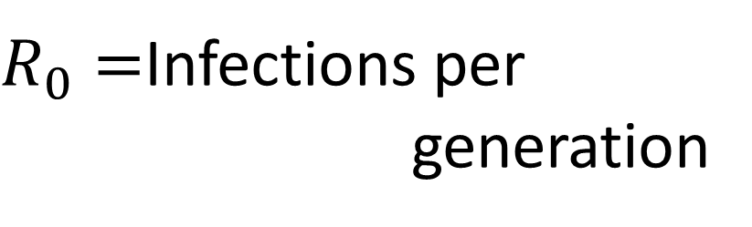
Next generation matrix method
$R_{0}=$Infections per
generation
Diekmann, O., Heesterbeek, J.A.P. and Roberts, M.G., 2009. The construction of next-generation matrices for compartmental epidemic models. Journal of the Royal Society Interface, p.rsif20090386.

Slide 17
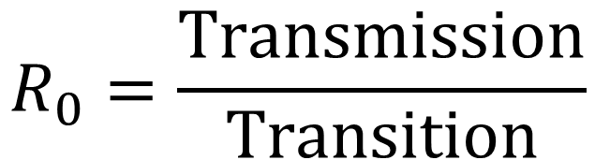
Next generation matrix method
$$R_{0}=\frac{\text{Transmission}}{\text{Transition}}$$
1
Examine how our system of infectious differential equations changes with respect to each infectious variable

Slide 18
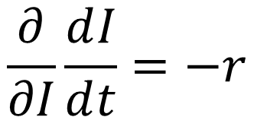
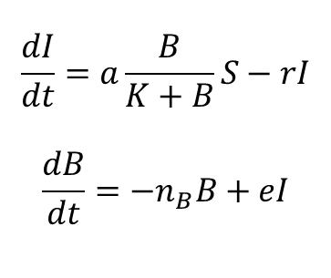
Next generation matrix method
$$R_{0}=\frac{\text{Transmission}}{\text{Transition}}$$
$$\frac{dI}{dt}=a\frac{B}{K+B}S−rI$$
$$\frac{dB}{dt}=−n_{B}B+eI$$
1
Examine how our system of infectious differential equations changes with respect to each infectious variable
Infected hosts
$$\frac{∂}{∂I}\frac{ⅆI}{ⅆt}=−r$$
Notes:
2 new concepts, partial and operator

Slide 19
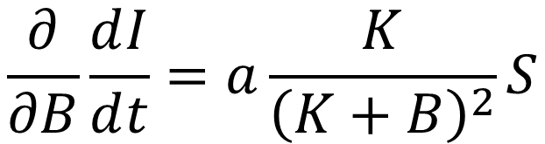
Next generation matrix method
$$R_{0}=\frac{\text{Transmission}}{\text{Transition}}$$
$$\frac{dI}{dt}=a\frac{B}{K+B}S−rI$$
$$\frac{dB}{dt}=−n_{B}B+eI$$
1
Examine how our system of infectious differential equations changes with respect to each infectious variable
Infected hosts
$$\frac{∂}{∂I}\frac{ⅆI}{ⅆt}=−r$$
$$\frac{∂}{∂B}\frac{ⅆI}{ⅆt}=a\frac{K}{{\left(K+B\right)}^{2}}S$$

Slide 20
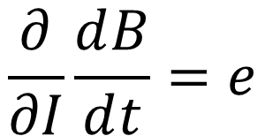
Next generation matrix method
$$R_{0}=\frac{\text{Transmission}}{\text{Transition}}$$
$$\frac{dI}{dt}=a\frac{B}{K+B}S−rI$$
$$\frac{dB}{dt}=−n_{B}B+eI$$
1
Examine how our system of infectious differential equations changes with respect to each infectious variable
Bacteria
$$\frac{∂}{∂I}\frac{ⅆB}{ⅆt}=ⅇ$$

Slide 21
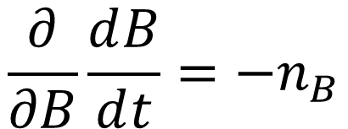
Next generation matrix method
$$R_{0}=\frac{\text{Transmission}}{\text{Transition}}$$
$$\frac{dI}{dt}=a\frac{B}{K+B}S−rI$$
$$\frac{dB}{dt}=−n_{B}B+eI$$
1
Examine how our system of infectious differential equations changes with respect to each infectious variable
Bacteria
$$\frac{∂}{∂I}\frac{ⅆB}{ⅆt}=ⅇ$$
$$\frac{∂}{∂B}\frac{ⅆB}{ⅆt}=−n_{B}$$

Slide 22
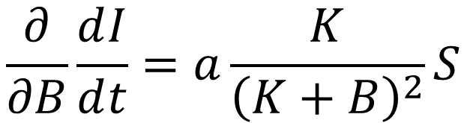
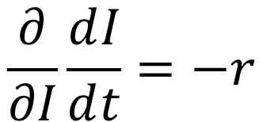
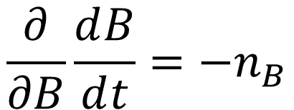
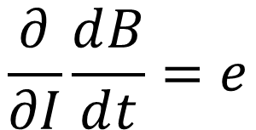
Next generation matrix method
$$R_{0}=\frac{\text{Transmission}}{\text{Transition}}$$
$$\frac{dI}{dt}=a\frac{B}{K+B}S−rI$$
$$\frac{dB}{dt}=−n_{B}B+eI$$
2
Substitute in variables at disease free equilibrium
Infected hosts
Bacteria
$$\frac{∂}{∂I}\frac{ⅆI}{ⅆt}=−r$$
$$\frac{∂}{∂I}\frac{ⅆB}{ⅆt}=ⅇ$$
$$\frac{∂}{∂B}\frac{ⅆI}{ⅆt}=a\frac{K}{{\left(K+B\right)}^{2}}S$$
$$\frac{∂}{∂B}\frac{ⅆB}{ⅆt}=−n_{B}$$

Slide 23
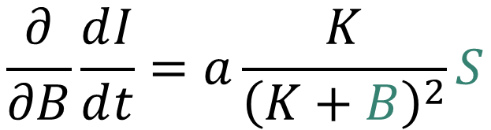
Next generation matrix method
$$R_{0}=\frac{\text{Transmission}}{\text{Transition}}$$
$$\frac{dI}{dt}=a\frac{B}{K+B}S−rI$$
$$\frac{dB}{dt}=−n_{B}B+eI$$
2
Substitute in variables at disease free equilibrium
Infected hosts
Bacteria
$$\frac{∂}{∂I}\frac{ⅆI}{ⅆt}=−r$$
$$\frac{∂}{∂I}\frac{ⅆB}{ⅆt}=ⅇ$$
$$\frac{∂}{∂B}\frac{ⅆI}{ⅆt}=a\frac{K}{{\left(K+B\right)}^{2}}S$$
$$\frac{∂}{∂B}\frac{ⅆB}{ⅆt}=−n_{B}$$

Slide 24
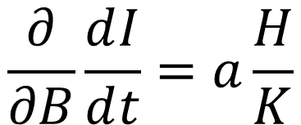
Next generation matrix method
$$R_{0}=\frac{\text{Transmission}}{\text{Transition}}$$
$$\frac{dI}{dt}=a\frac{B}{K+B}S−rI$$
$$\frac{dB}{dt}=−n_{B}B+eI$$
2
Substitute in variables at disease free equilibrium
Infected hosts
Bacteria
$$\frac{∂}{∂I}\frac{ⅆI}{ⅆt}=−r$$
$$\frac{∂}{∂I}\frac{ⅆB}{ⅆt}=ⅇ$$
$$\frac{∂}{∂B}\frac{ⅆI}{ⅆt}=a\frac{H}{K}$$
$$\frac{∂}{∂B}\frac{ⅆB}{ⅆt}=−n_{B}$$

Slide 25
Next generation matrix method
$$R_{0}=\frac{\text{Transmission}}{\text{Transition}}$$
$$\frac{dI}{dt}=a\frac{B}{K+B}S−rI$$
$$\frac{dB}{dt}=−n_{B}B+eI$$
3
Divide into transmission and transition terms
Infected hosts
Bacteria
$$\frac{∂}{∂I}\frac{ⅆI}{ⅆt}=−r$$
$$\frac{∂}{∂I}\frac{ⅆB}{ⅆt}=ⅇ$$
$$\frac{∂}{∂B}\frac{ⅆI}{ⅆt}=a\frac{H}{K}$$
$$\frac{∂}{∂B}\frac{ⅆB}{ⅆt}=−n_{B}$$

Slide 26
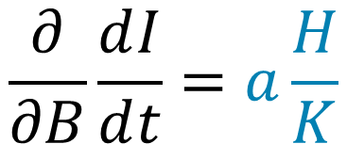
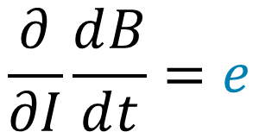
Next generation matrix method
$$R_{0}=\frac{\text{Transmission}}{\text{Transition}}$$
$$\frac{dI}{dt}=a\frac{B}{K+B}S−rI$$
$$\frac{dB}{dt}=−n_{B}B+eI$$
3
Divide into transmission and transition terms
Infected hosts
Bacteria
$$\frac{∂}{∂I}\frac{ⅆI}{ⅆt}=−r$$
$$\frac{∂}{∂I}\frac{ⅆB}{ⅆt}=ⅇ$$
$$\frac{∂}{∂B}\frac{ⅆI}{ⅆt}=a\frac{H}{K}$$
$$\frac{∂}{∂B}\frac{ⅆB}{ⅆt}=−n_{B}$$

Slide 27
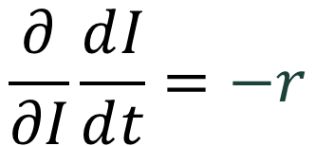
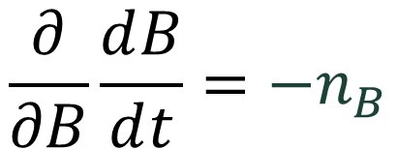
Next generation matrix method
$$R_{0}=\frac{\text{Transmission}}{\text{Transition}}$$
$$\frac{dI}{dt}=a\frac{B}{K+B}S−rI$$
$$\frac{dB}{dt}=−n_{B}B+eI$$
3
Divide into transmission and transition terms
Infected hosts
Bacteria
$$\frac{∂}{∂I}\frac{ⅆI}{ⅆt}=−r$$
$$\frac{∂}{∂I}\frac{ⅆB}{ⅆt}=ⅇ$$
$$\frac{∂}{∂B}\frac{ⅆI}{ⅆt}=a\frac{H}{K}$$
$$\frac{∂}{∂B}\frac{ⅆB}{ⅆt}=−n_{B}$$

Slide 28
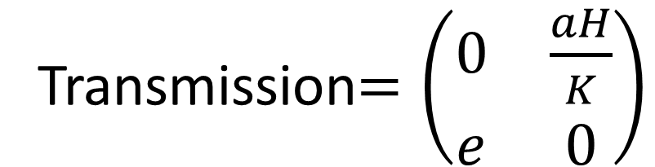
Next generation matrix method
$$R_{0}=\frac{\text{Transmission}}{\text{Transition}}$$
$$\frac{dI}{dt}=a\frac{B}{K+B}S−rI$$
$$\frac{dB}{dt}=−n_{B}B+eI$$
3
Divide into transmission and transition terms
Transmission$=\left(\begin{matrix}0 & \frac{aH}{K} \\ ⅇ & 0\end{matrix}\right)$

Slide 29
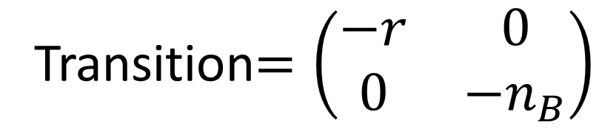
Next generation matrix method
$$R_{0}=\frac{\text{Transmission}}{\text{Transition}}$$
$$\frac{dI}{dt}=a\frac{B}{K+B}S−rI$$
$$\frac{dB}{dt}=−n_{B}B+eI$$
3
Divide into transmission and transition terms
Transition$=\left(\begin{matrix}−r & 0 \\ 0 & −n_{B}\end{matrix}\right)$
Notes:
describe in wordds

Slide 30

Next generation matrix method
$$R_{0}=\frac{\text{Transmission}}{\text{Transition}}$$
$$\frac{dI}{dt}=a\frac{B}{K+B}S−rI$$
$$\frac{dB}{dt}=−n_{B}B+eI$$
4
The Next Generation Matrix
$$NGM=−TΣ^{−1}$$

Slide 31
Next generation matrix method
$$R_{0}=\frac{\text{Transmission}}{\text{Transition}}$$
$$\frac{dI}{dt}=a\frac{B}{K+B}S−rI$$
$$\frac{dB}{dt}=−n_{B}B+eI$$
4
The Next Generation Matrix
$$NGM=−TΣ^{−1}$$
Transmission
Transition

Slide 32
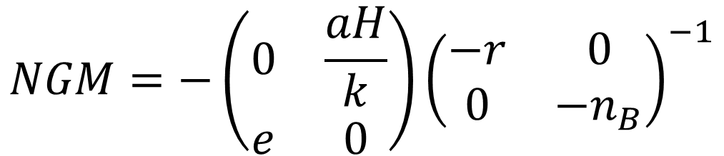
Next generation matrix method
$$R_{0}=\frac{\text{Transmission}}{\text{Transition}}$$
$$\frac{dI}{dt}=a\frac{B}{K+B}S−rI$$
$$\frac{dB}{dt}=−n_{B}B+eI$$
4
The Next Generation Matrix
$$NGM=−\left(\begin{matrix}0 & \frac{aH}{k} \\ ⅇ & 0\end{matrix}\right){\left(\begin{matrix}−r & 0 \\ 0 & −n_{B}\end{matrix}\right)}^{−1}$$

Slide 33
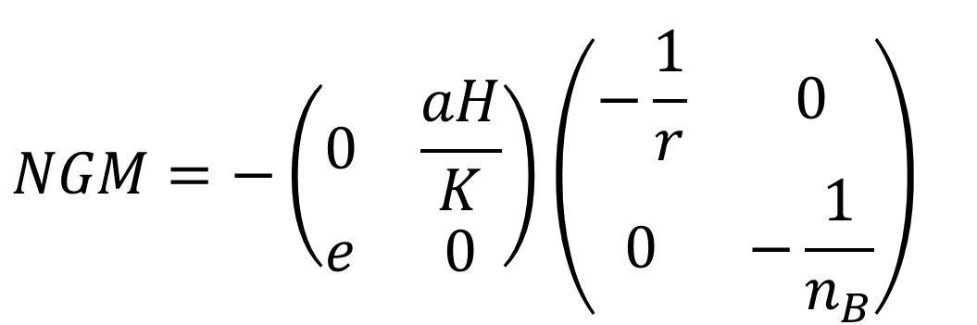
Next generation matrix method
$$R_{0}=\frac{\text{Transmission}}{\text{Transition}}$$
$$\frac{dI}{dt}=a\frac{B}{K+B}S−rI$$
$$\frac{dB}{dt}=−n_{B}B+eI$$
4
The Next Generation Matrix
$$NGM=−\left(\begin{matrix}0 & \frac{aH}{K} \\ ⅇ & 0\end{matrix}\right){\left(\begin{matrix}−\frac{1}{r} & 0 \\ 0 & −\frac{1}{n_{B}}\end{matrix}\right)}^{}$$

Slide 34
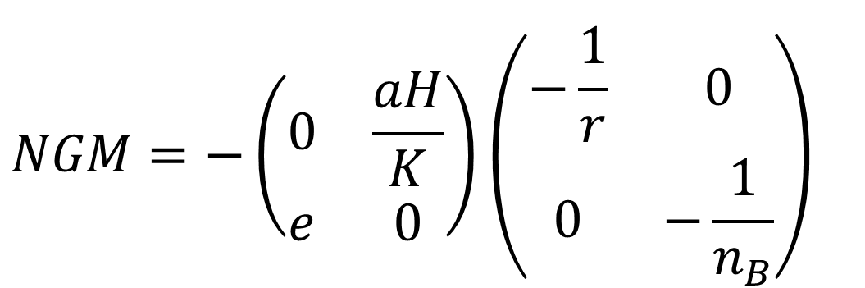
Next generation matrix method
$$R_{0}=\frac{\text{Transmission}}{\text{Transition}}$$
$$\frac{dI}{dt}=a\frac{B}{K+B}S−rI$$
$$\frac{dB}{dt}=−n_{B}B+eI$$
4
The Next Generation Matrix
$$NGM=−\left(\begin{matrix}0 & \frac{aH}{K} \\ ⅇ & 0\end{matrix}\right){\left(\begin{matrix}−\frac{1}{r} & 0 \\ 0 & −\frac{1}{n_{B}}\end{matrix}\right)}^{}$$

Slide 35

Next generation matrix method
$$R_{0}=\frac{\text{Transmission}}{\text{Transition}}$$
$$\frac{dI}{dt}=a\frac{B}{K+B}S−rI$$
$$\frac{dB}{dt}=−n_{B}B+eI$$
4
The Next Generation Matrix
$$NGM=−{\left(\begin{matrix} & \\ & \end{matrix}\right)}^{}$$

Slide 36
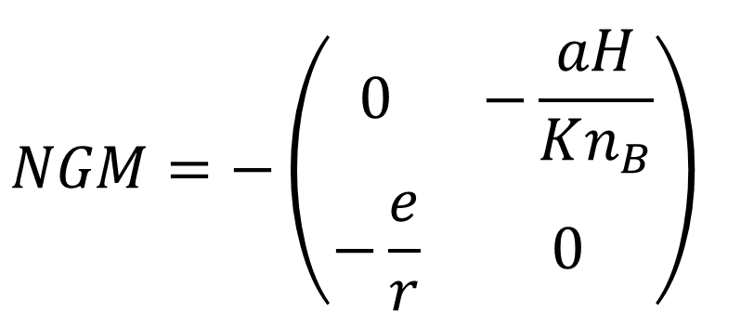
Next generation matrix method
$$R_{0}=\frac{\text{Transmission}}{\text{Transition}}$$
$$\frac{dI}{dt}=a\frac{B}{K+B}S−rI$$
$$\frac{dB}{dt}=−n_{B}B+eI$$
4
The Next Generation Matrix
$$NGM=−{\left(\begin{matrix}0 & −\frac{aH}{Kn_{B}} \\ −\frac{e}{r} & 0\end{matrix}\right)}^{}$$

Slide 37
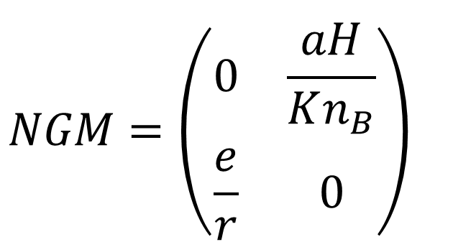
Next generation matrix method
$$R_{0}=\frac{\text{Transmission}}{\text{Transition}}$$
$$\frac{dI}{dt}=a\frac{B}{K+B}S−rI$$
$$\frac{dB}{dt}=−n_{B}B+eI$$
4
The Next Generation Matrix
$$NGM={\left(\begin{matrix}0 & \frac{aH}{Kn_{B}} \\ \frac{e}{r} & 0\end{matrix}\right)}^{}$$

Slide 38
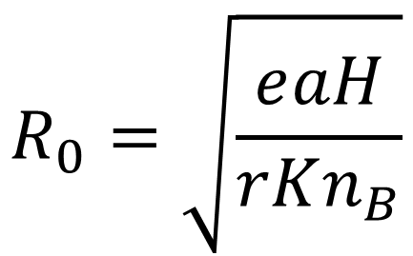
Next generation matrix method
$$R_{0}=\frac{\text{Transmission}}{\text{Transition}}$$
Expected number of secondary infectious given one average infectious individual is introduced to an entirely susceptible population
5
R₀ is the largest eigenvalue of the next generation matrix
$$R_{0}=\sqrt{\frac{ⅇaH}{rKn_{B}}}$$

Slide 39
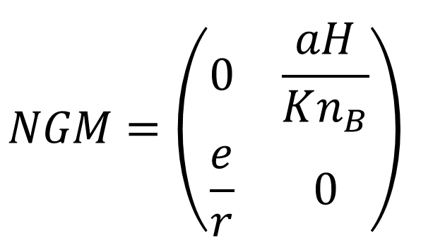
Next generation matrix – interpretation?
$$NGM={\left(\begin{matrix}0 & \frac{aH}{Kn_{B}} \\ \frac{e}{r} & 0\end{matrix}\right)}^{}$$

Slide 40
Next generation matrix – interpretation?
$$NGM={\left(\begin{matrix}0 & \frac{aH}{Kn_{B}} \\ \frac{e}{r} & 0\end{matrix}\right)}^{}$$
1 bacterial unit causes $\frac{aH}{Kn_{B}}$ human infections

Slide 41
Next generation matrix – interpretation?
$$NGM={\left(\begin{matrix}0 & \frac{aH}{Kn_{B}} \\ \frac{e}{r} & 0\end{matrix}\right)}^{}$$
1 bacterial unit causes $\frac{aH}{Kn_{B}}$ human infections
1 infected human causes $\frac{e}{r}$ bacterial units to be created
Notes:
badger cattle

Slide 42
Next generation matrix – interpretation?
$$NGM={\left(\begin{matrix}0 & \frac{aH}{Kn_{B}} \\ \frac{e}{r} & 0\end{matrix}\right)}^{}$$
How much does each infectious variable contribute to R₀?

Slide 43
Next generation matrix – interpretation?
$$NGM={\left(\begin{matrix}0 & \frac{aH}{Kn_{B}} \\ \frac{e}{r} & 0\end{matrix}\right)}^{}$$
We can decompose R₀ into part reproduction numbers by using the sum unit eigenvector corresponding to the largest eigenvalue and the sums of the columns of the NGM
These represent the individual contribution of each infectious class to R₀

Slide 44
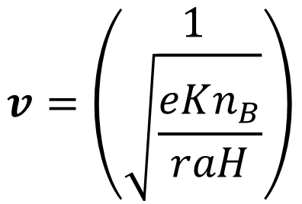
Next generation matrix – interpretation?
$$NGM={\left(\begin{matrix}0 & \frac{aH}{Kn_{B}} \\ \frac{e}{r} & 0\end{matrix}\right)}^{}$$
$$v=\left(\begin{matrix}1 \\ \sqrt{\frac{eKn_{B}}{raH}}\end{matrix}\right)$$
Lead eigenvector of NGM:

Slide 45
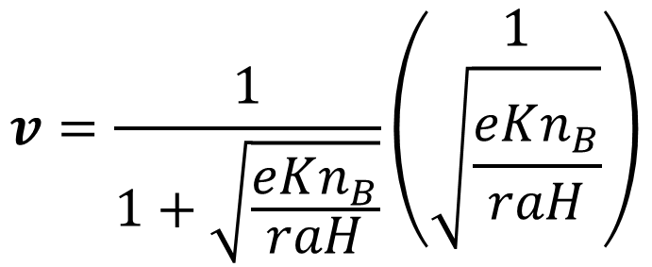
Next generation matrix – interpretation?
$$NGM={\left(\begin{matrix}0 & \frac{aH}{Kn_{B}} \\ \frac{e}{r} & 0\end{matrix}\right)}^{}$$
$$v=\frac{1}{1+\sqrt{\frac{eKn_{B}}{raH}}}\left(\begin{matrix}1 \\ \sqrt{\frac{eKn_{B}}{raH}}\end{matrix}\right)$$
Lead sum unit eigenvector of NGM:

Slide 46
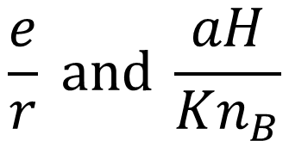
Next generation matrix – interpretation?
$$NGM={\left(\begin{matrix}0 & \frac{aH}{Kn_{B}} \\ \frac{e}{r} & 0\end{matrix}\right)}^{}$$
$$\frac{e}{r} \text{and} \frac{aH}{Kn_{B}}$$
Column sums of NGM:

Slide 47
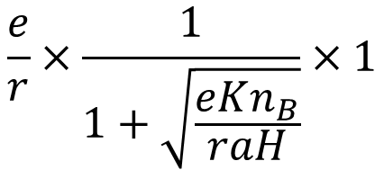
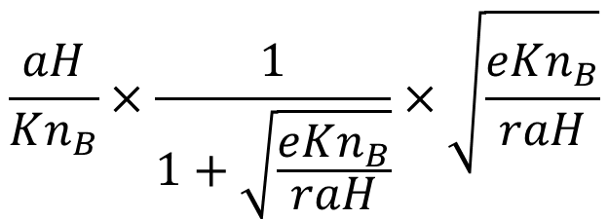
Next generation matrix – interpretation?
$$NGM={\left(\begin{matrix}0 & \frac{aH}{Kn_{B}} \\ \frac{e}{r} & 0\end{matrix}\right)}^{}$$
$$\frac{e}{r}×\frac{1}{1+\sqrt{\frac{eKn_{B}}{raH}}}×1$$
Contribution of infected humans to R₀ :
$$\frac{aH}{Kn_{B}}×\frac{1}{1+\sqrt{\frac{eKn_{B}}{raH}}}×\sqrt{\frac{eKn_{B}}{raH}}$$
Contribution of bacteria to R₀ :

Slide 48
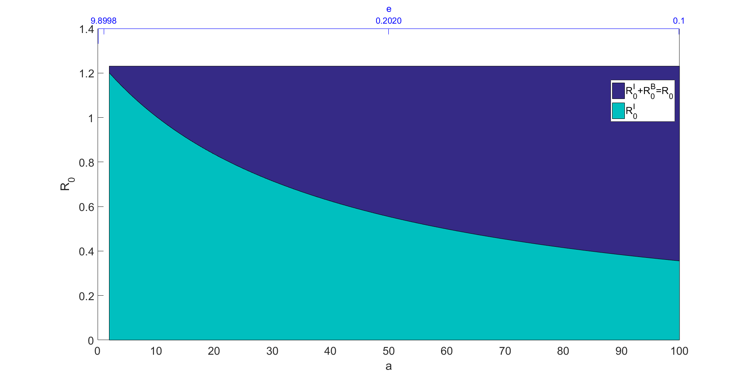
Next generation matrix – interpretation?
Changing the contribution
R₀=1.209

Slide 49
Summary
Including environmental transmission in models means we must examine the population of pathogens in the environment as well
As such, we need to consider the volume of the environmental reservoir
In this situation, we use the next generation matrix approach to calculate R0
We can also use the next generation approach to tell us about the relative transmission of each infectious class and we decompose R0
The extra detail contained in the next generation matrix can allow us to target strategies to the most influential infectious classes.

