Slide 1

Mathematical modelling for vaccine-preventable diseases
Epidemiology lecture 5
Stochastic Epidemic Models
Andrew J K Conlan
University of Cambridge
ajkc2@cam.ac.uk
Notes:
Introduce who we are

Slide 2









The importance of being discrete…
Recovery
Transmission
Transmission
Recovery is at a constant rate, so fractions of a infective duck can lead to transmission.
Recovery

Slide 3
In the large population limit…
Average rate of recovery
Fractional change in numbers of infectives
Recovery

Slide 4
A simple epidemic - the SI model
Two state variables, with no recovery only transmission.
S
I
Classical deterministic formulation of the model would be:
(Equivalent to logistic model)

Slide 5
SimInf
install.packages(‘SimInf’)
R package that provides ”an efficient and very flexible framework to conduct data-driven epidemiological modelling”
Designed to simulate meta-population models:
High level R interface to define models
Exact Gillespie algorithm for “within-patch” dynamics
Can model births, deaths, movements between patches as pre-scheduled (non-markov) events
Compiles model to native C/C++ code…
https://arxiv.org/abs/1605.01421

Slide 6
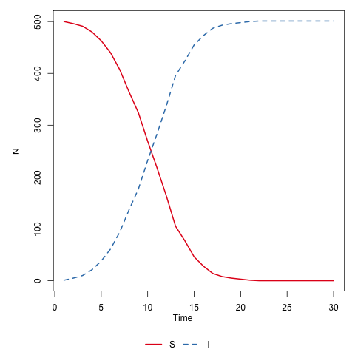
SI model
install.packages(‘SimInf’)
require(SimInf)
initial_state <- data.frame(S=499,I=1)
compartments <- c("S","I")
transitions <- c("S -> beta*S*I/(S+I) -> I")
tspan <- seq(from = 1, to =30, by = 1)
model <- mparse(transitions = transitions, compartments = compartments, gdata = c(beta=0.5), u0 = initial_state, tspan = tspan)
out <- run(model = model, threads = 1)
plot(out)

Slide 7
Running multiple realisations
N independent
patches
N <- 5
initial_state <- data.frame(S=rep(499,N),I=rep(1,N))
compartments <- c("S","I")
transitions <- c("S -> beta*S*I/(S+I) -> I")
tspan <- seq(from = 1, to =30, by = 1)
model <- mparse(transitions = transitions, compartments = compartments, gdata = c(beta=0.5), u0 = initial_state, tspan = tspan)
out <- run(model = model, threads = 1)
plot(out,compartments=‘I’,range=FALSE)

Slide 8
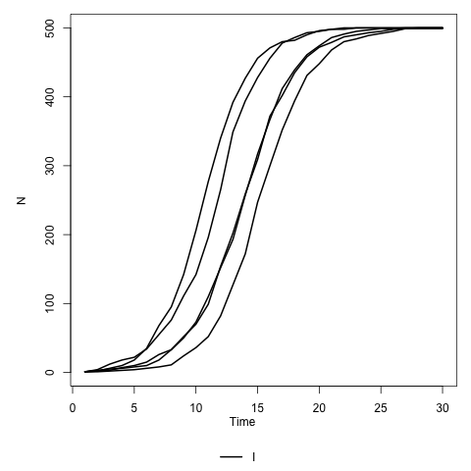
SI model
Variable “delay” time at the start of the epidemic
Epidemic phase
is consistent
across replicates

Slide 9
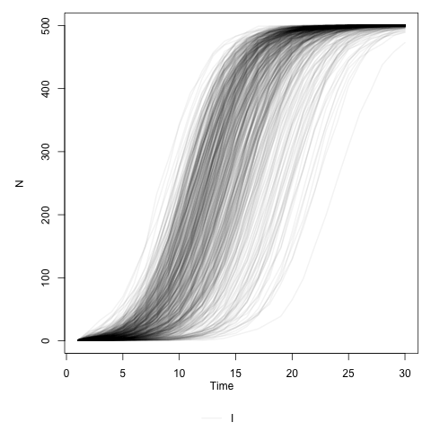
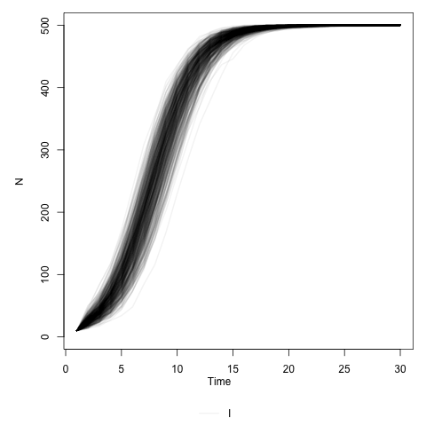
The large population limit?
plot(out,range=FALSE,compartments='I',col=rgb(0,0,0,0.05))
I(0) = 1
I(0) = 10
Why are stochastic epidemic curves more likely to be late rather than early?

Slide 10
The Art of Averaging (Advanced!)
If we derive equations for the expected values of the state variables:
Why? Recall the definition of variance:
If our stochastic model contains non-linear terms (transmission!) then the mean behaviour will deviate from the classical deterministic equations.

Slide 11
The covariance (loosely the correlation) between two state variables
can be defined as:
``Mean Field’’
Correlation between
S and I (-ve)
Classical “Mean Field” epidemic theory assumes that state variables are uncorrelated.

Slide 12
Stochastic SIR model
S
I
R
Three state variables
Two Events
Transmission
Recovery

Slide 13
Stochastic SIR model
S
I
R
N <- 1
initial_state <- data.frame(S=rep(99,N),I=rep(1,N),R=rep(0,N))
compartments <- c("S","I","R")
transitions <- c("S -> beta*S*I/(S+I+R) -> I","I -> I/TI -> R")
tspan <- seq(from = 1, to =30, by = 1)
model <- mparse(transitions = transitions, compartments = compartments, gdata = c(beta=1.0,TI=5), u0 = initial_state, tspan = tspan)
out <- run(model = model, threads = 1)
plot(out)

Slide 14
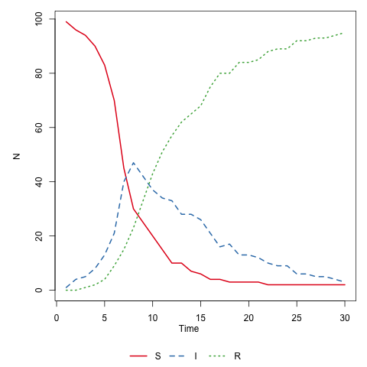

Slide 15
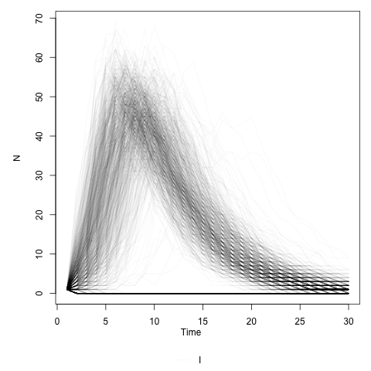
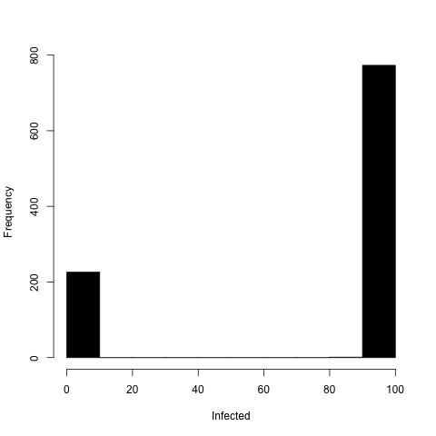
Invasion in the stochastic SIR model
Variable timing and size of epidemic
Some epidemics fail to take off
Rtraj = (trajectory(out,compartments='R'))
final_size = Rtraj$R[Rtraj$time==30]
hist(final_size,col='black',xlab='Infected',main='')

Slide 16
Modelling Recovery
For individuals the probability of recovery is constant per unit time
The time to recovery for an individual is therefore exponentially distributed:

Slide 17
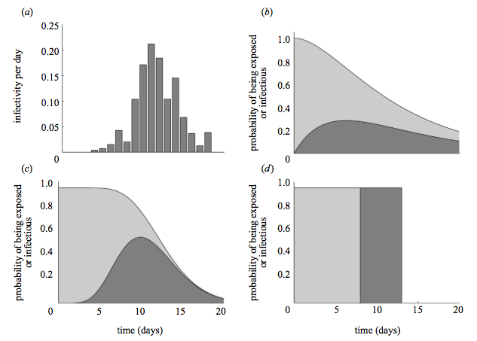
Measles incubation times
Latent
Infectious
Empirical
Exponential
Gamma
Fixed
Keeling and Grenfell Proc Roy Soc B (2002)
doi: 10.1098/rspb.2001.1898
Empirical Distributions can be less or more dispersed…

Slide 18
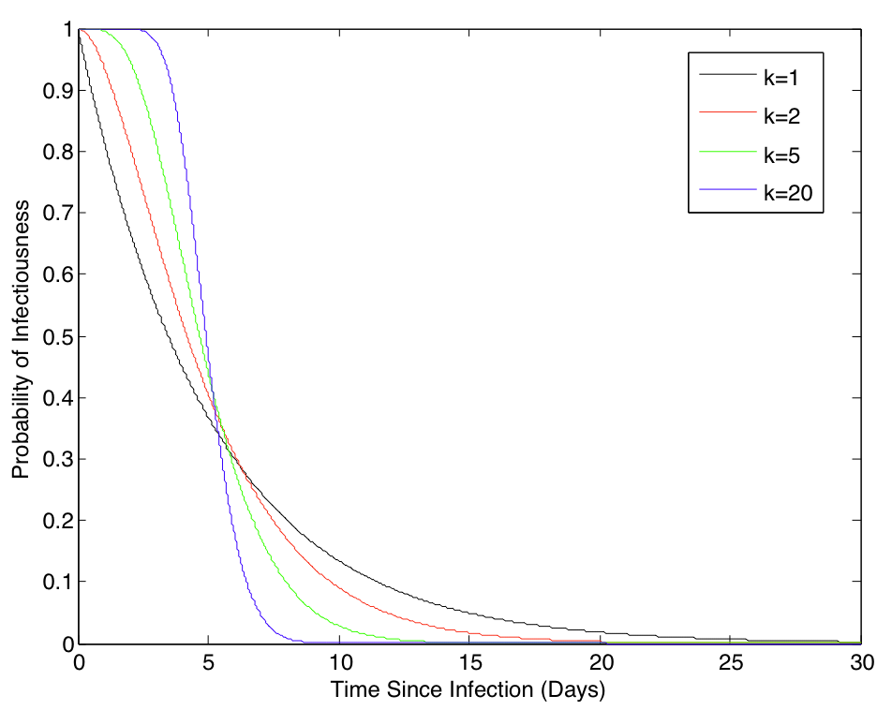
Shape parameter k controls dispersion of distribution
Gamma Distributions are a convenient description for less dispersed infectious period distributions

Slide 19
Method of stages can be used to incorporate gamma distributions into the standard Markov chain framework
I₁
I₂
I₃
...
n/(TI) I_{n}
I_{n}
I_{TOT}
Number of stages (n) analogous to shape parameter (k)
Discrete infectious period distributions correspond to limit as n -> ∞

Slide 20
Method of Stages
Split I compartment up into n sub-compartments

Slide 21
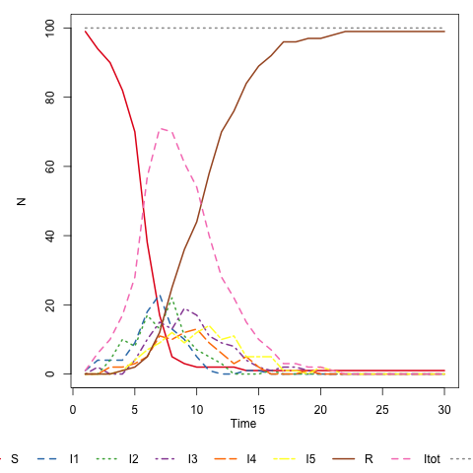
ϒ-SIR model
N <- 1
stages <- 5
initial_state <- mkGammaInitialState(99,1,0,stages,N)
compartments <- names(initial_state)
transitions <- mkGammatransitions(stages)
tspan <- seq(from = 1, to = 30, by = 1)
model <- mparse(transitions = transitions, compartments = compartments, gdata = c(beta=1.0,TI=5,n=stages), u0 = initial_state, tspan = tspan)
plot(run(model = model, threads = 1))

Slide 22
S
I₁
I_{n-1}
I_{n}
R
I_{TOT}
N
ϒ-SIR model (Setup Functions)
mkGammaInitialState <- function(S,I,R,stages,n)
{
labelStates <- "S"
for(i in 1:stages) { labelStates <- c(labelStates,sprintf("I%d",i))}
labelStates <- c(labelStates,"R","Itot","N")
initialState = data.frame(S=rep(S,n),I1=rep(I,n))
for(i in 2:stages){initialState <- cbind(initialState,rep(0,n))}
initialState <- cbind(initialState,rep(R,n),rep(I,n),rep(S+I+R,n))
names(initialState) <- labelStates
return(initialState)
}
> mkGammaInitialState(99,1,0,5,1)
S I1 I2 I3 I4 I5 R Itot N
1 99 1 0 0 0 0 0 1 100
How do we
update?
I_{TOT}
N

Slide 23
More transitions…
A
SimInf
Effect
r
“A -> r -> B”
A -> A - 1
B -> B+1
Birth
B
r
A
SimInf
Effect
A
“@ -> r -> A”
r
A -> A - 1
B -> B+1
C -> C+1
r
“A -> r -> B+C”
Death
B
C
A
“A -> r -> @”
SimInf
Effect
r
B
C
“B+C -> r -> A”
B -> B - 1
C -> C - 1
A -> A +1
r
r
A

Slide 24
mkGammatransitions <- function(n)
{
# Transmission event
transitions <- c("S -> beta*S*Itot/(N) -> I1 + Itot")
# Progression through gamma stages to recovery
for(i in 1:(n-1))
{ transitions <- c(transitions,sprintf("I%d -> n*I%d/TI -> I%d",i,i,i+1))}
transitions <- c(transitions,sprintf("Itot + I%d -> n*I%d/TI -> R",n,n))
return(transitions)
}
> mkGammatransitions(5)
[1] "S -> beta*S*Itot/(N) -> I1 + Itot" "I1 -> n*I1/TI -> I2" "I2 -> n*I2/TI -> I3"
[4] "I3 -> n*I3/TI -> I4" "I4 -> n*I4/TI -> I5" "Itot + I5 -> n*I5/TI -> R"

Slide 25
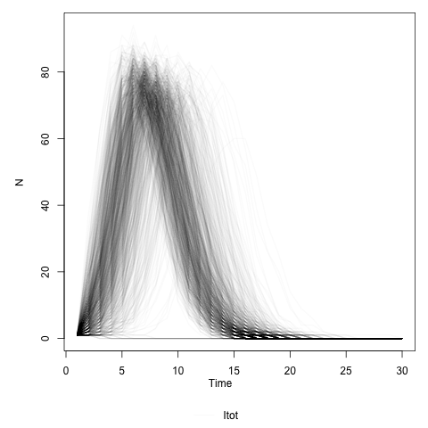
ϒ-SIR model
n=1
n=10
Initial growth of epidemic increases with n
Variability between replicates decreases with n

Slide 26
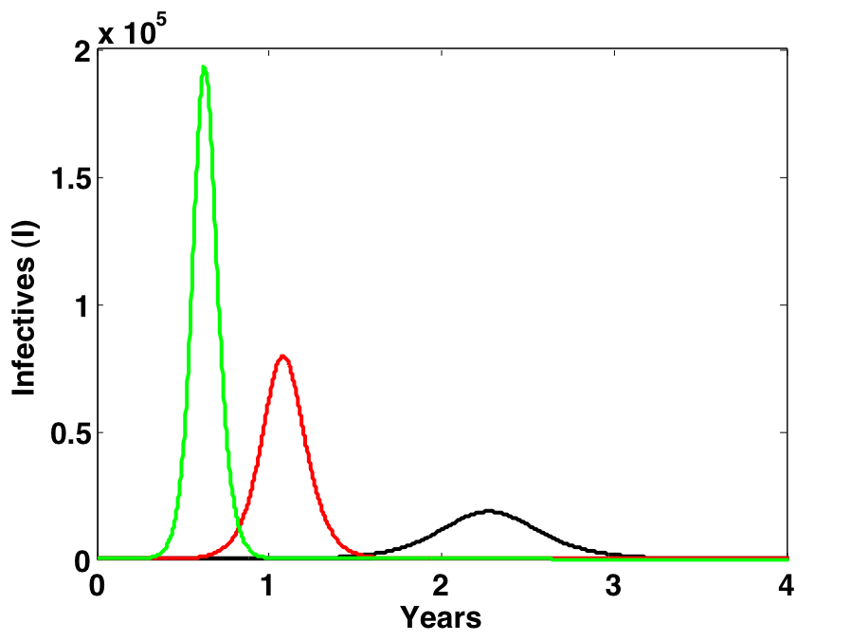
When does stochasticity matter?
When numbers are small
At the beginning and end of an epidemic
When transmission rates are low
R₀ = 2
R₀ = 1.5
R₀ = 1.2
When correlations are large
Clustering of infection
Spatial and social networks

