Slide 1

Mathematical modelling for vaccine-preventable diseases
Mathematics lecture 1
Functions and Equations
Katy Gaythorpe
School of Public Health
Imperial College London
k.gaythorpe@imperial.ac.uk
With materials contributed by Nik Cunniffe
Notes:
Introduce who we are

Slide 2
Aim
Functions
What is a function?
Revision of some functions that are commonly encountered
Linear and quadratic
Exponential and logarithmic
Solving equations
Quadratic equations
Exponential equations
Systems of equations (i.e. “simultaneous equations”)
Notation for sums and products
Revision of basic mathematical concepts needed in the course

Slide 3
What is a function?
Mathematical way of encoding a numerical rule
Formally, a relation between
independent variable (x)
dependent variable y(x)
Independent variable comes from a “domain” D, and the set of possible outputs is the “range”, R (or “codomain” or “image”)
Examples
f (x) = 10x + 3
g(x) = log_{e} (x) where D = {x|x > 0}
h(x) = 3e^{x} + 1 where R = {h(x)|1 < h(x)}
Properties of functions can be conveniently summarised by their graphs

Slide 4
What is a function?
What functions do I need to know about?
Linear
Quadratic
Exponential
Logarithm

Slide 5
Linear functions y(x) = mx + c
Linear functions
m and c are constants
Examples
y(x) = 2x + 3 (m = 2, c = 3)
y(x) = 5 − 2x (m = −2, c = 5)
y(x) = 2x (m = 2, c = 0)
y(x) = 10 (m = 0, c = 10)
For every increase of one in the value of x, the value of y increases by m
i.e. “gradient” (rise/run) is constant (i.e. independent of x)
When x = 0, y = c
Properties summarised by
m = gradient of the line
c = y-intercept of the line

Slide 6
Linear functions y(x) = mx + c
gradient = 2, y-intercept = 3
gradient = -2, y-intercept = 5

Slide 7
Quadratic functions y(x) = ax² + bx + c
Quadratic functions
a, b and c are constants
Examples
y(x) = x² (a = 1, b = c = 0)
y(x) = 3 − x² (a = −1, b = 0, c = 3)
y(x) = x² − 5x + 6 (a = 1, b = −5, c = 6)
y(x) = x² + 1 (a = 1, b = 0, c = 1)
Again c is the y-intercept
More important is a which controls behaviour for large x
a > 0 means that y → +∞ as |x| → ∞ (“happy”)
a < 0 means that y → −∞ as |x| → ∞ (“unhappy”)
a = 0 means you do not really have a quadratic at all
Zero, one or two “roots” (solutions to the equation y(x) = 0)
Depends on the “discriminant” Δ = b² − 4ac
(see later for why)

Slide 8
Quadratic functions y(x) = ax² + bx + c
y=x²-5x+6
y=3-x²
“happy” (a=1>0)
y-intercept = 6
two roots (both +ve)
“unhappy” (a=-1<0)
y-intercept = 3
two roots (one +ve, one -ve)

Slide 9
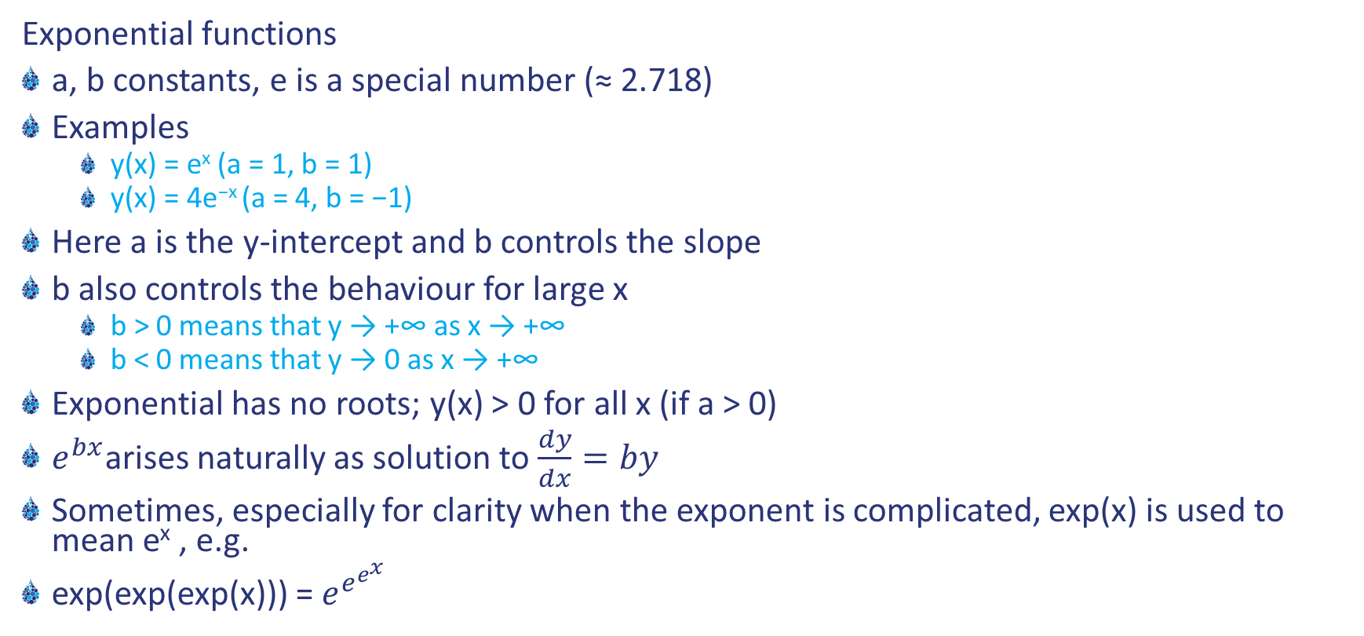
Exponential functions y(x) = ae^{bx}
Exponential functions
a, b constants, e is a special number (≈ 2.718)
Examples
y(x) = e^{x} (a = 1, b = 1)
y(x) = 4e^{−x} (a = 4, b = −1)
Here a is the y-intercept and b controls the slope
b also controls the behaviour for large x
b > 0 means that y → +∞ as x → +∞
b < 0 means that y → 0 as x → +∞
Exponential has no roots; y(x) > 0 for all x (if a > 0)
$e^{bx}$arises naturally as solution to $\frac{dy}{dx}=by$
Sometimes, especially for clarity when the exponent is complicated, exp(x) is used to mean e^{x} , e.g.
exp(exp(exp(x))) = $e^{e^{e^{x}}}$

Slide 10
Exponential functions y(x) = ae^{bx}
y-intercept=1
no roots
y → +∞ as x → +∞y
y-intercept=4
no roots
y → 0 as x → +∞y

Slide 11

Exponentials often used to “build” other functions
e.g. Logistic Function (see Populations Lectures)
$$y\left(x\right)= \frac{10}{1+99e^{−x}}$$

Slide 12
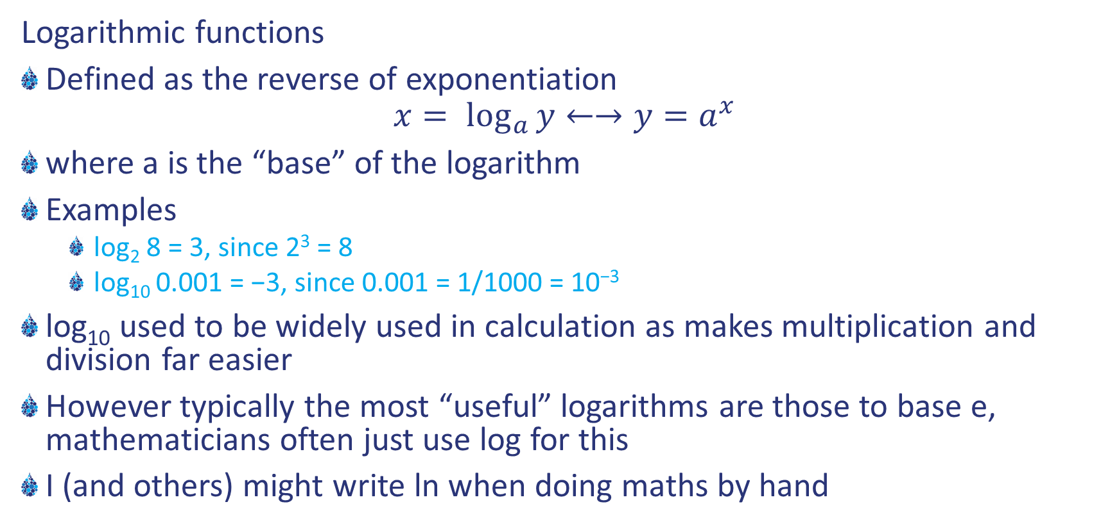
Logarithmic functions y(x) = log_{a} x
Logarithmic functions
Defined as the reverse of exponentiation
$$x= \log_{a}{y}←→y=a^{x}$$
where a is the “base” of the logarithm
Examples
log₂ 8 = 3, since 2³ = 8
log₁₀ 0.001 = −3, since 0.001 = 1/1000 = 10⁻³
log₁₀ used to be widely used in calculation as makes multiplication and division far easier
However typically the most “useful” logarithms are those to base e, mathematicians often just use log for this
I (and others) might write ln when doing maths by hand

Slide 13
Solving equations
What sorts of equations do I need to be able to solve?
Quadratic
Exponential
Logarithmic
Simultaneous

Slide 14
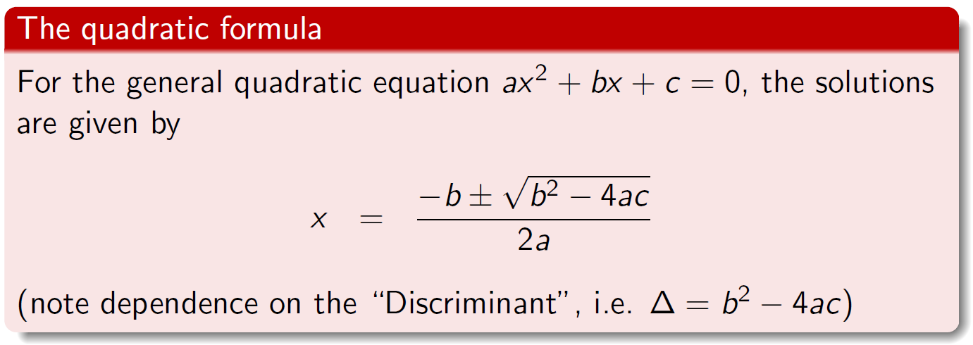
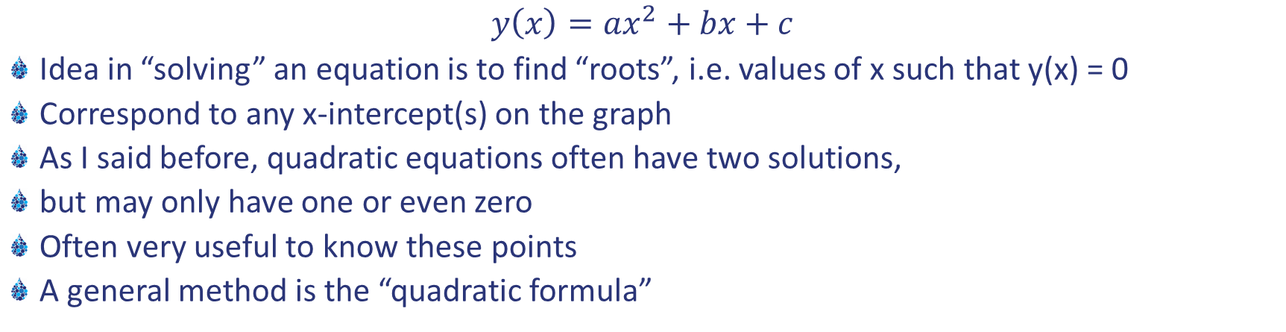
Solving quadratic equations
$$y\left(x\right)=ax^{2}+bx+c$$
Idea in “solving” an equation is to find “roots”, i.e. values of x such that y(x) = 0
Correspond to any x-intercept(s) on the graph
As I said before, quadratic equations often have two solutions,
but may only have one or even zero
Often very useful to know these points
A general method is the “quadratic formula”

Slide 15
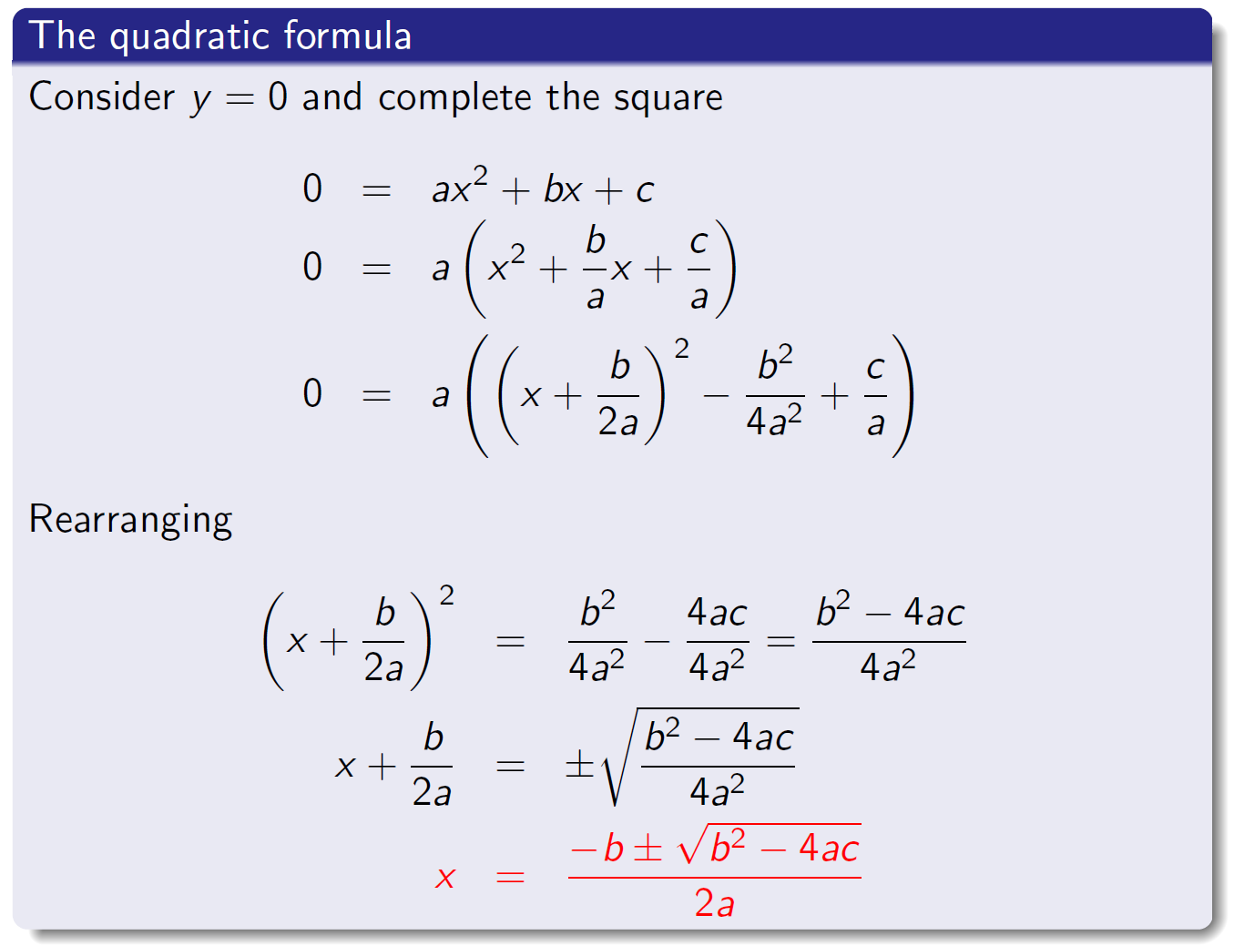
Where does the quadratic formula come from?

Slide 16
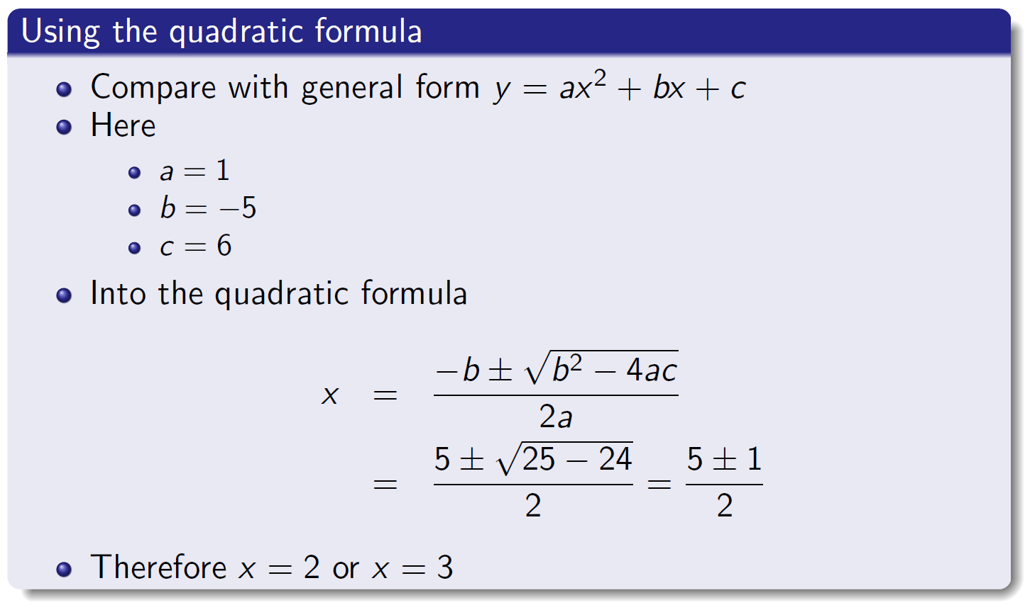
Example: x² − 5x + 6 = 0

Slide 17
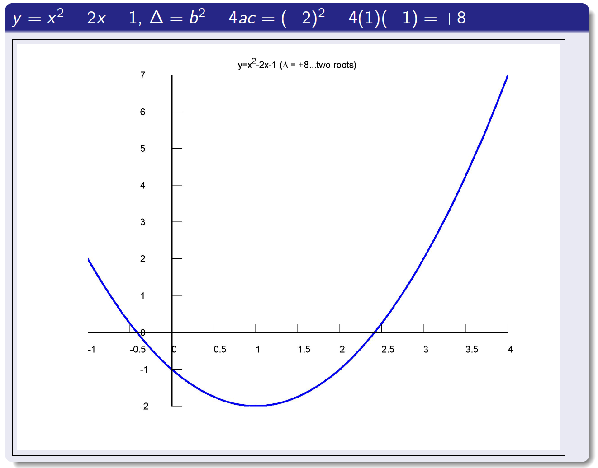
Δ = b² − 4ac > 0 means there are two roots

Slide 18
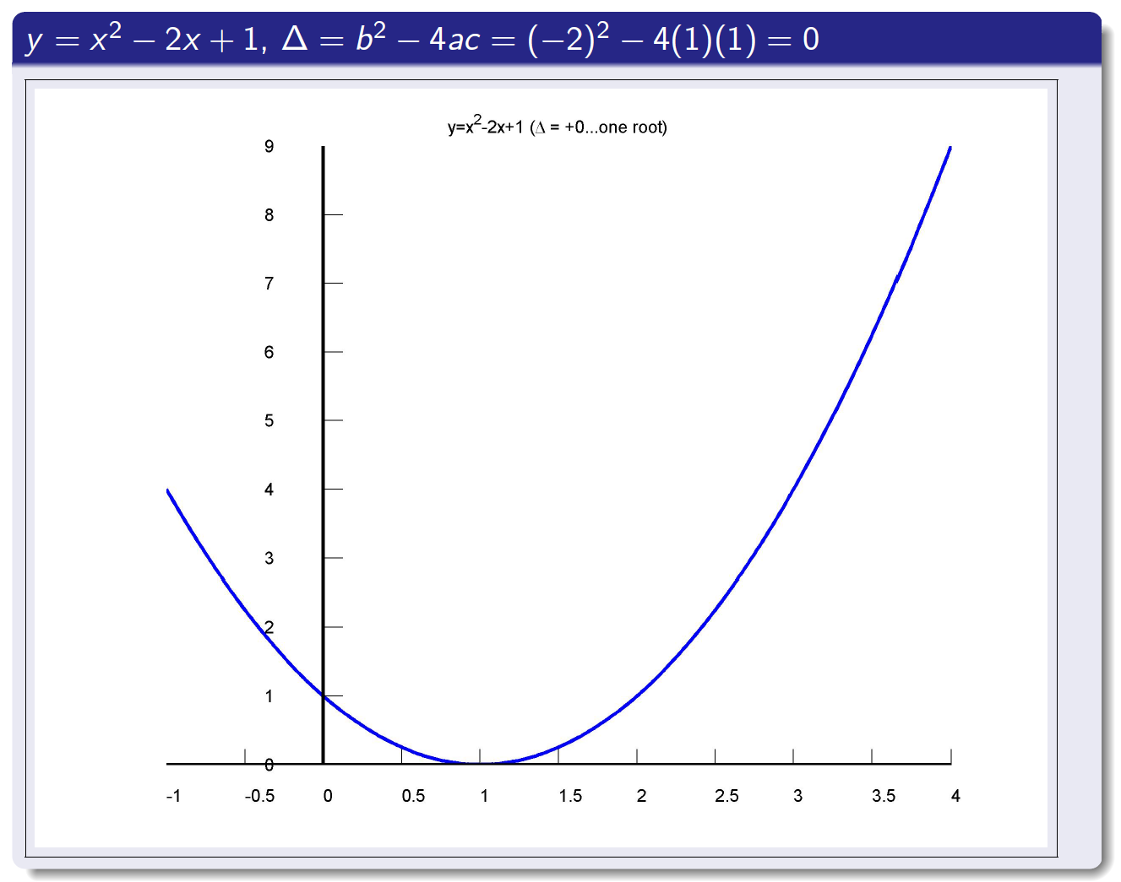
Δ = b² − 4ac = 0 means there is one root

Slide 19
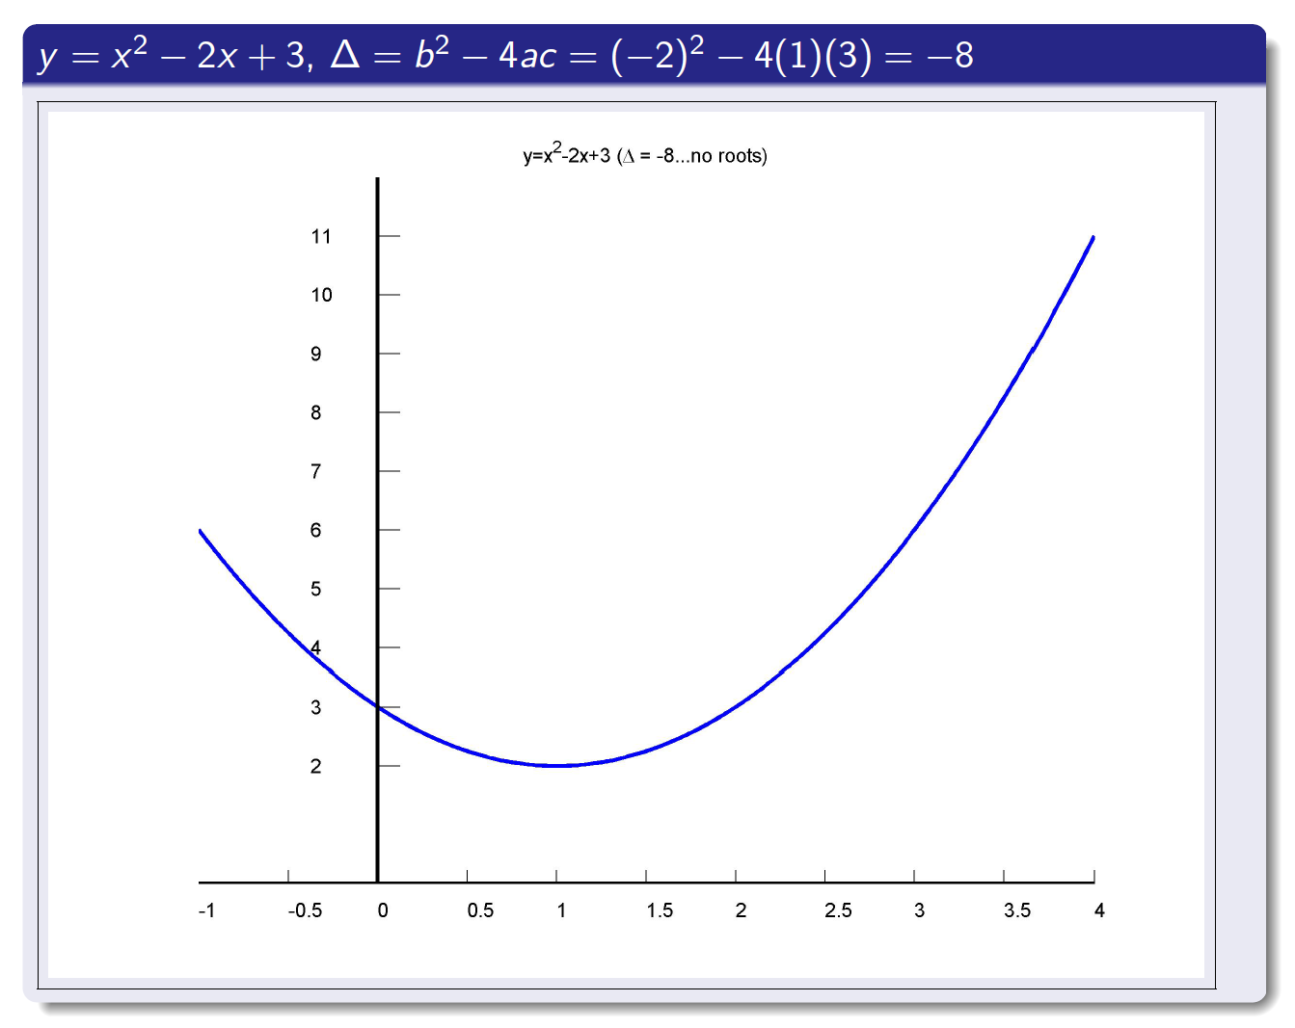
Δ = b² − 4ac < 0 means there are no roots

Slide 20
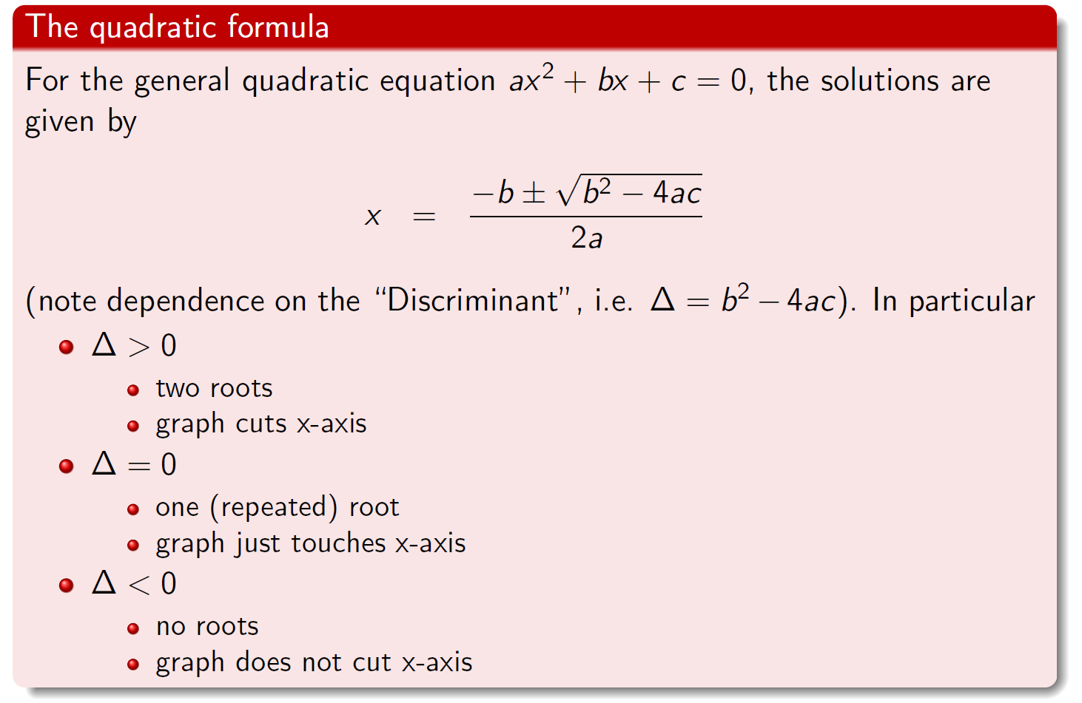
Full form of quadratic formula

Slide 21
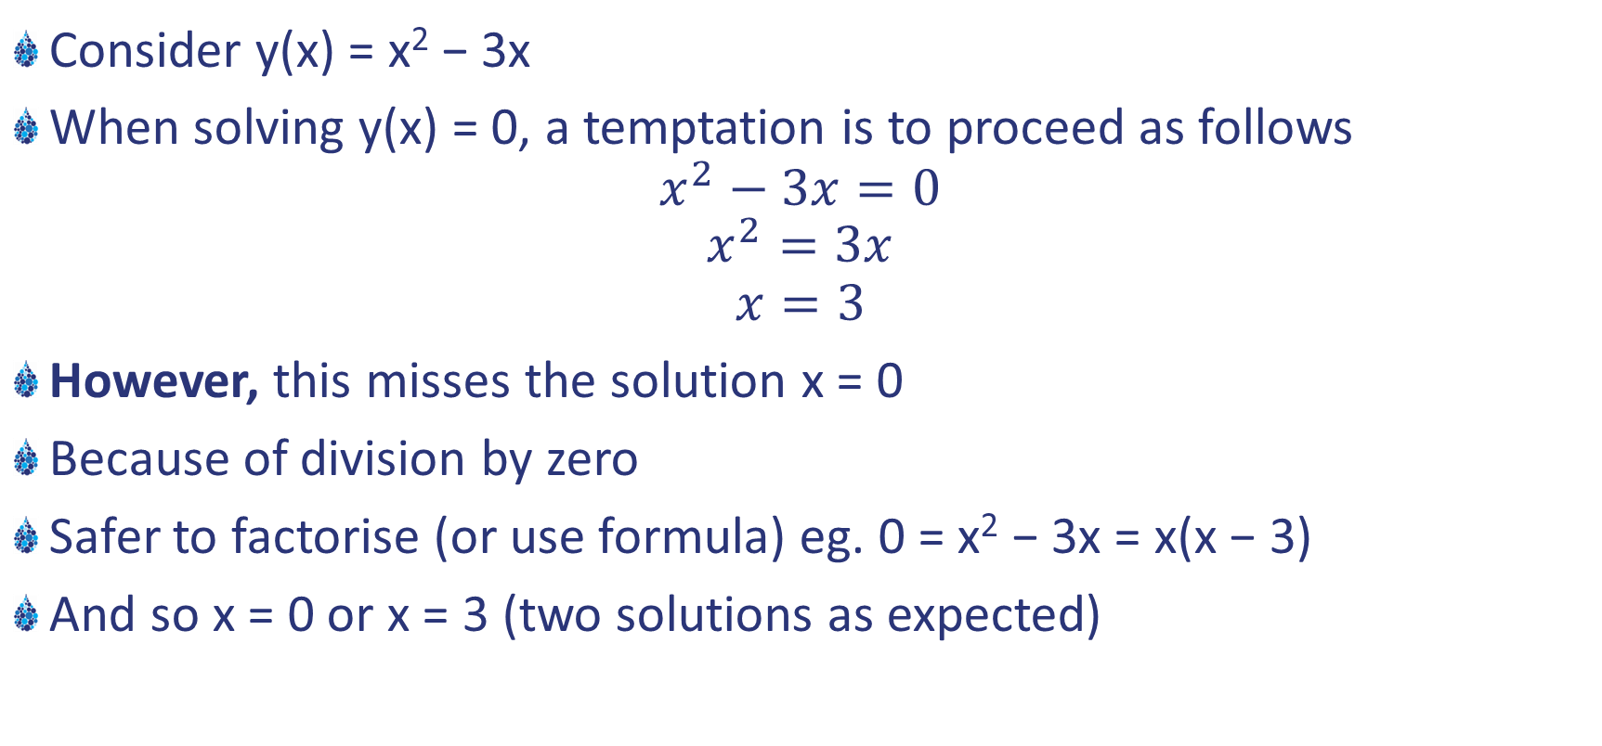
c = 0: a special case worth emphasising
Consider y(x) = x² − 3x
When solving y(x) = 0, a temptation is to proceed as follows
$$x^{2}−3x=0$$
$$x^{2}=3x$$
$$x=3$$
However, this misses the solution x = 0
Because of division by zero
Safer to factorise (or use formula) eg. 0 = x² − 3x = x(x − 3)
And so x = 0 or x = 3 (two solutions as expected)

Slide 22
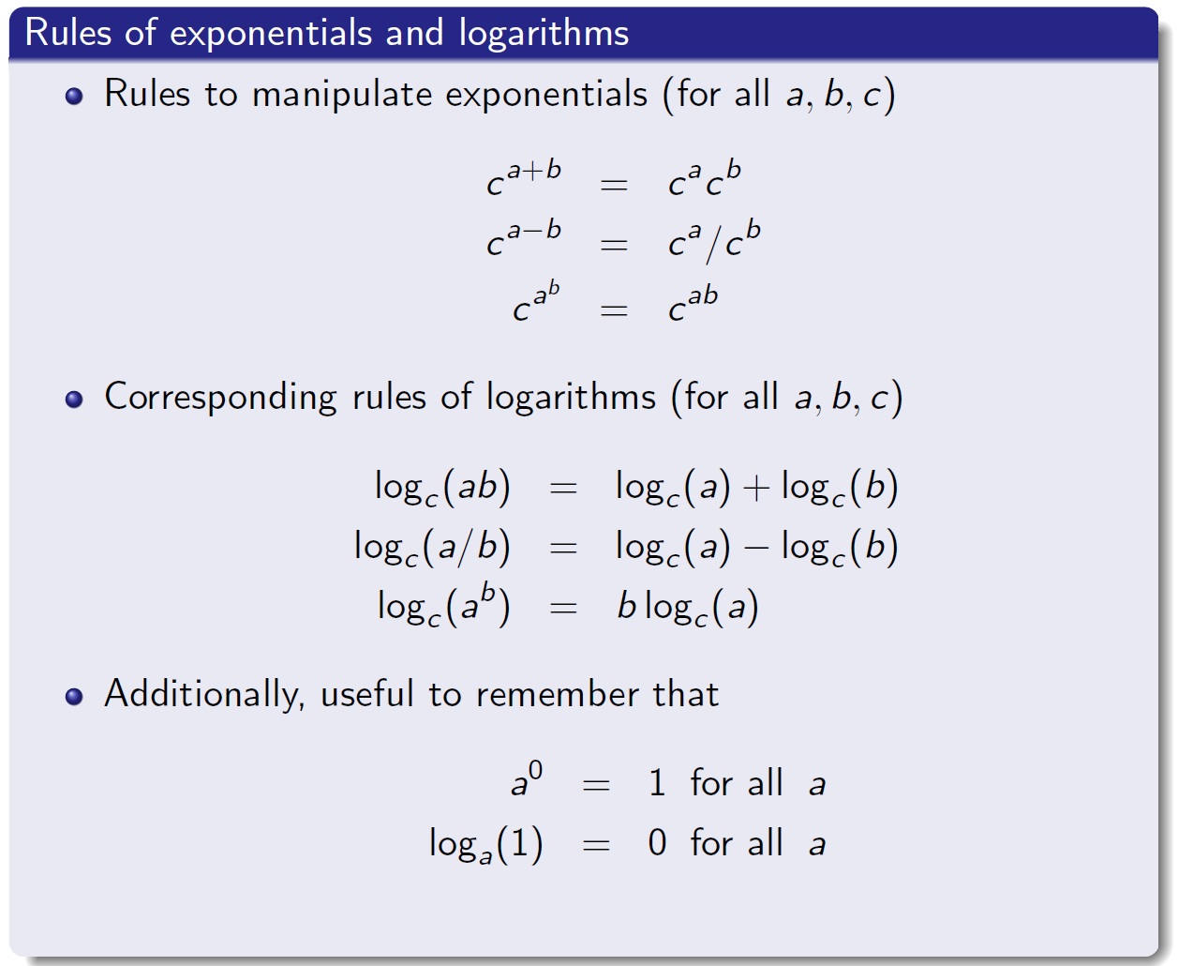
Manipulating exponentials and logarithms

Slide 23
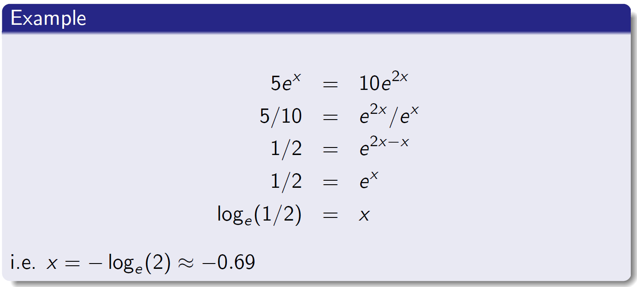
Solving exponential equations
Exponential equations
Logarithms will be involved somewhere along the line
Safest to rearrange to a^{b} = c before taking logarithms

Slide 24
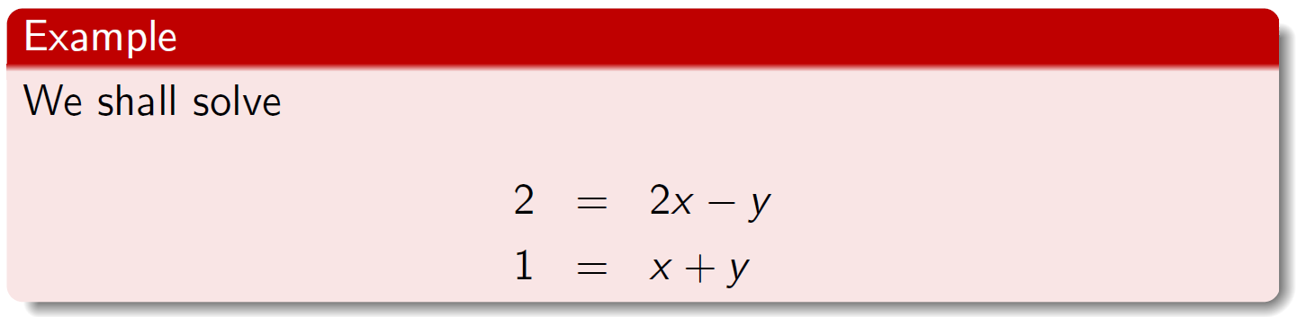

Systems of equations
“Simultaneous” equations
Most encountered are pairs of linear equations
Two basic methods
Elimination
Substitution
Can also be tackled using matrix methods (if you know them)
Concentrate on the two basic methods today

Slide 25
Method of elimination
Solution by elimination (note more than one way to do this)
Idea is to remove one variable by subtraction/addition
Here multiply (2) by 2 : 2 = 2x + 2y
Now can subtract this from Equation (1) to remove a variable
2 = 2x − y
2 = 2x + 2y
= = ====
0 = 0x − 3y
Therefore y = 0 (and so x = 1 using either equation)
So final solution is (x, y) = (1, 0)

Slide 26
Method of substitution
Solution by substitution
Rearrange one equation to isolate one variable (y say)
Here from Equation (2): y = 1 − x
Back into Equation (1): 2 = 2x − (1 − x)
This equation in x alone is easy to solve
2 = 2x − 1 + x
3 = 3x
Therefore x = 1 (and so y = 0 using either equation)
Again final solution is (x, y) = (1, 0)

Slide 27
Geometric interpretation

Slide 28
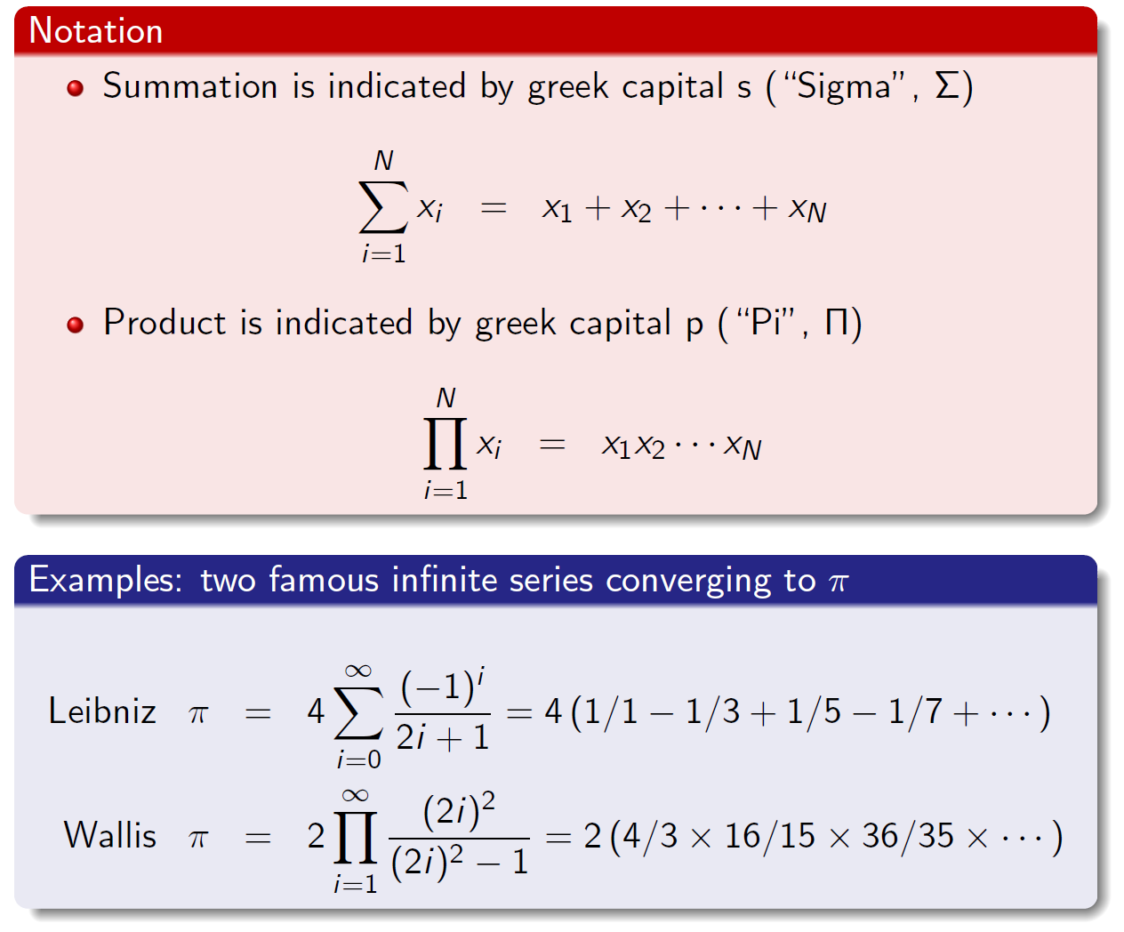
Summations and products

Slide 29
Summary
Functions
What is a function?
Reminder of some common functions
Linear and quadratic
Exponential and logarithmic
Solving equations
Quadratics
Exponential equations
Systems of equations (i.e. “simultaneous equations”)
Sum and product notation

