Slide 1

Mathematical modelling for vaccine-preventable diseases
Mathematics lecture 2
Differentiation
Katy Gaythorpe
School of Public Health
Imperial College London
k.gaythorpe@imperial.ac.uk
With materials contributed by Nik Cunniffe
Notes:
Introduce who we are

Slide 2
Aim
Differentiation
Graphical interpretation
Definition
Techniques of differentiation
Rules for basic functions
Sums and differences
Products and quotients
Functions of functions
Applications
Increasing and decreasing intervals
Stationary points (i.e. maxima/minima) of functions
Revision of differentiation and its applications

Slide 3
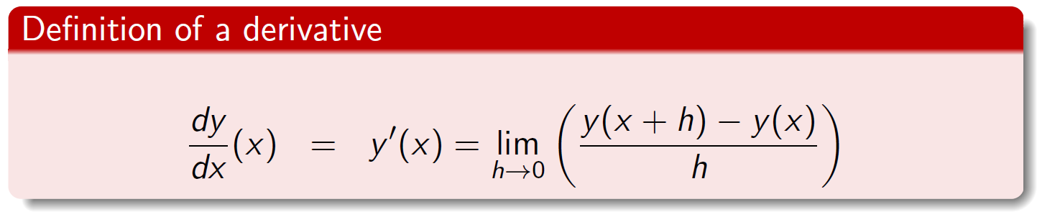
What is differentiation?
Differentiation
Mathematical way of determining how quickly a function changes as the independent variable changes
Can think of it as the slope/gradient of the tangent
Formally follows from a limiting process, looking at the gradient of successively more accurate chords
Very useful since often processes can be phrased in terms of how quickly things change
Also allows us to find maxima/minima of functions

Slide 4
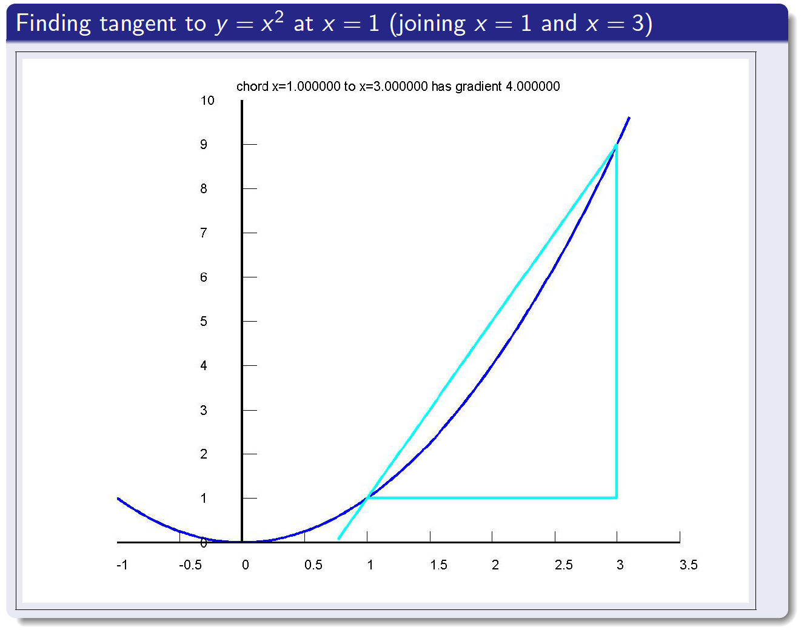
Graphical interpretation of differentiation

Slide 5
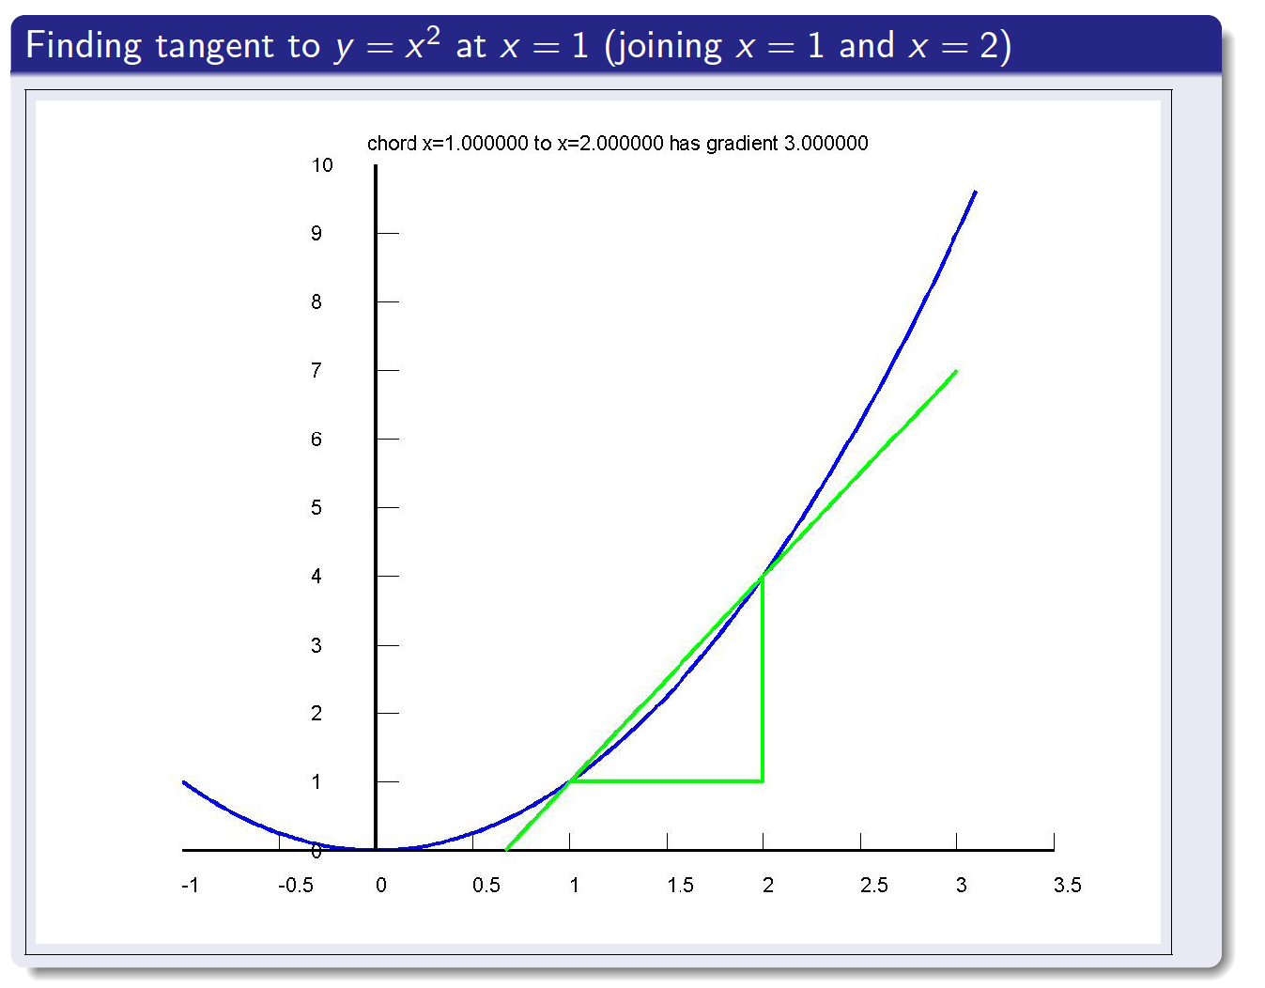
Graphical interpretation of differentiation

Slide 6
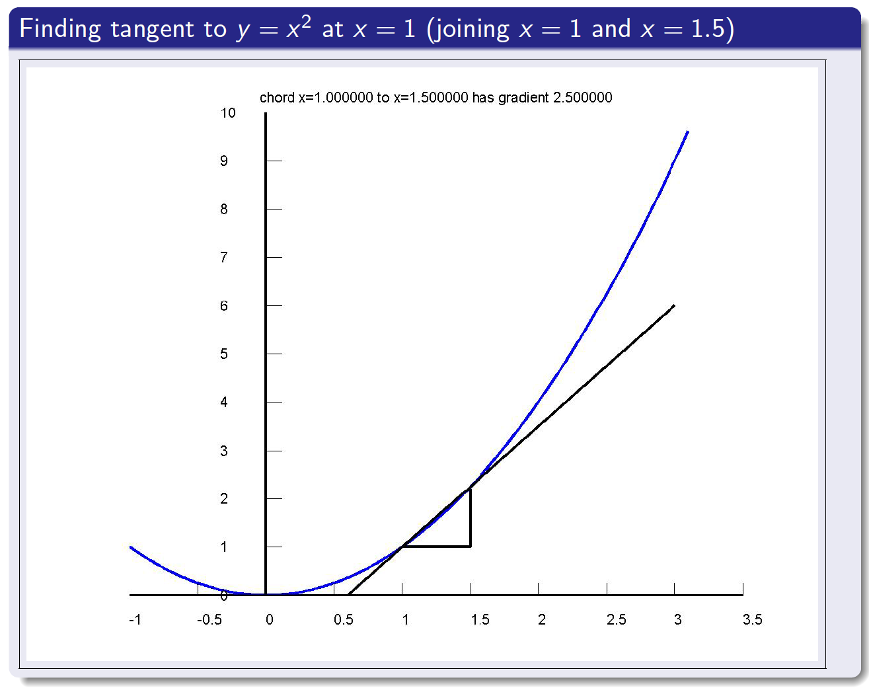
Graphical interpretation of differentiation

Slide 7
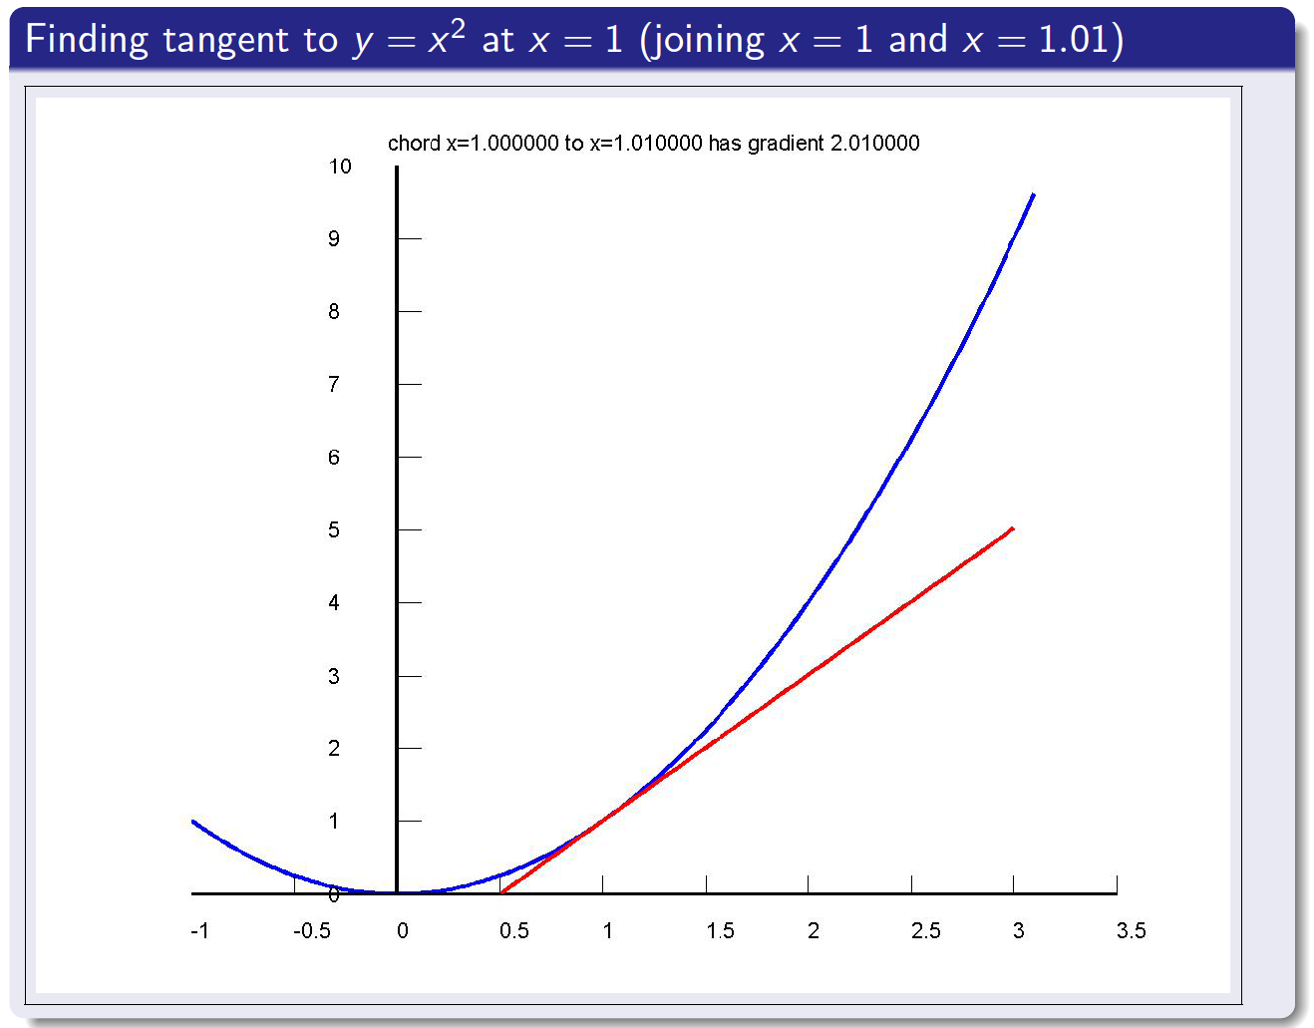
Graphical interpretation of differentiation

Slide 8
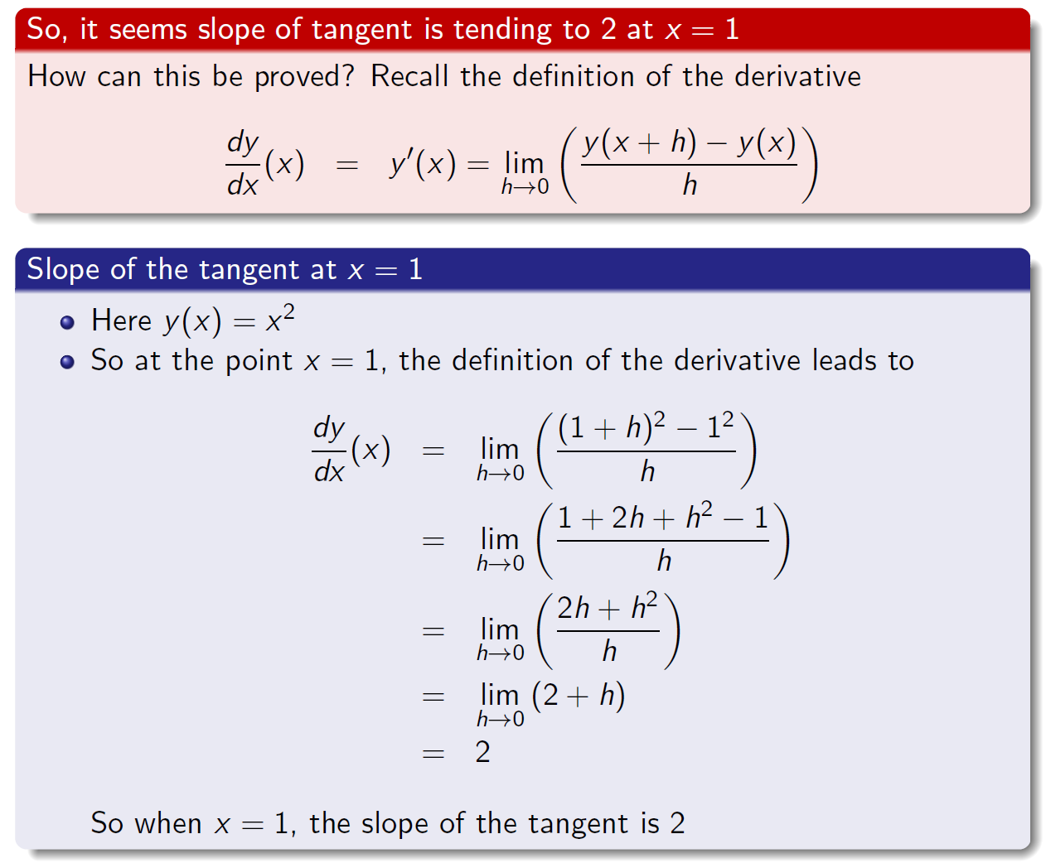
Algebraic calculation of derivative at x = 1

Slide 9
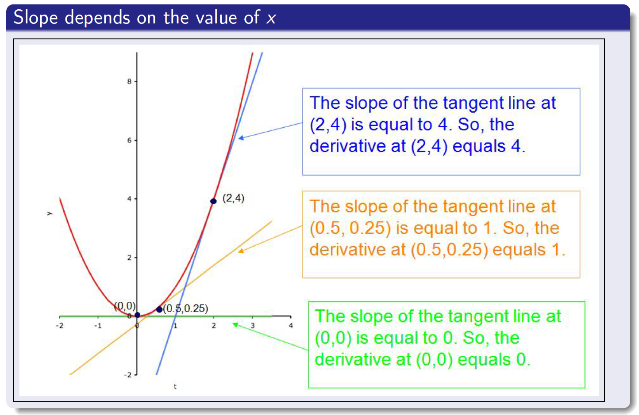
Slope of the tangent at different values of x

Slide 10
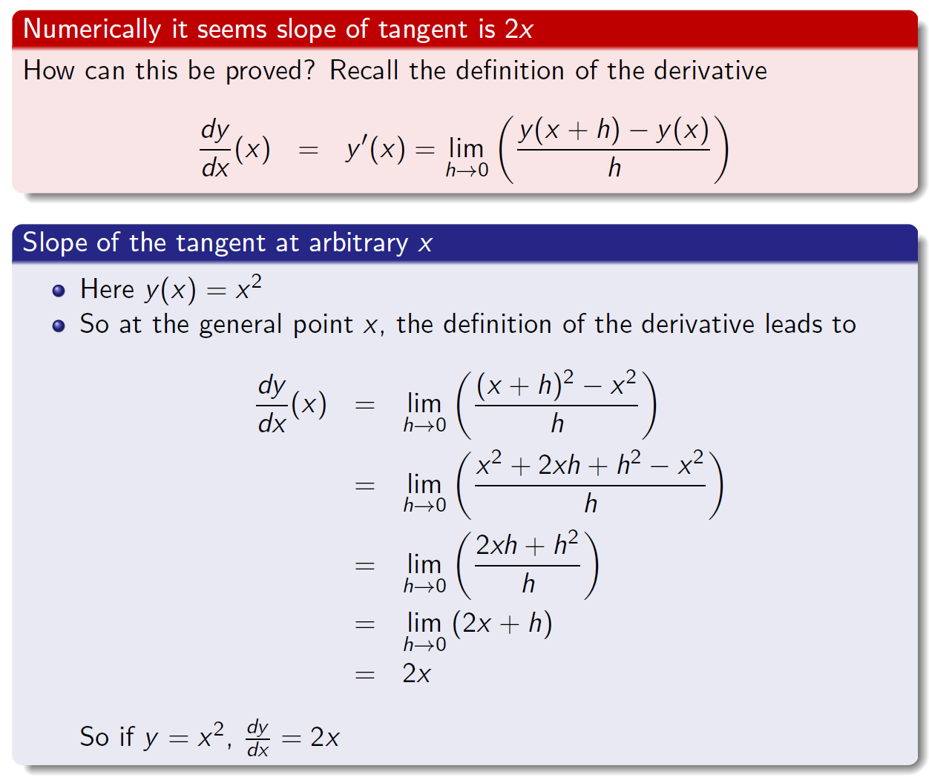
Algebraic calculation of derivative as a function of x

Slide 11
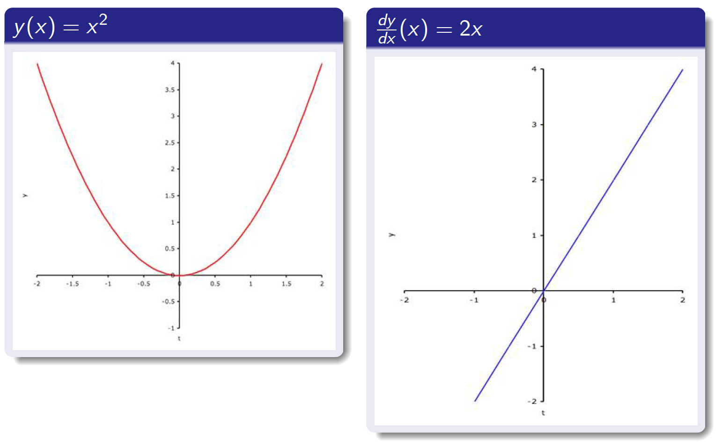
The derivative of a function is just another function

Slide 12
Derivatives of basic functions
Some good news...
Finding derivatives of functions can always be performed by substituting the function into the definition of a derivative and then doing some algebra (this is called “Differentiation from first principles”)
Some bad news...
This can be fiddly, though
Some good news again...
It would be totally and absolutely remarkable for you to ever do this, since someone else has already done it for you

Slide 13
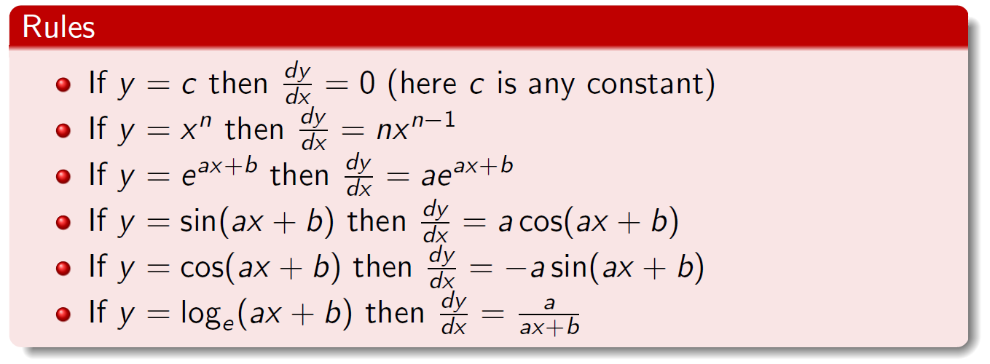
Derivatives of basic functions
An unfortunate reality...
Derivatives of certain functions need to be committed to memory
...but now even more good news
If you know the above (and a couple of general principles), then you can differentiate absolutely any function you want (assuming differentiation is possible; what, for example, is the derivative of y = |x| at x = 0?)

Slide 14
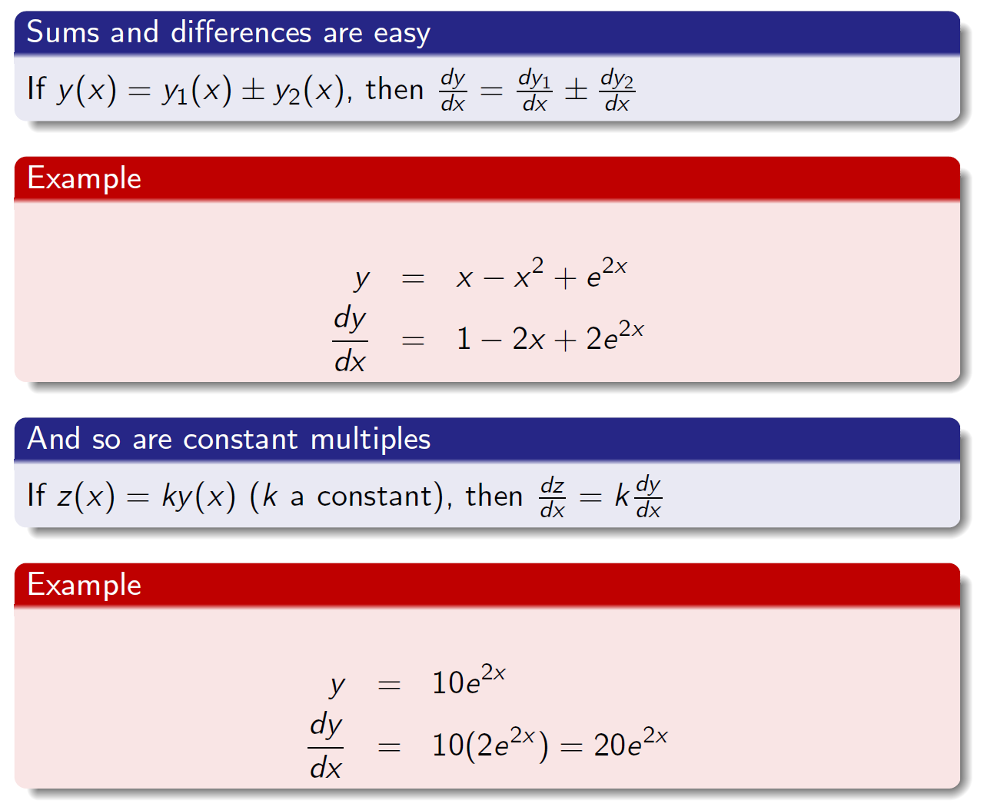
Derivatives of sums, differences and constant multiples

Slide 15
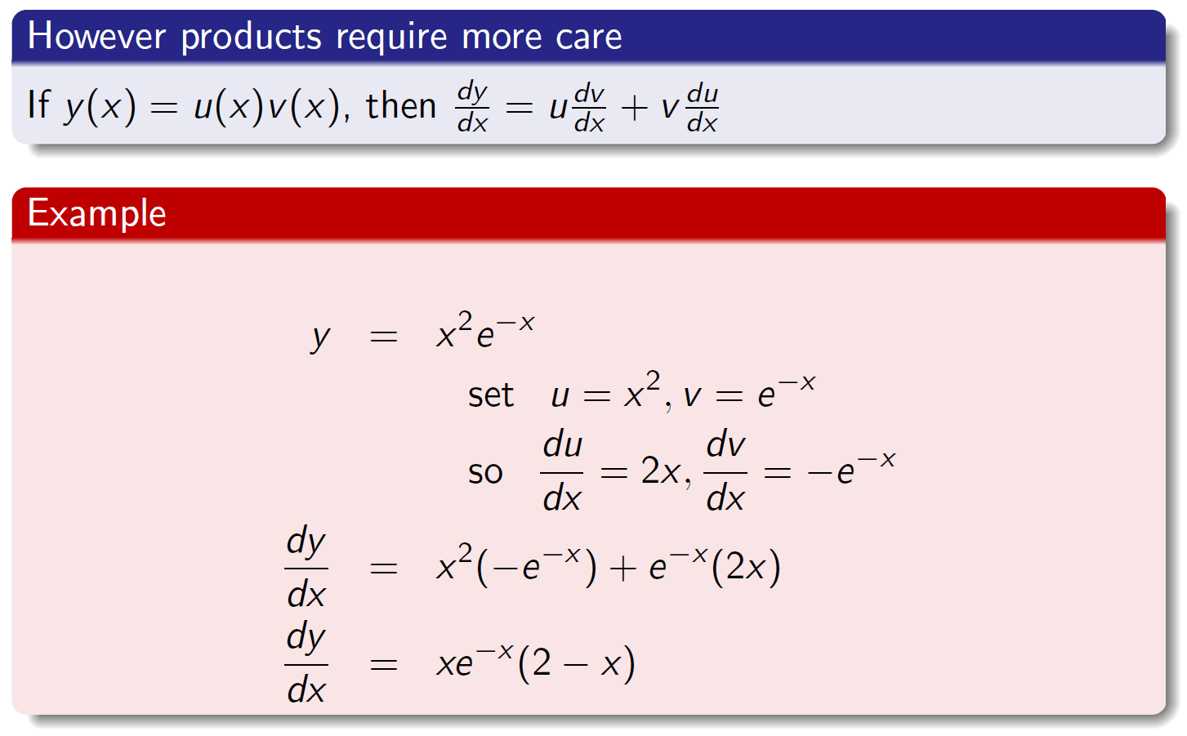
Derivatives of products

Slide 16
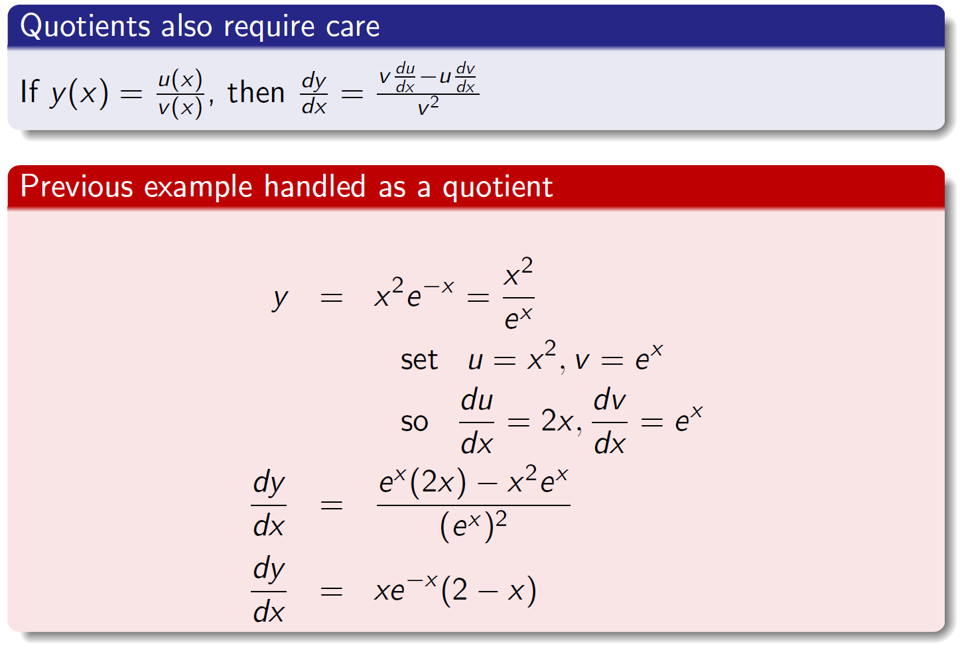
Derivatives of quotients

Slide 17
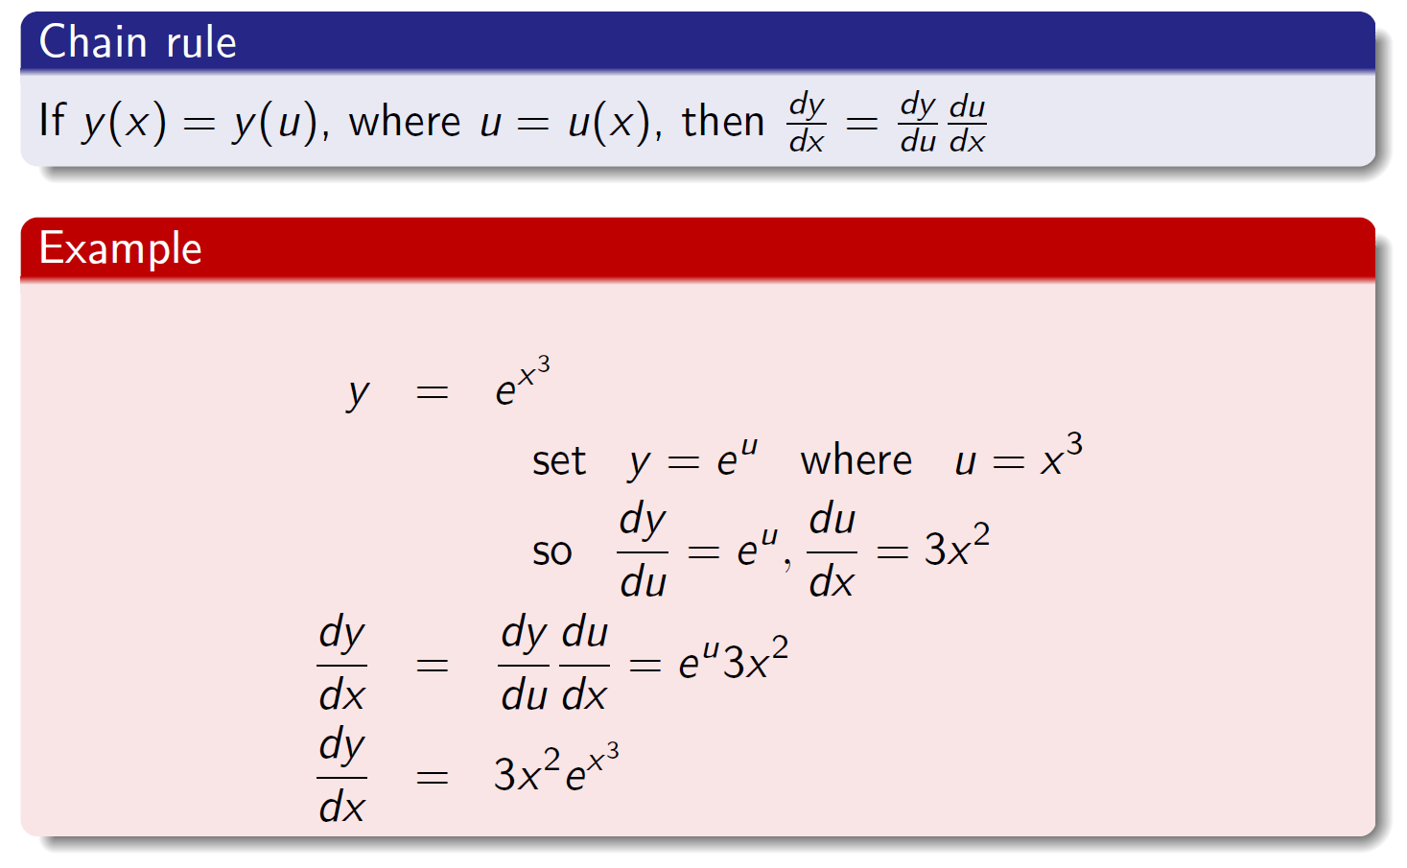
Functions of functions (“chain rule”)

Slide 18
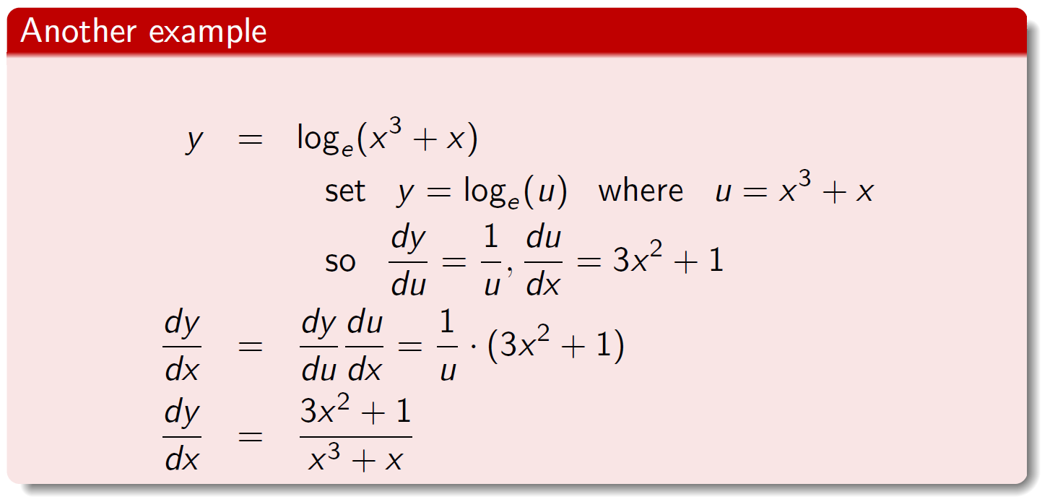
Functions of functions (“chain rule”)

Slide 19
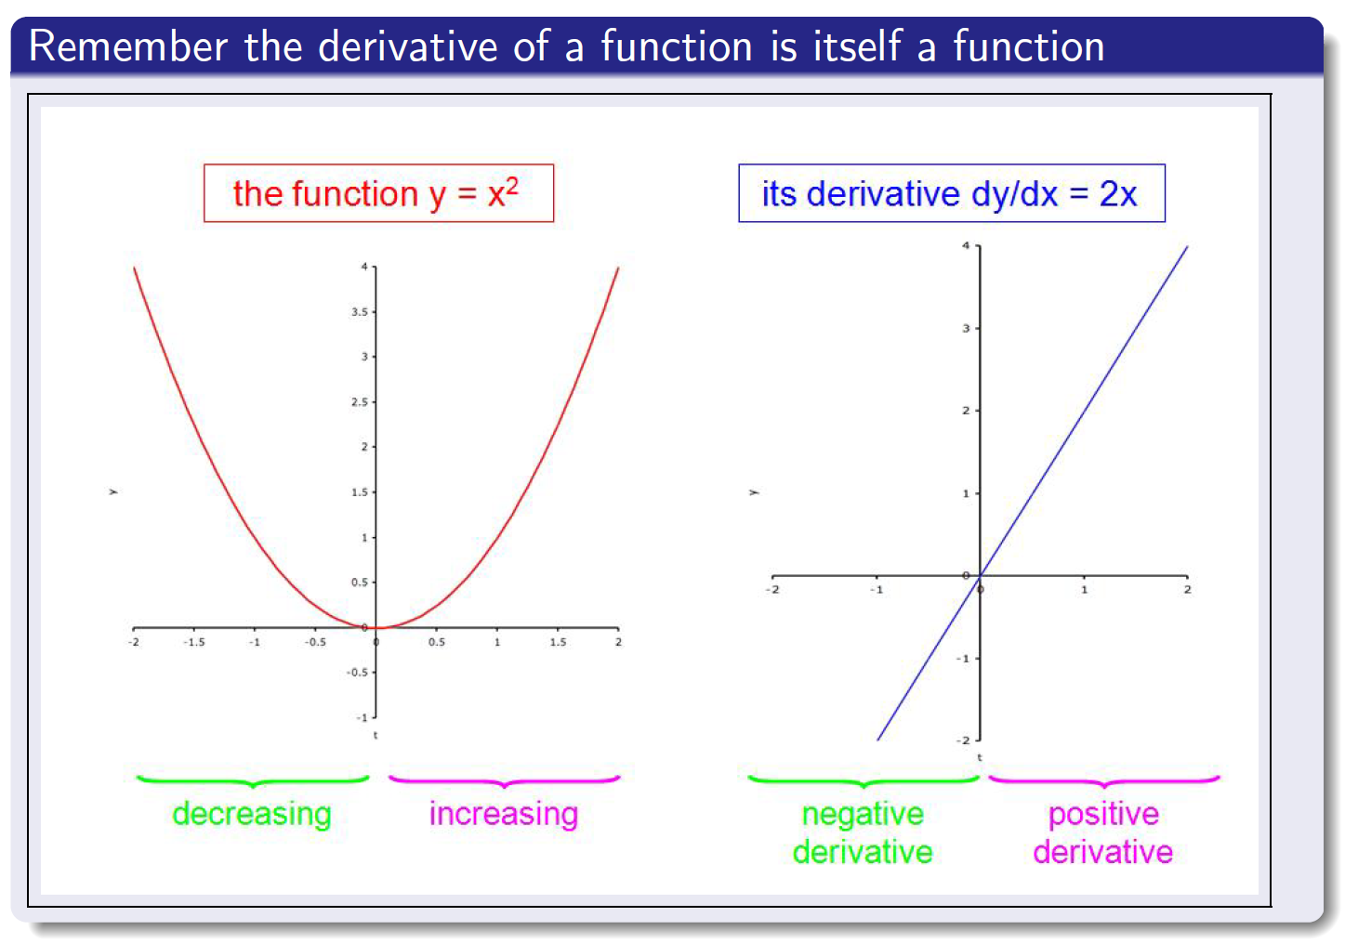
Increasing and decreasing functions

Slide 20
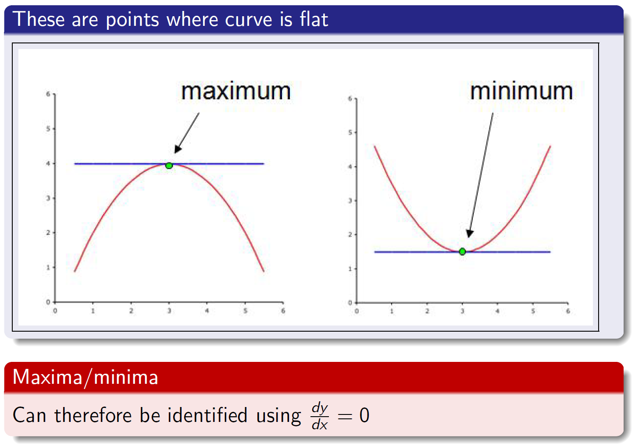
Maxima and minima

Slide 21
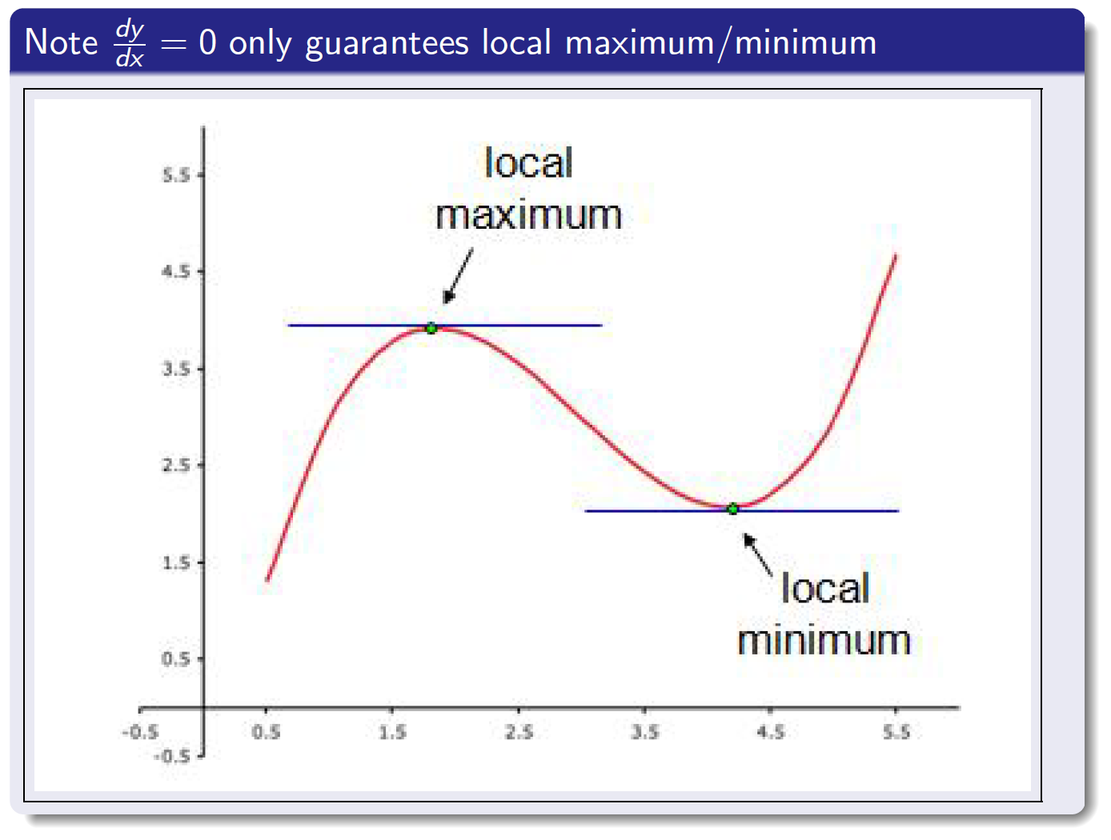
Maxima and minima

Slide 22
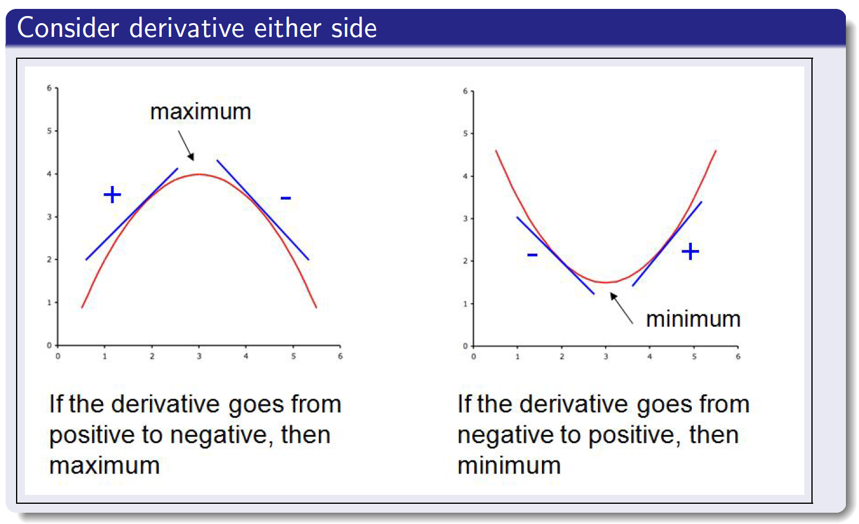
Distinguishing maxima and minima

Slide 23
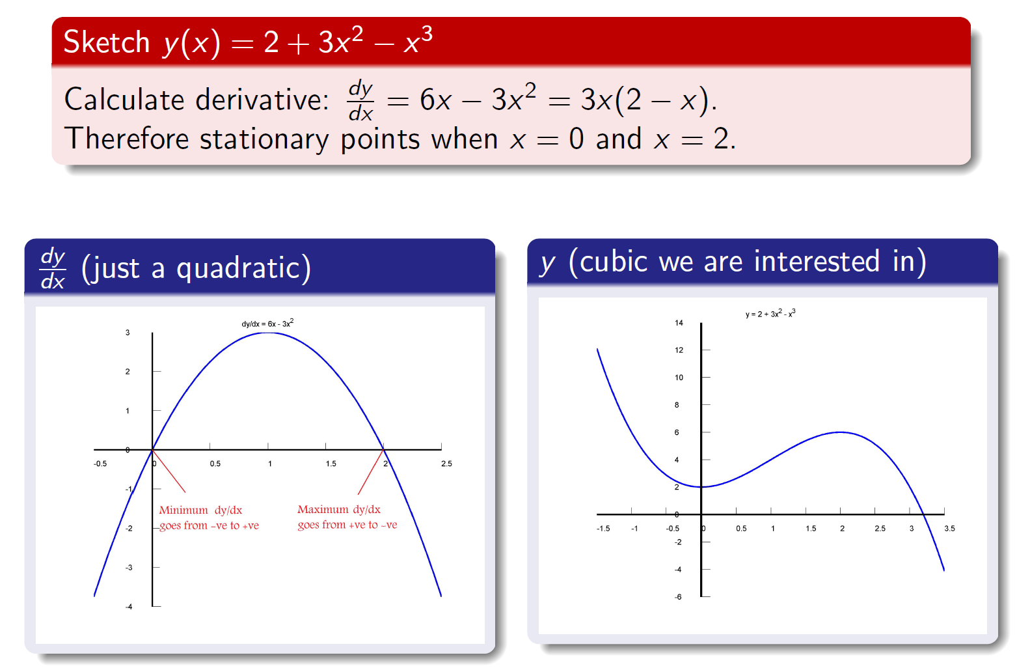
Example of a function and its derivative

Slide 24
Summary
Differentiation
Graphical interpretation
Definition
Techniques of differentiation
Rules for basic functions
Sums and differences
Products and quotients
Functions of functions
Applications
Increasing and decreasing intervals
Stationary points (i.e. maxima/minima) of functions

